Slide 1

Web Development
Week #06

Slide 2
This Week
Designing the navigation for a website.
Embedded media,
Embedded media
YouTube Video
Google Maps
advanced image use,
their importance
file format and performance
icons.
Notes:
HTML forms​
–controls​
–labels​
–input validation​
CSS3 selectors​
CSS3 units​

Slide 3
Site Structure / Site Map
The foundation on which you build everything else
A well-designed structure makes it easy to define a navigation system
Once structure and navigation systems are in place a page template will be built.
A well-designed site structure gives immediate feedback regarding the structure of the design
Notes:
*** not to be confused with “sitemap” which actually refers to the xml file that is used by search engines (if one was created for website!)

Slide 4
Site map
Most people prefer to see a tree-structure type of map rather than text
Detailed blueprints also show on- and off-site links
Look at the next slides to see
a screen shot of the navigation of the Wentworth Institute of Higher Education (our College)
a partial site map of the Wentworth Institute of Higher Education

Slide 5

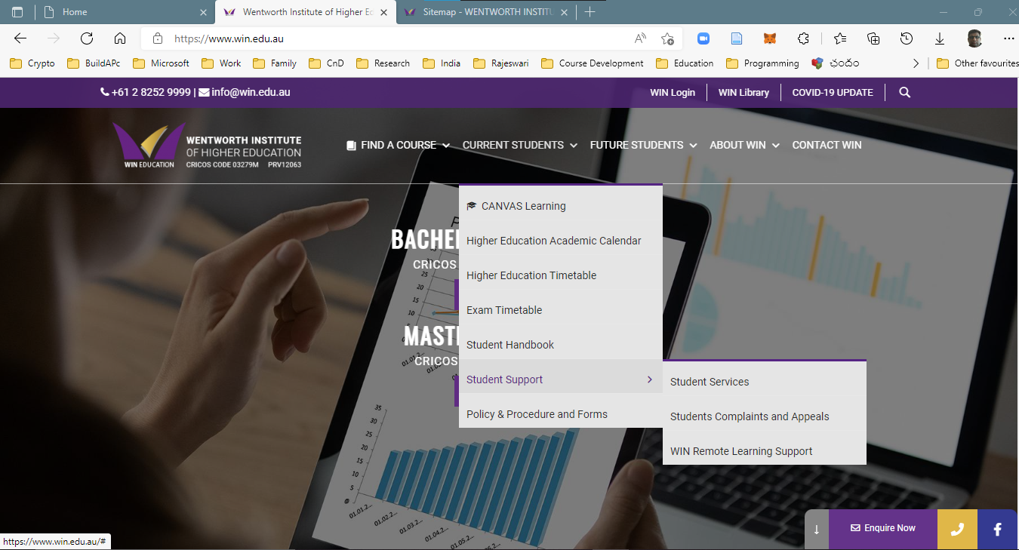

Slide 6
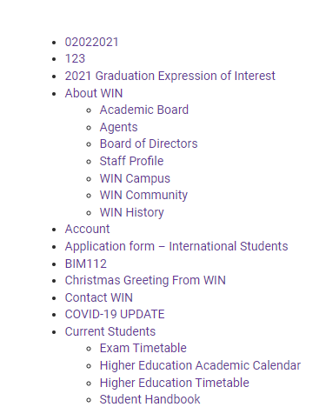
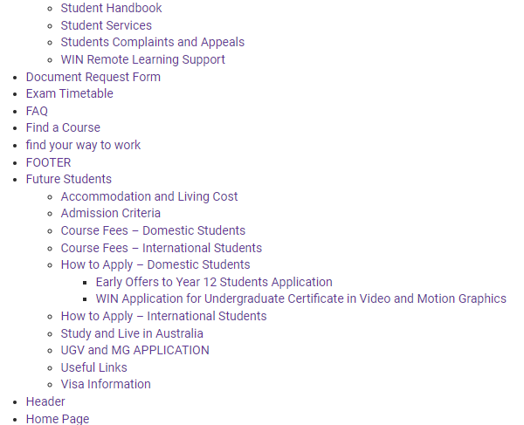
Website Sitemap
Notes:
This site map shows a portion of the website shown on the next
For your website you must have a site map with 8 pages.

Slide 7
Navigation
Define Navigation
How will users use the site?
How will they get from one place to another?
How do you prevent them from getting lost?
Designing good navigation is an art
Well-planned web sites suggest every type of navigation required
Notes:
Organizing and designing navigation can be very complex for large sites

Slide 8
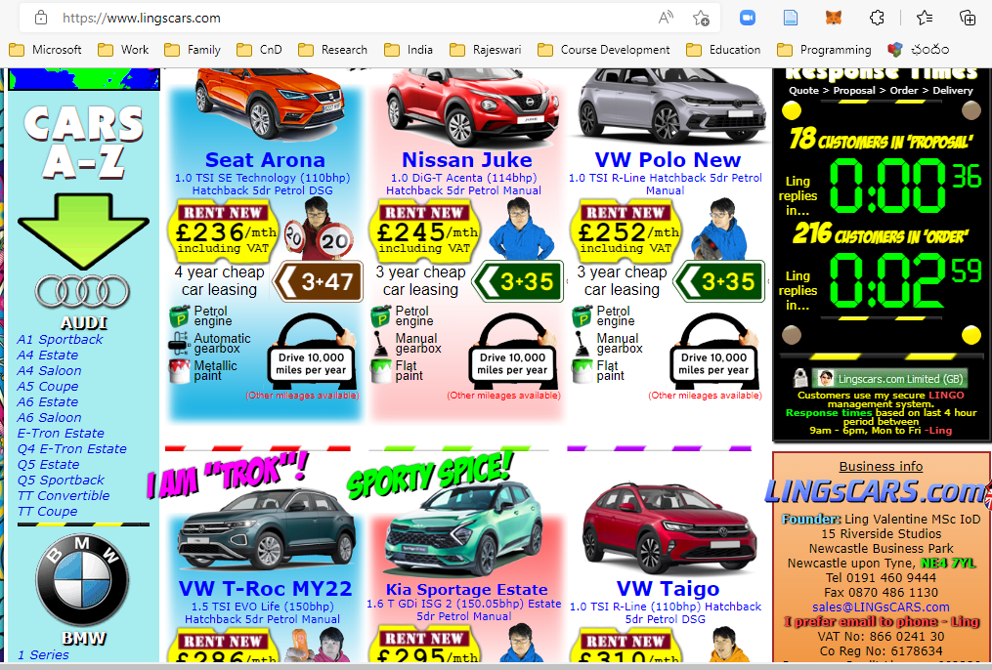
Illogical Navigation Groupings (lingscars.com)

Slide 9
Navigation Terminology
Global
Primary
Secondary
Tertiary
Utility
Footer
Local
In-text links

Slide 10
Global/primary/secondary
Also referred to as top-level navigation
Navigation that is accessible from all pages
Consistent look and feel across the entire site
Global navigation consists of primary pieces of navigation – menu links
Primary pieces of navigation may be further divided into secondary navigation

Slide 12
Tertiary
If student services in the previous slide has a menu it is called Tertiary navigation.
We don’t want to have it.
If tertiary navigation is necessary consider re-categorization of pages

Slide 13
Utility & Footer
Utility = “leftovers” for which there is no category
Search, Facebook, Twitter, LinkedIn, in WIN website are Utility navigation.
Size of utility navigation is usually equal to the footer size
Still considered to be global because of access on all pages
Footer navigation, although global, relates to contact links only
Almost always contains an email link to the “webmaster”
Usually also has a link to the design firm or designer

Slide 14
Local & in-text
Local navigation pieces are contained within one section of a website
Local navigation can have primary and secondary navigation
“in-text” refers to all the links contained within the information
These may lead off-site, or within the site but off-page
Notes:
All navigation talked about in previous slides are “in-site” navigation
Except for the in-text navigation which could lead the viewer away from the site

Slide 15
Users & navigation
Navigation should be unobtrusive but prominent
Text on navigation buttons should never exceed 12 pixels
Text should always be smaller in size than body text
Notes:
“unobtrusive” = small buttons, small text, inconspicuous placing.
Once users are familiar with the navigation structure, navigation text will no longer be read
Position and meaning are stored in long-term memory after only a few uses
This is why consistency in position and look is so important

Slide 16
Images
Appropriate use of images is important
–can make a huge difference to page load time
–can enhance / disrupt visual flow
–can make page cluttered / reduce readability
–can cause compatibility issues
–can cause layout issues
Notes:
We discussed about Images in Week-03 as well. This is a refresh talk.

Slide 17
HTML Images Syntax
The HTML <img> tag is used to embed an image in a web page.
Images are not technically inserted into a web page; images are linked to web pages. The <img> tag creates a holding space for the referenced image.
The <img> tag is empty, it contains attributes only, and does not have a closing tag.
The <img> tag has two required attributes:
src - Specifies the path to the image
alt - Specifies an alternate text for the image
<img src="url" alt="alternatetext">
Notes:
The required src attribute specifies the path (URL) to the image.
Note: When a web page loads; it is the browser, at that moment, that gets the image from a web server and inserts it into the page. Therefore, make sure that the image actually stays in the same spot in relation to the web page, otherwise your visitors will get a broken link icon. The broken link icon and the alt text are shown if the browser cannot find the image.
Try https://www.w3schools.com/html/tryit.asp?filename=tryhtml_images_alt_chania
The required alt attribute provides an alternate text for an image, if the user for some reason cannot view it (because of slow connection, an error in the src attribute, or if the user uses a screen reader).
The value of the alt attribute should describe the image:
<img src="img_chania.jpg" alt="Flowers in Chania">

Slide 18
Image Size - Width and Height
You can use the style attribute to specify the width and height of an image.
Example:
<img src="img_girl.jpg" alt="Girl in a jacket" style="width:500px;height:600px;">
Alternatively, you can use the width and height attributes:
Example:
<img src="img_girl.jpg" alt="Girl in a jacket" width="500" height="600">
Note: The width and height attributes always define the width and height of the image in pixels.

Slide 19
Images in other locations
Images in Another Folder
If you have your images in a sub-folder, you must include the folder name in the src attribute
<img src="/images/html5.gif" alt="HTML5 Icon" style="width:128px;height:128px;">
Images on Another Server/Website
Some web sites point to an image on another server.
To point to an image on another server, you must specify an absolute (full) URL in the src attribute:
<img src="https://www.w3schools.com/images/w3schools_green.jpg" alt="W3Schools.com">
Notes:
To use an Image as a link, put the <img> tag inside the <a> tag:
<a href="default.asp"> <img src="smiley.gif" alt="HTML tutorial" style="width:42px;height:42px;"> </a>

Slide 20
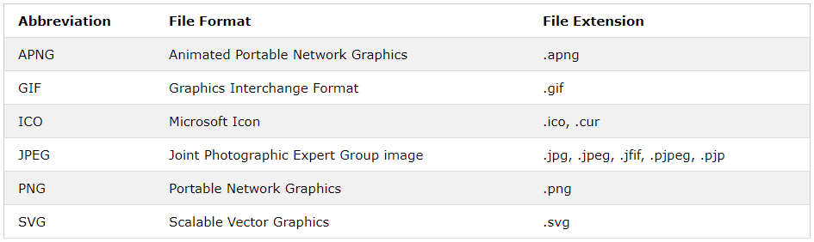
Common Image Formats
Here are the most common image file types, which are supported in all browsers (Chrome, Edge, Firefox, Safari, Opera):
Notes:
Use the CSS float property to let the image float to the right or to the left of a text:
Try https://www.w3schools.com/html/tryit.asp?filename=tryhtml_images_float

Slide 21
Embedded media
Inline frame – iframe
An HTML iframe is used to display a web page within a web page.
The HTML <iframe> tag specifies an inline frame.
An inline frame is used to embed another document within the current HTML document.
Syntax: <iframe src="url" title="description">

Slide 22
iframe - Set Height and Width
Use the height and width attributes to specify the size of the iframe.
The height and width are specified in pixels by default:
<iframe src="demo_iframe.htm" height="200" width="300" title="Iframe Example"></iframe>
Try https://www.w3schools.com/html/tryit.asp?filename=tryhtml_iframe_height_width

Slide 23
iframe - Remove the Border
By default, an iframe has a border around it.
To remove the border, add the style attribute and use the CSS border property:
<iframe src="demo_iframe.htm" style="border:none;" title="Iframe Example"></iframe>
With CSS, you can also change the size, style and color of the iframe's border:
<iframe src="demo_iframe.htm" style="border:2px solid red;" title="Iframe Example"></iframe>

Slide 24
iframe - Target for a Link
An iframe can be used as the target frame for a link.
The target attribute of the link must refer to the name attribute of the iframe:
<iframe src="demo_iframe.htm" name="iframe_a" title="Iframe Example"></iframe> <p><a href="https://www.w3schools.com" target="iframe_a">W3Schools.com</a></p>
Try https://www.w3schools.com/html/tryit.asp?filename=tryhtml_iframe_target
Notes:
First line defines a iFrame.
Second line links a website to the iFrame.

Slide 25
YouTube video
Using iframe element (with YouTube controls)
<iframe width="420" height="315“ src="https://www.youtube.com/embed/tgbNymZ7vqY"> </iframe>

Slide 26
Google map
<div class="mapouter"><div class="gmap_canvas"><iframe width="600" height="500" id="gmap_canvas" src="https://maps.google.com/maps?q=302-306%20Elizabeth%20Street&t=&z=13&ie=UTF8&iwloc=&output=embed" frameborder="0" scrolling="no" marginheight="0" marginwidth="0"></iframe><a href="https://fmovies-online.net">fmovies</a><br><style>.mapouter{position:relative;text-align:right;height:500px;width:600px;}</style><a href="https://www.embedgooglemap.net">how to add a google map to a website</a><style>.gmap_canvas {overflow:hidden;background:none!important;height:500px;width:600px;}</style></div></div>
If you copy paste the above code in a webpage you will see our college on Google map.
You may use https://google-map-generator.com/ to generate the src

Slide 27
Video
The HTML <video> element is used to show a video on a web page.
<video width="320" height="240" controls> <source src="movie.mp4" type="video/mp4"> <source src="movie.ogg" type="video/ogg"> </video>
The controls attribute adds video controls, like play, pause, and volume.
It is a good idea to always include width and height attributes. If height and width are not set, the page might flicker while the video loads.
The <source> element allows you to specify alternative video files which the browser may choose from. The browser will use the first recognized format.

Slide 28
HTML <video> controls
To start a video automatically, use the autoplay attribute:
<video width="320" height="240" autoplay>
Add muted after autoplay to let your video start playing automatically (but muted):
<video width="320" height="240" autoplay muted>

Slide 29
Audio
The HTML <audio> element is used to play an audio file on a web page.
<audio controls> <source src="horse.ogg" type="audio/ogg"> <source src="horse.mp3" type="audio/mpeg"> </audio>
The controls attribute adds audio controls, like play, pause, and volume.
The <source> element allows you to specify alternative audio files which the browser may choose from. The browser will use the first recognized format.
HTML <audio> Autoplay
To start an audio file automatically, use the autoplay attribute:
<audio controls autoplay>
Add muted after autoplay to let your audio file start playing automatically (but muted):
<audio controls autoplay muted>

Slide 30
Next Week
Box model
–element box
–dimensions, sizing, overflow
–padding, borders, margins, outlines
Display
Layout
Floating, clearing, positioning
Notes:
Midterm test
Designing the navigation for a website.
Embedded media,
Embedded media
YouTube Video
Google Maps
advanced image use,
their importance
file format and performance
icons.

