Slide 1

Web Development
Week #08

Slide 2
This Week
Box model
–element box
–dimensions, sizing, overflow
–padding, borders, margins, outlines
Display
Layout
Floating, clearing, positioning

Slide 3
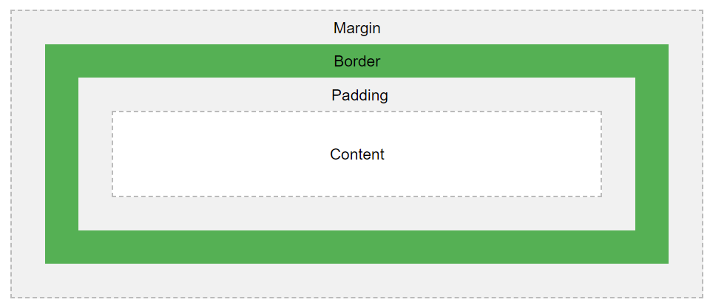
CSS Box Model
In CSS, the term "box model" is used when talking about design and layout.
The CSS box model is essentially a box that wraps around every HTML element.
It consists of: margins, borders, padding, and the actual content.
The figure illustrates the box model:

Slide 4
Different parts of Box Model
Content - The content of the box, where text and images appear
Padding - Clears an area around the content. The padding is transparent
Border - A border that goes around the padding and content
Margin - Clears an area outside the border. The margin is transparent
Note: The box model allows us to add a border around elements, and to define space between elements.
Try the code in link below:
https://www.w3schools.com/css/tryit.asp?filename=trycss_boxmodel

Slide 5
Width and Height of an Element
In order to set the width and height of an element correctly in all browsers, you need to know how the box model works.
Important: When you set the width and height properties of an element with CSS, you just set the width and height of the content area. To calculate the full size of an element, you must also add padding, borders and margins.

Slide 6
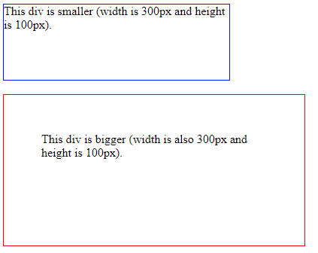
CSS Box Sizing
The CSS box-sizing property allows us to include the padding and border in an element's total width and height.
When you set the width/height of an element, the element often appears bigger than you have set (because the element's border and padding are added to the element's specified width/height).
The two <div> elements above end up with different sizes in the result (because div2 has a padding specified):
.div1 { width: 300px; height: 100px; border: 1px solid blue; } .div2 { width: 300px; height: 100px; padding: 50px; border: 1px solid red; }

Slide 7
CSS overflow Property
determines what happens when box is too small
–visible : content extends past box to remain visible
–hidden : content is cut off at the edges of the box
–scroll : scrollbars are added to the content box
–auto : browser decides
Try the exercise below:
https://www.w3schools.com/cssref/tryit.asp?filename=trycss_overflow

Slide 8
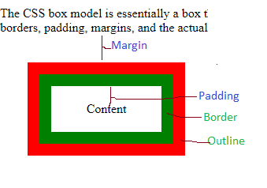
CSS Outline
An outline is a line that is drawn around elements, OUTSIDE the borders, to make the element "stand out".
When “outline” property is used it sits between “border” and “margin” properties.
Find more properties of Outline through the link below:
https://www.w3schools.com/css/css_outline.asp
Notes:
Content - The content of the box, where text and images appear
Padding - Clears an area around the content. The padding is transparent
Border - A border that goes around the padding and content
Margin - Clears an area outside the border. The margin is transparent

Slide 9
CSS display Property
https://www.w3schools.com/cssref/playit.asp?filename=playcss_display&preval=inline
The display property specifies the display behavior (the type of rendering box) of an element.
More examples:
https://www.w3schools.com/cssref/pr_class_display.asp

Slide 10
Layout
normal flow
–block elements stack on top of each other and fill entire width of their parent container
–inline elements stack next to each other and flow/wrap as required to fill the block elements
–block elements are containers for other elements
floating and positioning elements changes the normal flow behaviour

Slide 11
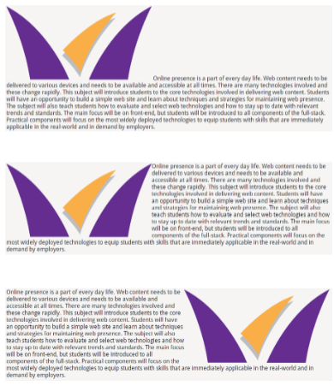
Floating
Float
–none
–left
–right
moves the element as far as possible to the left / right
following content will wrap around the element
floated elements are placed within the content area of the enclosing container
any element can be floated
use margins to improve spacing (they do not collapse)
specify width for floated elements
–without this you run the risk that the element will just fill the container width
Useful link: https://www.w3schools.com/cssref/pr_class_float.asp
Notes:
Demonstrate this in the w3schools.

Slide 12
CSS clear Property
Do not allow floating elements on the left or the right side of a specified <p> element
Remove the "clear" class from the code below to see the effect.
https://www.w3schools.com/cssref/tryit.asp?filename=trycss_class-clear

Slide 13
Positioning
The position property specifies the type of positioning method used for an element (static, relative, fixed, absolute or sticky).
Elements are then positioned using the top, bottom, left, and right properties. However, these properties will not work unless the position property is set first. They also work differently depending on the position value.

Slide 14
Positioning
Static
–takes up space in normal flow
–at default position in the normal flow
Relative
–takes space in normal flow
–offset from the default position in normal flow
Absolute
–removed from normal flow
–positioned at a specific location in containing block
–scrolls with the document
Fixed
–removed from normal flow
–positioned at a specific location in viewport
–stays in place even if the document scrolls
Sticky
–takes up space in normal flow
–at default position in normal flow until scrolled near edge of viewport, then it becomes fixed
https://www.w3schools.com/css/css_positioning.asp

Slide 15
Stacking
The z-index property specifies the stack order of an element.
An element with greater stack order is always in front of an element with a lower stack order.
Note: z-index only works on positioned elements (position: absolute, position: relative, position: fixed, or position: sticky) and flex items (elements that are direct children of display:flex elements).

Slide 16
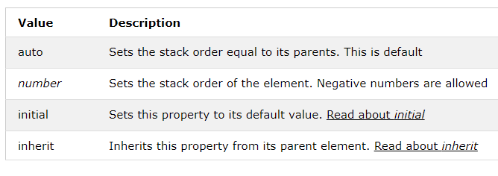
Stacking Property Values
Try the link below for some examples
https://www.w3schools.com/css/css_z-index.asp

Slide 17
Summary
Box model
–element box
–dimensions, sizing, overflow
–padding, borders, margins, outlines
Display
Layout
Floating, clearing, positioning

Slide 18
Next Week
Responsive web design
Viewport
CSS media queries
Flexbox
CSS Grid

