Slide 1

Web Development
Week #09

Slide 2
This Weeks Lecture
Responsive web design
Viewport
CSS Grid
CSS media queries
Flexbox

Slide 3
HTML Responsive Web Design
Responsive web design is about creating web pages that look good on all devices!
A responsive web design will automatically adjust for different screen sizes and viewports.
Responsive Web Design is about using HTML and CSS to automatically resize, hide, shrink, or enlarge, a website, to make it look good on all devices (desktops, tablets, and phones)

Slide 4
Setting The Viewport
The viewport is the user's visible area of a web page.
This will set the viewport of your page, which will give the browser instructions on how to control the page's dimensions and scaling.
<meta name="viewport" content="width=device-width, initial-scale=1.0">

Slide 5
Responsive Images
Responsive images are images that scale nicely to fit any browser size.
Using the width Property
If the CSS width property is set to 100%, the image will be responsive and scale up and down
<img src="img_girl.jpg" style="width:100%;">

Slide 6
Using the max-width Property
In previous example, the image can be scaled up to be larger than its original size. A better solution, in many cases, will be to use the max-width property instead.
If the max-width property is set to 100%, the image will scale down if it has to, but never scale up to be larger than its original size
<img src="img_girl.jpg" style="max-width:100%;height:auto;">

Slide 7
Show Different Images Depending on Browser Width
The HTML <picture> element allows you to define different images for different browser window sizes.
Resize the browser window to see how the image below change depending on the width
<picture> <source srcset="img_smallflower.jpg" media="(max-width: 600px)"> <source srcset="img_flowers.jpg" media="(max-width: 1500px)"> <source srcset="flowers.jpg"> <img src="img_smallflower.jpg" alt="Flowers"> </picture>
Notes:
Tryit Editor v3.7 (w3schools.com)

Slide 8
Responsive Text Size
The text size can be set with a "vw" unit, which means the "viewport width".
That way the text size will follow the size of the browser window
<h1 style="font-size:10vw">Hello World</h1>
Note: Viewport is the browser window size. 1vw = 1% of viewport width. If the viewport is 50cm wide, 1vw is 0.5cm.
Checkout: https://www.w3schools.com/html/tryit.asp?filename=tryhtml_responsive_text

Slide 9
Responsive Grid-View
Many web pages are based on a grid-view, which means that the page is divided into columns
Using a grid-view is very helpful when designing web pages. It makes it easier to place elements on the page.
A responsive grid-view often has 12 columns, and has a total width of 100%, and will shrink and expand as you resize the browser window.
First ensure that all HTML elements have the box-sizing property set to border-box. This makes sure that the padding and border are included in the total width and height of the elements.

Slide 10
Responsive Grid-View …
Add the following code in your CSS:
* { box-sizing: border-box; }
The following example shows a simple responsive web page, with two columns:
https://www.w3schools.com/css/tryit.asp?filename=tryresponsive_webpage

Slide 11
Responsive Grid-View …
The previous example is fine if the web page only contains two columns.
However, we want to use a responsive grid-view with 12 columns, to have more control over the web page.
First we must calculate the percentage for one column: 100% / 12 columns = 8.33%.
Then we make one class for each of the 12 columns, class="col-" and a number defining how many columns the section should span: https://www.w3schools.com/css/tryit.asp?filename=tryresponsive_cols
All these columns should be floating to the left, and have a padding of 15px
Each row should be wrapped in a <div>. The number of columns inside a row should always add up to 12
Notes:
Copy paste many col-01 to five and six times and show to students.

Slide 12
Responsive Grid-View …
The columns inside a row are all floating to the left, and are therefore taken out of the flow of the page, and other elements will be placed as if the columns do not exist. To prevent this, we will add a style that clears the flow:
.row::after { content: ""; clear: both; display: table; }
Notice that the webpage in the example does not look good when you resize the browser window to a very small width. In the slides you will learn how to fix that

Slide 13
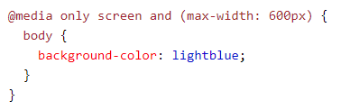
Media Queries
In addition to resize text and images, it is also common to use media queries in responsive web pages.
Media query is a CSS technique introduced in CSS3.
It uses the @media rule to include a block of CSS properties only if a certain condition is true.
With media queries you can define completely different styles for different browser sizes.
Example: If the browser window is 600px or smaller, the background color will be lightblue:

Slide 14
Media Queries
Example: resize the browser window to see that the three div elements below will display horizontally on large screens and stacked vertically on small screens:
https://www.w3schools.com/html/tryit.asp?filename=tryhtml_responsive_media_query

Slide 15
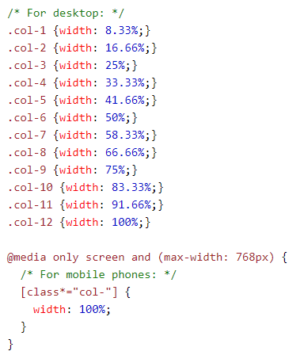
Add a Breakpoint
Earlier in slide 12, we made a web page with rows and columns, and it was responsive, but it did not look good on a small screen.
Media queries can help with that. We can add a breakpoint where certain parts of the design will behave differently on each side of the breakpoint.
Use a media query to add a breakpoint at 768px:
https://www.w3schools.com/css/tryit.asp?filename=tryresponsive_breakpoints

Slide 16
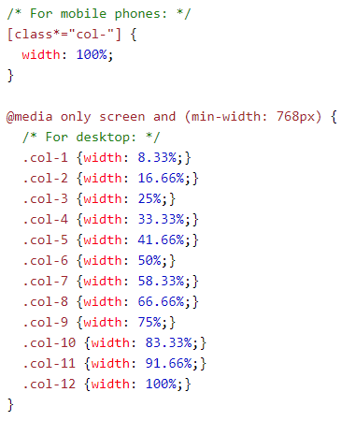
Always Design for Mobile First
Mobile First means designing for mobile before designing for desktop or any other device (This will make the page display faster on smaller devices).
This means that we must make some changes in our CSS.
Instead of changing styles when the width gets smaller than 768px, we should change the design when the width gets larger than 768px. This will make our design Mobile First:

Slide 17
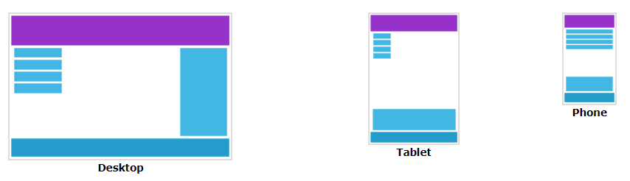
Another Breakpoint
You can add as many breakpoints as you like.
We will also insert a breakpoint between tablets and mobile phones.
We do this by adding one more media query (at 600px), and a set of new classes for devices larger than 600px (but smaller than 768px):
https://www.w3schools.com/css/tryit.asp?filename=tryresponsive_col-s

Slide 18
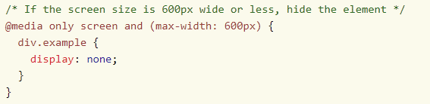
Hide Elements With Media Queries
Another common use of media queries, is to hide elements on different screen sizes:
https://www.w3schools.com/css/tryit.asp?filename=trycss_mediaqueries_hide

Slide 19
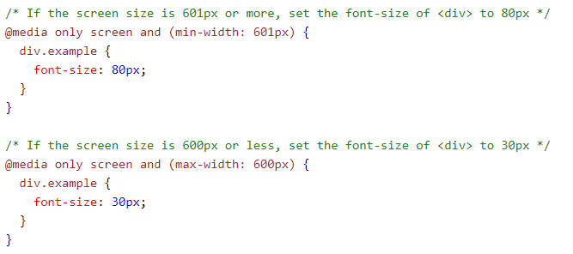
Change Font Size With Media Queries
You can also use media queries to change the font size of an element on different screen sizes:

Slide 20

CSS Flexbox
The Flexible Box Layout Module, makes it easier to design flexible responsive layout structure without using float or positioning.
To start using the Flexbox model, you need to first define a flex container.
The element above represents a flex container (the blue area) with three flex items.
<div class="flex-container"> <div>1</div> <div>2</div> <div>3</div> </div>

Slide 21
CSS Flex Container
The flex container becomes flexible by setting the display property to flex:
.flex-container { display: flex; }
The flex container properties are:
flex-direction
flex-wrap
flex-flow
justify-content
align-items
align-content
Checkout: https://www.w3schools.com/css/css3_flexbox_container.asp
Notes:
https://www.w3schools.com/css/tryit.asp?filename=trycss3_flexbox_flex-wrap_wrap

Slide 22
Summary
Responsive web design
Viewport
CSS Grid
CSS media queries
Flexbox

Slide 23
Next Weeks Lecture
GitHub
Bitbucket
VS code
GUI vs CLI–why not have both?
Development web server
Frameworks
Quality assurance & automation
Additional reading

