Slide 1

Web Development
Week #11

Slide 2
This Weeks Lecture
What is JavaScript?
How to add it to a web page?
Simple example
Basics of JavaScript programming
–variables, functions, events
Fully featured example

Slide 3
What is JavaScript?
a high-level programming language
usually runs in a browser (client side)
it can be standalone (server side) (Node.js)
used to make web pages interactive
insert dynamic text into HTML (ex: username)
react to events (ex: page load user click)
get information about a user's computer (ex: browser type)
perform calculations on user's computer (ex: form validation)

Slide 4
When to use JavaScript?
client-side scripting (JavaScript) benefits:
usability: can modify a page without having to post back to the server (faster UI)
efficiency: can make small, quick changes to page without waiting for server
event-driven: can respond to user actions like clicks and key presses

Slide 5
Adding JavaScript
loaded from external file
recommended
same code can be shared by many pages
<script src="scriptfile.js"></script>
embedded within a page
<script> // JavaScript code</script>
Inline
<a onclick="//JS code">

Slide 6
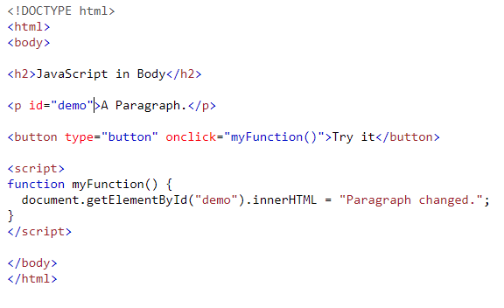
Simple Example
Try it
https://www.w3schools.com/js/tryit.asp?filename=tryjs_whereto_body
Notes:
Embedded Script

Slide 7
Variables
var name = "Peter“
var now = new Date()
Variables have a name (identifier)
case sensitive
must start with a letter or $ or _
can contain letters, numbers, $ and _
Variables hold a value–type of value can be
number (1, 2.0, etc.)
string ("hello", 'Peter')
boolean (true / false)
array ([1, 2, 3] group of values)
object

Slide 8
Functions
functions hold a series of statements/expressions
they are used to "package" some functionality
function calculatePrice (qty, unitPrice){
return qty * unitPrice
}
Functions have a name (identifier, same rules as variables)
Functions have some arguments (parameters) as inputs
used to pass information to the function
Functions return some value back to the caller.
we use functions by calling them
var total = calculatePrice(12, 1.25)
Notes:
Qty, UnitPrice are variavbles.
Claculte Pay is the function.

Slide 9
JS Events
we can get JS to run code when something happens
inline, using attribute
onclick
<button onclick="this.textContent = Date()">
Click me to find out what the time is</button>
by attaching a listener
–event name
–function to call when event occurs
document.getElementById("qty").addEventListener("change", updateTotal)

Slide 10
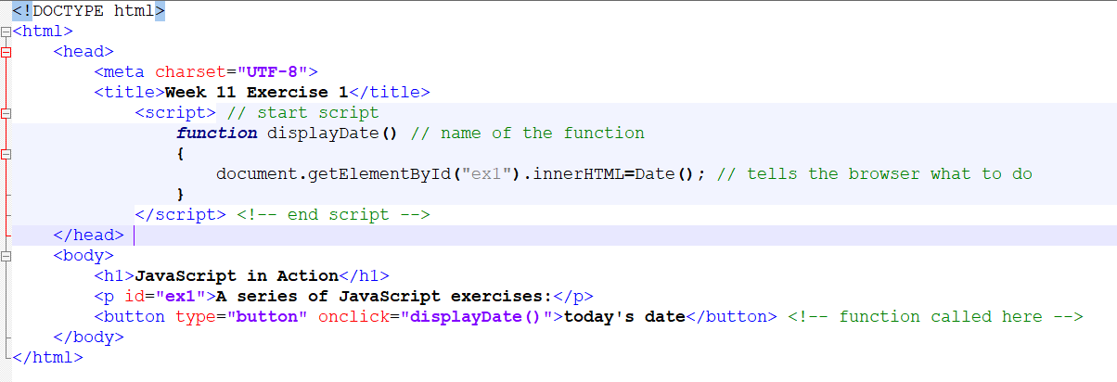
Function Example

Slide 11
Most used events
change – an HTML element has been changed
click – the user clicked an HTML element
focus – an element gets focus (ready for keyboard input)
blur – an element loses focus
mouseover – the mouse moved over an HTML element
mouseout – the mouse moved away from an HTML element
keydown – a keyboard key was pressed
load – the browser finished loading the page
submit – a form is submitted

Slide 12
Try the following examples…
https://www.w3schools.com/js/tryit.asp?filename=tryjs_intro_lightbulb

Slide 13
Document Object Model (DOM)
HTML is parsed to construct DOM
selectors are used to apply CSS to DOM elements
JavaScript code can manipulate DOM
–change the elements
style, value, content, etc.
–change the structure of DOM
add and remove elements

Slide 14
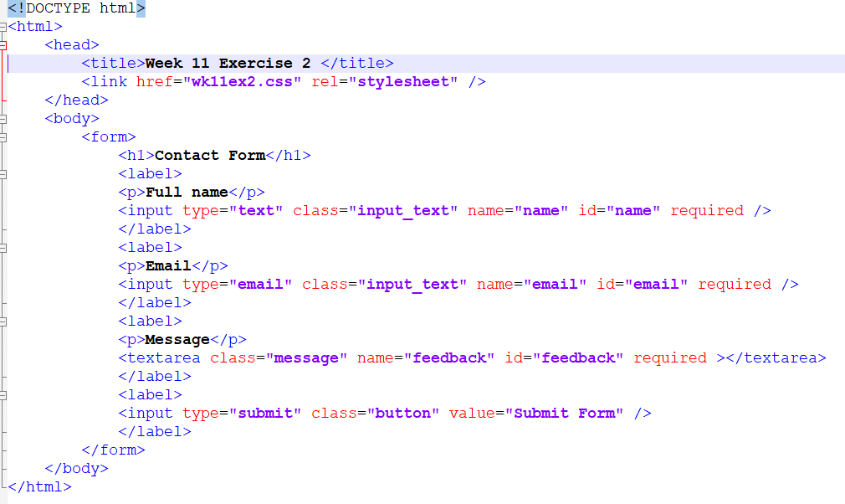
Forms Revisited
Notes:
Input and Text area are the form elements.
Type: Data type
Name: is the name of the attribute. If the name attribute is removed data will not be submitted.
ID: a unique name is the html page. JavaScript code can be written using this id field. See slide 10. GetElementbyID usage.
Required. HTML5 attribute that makes sure the value is filled in. This is normally checked when Submit button is clicked.

Slide 15
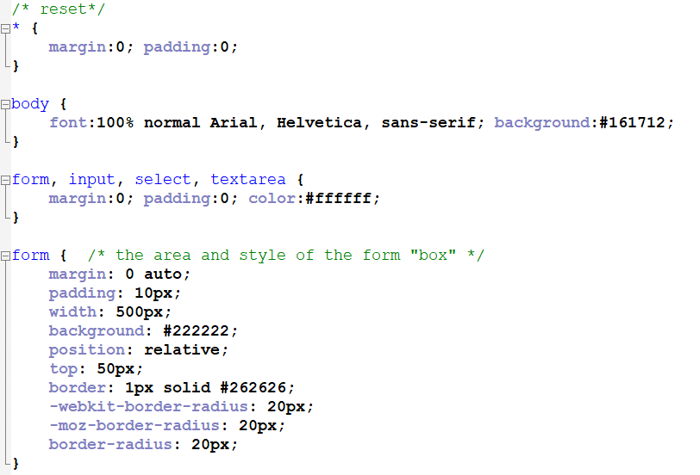
CSS for this form

Slide 16
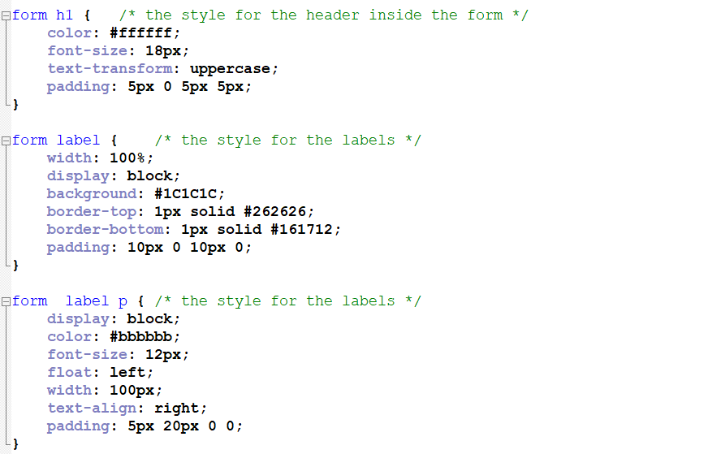

Slide 17
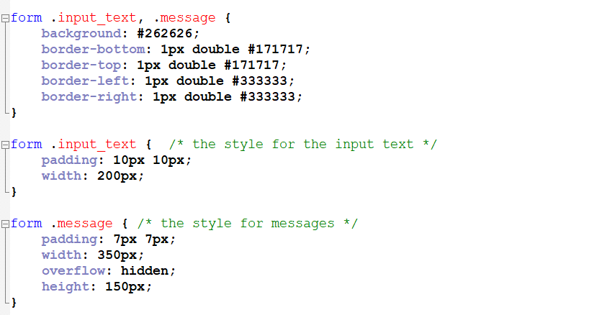

Slide 18
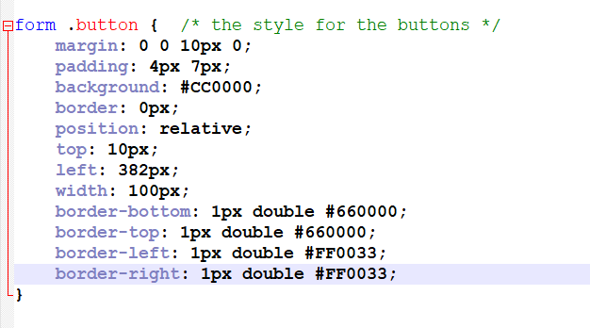
CSS for this form

Slide 19
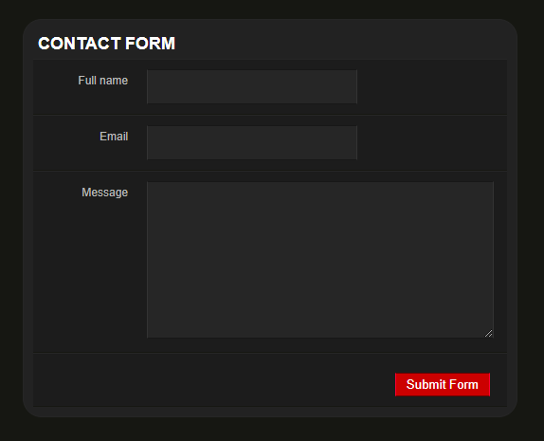
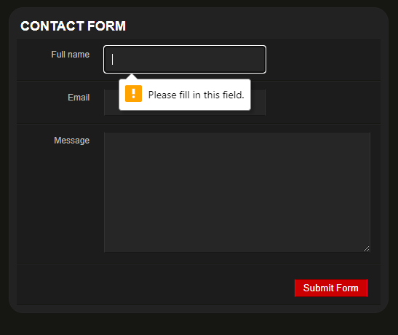
Running this Code

Slide 20
Just a warning
You can take the code to create a contact us form for your assignment. However, you must use Java Script to validate the fields instead of the “required” attribute.

Slide 21
Summary
What is JavaScript?
How to add it to a web page?
Simple example
Basics of JavaScript programming
–variables, functions, events
Fully featured example

