Slide 1

Web Development
Week #12

Slide 2
This Weeks Lecture
Building a website
plan
design
execute
Explain how to test a website before it is published
Describe how to publish a website to a web server
Identify ways to promote a published website
Discuss the importance of maintaining and evaluating a published website

Slide 3
Before you start- Remember!
Attempting to build a website without a plan is like trying to construct a house without an architectural blueprint.
You need to learn about:
The skills, functions, and job roles needed for a successful web development project
Familiarize yourself with the web development process and its different components

Slide 4
Skills and Functions needed
Project Manager
Marketing Representative
Copy Writer & Editor
Content Manager
Graphic Designer
Database Administrator
Network Administrator
Information Architect
Web Developer

Slide 5
Skills and Functions needed
The web developer may also be the graphic designer.
Some job roles may be outsourced
◦ An external web site provider is used so there is less (if any) need for a Network Administrator.

Slide 6
GitHub features
Documentation (wiki)
Issue tracking
Project management
Commenting
Collaborators with access to repository
Fork – contributor makes their own copy of repo
Pull request – update from one repo to another

Slide 7
Website Testing
Ensure navigation is user-based and user-controlled
Identify structural problems or content issues
Evaluate the following:
Does my website meet its goals and objectives?
Does the design and functionality incorporate UX?
Have I met accessibility standards?
Have I incorporated RWD standards?
Beta testing involves using a prepublication version
Beta website
Staging server enables testing in environment like live web server
Sometimes testing occurs on two or more website versions

Slide 8
Self- and Internal Testing
Limited to those involved in web design
Images and multimedia should appear and work
Test the navigation and search tools
Test internal and external links
Broken link does not work
WAI guidelines
Use optimization tools
RWD compliance
Correct any problems

Slide 9
Target Audience Testing
Questions to Ask:
Which pages appear to appeal to them?
Which pages appear to disinterest them?
How much time do they spend on various pages?
Which links do they visit or ignore?
How easily do they navigate the website?
Do they at any time demonstrate any confusion or frustration?
Recruit outside testers
Use a variety of devices and screen sizes
Colleagues not involved in development
Target audience
Test navigation and links
Ask testers to complete a UX survey
After testing, consider all feedback
Notes:
Ask testers to complete a UX survey
Did the website’s content satisfy wants, needs, expectations
Was the content interesting and valuable?
Was it easy or difficult to navigate?
After testing, consider all feedback
Implement suggestions that support goals and objectives, meet audience needs, improve value

Slide 10
Website Publishing
After testing, publish to live server
Acquire a domain name
Allot server space
Upload files
HTML and CSS
Images
Multimedia

Slide 11
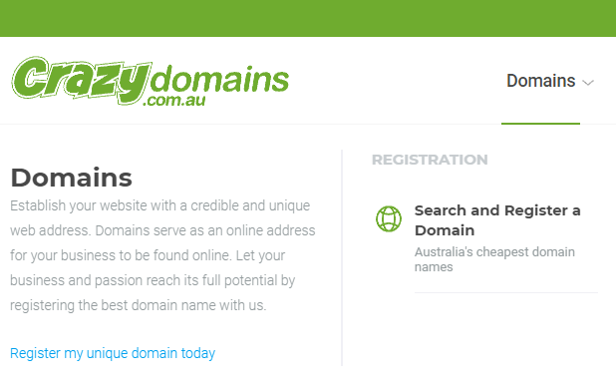
Domain Name
Use business or organization name
Avoid abbreviations and hyphens
Add words that further specify purpose
Use an accredited registrar

Slide 12
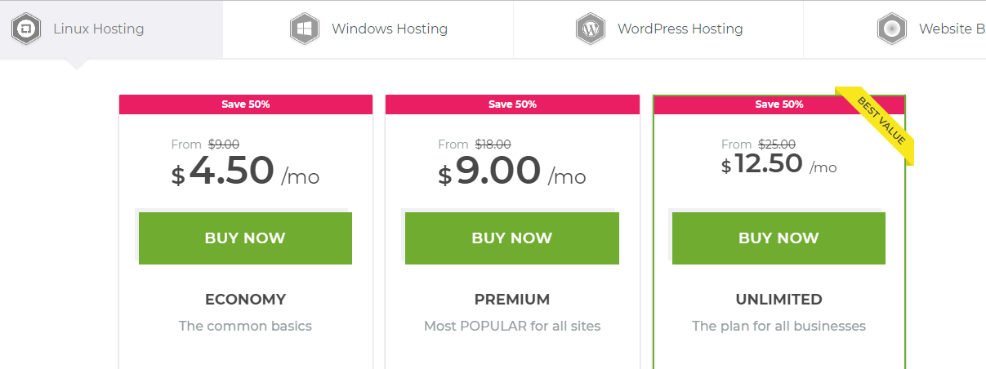
Server Space
A web server runs server software
Displays webpages upon browser request
Web hosting companies offer space for monthly fee
How much server space will I have? Are there limits
What is procedure for updating and republishing pages?
Support for e-commerce, multimedia, interactivity?
What is typical response time for technical support?
Does the server experience outages?
Have servers had security breaches?

Slide 13
Uploading Website Folders and Files
Uploading all website files to the server specified by your web hosting service
Dedicated folder
Know name and URL of server
Before uploading, move unnecessary files to save space and limit page loading time

Slide 14
File Transfer Protocol
An FTP client is used to transfer files using the FTP protocol
Provides split view of folders and files on a local computer and remote computer
After you publish the website, you can sync the files, which makes sure any changed files are the same on both servers.
Allows you to upload your website directly from within the program
You need to arrange for server space
Provide name and URL of server
Username and password

Slide 15
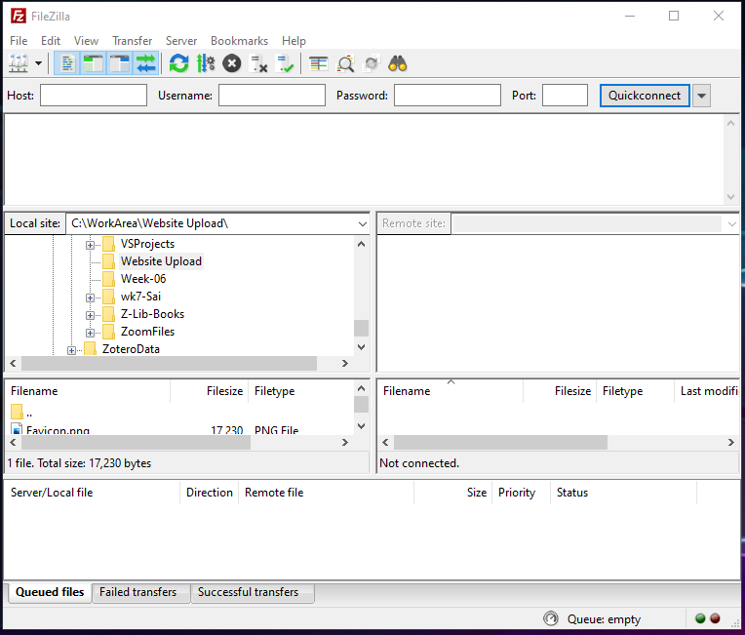
Notes:
I use a software called FileZilla to upload my files to my website.

Slide 16
Retesting Published Pages
Confirm that all images display properly
Make certain that no broken links exist
Ensure all interactive elements function properly
Skim the content

Slide 17
Website Promotion
Promote your website to reach the target audience
Use online and offline promotional techniques
Maximize search tool exposure
Consider purchasing ads
Geotargeting provides ad content based on visitor’s location

Slide 18
Social Media
Basic social media presence is easy and free
Share updates
Invite customers to events
Ask for feedback
Create targeted ads

Slide 19
Search Engine Optimization
SEO refers to applying design and development techniques to appear at top of search results
Include meta tags
Page titles
Clearly worded text
Density of keywords
Keyword stuffing is adding commonly used terms to increase rankings
Incoming links
Consider hiring an SEO expert

Slide 20
Search Tool Indexing
When your website appears in indexes, visitors can find it using relevant keywords
Can register your URL with search engines and directories
Bing
Google
A Search tool submission service registers websites with multiple search tools

Slide 21
Website Maintenance and Evaluation
The web is a dynamic environment
Rapid changes in technology and visitors’ expectations
The work of maintaining a website never ends
Ongoing Maintenance, Updating, and Retesting
Add and promote timely content
Maintain functional navigation system
Use analytics
Evaluate and implement new technologies
Most web design tools include capability to update page content by editing HTML files
Ensure you have the most current HTML file and backup originals
Edit webpage
Preview the webpage
Upload or republish webpage

Slide 22
Evaluating Website Performance
After publishing, evaluate the website performance towards achieving goals and purpose
Analytics determine fees a website can charge for ads
Large websites follow a formal evaluation plan
Professional marketers provide complete analytic packages

Slide 23
Analytics
Web analytics (also called web metrics)
Server log analysis
Geolocation
Device type
Social media sharing
Tracking cookies
Page tagging
Sales data
Notes:
Web server log analysis provides:
Requesting computer’s IP address
Browser making the request
Date and time of request
URL of referring link
Path a visitor takes through website
Web server log analysis software

Slide 24
Benchmarking
Benchmarking involves using a defined standard to measure overall performance or evaluate a specific aspect of a website
After evaluation, adjust benchmark goals as necessary

Slide 25
Summary
Building a website
plan
design
execute
Explain how to test a website before it is published
Describe how to publish a website to a web server
Identify ways to promote a published website
Discuss the importance of maintaining and evaluating a published website

Slide 26
Next Week
Exam review
Subject Review

