Slide 1

Web Development
Week 2
Week02
Campbell, J., 2018, Web Design: Introductory (6ed), Cengage, Boston, MA, ISBN 978-1-
337-27793-8
© 2018 Cengage. All Rights Reserved. May not be copied, scanned, or duplicated, in whole or in part, except for use as permitted in a license distributed with a certain product or service or otherwise on a password-protected website for classroom use.

Slide 2
This Weeks Lecture
Describe the advantages of web publishing
Discuss basic web design principles
Familiar with HTML5

Slide 3
Advantages of Web Publishing
Web publishing offers distinct advantages over print
Currency
Connectivity
Interactivity
Cost
Delivery
© 2018 Cengage. All Rights Reserved. May not be copied, scanned, or duplicated, in whole or in part, except for use as permitted in a license distributed with a certain product or service or

Slide 4
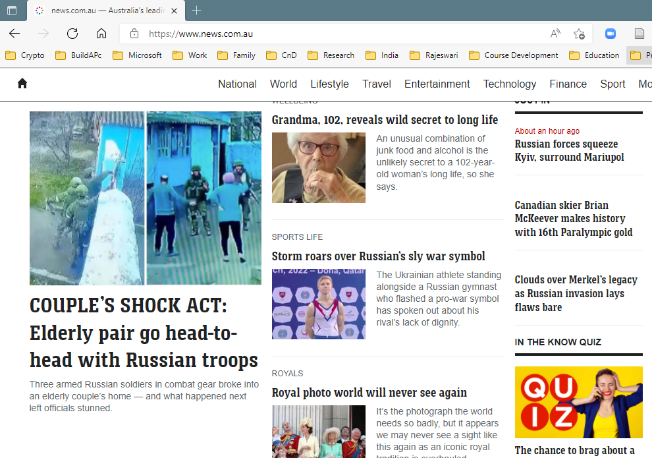
1. The Currency Advantage
Websites can be updated continuously, while print publications are only as current as their date of publication
To keep visitors on your site, always supply timely, changing material
Use Connectivity tools to communicate with customers and enable social media sharing

Slide 5
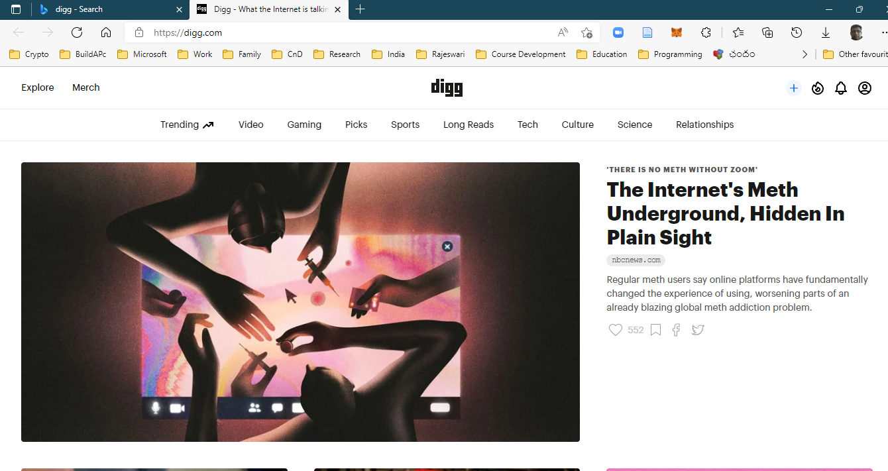
2. The Connectivity Advantage
The web’s connectivity advantage, or ability to instantaneously distribute and share content
Content aggregators
Digg
StumbleUpon
Streamline the writing process

Slide 6
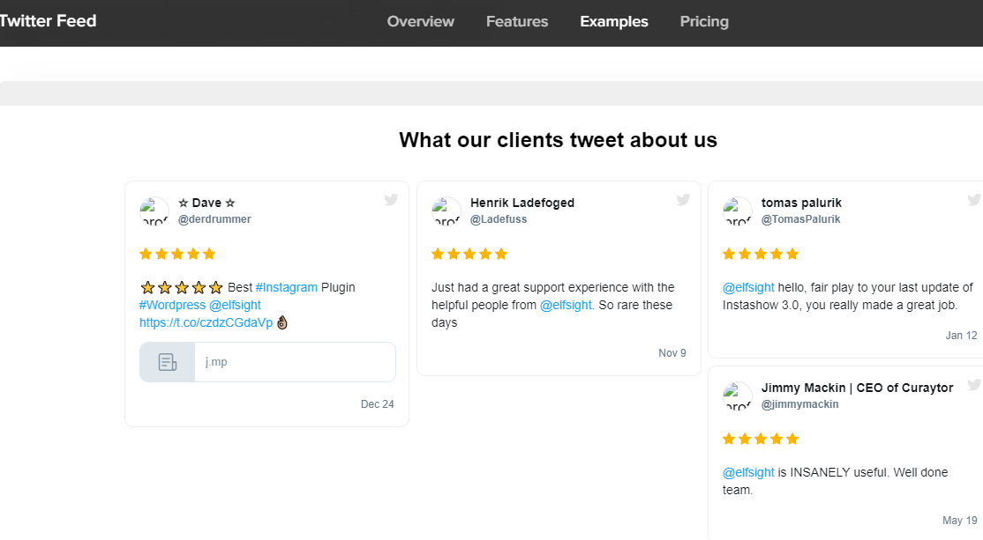
3. The Interactivity Advantage
Internet and web technologies promote data and resource sharing
Page of contact information
Links to blog, Twitter feed, Facebook page
Account signups
Web-based forms
Comments

Slide 7
4. The Cost Advantage
Updating web content is more cost effective than updating print content
Web publishing costs do not vary based on length, color, or design complexity.
Developing a website can be expensive:
Web design
Content writing or adaptation
Multimedia development
Website hosting
Domain name registration
Promotional Services

Slide 8
5. The Delivery Advantage
Distributing information via the web can be fast and inexpensive
With the same immediacy and cost, the web can reach both global and local audiences
Consider the web when the need exists for economical and rapid distribution of information
Use your website to expand upon printed content

Slide 9






Basic Web Design Principles
Balance and proximity
Contrast and focus
Unity and visual identity

Slide 10
Balance and Proximity
Arrange web elements symmetrically (centered and balanced) to suggest a conservative, safe, peaceful atmosphere
Arrange web elements asymmetrically (off balance) to create an energetic mood
Asymmetrical designs typically do not adapt well to mobile devices
Proximity (closeness) is closely associated with balance
Elements that have a relationship should be placed close to each other
White space can help define proximity and organize webpage elements

Slide 11
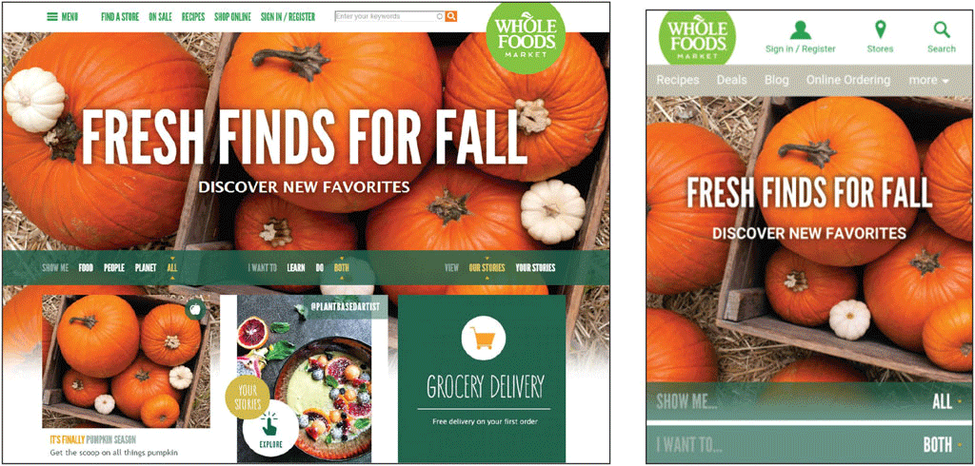
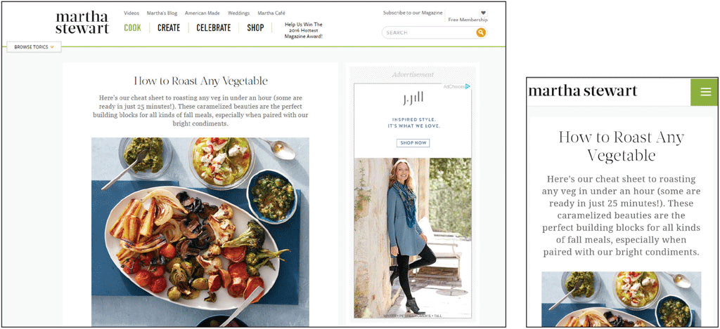
Balance and Proximity

Slide 12
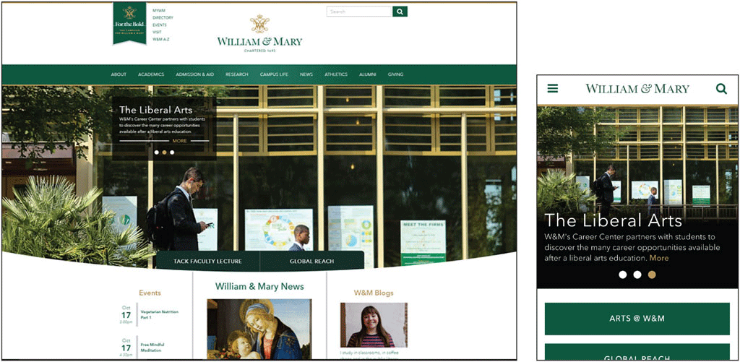
Contrast and Focus
Contrast is a mix of elements to stimulate attention
Use different text styles, colors, and size
Focus is the center of interest or activity
A webpage needs a focal point
Create webpages with contrast to elicit awareness and establish
a focal point, the center of interest
or activity

Slide 13
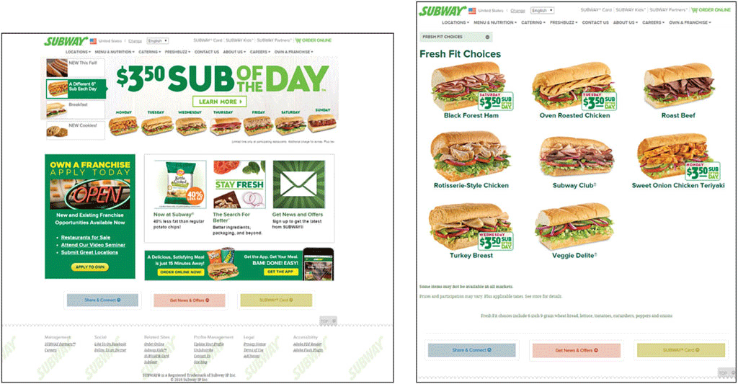
Unity and Visual Identity
All pages at a website must have unity, a sense of oneness or belonging, to create the visual identity
Create unity with consistency and repetition throughout a website
Unity is associated with branding
Branding specifications
Tag line
Alignment is the arrangement of objects in fixed or predetermined positions
Using grids for layout is part of RWD

Slide 14
Color as Web Design Tool
Color can be a powerful design tool
Reinforces branding
Brings focus
Increases contrast
Improves readability
Sets mood

Slide 15
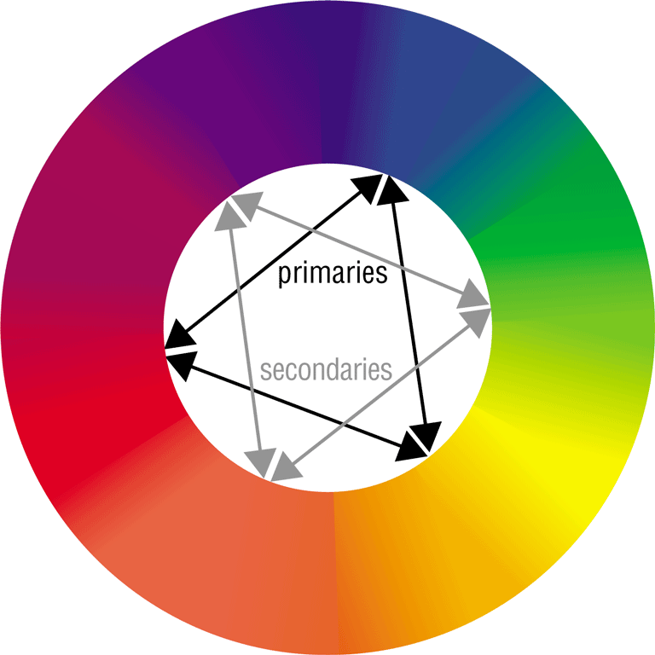
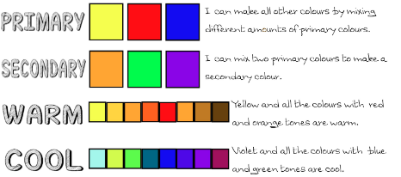
The Color Wheel
The color wheel can help you choose effective and appealing color combinations
Complementary colors

Slide 16
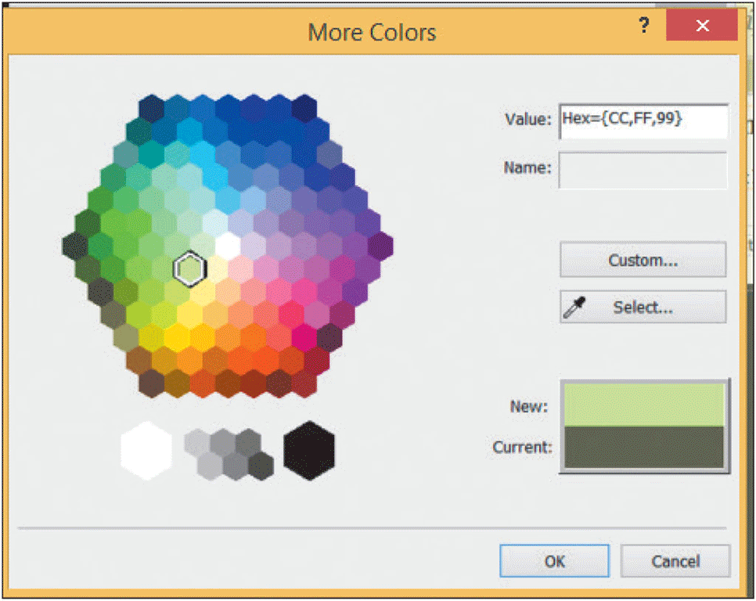
The RGB Color System
Monitors project color using the RGB color system
Combines red, green, and blue light
Levels of intensity are measured from 0 to 255
Values
A monitor’s color depth is the actual number of colors that a
monitor displays
The hexadecimal system uses 16 symbols to signify values

Slide 17
Target Audience Expectations
Certain colors have come to symbolize qualities
Keep in mind the qualities generally associated with different
colors when selecting colors for your website
Review several commercial and noncommercial website color schemes

Slide 18
More theory next week. Lets have a look at HTML and CSS

Slide 19
What is HTML?
document markup language
describes structure of web pages
early 1990's Tim Berners-Lee created “HTML Tags”
mid 2010's HTML5 standardised
https://html.spec.whatwg.org/ (huge / complex)
more accessible
https://www.w3schools.com/
https://developer.mozilla.org/

Slide 20
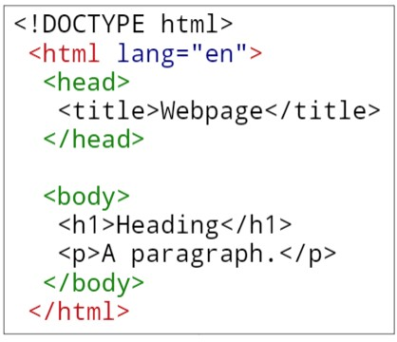
Closer look at HTML
elements marked by <tags>
opening <> and closing </> tags
must nest correctly
attributes provide more information lang=”en”
browser constructs DOM (Document Object Model)
use validation / lint tools to check syntax
https://html5.validator.nu/

Slide 21
Under the Hood of a Web Page
DTD – describes the markup language syntax
HTML element– contains the web page document
Head element – contains the head section
The head section contains information that describes the web page document
Title element– Text displays in title bar of window
Body element – contains the body section
The body section contains the text and elements that display in the browser viewport.

Slide 22
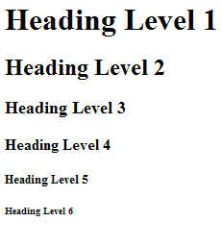
The Heading Element
<h1>Heading Level 1</h1>
<h2>Heading Level 2</h2>
<h3>Heading Level 3</h3>
<h4>Heading Level 4</h4>
<h5>Heading Level 5</h5>
<h6>Heading Level 6</h6>

Slide 23
The Paragraph Element <p> tag
Paragraph element
<p> …paragraph goes here… </p>
Groups sentences and sections of text together.
Configures empty space above and below the paragraph

Slide 24
The Line Break Element <br> tag
Line Break element
Stand-alone tag
Called a void element in HTML5
…text goes here <br> This starts on a new line….
Causes the next element or text to display on a new line

Slide 25
The Horizontal Rule Element <hr> tag
Horizontal Rule element
void element
<hr >
Configures a horizontal line on the page
In HTML5, it should be used to indicate a thematic break at the paragraph level

Slide 26
The Blockquote Element <blockquote>
Blockquote element
Indents a block of text for special emphasis
<blockquote>
…text goes here…
</blockquote>

Slide 27
Phrase Elements
Indicate the context and meaning of the text
Display inline with the text
Common Phrase Elements
<b></b> : Text is displayed in bold font
<strong></strong> : Text has strong importance and is displayed in bold
<i></i>: Text is displayed in italic font
<em></em> : Text has emphasis and is displayed in italic font

Slide 28
Proper Nesting
CODE:
<p><i>Call for a free quote for your web development needs: <strong>888.555.5555 </strong></i></p>
BROWSER DISPLAY:
Call for a free quote for your web development needs: 888.555.5555

Slide 29
HTML List Basics
Unordered List
Ordered List

Slide 30
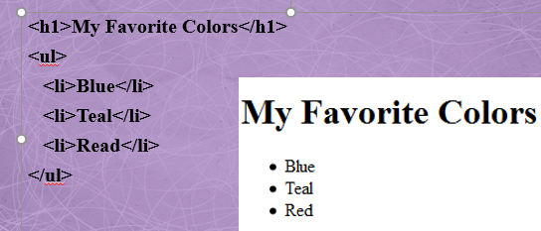
Unordered List
Displays information with bullet points
Unordered List Element
<ul> Contains the unordered list
List Item Element <li> Contains an item in the list

Slide 31
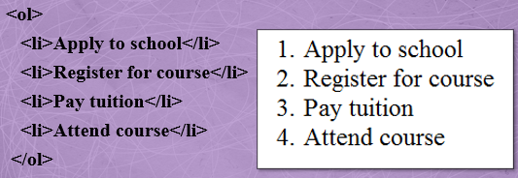
Ordered List
Conveys information in an ordered fashion
Ordered List Element
<ol> Contains the ordered list
type attribute determines numbering scheme of list
default is numerals
List Item Element <li> Contains an item in the list

Slide 32
Special Entity Characters
Display special characters such as quotes, copyright symbol, etc.
Character Code
© &copy;
< &lt;
> &gt;
& &amp;
&nbsp;
Notes:
&nbsp is for space

Slide 33
The div element <div>
Purpose:
Configure a specially formatted division or area of a web page
Block display with empty space above and below the div
Can contain other block display and inline display elements

Slide 34
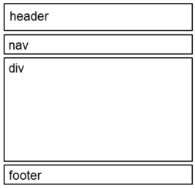
HTML5 Structural Elements
Header Element
<header></header> Contains the web page document’s headings
Nav Element
<nav></nav> Contains web page document’s main navigation
Footer Element
<footer></footer> Contains the web page document’s footer

Slide 35
HTML5 Structural Elements
Example:
<body>
<header> document headings go here </header>
<nav> main navigation goes here </nav>
<div> main content goes here </div>
<footer> document footer information goes here </footer>
</body>

Slide 36
The Anchor Element <a>
The anchor element
Inline display element
Specifies a hyperlink reference (href) to a file
Text between the <a> and </a> is displayed on the web page.
<a href="contact.html">Contact Us</a>
href Attribute
Indicates the file name or URL Web page document, photo, pdf, etc.

Slide 37
Hyperlinks
Absolute link
Link to other websites
<a href="http://yahoo.com">Yahoo</a>
Relative link
Link to pages on your own site
Relative to the current page
<a href="index.html">Home</a>

Slide 38
Opening a Link in a New Browser Window
The target attribute on the anchor element opens a link in a new browser window or new browser tab.
<a href="http://yahoo.com" target="_blank">Yahoo!</a>

Slide 39
Email Hyperlinks
Automatically launch the default mail program configured for the browser
If no browser default is configured, a dialog box is displayed
<a href="mailto:me@hotmail.com">me@hotmail.com</a>

Slide 40
Writing Valid HTML
Check your code for syntax errors
Benefit:
Valid code → more consistent browser display
W3C HTML Validation Tool
http://validator.w3.org
Additional HTML5 Validation Tool
http://html5.validator.nu

Slide 41
Chapter Summary
Describe the advantages of web publishing
Discuss basic web design principles
Familiar with HTML5

Slide 42
Next Weeks Lecture
Define the requirements for writing for the web
Explain the use of color as a web design tool
Identify web publishing issues
Constructing a trivial website
simple markup
adding images
adding links and navigation

