Slide 1

Week-03
Web Development
Week #03

Slide 2
This week
Define the requirements for writing for the web
Identify web publishing issues
More HTML
Adding Links and Navigation
Adding Images

Slide 3
Writing for the Web
Use language that is:
Straightforward
Contemporary
Geared toward an educated audience
Avoid overly-promotional language
Use headings to communicate content
Be cautious with humor

Slide 4





Writing for the Web
Scannability
Accuracy and Currency
Organization

Slide 5
Accuracy and Currency
Confirm the accuracy of your material with a reliable source
Avoid spelling and grammar errors
Keep content current
Indicate the date and time of the last update to your website

Slide 6
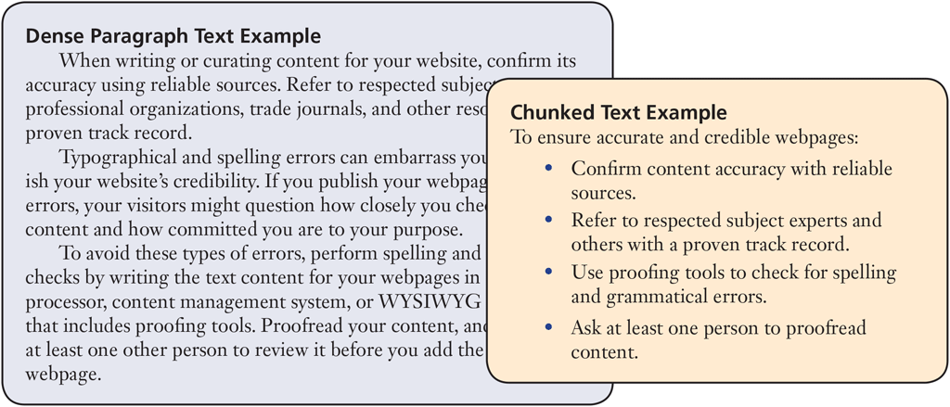
Scannability
Chunked text is easier to scan
Small sections
Headings
Subheadings
Bulleted lists
Use chunked text
Begin long paragraphs with topic sentences
Avoid colored text or underline for emphasis
Avoid using only uppercase characters

Slide 7
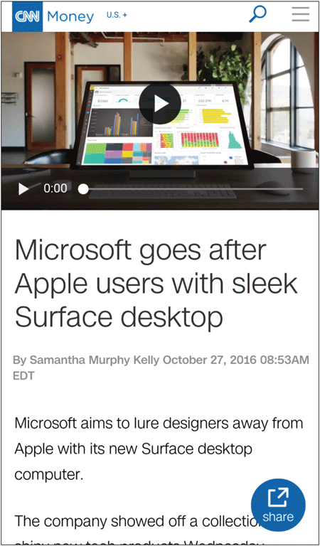
Organization
Inverted pyramid style
Summary
Details
Background information

Slide 8




Web Publishing Issues
Technical
Legal and Privacy
Accessibility and Usability

Slide 9
1. Technical Issues
Bandwidth: is the quantity of data that can be transmitted in a specific time frame
Keep file sizes to a minimum
Use thumbnails
Optimize graphics
Browser differences
Graphical vs. non-graphical display
Alternative text
Resolution
The measure of sharpness and clarity
A pixel is a single point in an electronic image
Page elements display differently at different resolutions
When designing websites for mobile devices, you must account for a smaller screen size and the auto-rotate feature included in many smartphones and tablets

Slide 10
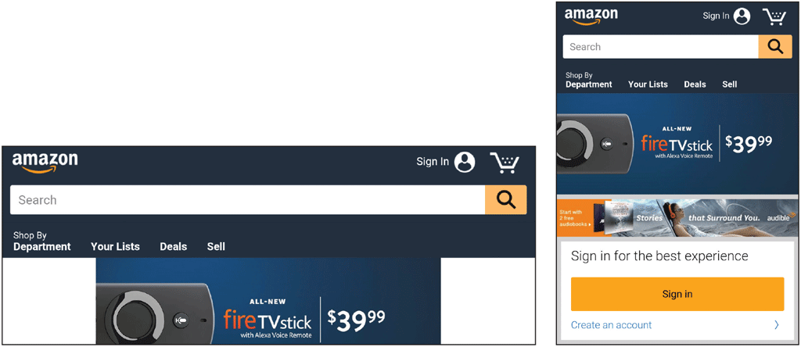
1. Technical Issues
Mobile-friendly practices
Responsive Web Design(RWD)
Bandwidth
Mobile-first
Notes:
Responsive web design ( RWD) is an approach to web design that makes web pages render well on a variety of devices and window or screen sizes. Recent work also considers the viewer proximity as part of the viewing context as an extension for RWD. Content, design and performance are necessary across all devices to ensure usability and satisfaction
Mobile-first design — a design strategy that implies you start designing your digital product with the focus on mobile design, whereas desktop/laptop experiences follow.

Slide 11
2. Legal and Privacy Issues
Legal Issues
Easy to acquire images from the web
Make sure the material on your website is free of copyright infringement
Ownership of intellectual property
Obtain permission from the owner to use any copyrighted
material
Use connectivity tools

Slide 12
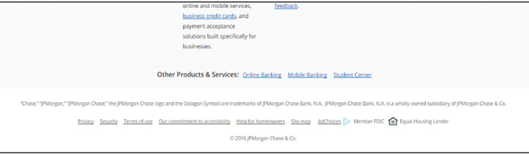
2. Legal and Privacy Issues
Protect your work by copyrighting your material

Slide 13
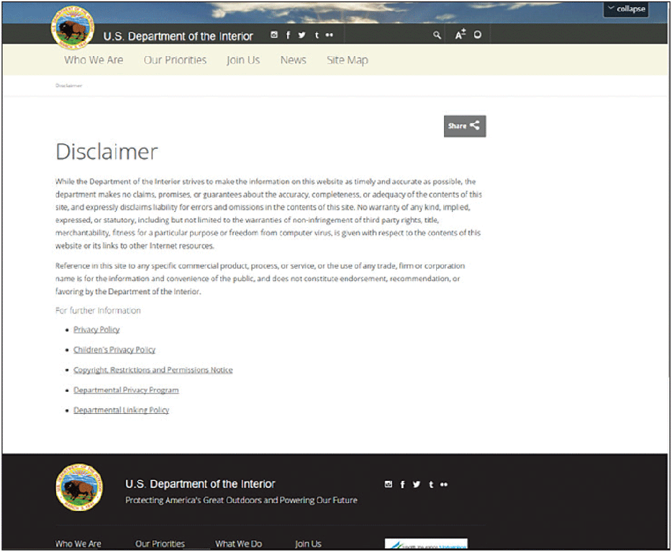
2. Legal and Privacy Issues

Slide 14
2. Legal and Privacy Issues
Privacy Issues
Cautiously give out personally identifiable information (PII)
Encryption
Decryption
Secure Sockets Layer (SSL)
Cookies
Privacy policy statement

Slide 15
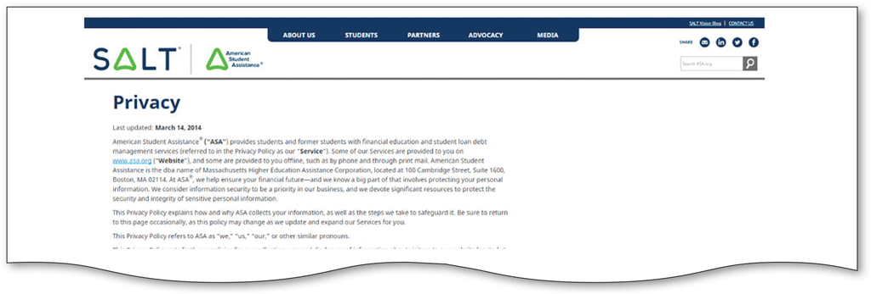
2. Legal and Privacy Issues

Slide 16
3. Accessibility and Usability Issues
Web accessibility deals with ensuring access to web- based information
W3C sets web standards
WAI
Section 508
Web usability involves designing a website and its pages so that all visitors to the website can easily and quickly satisfy their goals
Web designers incorporate user experience (UX) practices into webpage design

Slide 17
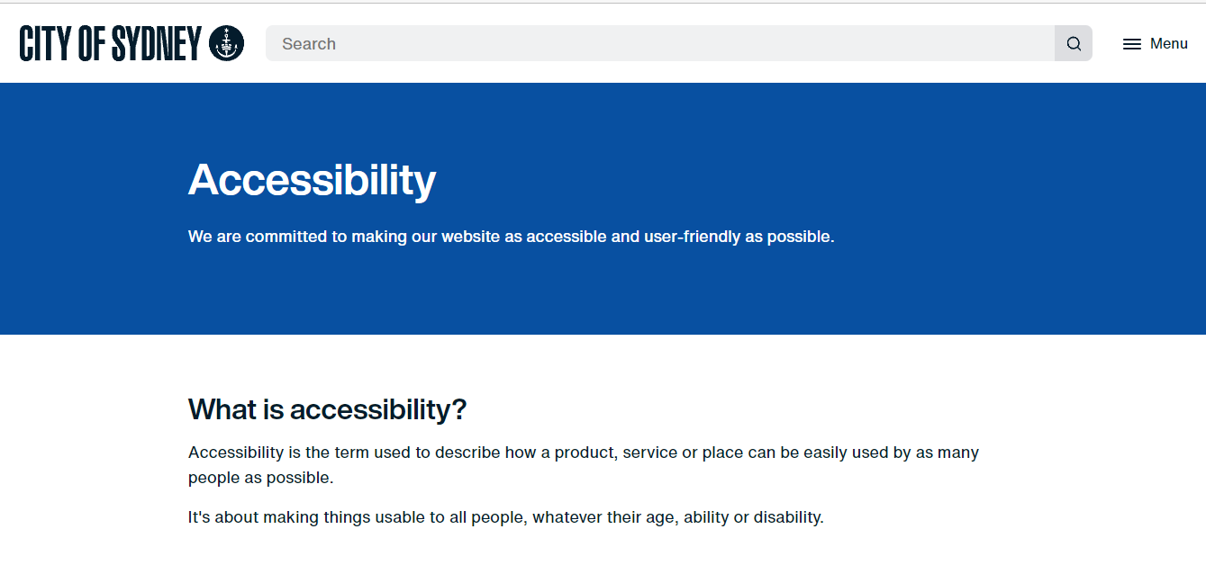
Accessibility and Usability Issues

Slide 18
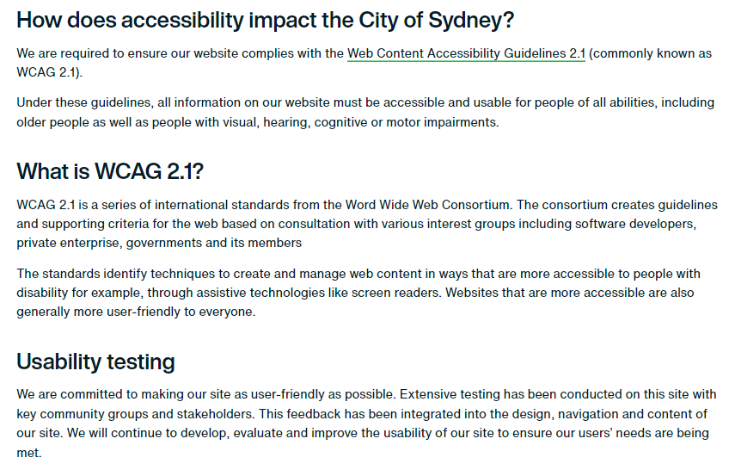
Accessibility and Usability Issues

Slide 19
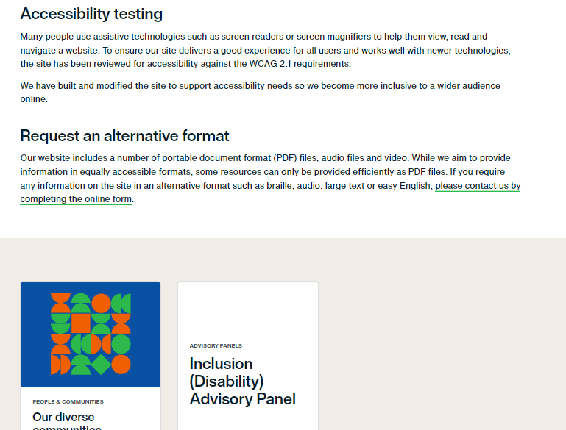
Accessibility and Usability Issues

Slide 20
The Anchor Element <a>
The anchor element
Inline display element
Specifies a hyperlink reference (href) to a file
Text between the <a> and </a> is displayed on the web page.
<a href="contact.html">Contact Us</a>
href Attribute
Indicates the file name or URL Web page document, photo, pdf, etc.

Slide 21
Hyperlinks
Absolute link
Link to other websites <a href="http://yahoo.com">Yahoo</a>
Relative link
Link to pages on your own site
Relative to the current page . <a href="index.html">Home</a>
The target attribute on the anchor element opens a link in a new browser window or new browser tab.
<a href="http://yahoo.com" target="_blank">Yahoo!</a>

Slide 22
Email Hyperlinks
Automatically launch the default mail program configured for the browser
If no browser default is configured, a dialog box is displayed
<a href="mailto:me@hotmail.com">me@hotmail.com</a>

Slide 23
Adding images
Tag: <img>
Attributes: src , alt (both are essential)
Src : is the name of the image file.
Alt: is the text that must be displayed if the browser cannot find the image.
Syntax: <img src=“source name” alt=“alternative text”>
Ex: <img src=“img_win.png” alt=“WIN Logo”>

Slide 24
Adding images
There are two more attributes for the img tag; width and height.
These are not essential. Once you learn CSS you will format images using CSS.
<img src="img_win.png" alt=“win_logo" width="500" height="600">
Accessing images from another folder
<img src=“/images/img_win.png" alt=“win_logo" width="500" height="600">

Slide 25
Adding Images
Accessing images from a web server
<img src="https://www.w3schools.com/images/w3schools_green.jpg" alt="W3Schools.com">
Adding animated images
Animated images are stored as “gif” files.
<img src="img_win.gif" alt=“win_logo" width="500" height="600">

Slide 26
Next Week
Tables
Basic CSS3
Adding styles to pages

