Slide 1

Week-04
Web Development
Week #04

Slide 2
This Week
Tables
The DOM
Basic CSS3
Adding styles to pages

Slide 3

HTML Table
Tables are used on web pages to organize tabular information
Composed of rows and columns – like a spreadsheet.
Each individual table cell is at the intersection of a specific row and column.
Configured with table, tr, and td elements

Slide 4
HTML Table Elements
<table> Contains the table
<th>
Contains a table header
<tr> Contains a table row
<td> Contains a table cell
<caption> Configures a description of the table

Slide 5
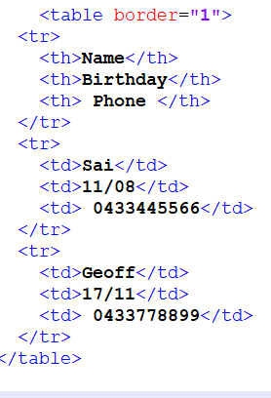
HTML Table Example

Slide 6
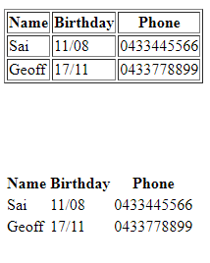
HTML border Attribute
Indicates the table is specifically not used for page layout
Optional
border=“1” Visible browser default border
border=“” No visible browser default border.

Slide 7
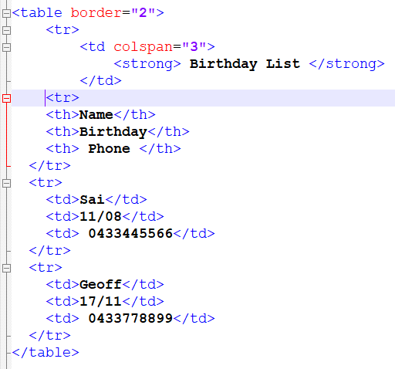
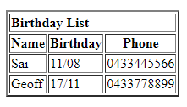
HTML colspan Attribute

Slide 8
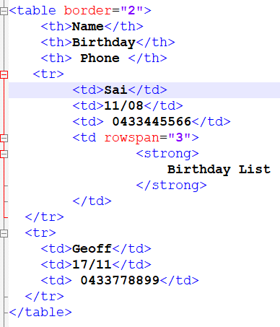
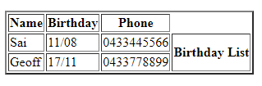
HTML rowspan Attribute

Slide 9
Accessibility and Tables
Use table header elements (<th> tags) to indicate column or row headings.
Use the summary attribute on the table element to provide an overview of the purpose and organization of the table.
Use the caption element to provide the title/caption for the table.
Other attributes that provide for accessibility:
headers & id
scope

Slide 10
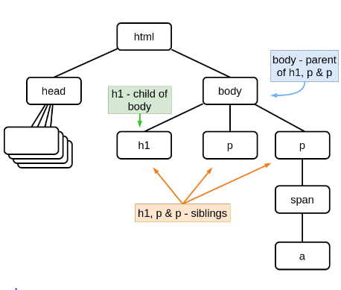
The DOM
Document Object Model (DOM) constructed from HTML
Nodes in DOM correspond to element instances
CSS selectors specify DOM nodes
–this provides the link between HTML and CSS
Notes:
We can review the HTML tags that we discussed in the past two weeks and direct students to a website that has all the HTML tags.

Slide 11
Cascading Style Sheets (CSS)
See what is possible with CSS:
Visit http://www.csszengarden.com
Style Sheets
used for years in Desktop Publishing
apply typographical styles and spacing to printed media
CSS
provides the functionality of style sheets (and much more) for web developers
a flexible, cross-platform, standards-based language developed by the W3C.

Slide 12
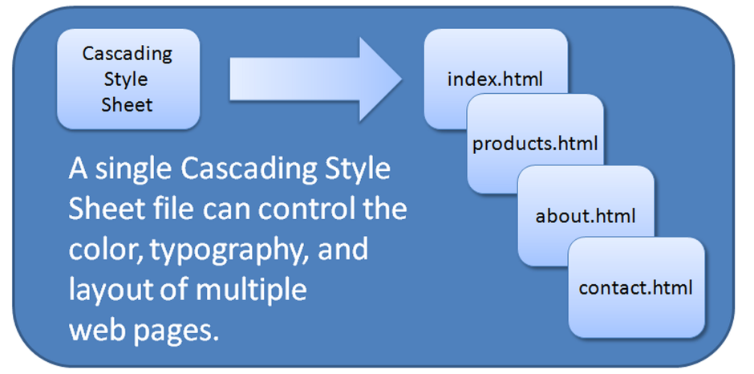
CSS Advantages
Greater typography and page layout control
Style is separate from structure
Styles can be stored in a separate document and linked to from the web page
Potentially smaller documents
Easier site maintenance

Slide 13
Types of Cascading Style Sheets
Inline Styles
Embedded Styles
External Styles
Imported Styles

Slide 14
Description of the Types of CSS
Inline Styles
Configured in the body of the web page
Use the style attribute of an HTML tag
Apply only to the specific element
Embedded Styles
Configured in the head section of a web page.
Use the HTML <style> element
Apply to the entire web page document
External Styles
Configured in a separate text file with .css file extension
The HTML <link> element in the head section of a web page associates it with the .css file
Imported Styles
Similar to External Styles
We’ll concentrate on the other three types of styles.

Slide 15
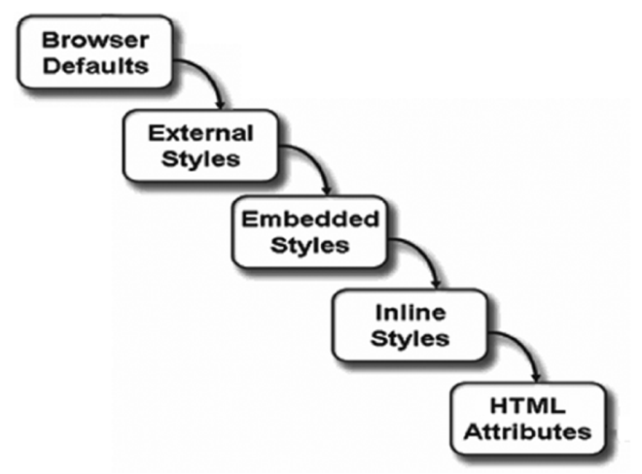
The “Cascade”

Slide 16
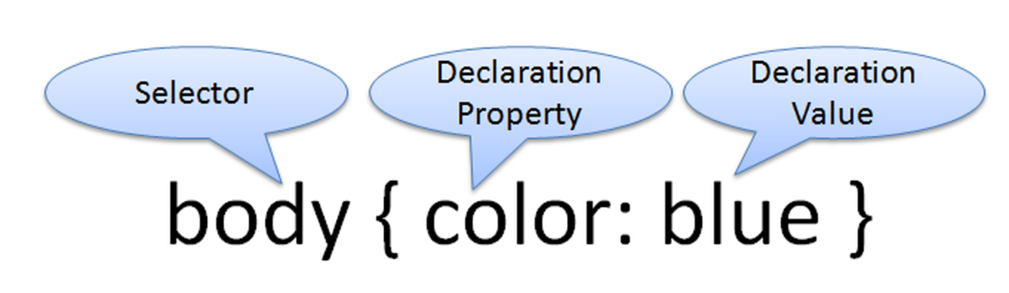
CSS Syntax
Style sheets are composed of "Rules" that describe the styling to be applied.
Each rule contains a Selector and a Declaration

Slide 17
CSS Syntax Sample
Configure a web page to display blue text and yellow background.
body { color: blue;
background-color: yellow; }
This could also be written using hexadecimal color values as shown below.
body { color: #0000FF;
background-color: #FFFF00; }
Notes:
Let us choose one style and stick to it.

Slide 18
CSS Syntax for Color Values
p { color: red } | Color name
p { color: #FF0000 } | Hexadecimal color value
p { color: #F00 } | Shorthand hexadecimal (one character for each hexadecimal pair – only used with web safe colors)
p { color: rgb(255,0,0) } | Decimal color value (RGB triplet)
p { color: rgba(255,0,0,0.5) } | CSS3: Decimal color value (RGB triplet) followed by the alpha opacity (a value from 0 to 1). The CSS3 Color Module is in draft status and is not yet uniformly supported by browsers.
p { color: hsl(0, 100%, 50%) } | HSL color values. The CSS3 Color Module is in draft status and is not yet uniformly supported by browsers. See http://www.w3.org/TR/css3-color/#hsl-color

Slide 19

Inline CSS with the Style Attribute
Inline CSS
Configured in the body of the Web page
Use the style attribute of an HTML tag
Apply only to the specific element
The Style Attribute
Value: one or more style declaration property and value pairs
Examples
<h1 style="color:#ff0000">Heading text is red</h1>

Slide 20
Embedded CSS with the Style Element
Configured in the head section of a web page.
Use the HTML <style> element
Apply to the entire web page document
Style declarations are contained between the opening and closing <style> tags
The optional type attribute indicates the MIME type of text/css
Example:
<style>
body { background-color: #000000; color: #FFFFFF; }
</style>

Slide 21
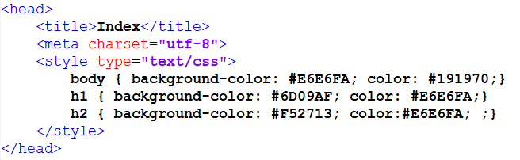
CSS Embedded Styles
The body selector sets the global style rules for the entire page.
These global rules are overridden for <h1> and <h2> elements by the h1 and h2 style rules.
Notes:
🎨 HTML Color Codes (html-color.codes)

Slide 22



Slide 23
External Style Sheets
CSS style rules are contained in a text file separate from the HTML documents.
The External Style Sheet text file:
extension ".css"
contains only style rules
does not contain any HTML tags
Multiple web pages can associate with the same external style sheet file.

Slide 24
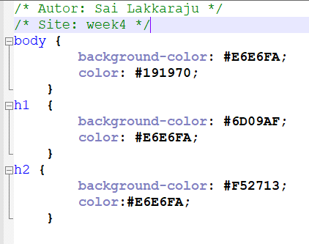
External Style Sheets - 2
siteStyle.css
index.html
clients.html
about.html
Etc…

Slide 25
The <link> Element
A self-contained tag
Placed in the header section
Purpose: associates the external style sheet file with the web page.
Example:
<link rel="stylesheet" href="color.css">

Slide 26
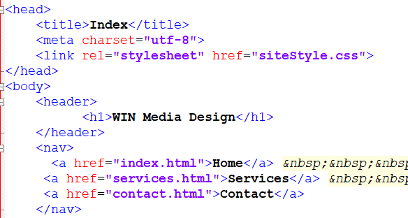
Notes:
See the link option

Slide 27
Notes:
Output looks exactly the same . What is the use of external CSS?

Slide 28
Next Week
Forms
Advanced CSS
Designing the navigation for a website.

