Slide 1

Web Development
Week-05

Slide 2
This Week
Forms
Advanced CSS

Slide 3
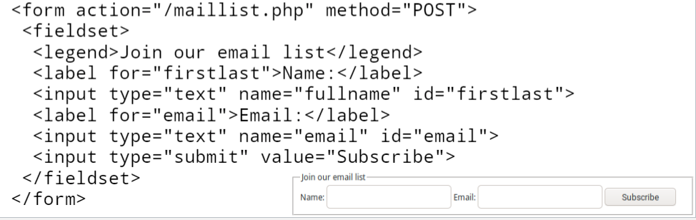
Forms
Used to gather information from users
Sent to the server (usually POST HTTP request)
Require back-end processing on the server
Example

Slide 4
The <form> Element
The HTML <form> element is used to create an HTML form for user input
The <form> element is a container for different types of input elements, such as: text fields, checkboxes, radio buttons, submit buttons, etc.
<form>
Form elements
</form>

Slide 5
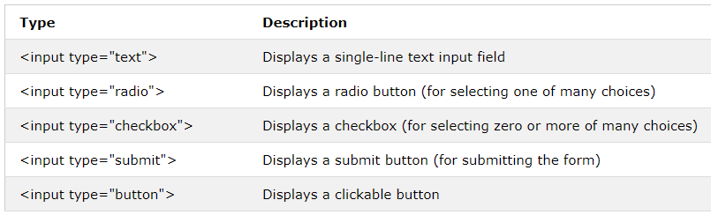
The <input> Element
The HTML <input> element is the most used form element.
An <input> element can be displayed in many ways, depending on the type attribute.
Here are some examples:

Slide 6
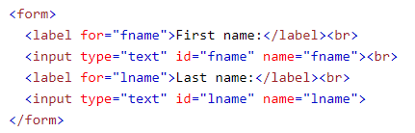
Text Fields
The <input type="text"> defines a single-line input field for text input.
A form with input fields for text:

Slide 7
The <label> Element
The <label> tag defines a label for many form elements.
The <label> element is useful for screen-reader users, because the screen-reader will read out loud the label when the user focus on the input element.
The <label> element also help users who have difficulty clicking on very small regions (such as radio buttons or checkboxes) - because when the user clicks the text within the <label> element, it toggles the radio button/checkbox.
The for attribute of the <label> tag should be equal to the id attribute of the <input> element to bind them together.

Slide 8
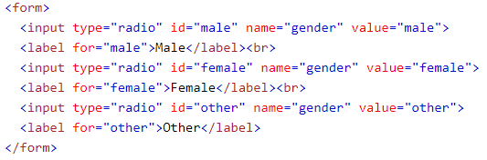

Radio Buttons
The <input type="radio"> defines a radio button.
Radio buttons let a user select ONE of a limited number of choices.
A form with radio buttons:

Slide 9
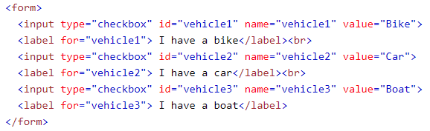

Checkboxes
The <input type="checkbox"> defines a checkbox.
Checkboxes let a user select ZERO or MORE options of a limited number of choices.

Slide 10
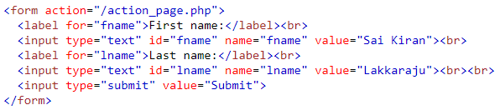
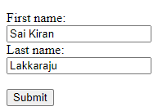
The Submit Button
The <input type="submit"> defines a button for submitting the form data to a form-handler.
The form-handler is typically a file on the server with a script for processing input data.
The form-handler is specified in the form's action attribute.

Slide 11
The Name Attribute for <input>
Notice that each input field must have a name attribute to be submitted.
If the name attribute is omitted, the value of the input field will not be sent at all.
https://www.w3schools.com/html/tryit.asp?filename=tryhtml_form_submit_id
Notes:
Without the name attribute the output of the code will be blank.
In the string add name=“fname” and show the output.
<input type="text" id="fname" name="fname" value="John"><br><br>

Slide 12
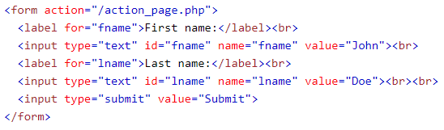
The Action Attribute
The action attribute defines the action to be performed when the form is submitted.
Usually, the form data is sent to a file on the server when the user clicks on the submit button.
In the example below, the form data is sent to a file called "action_page.php". This file contains a server-side script that handles the form data:

Slide 13
The Method Attribute
The method attribute specifies the HTTP method to be used when submitting the form data.
The form-data can be sent as URL variables (with method="get") or as HTTP post transaction (with method="post").
The default HTTP method when submitting form data is GET.

Slide 14
Notes on GET
Appends the form data to the URL, in name/value pairs
NEVER use GET to send sensitive data! (the submitted form data is visible in the URL!)
The length of a URL is limited (2048 characters)
GET is good for non-secure data, like query strings in Google

Slide 15
Notes on POST
Appends the form data inside the body of the HTTP request (the submitted form data is not shown in the URL)
POST has no size limitations, and can be used to send large amounts of data.
Tip: Always use POST if the form data contains sensitive or personal information!

Slide 16
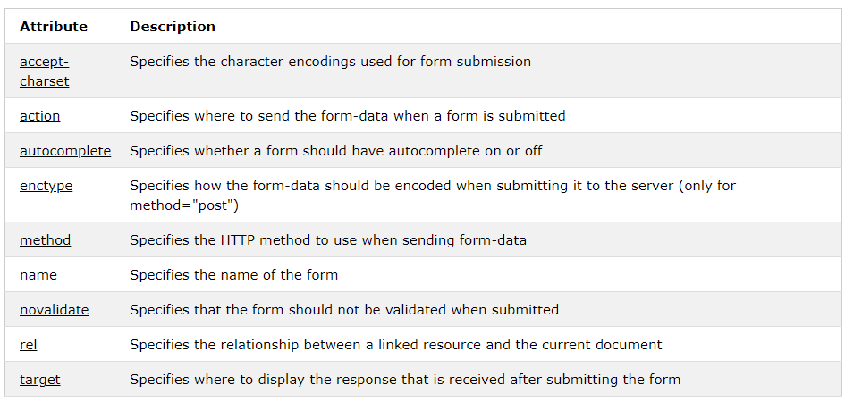
List of All <form> Attributes

Slide 17
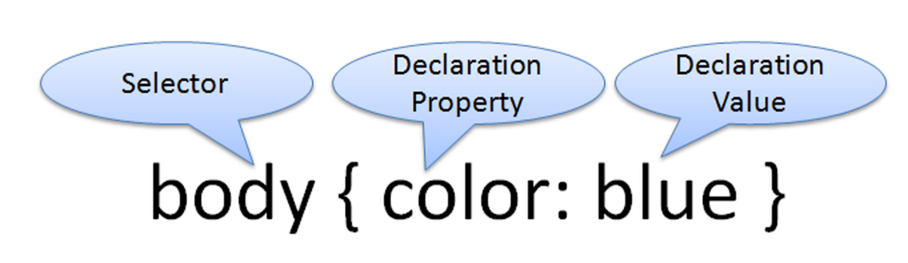
CSS Syntax
Style sheets are composed of "Rules" that describe the styling to be applied.
Each rule contains a Selector and a Declaration

Slide 18
CSS Syntax Sample
Configure a web page to display blue text and yellow background.
body { color: blue;
background-color: yellow; }
This could also be written using hexadecimal color values as shown below.
body { color: #0000FF;
background-color: #FFFF00; }
Notes:
Let us choose one style and stick to it.

Slide 19
CSS Selectors
Common Types of Selectors:
HTML element name selector
class selector
id selector
descendant selector

Slide 20
Using CSS with “class”
class Selector
Apply a CSS rule to ONE OR MORE elements on a web page
Does not associate the style to a particular HTML element
Configure with .classname
The sample creates a class called “new” with red italic text.
To use the class, code the following HTML:
<p class=“new”>This is text is red and in italics</p>
<style type="text/css">
.new { color: #FF0000; font-style: italic;
}
</style>

Slide 21

Using a CSS id Selector
<style type="text/css">
#new { color: #FF0000;
font-size:2em;
font-style: italic;
}
</style>
id Selector
Apply a CSS rule to ONLY ONE element on a web page.
Configure with #idname
The sample creates an id called “new” with red, large, italic text.
To use the id, code the following HTML:
<p id=“new”>This is text is red, large, and in italics</p>

Slide 22
Using a CSS Descendant Selector
Descendant Selector
Apply a CSS rule within the context of the container (parent) element.
Sometimes called a contextual selector.
Configure by listing the container selector followed by the selector you are styling.
The sample specifies a green text color for only the paragraph elements located within the footer element.
<style>
footer p {color: #00ff00; }
</style>

Slide 23
The div element <div>
A block-display element
Purpose: configure a specially formatted division or area of a web page
There is a line break before and after the division.
Can contain other block-level and inline elements
Useful to define a generic area that will contain other block display tags (such as paragraphs or spans) within it.

Slide 24
The Span Element <span>
An inline-level element
Purpose:
Configure a specially formatted area displayed in-line with other elements, such as within a paragraph.
There is no line break before and after the span.

Slide 25
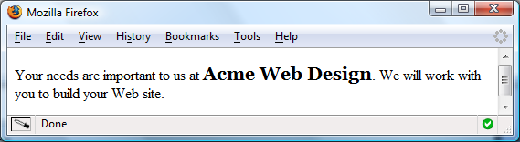
<span> Example
Embedded CSS: <style>
.companyname { font-weight: bold;
font-family: Georgia, "Times New Roman", serif;
font-size: 1.25em; }
</style>
HTML:
<p>Your needs are important to us at <span class=“companyname">Acme Web Design</span>. We will work with you to build your website.</p>

Slide 26
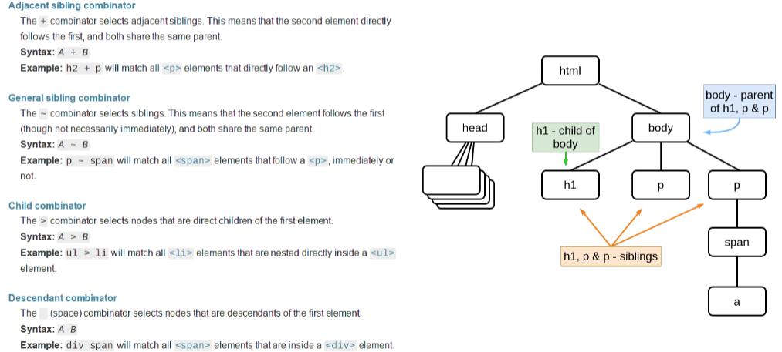
CSS3 combinator selectors
https://www.w3schools.com/css/css_combinators.asp

Slide 27

CSS3 Pseudo-elements
pseudo-element is used to style specified parts of an element.
For example, it can be used to:
Style the first letter, or line, of an element
Insert content before, or after, the content of an element
The syntax of pseudo-elements:

Slide 28
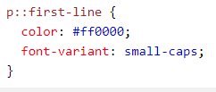
The ::first-line Pseudo-element
The ::first-line pseudo-element is used to add a special style to the first line of a text.
The following example formats the first line of the text in all <p> elements:

Slide 29

The ::first-letter Pseudo-element
The ::first-letter pseudo-element is used to add a special style to the first letter of a text.
The following example formats the first letter of the text in all <p> elements:

Slide 30
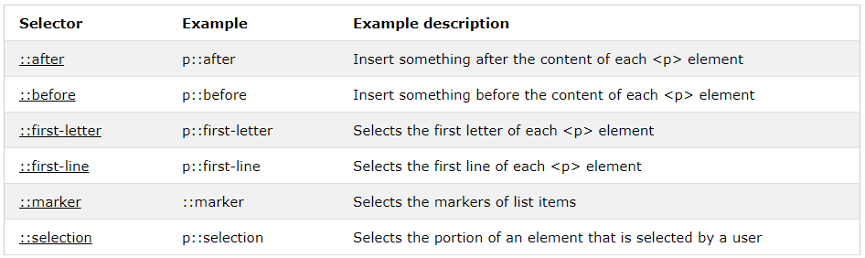
CSS3 Pseudo Elements
https://www.w3schools.com/css/css_pseudo_elements.asp

Slide 31

CSS3 Pseudo-classes
A pseudo-class is used to define a special state of an element.
For example, it can be used to:
Style an element when a user mouses over it
Style visited and unvisited links differently
Style an element when it gets focus
The syntax of pseudo-classes:

Slide 32
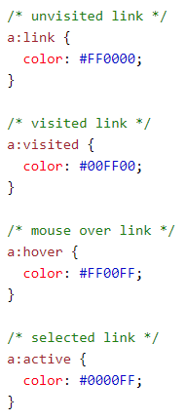
Semantic Inline Elements
https://www.w3schools.com/css/tryit.asp?filename=trycss_link
Note: a:hover MUST come after a:link and a:visited in the CSS definition in order to be effective! a:active MUST come after a:hover in the CSS definition in order to be effective! Pseudo-class names are not case-sensitive.

Slide 33
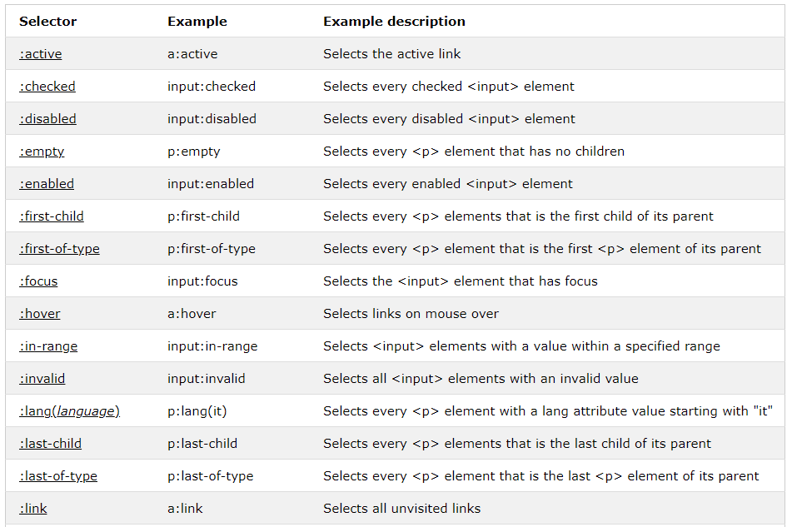
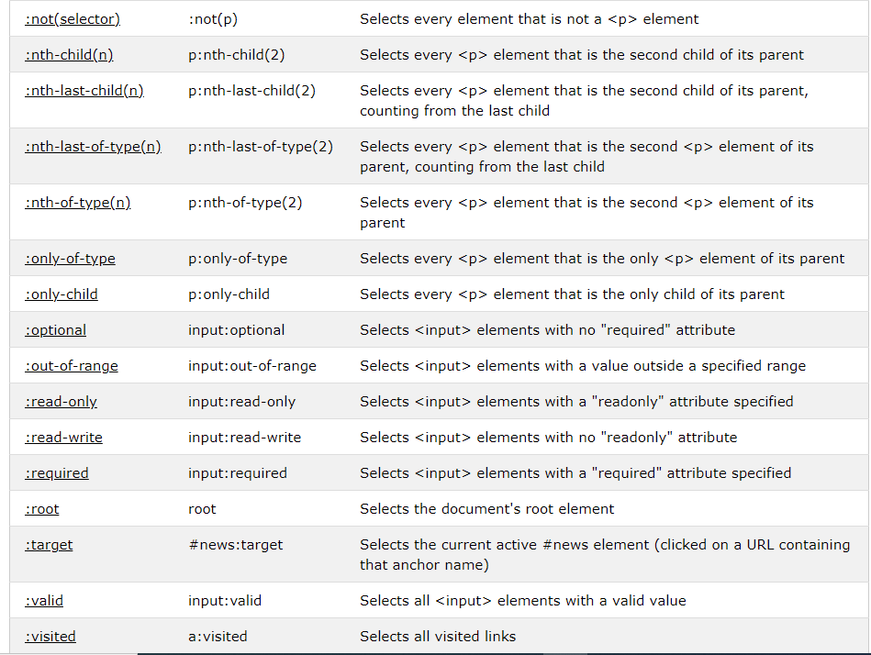
All CSS Pseudo Classes

Slide 34
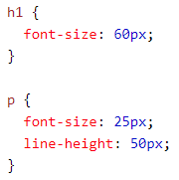
CSS3 Unit
CSS has several different units for expressing a length.
Many CSS properties take "length" values, such as width, margin, padding, font-size, etc.
Length is a number followed by a length unit, such as 10px, 2em, etc.
Set different length values, using px (pixels):
https://www.w3schools.com/cssref/css_units.asp

Slide 35
Next Week
Embedded media,
Embedded media
YouTube Video
Google Maps
advanced image use,
their importance
file format and performance
icons.
Designing the navigation for a website.
Notes:
HTML forms​
–controls​
–labels​
–input validation​
CSS3 selectors​
CSS3 units​

