Slide 1

Web Development
Week #10

Slide 2
Week 10 (Lecture 9)
1) Page Design
Sketch
Wireframe
Mockups
2) Use of AI powered tools
GitHub
Bitbucket
VS code
GUI vs CLI–why not have both?
Development web server
Frameworks
Quality assurance & automation
Additional reading

Slide 3
Page Design
Designing for multiple screen resolutions is a necessity
Most web pages fit one of the following designs:
Fixed design - as the screen resolution changes, content remains aligned to left side of the page
Flexible design - as the screen resolution changes, content expands/contracts to accommodate varying screen widths
Centered design - as the screen resolution changes, the web page stays centered in the browser window, remaining space is divided equally between left and right side of the browser window
Responsive design – a type of flexible design to allow for “new media” (see later lecture on CSS3, and New Media)
Notes:
With more and more users viewing websites from platforms other than their desktops/laptops it has become imperative that web pages adapt themselves automatically to a different screen resolution.
This has now been made much easier with the advent of CSS’3’s media queries.
It is no longer necessary to have a variety of different version of the same website; instead, all that is required is a series of “instructions” in the main CSS file for the website, identifying what needs to happen when content is viewed on platforms of different sizes.
In general there will be 4 such instructions covering PC, iPad, iPhone, and smartphones.
Examples:
Fixed: https://www.google.com.au/#q=google
Flexible: http://en.wikipedia.org , http://www.amazon.com/
Centered: http://federation.edu.au/ , http://www.ebay.com.au/
Responsive: https://www.youtube.com/ , http://www.microsoft.com/en-au/default.aspx

Slide 4
Establishing a page layout
Sketches and wireframes are used to determine where content is to be placed
the nature of the content;
Where the content is to be shown
How the content will be navigated
Detailed content development will be possible after the page layouts have been established

Slide 5
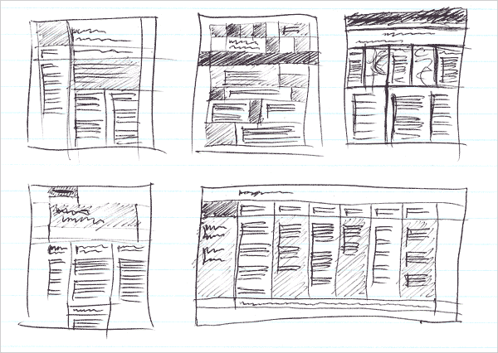
Sketches
Notes:
Sketches are not compulsory for the Design Document, students can make sketches if they like, wireframes ARE required.
Example of sketches made during consultation with client. From these sketches it is relatively simple to create wireframes/storyboards.
Notice the lack of information other than the placeholders for content. For initial client/designer contact this is all that is necessary to begin the process of content design. Wireframes will take this step much further by providing solid information regarding text, colour schemes, media etc.

Slide 6
Wire frames
Wireframes are a step up from sketches
Good wireframes must show all interested parties:
The information design
The navigation design
The interface design
Information design:
Placement of information – information arrangement
Navigation design:
The means by which to find information
Interface design:
How users will/can interact with the product

Slide 7
Content of wireframes
Basic wireframes just show the positioning of all content
Good wireframes should consist of all/most of the following:
Navigation: look, font type, font size, colour
Content: type (video/sound/text/animation), placeholder
Text: identify font, size, colour
Heading: identify font, size, colour
Branding: size, format (logo)
Footer: identify font, size, colour
Background: colour/image
Colour: must be defined as a hexadecimal value (#999999)
Font: must be mentioned by name (Arial, Garamond, etc)
Notes:
In the Assignment 2 Design Document – The wireframes will make up the bulk of the content design section!
Sketching and wireframe templates can be obtained free from
http://www.smashingmagazine.com/2010/03/29/free-printable-sketching-wireframing-and-note-taking-pdf-templates/

Slide 8
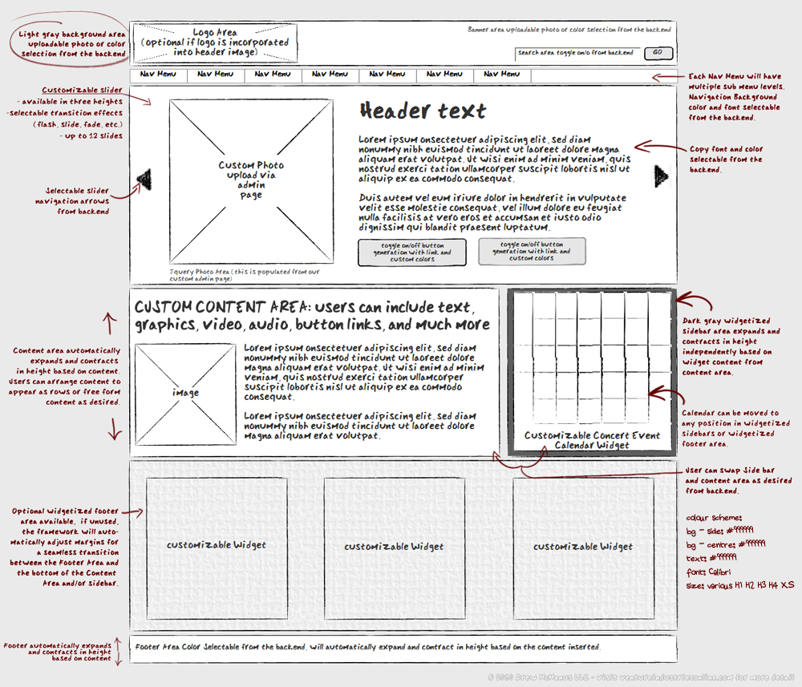
Wireframes
Notes:
Image adapted from http://www.adaptistration.com/blog/2010/03/01/venture-project-update-fun-with-wireframes/

Slide 9
Wireframes
Identify:
Look
Content Type
Fonts
Colours
File Types
Of:
Navigation
Content
Text
Headings
Branding
Footer
Background
Notes:
Identify (where applicable)

Slide 10
Page template(s)
Once the page layout has been determined one or more templates may be created
Bring order to chaos
Establish a consistent, logical screen layout
Allow easy dropping in of text and graphics for each new page
No need to stop and rethink basic design approach for every new page

Slide 11
Mock-ups
Mock-ups are an extension of wire-frames
Wire frames were created for initial consultation with clients
Likes and dislikes have become known
More concrete look and feel pages may now be created
Remember: wire frames are basically place-holders
Mock-ups are more concrete
Designers must expect a lot of critique after submission of mock-ups
This is the stage where real likes and dislikes become known
Designers must get a firm acceptance from clients before proceeding with more detailed designs.
Notes:
It is important that designers get clients to sign off on the mock-ups before anything else proceeds.
If left to change, design-creep, and ultimately project-creep will set in and the project is likely to suffer badly.
“Design creep” is a term given to the situation where the client constantly changes their mind about the look and feel of the site.
It is very important that designer establish what the clients needs and preferences are very early in the process so that design can focus on those needs.

Slide 12
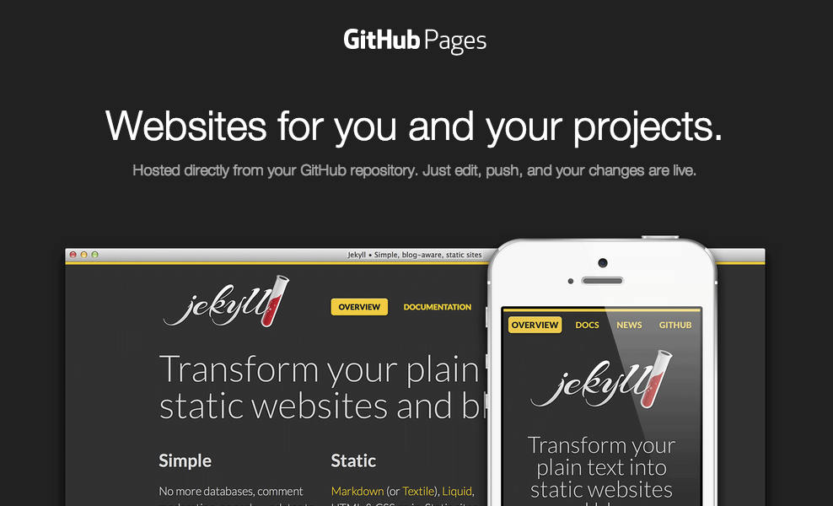
GitHub
GitHub Pages are public webpages hosted and easily published through GitHub.
The quickest way to get up and running is by using the Jekyll Theme Chooser to load a pre-made theme.
You can then modify your GitHub Pages’ content and style remotely via the web or locally on your computer.

Slide 13
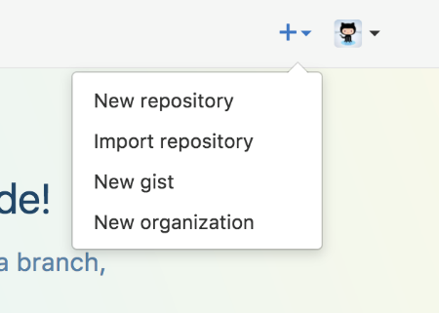
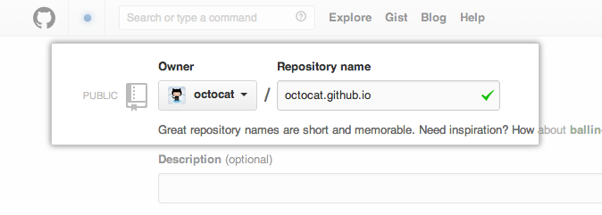
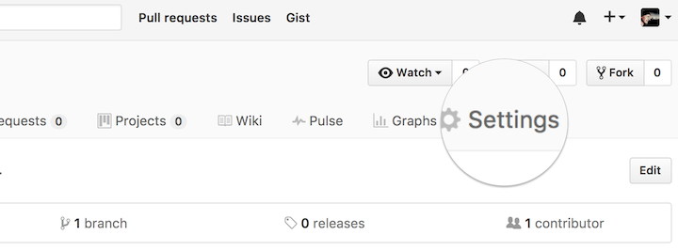
GitHub: Create Your Website
Once you’ve signed in, you’ll create a new repository to get started.
On the new repository screen, you need to give this repository a special name to generate your website.
Your website’s files will live in a repository named username.github.io (where “username” is your actual GitHub user name). To begin setting up your site, you have to open the Settings tab

Slide 14
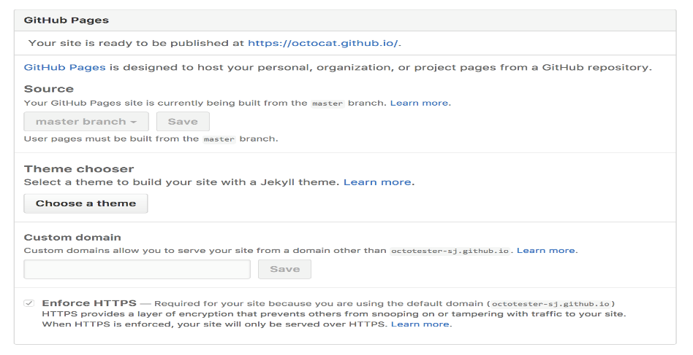
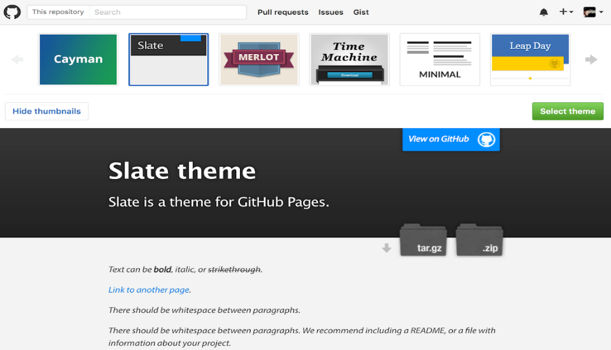
GitHub: Create Your Website
If you scroll down on the settings page, you’ll see the GitHub Pages section near the bottom. Click the Choose a theme button to start the process of creating your site.
Once you’ve clicked the button, you’ll be directed to the Theme Chooser. You’ll see several theme options in a carousel across the top of the page. Click on the images to preview the themes. Once you’ve selected one, click Select theme on the right to move on. It’s easy to change your theme later, so if you’re not sure, just choose one for now.

Slide 15
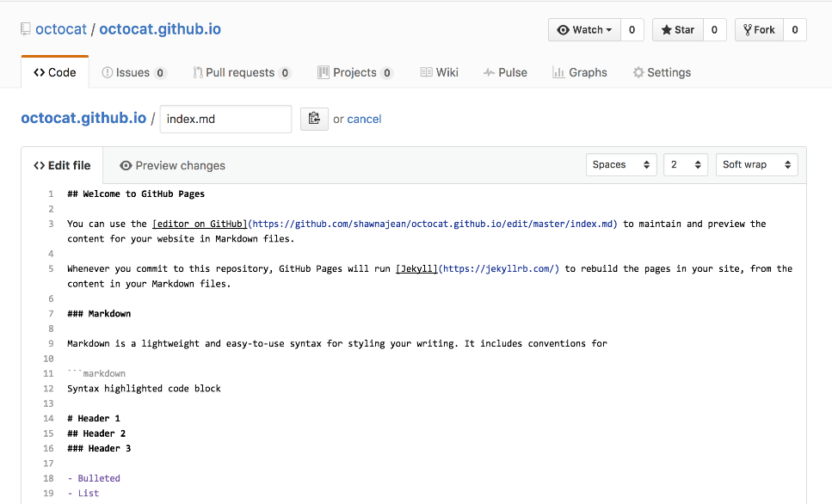
GitHub: Create Your Website
Here’s where you’ll write your own content (You can keep the default content for now, if you’d like).
Once you’re finished editing, scroll down to the bottom of the page and click Commit changes.
GitHub does all the work to direct visitors to username.github.io to view your new website. This can take up to 10 minutes. After some time has passed, you can open a new tab in your browser to go to your site!

Slide 16
GitHub : features
issues tracker
wiki
forks
pull requests
actions / builds / deployment
insights

Slide 17
Bit bucket
GitHub owned by Microsoft
https://bitbucket.org/ owned by Atlassian
–issue tracker (Jira integration)
–wiki
–forks
–pull requests
–pipelines / deployments

Slide 18
Visual Studio Code
Open Source Microsoft product
Extensions
spell check
CSS formatter
lint / validate
emmet /Zen coding (a set of plug-ins for editors)
HTML preview

Slide 19
What are the differences between GUI and CLI?
GUI means a Graphical user interface while CLI means the command line interface.
GUI offers graphics that consist of icons and images that enable users to do a task directly connected to commands those perform a certain CLI system task
CLI requires expertise in commands for performing a certain task, while a beginner can operate GUI

Slide 20
Running your own development server
Virtual Box
https://www.virtualbox.org/
Linux - Ubuntu Server and Desktop
https://www.ubuntu.com/server
https://www.ubuntu.com/desktop
WAMP Windows+ Apache + MariaDB/MySQL + PHP
WampServer, la plate-forme de développement Web sous Windows - Apache, MySQL, PHP

Slide 21
Command line
CLI for Web Design
– https://webdesign.tutsplus.com/series/the-command-line-for-web-design--cms-777
Node.js
– http://www.nodejs.org/
CSS preprocesors
Sass
– https://sass-lang.com/
LESS
– http://lesscss.org/

Slide 22
Frameworks
Skeleton
http://getskeleton.com/
–very simple
Bootstrap
https://getbootstrap.com/
–probably most popular
Materialize
https://materializecss.com/
–Google Material Design look and feel
Material Design Lite
https://getmdl.io/
- lighter / smaller version
Milligram
https://milligram.io/
–small

Slide 23
Quality Assurance & automation
Checking for problems
–Stylelint: modern CSS linter that helps you enforce consistent conventions and avoid errors in your stylesheets
https://stylelint.io/
Build tools / automation
–Grunt (config): a tool used to automatically perform frequent tasks such as minification, compilation, unit testing, and linting.
– https://gruntjs.com/
–Gulp (code): lets developers automate many development tasks. At a high level, gulp reads files as streams and pipes the streams to different tasks. These tasks are code-based and use plugins.
– https://gulpjs.com/

Slide 24
AI Generated websites and Tools
Checking for problems
–Stylelint: modern CSS linter that helps you enforce consistent conventions and avoid errors in your stylesheets
https://stylelint.io/
Build tools / automation
–Grunt (config): a tool used to automatically perform frequent tasks such as minification, compilation, unit testing, and linting.
– https://gruntjs.com/
–Gulp (code): lets developers automate many development tasks. At a high level, gulp reads files as streams and pipes the streams to different tasks. These tasks are code-based and use plugins.
– https://gulpjs.com/

Slide 25
AI Generated websites
Four examples:
Wix for most people
Jimdo for a free website builder
Framer for designers
Chariot for vide coding of a website

Slide 26
AI Generated websites (1)
Wix for most people
Advantages | Disadvantages
Effective and easy to use | Not the most futuristic-feeling available AI
Backed by Wix’s mature web-site designer

Slide 27
AI Generated websites (2)
2. Jimdo for a free website builder
Advantages | Disadvantages
Real site builder with all the features you need | AI is limited to initial we site creation
Great free plan and affordable paid plans

Slide 28
AI Generated websites (3)
3. Framer for designers
Advantages | Disadvantages
AI wireframer is a useful tool | More work required for AI which builds a draft version
Rest of the application is great

Slide 29
AI Generated websites (4)
4. Chariot for vide coding of a website
Advantages | Disadvantages
Create a website using a chatbot | You have to use the chatbot for everything

Slide 30
Additional reading
Front End Developer Handbook, 2019
https://frontendmasters.com/books/front-end-handbook/2019/
–read this if you are considering a career path that involves web user interface development
●Scalable Web Architecture and Distributed Systems, Kate Matsudaira
http://www.aosabook.org/en/distsys.html
–creating websites that can handle a lot of traffic
https://guides.github.com/features/pages/

Slide 31
Summary
Page Design
Sketch
Wireframe
Mockups
GitHub
Bitbucket
VS code
GUI vs CLI–why not have both?
Development web server
Frameworks
Quality assurance & automation
AI for website development
Additional reading

Slide 32
Next Week
Lab: Working on your Assignment.
Building a Website
Using Git Hub

