Slide 1
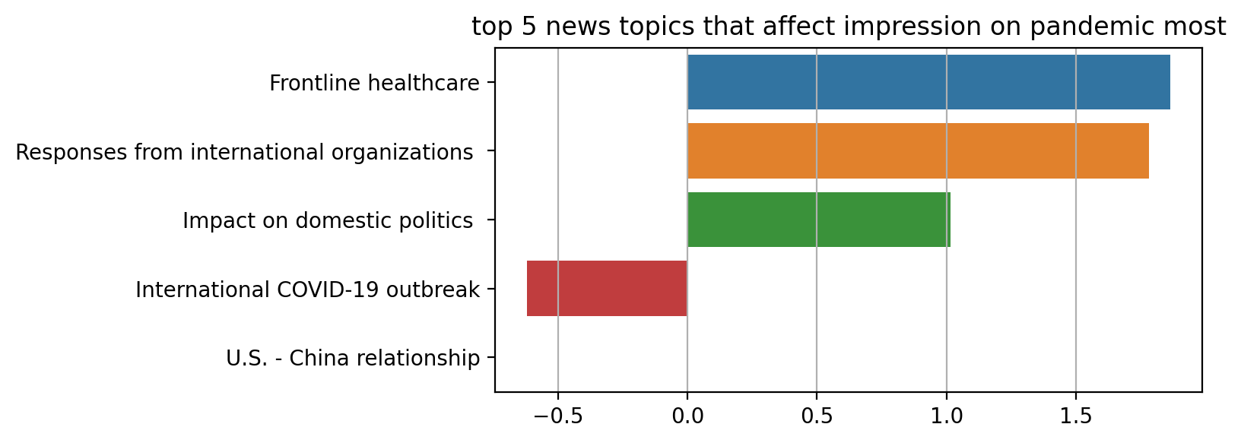
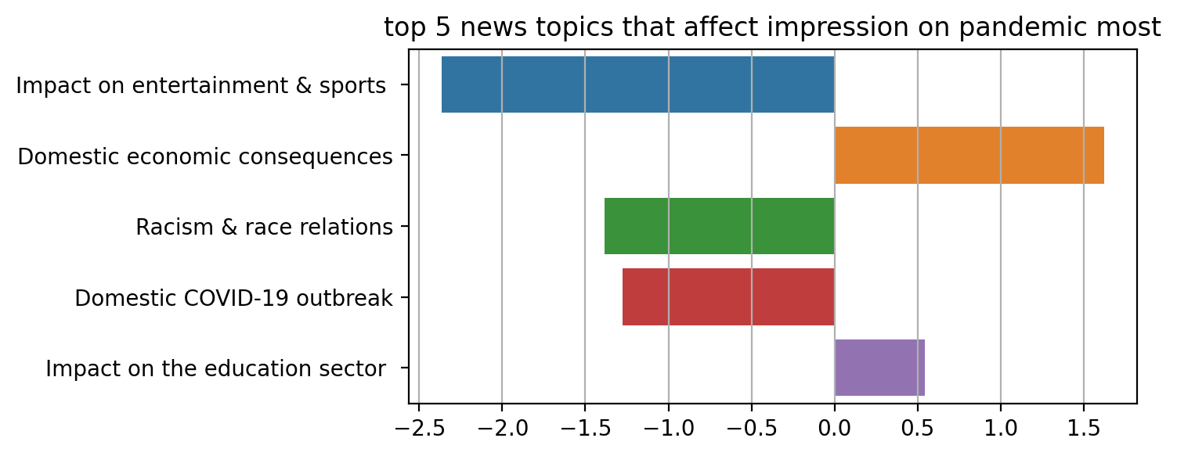
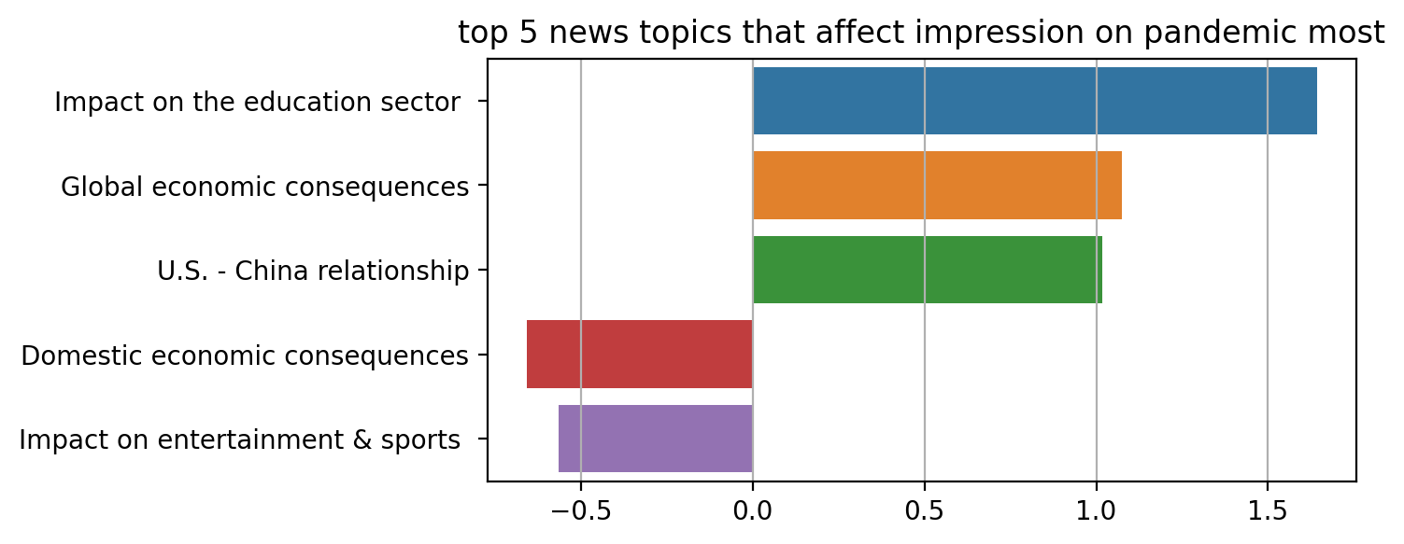
Covid-19 News Classification
Authors: Ding Ma, Gordon Ng, Tegveer Ghura, Yining Wang
Introduction
Methods
We aim to comprehensively analyze the correlation between the impression of the US public on pandemic from April 2020 to August 2020 captured by GALLUP poll together with the proportion of news reports in the United States, China and South Korea, utilizing tools such as the correlation coefficient and Granger causality. We use the rationality of these results to compare the reality people are being faced with within the real world.
Data preparation:
Dimension reduction
transform the impression of the public on pandemic from a 5-dimensional space into a 1-dimensional space.
Z-score normalization
a strategy of normalizing data .to meet the requirement of using Granger Causality and avoid the influence of dimension, variable variation, and numerical value.
Correlation analysis:
Spearman correlation
a non-parametric test to measure the degree of association between two variables.
Granger Causality.
a statistical hypothesis test for determining whether one-time series is helpful for forecasting another. The F-test value indicates the degree of impacts, and the P-value indicates reliability, a p-value <0.05 indicates significance;
Results
US news topic
Correlation result:
According to the result of the Spearman correlation coefficient, the most correlated with impression on pandemic news topic is the impact on entertainment & sports (negative), domestic economic consequences (positive), racism & race relations (negative), domestic COVID-19 outbreak (negative).
China news topic
Correlation result:
According to the result of the Spearman correlation coefficient, the most correlated with impression on pandemic news topic are Frontline healthcare. (positive), Responses from international organizations.(positive), International COVID-19 outbreak. (negative).
Korea news topic
Correlation result:
According to the result of the Spearman correlation coefficient, the most correlated with impression on pandemic news topic are impact on education sector (positive), global economic consequences (positive), US-China relationship (positive), domestic economic consequences (negative), Impact on entertainment & sports (negative).
Granger causality result:
1: impact on entertainment & sports. 2: Domestic economic consequences. 3: Racism & race relation. 4:Domestic COVID-19 outbreak
Granger causality result:
1: Frontline healthcare. 2: Responses from international organizations.3: Impact on domestic politics. 4: International COVID-19 outbreak.
Granger causality result:
1: impact on the education sector. 2: global economic consequences. 3: US-China relationship. 4. domestic economic consequences 5.Impact on entertainment & sports
 | 1-Lag |  | 2-Lag |  | 3-Lag |  | 4-Lag
 | F-test | P value | F-test | P value | F-test | P value | F-test | P value
1 | 12.968 | 0.0029 | 2.3006 | 0.1463 | 2.0010 | 0.1925 | 1.4428 | 0.3435
2 | 0.7356 | 0.4055 | 4.8710 | 0.0305 | 2.4654 | 0.1368 | 4.1375 | 0.0757
3 | 3.7116 | 0.0746 | 3.8085 | 0.0454 | 3.3322 | 0.0770 | 1.7686 | 0.2720
4 | 0.5213 | 0.4822 | 1.2166 | 0.3332 | 0.5938 | 0.6365 | 6.8458 | 0.0292
 | 1-Lag |  | 2-Lag |  | 3-Lag |  | 4-Lag
 | F-test | P value | F-test | P value | F-test | P value | F-test | P value
1 | 3.1907 | 0.0957 | 2.3971 | 0.1367 | 1.1116 | 0.3996 | 1.0926 | 0.4504
2 | 1.9759 | 0.1816 | 0.9279 | 0.4242 | 1.6213 | 0.2596 | 1.7378 | 0.2778
3 | 1.1861 | 0.2944 | 0.8575 | 0.4507 | 0.5050 | 0.6894 | 1.0316 | 0.4732
4 | 0.0024 | 0.9609 | 0.5196 | 0.6086 | 0.1706 | 0.9132 | 1.3223 | 0.3761
 | 1-Lag |  | 2-Lag |  | 3-Lag |  | 4-Lag
 | F-test | P value | F-test | P value | F-test | P value | F-test | P value
1 | 5.1942 | 0.0388 | 1.0595 | 0.3794 | 0.5145 | 0.6836 | 0.8185 | 0.5647
2 | 1.2215 | 0.2876 | 2.1270 | 0.1655 | 2.0227 | 0.1893 | 2.7296 | 0.1501
3 | 1.8819 | 0.1916 | 1.7130 | 0.2250 | 2.4961 | 0.1338 | 2.3165 | 0.1908
4 | 1.2067 | 0.2905 | 0.8253 | 0.4634 | 0.5055 | 0.6891 | 1.1583 | 0.4274
5 | 5.8402 | 0.0298 | 3.1422 | 0.0832 | 1.2353 | 0.3588 | 4.5482 | 0.0638
Granger Causality Result Analysis
Conclusion
US: We find the 1-lag impact on entertainment & sports Granger-cause citizens' impression on the pandemic. And the Spearman correlation coefficients between them are negative, which indicates that an increase in coverage of impact on entertainment & sports is followed by a decline in citizens' impression of the pandemic. Similarly, we could see that Racism has a negative effect, which is correlated with the "Black Lives Matter" movement that starts at the end of May. Further, we could see the Domestic Covid-19 outbreak has negative impacts, but with a longer time lag, that means the US public’s attitudes didn't change until things got serious. Furthermore, we could see that Trump's economic stimulation positively impacts people's attitudes, which is reflected by the granger results of Domestic economic consequences.
China : Although the result of Spearman correlation coefficients shows that they correlate with each other, the Granger causality result shows that the news coverage in China is not followed by the impression of the pandemic of US citizens. Most of the news topics related to the impression of the American pandemic are about international pandemic or health care. But there is no precise sequence of this relationship.
Korea :The Granger causality result shows that most news topics do not Granger cause the impression of the pandemic. Only 1-lag impact on the education sector and impact on entertainment & sports Granger cause pandemic. This result probably shows the inconsistency of the peak of the epidemic situation between South Korea and the United States. Before the epidemic situation in the United States expanded, the epidemic situation in South Korea reached its peak, with the most negative reports on the epidemic situation. From July to August, the epidemic situation in South Korea retreated. After the outbreak in the United States became severe, the negative reports on the epidemic situation in South Korea decreased. At the same time, the impression of pandemics in the United States also reduced. So they may have high Spearman correlation coefficients. But there is no precise sequence of this relationship.
Our results restore the pandemic environment from April to August 2020, showing both local and international news effects on the American people's attitude towards Covid-19. According to our expectations, most of our results are like how local news about economics, pandemics, and racism influences public attitudes. Some of the results are out of our expectations, like how the Korean news on education and entertainment influences, and to further analyze these results, we have to rely on more data sources. Overall, from our results, we can conclude that news reports closely correlate with the public's attitude on specific events during the pandemic.
References
Impression_on_coronavirus.xlsx
Themes by Weeks.xlsx
“Framing and Agenda-setting in Russian News: a Computational Analysis of Intricate Political Strategies”
Notes:
Prints as 33.1 x 46.8 (A0) at 100%. When printed using the library printing service, this will require trimming from 36 inch wide paper. To fill 36 inch paper roll, scale to 108.5% (prints as ~ 36 X 51).

