Slide 1
COESY IVENTORY MANAGEMENT
Presentation
Group 6

Slide 2
@ Members
Nguyễn Minh Khôi
Bùi Tiến Đạt
Đào Tiến Dũng
Nguyễn Quý Thịnh
Đỗ Quốc Trung
Dương Hải Minh

Slide 3
@ Problem Set
Organizations are using paperwork to control and manage their stock inventory, which is less efficient and cost much more time. So they looking for an electronic solutions which provide a solid, fast and reliable online system

Slide 4
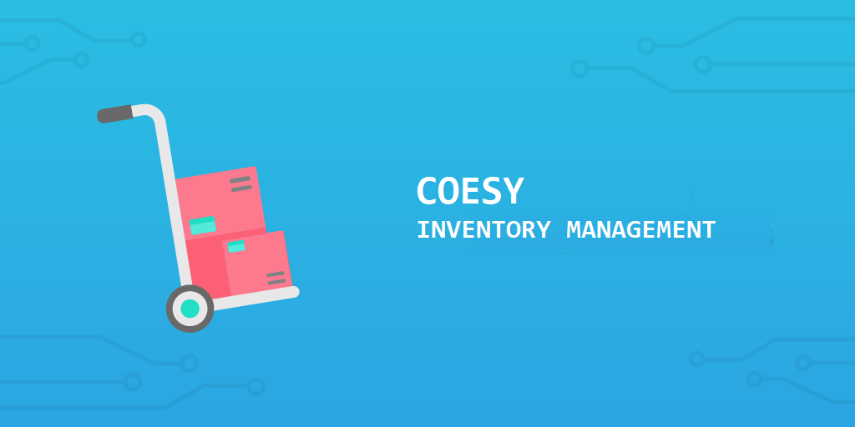
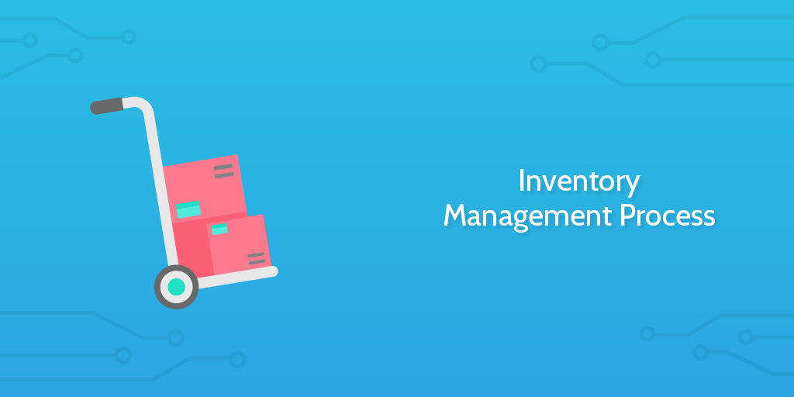
Solution

Slide 5
Introduction
Web-based application with a local database that helps managing an organization’s inventory, with overview tools.

Slide 6



@ Framework and tools used

Slide 7
Features
Sees user’s basic information
Manage inventory

Slide 8
PROBLEM DURING PROJECT

Slide 9


