Slide 1
Sprint 9
Team 303 - In person
Recommending Courses

Slide 2

Sprint Thoughts

Slide 3
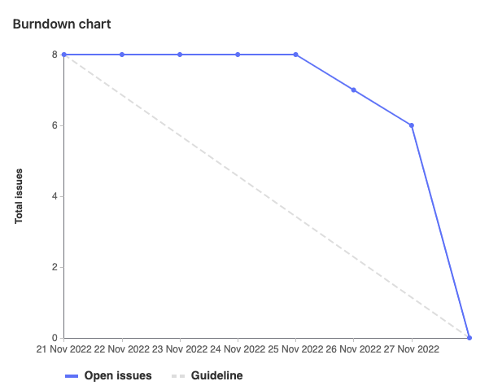
Burndown Chart

Slide 4
Main User Story
As a University of Guelph student, I want to be able to filter my searched courses to only Mon/Wed/Fri or Tues/Thurs courses so that I can create my ideal course schedule.

Slide 5
What Went Well
Communication - The team kept each other updated about their progress and when help was needed
Git - The team kept update their git tickets so burndown chart looked better
Planning - Team was able to quickly agree on what tasks we would like to do this week

Slide 6
What Could Be Improved
for Our Next Sprint
Planning out time to sort out bugs when merging code
Increasing the speed of our recommended courses algorithm

Slide 7
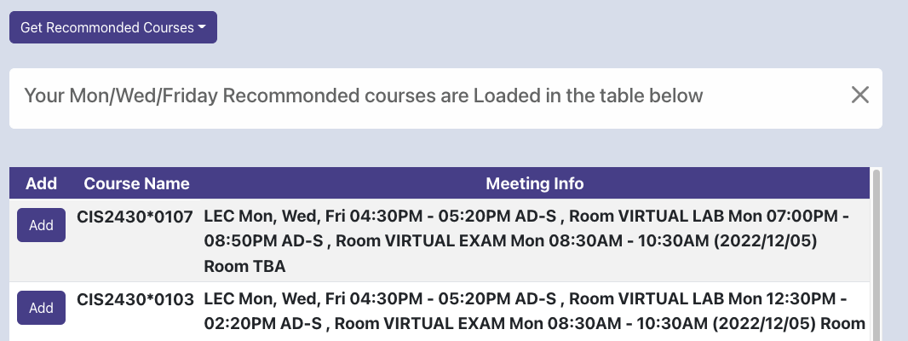
Bianca - Team Lead
Meeting - 2 hours
Prep - 1 hour
Preparing notes for task
for this week
Updating readme
Coding - 7 hours
Add new UI dropdown for
recommendations
Worked on bugs integrating new api query with front end
Update table with the recommended Courses

Slide 8
Rachael
Meetings (1 hour)
Coding (10 hours)
Updated browser header and logo
Exporting course calender → issues with external libraries
Remembering course data when changing semesters → issues with data formatting

Slide 9
Ali - Test Cases
Meetings: 2 hours
Coding: 6 hours
Write and implement a few more test cases for front-end react
Research: 2 hours
Jest and react-testing-library

Slide 10
Tehreem
Meetings - 3 hours
Coding - 7 hours
Adding monday wednesday filter
Adding tuesday thursday filter
Fixing pipeline

Slide 11
Julien
Meetings: 2 hours
Coding: 7 hours
Updating and bug fixing python tests
Updating and bug fixing pipeline
Research: 1 hour
Yaml files and CI/CD

Slide 12
Anupta
Meetings (3 hours)
Coding (7 hours)
Implementing the Tuesday / Thursday and Monday / Wednesday / Friday filters
Querying the Dynamo DB table for the filtered courses

Slide 13
Now it’s time for the demo!

