Slide 1
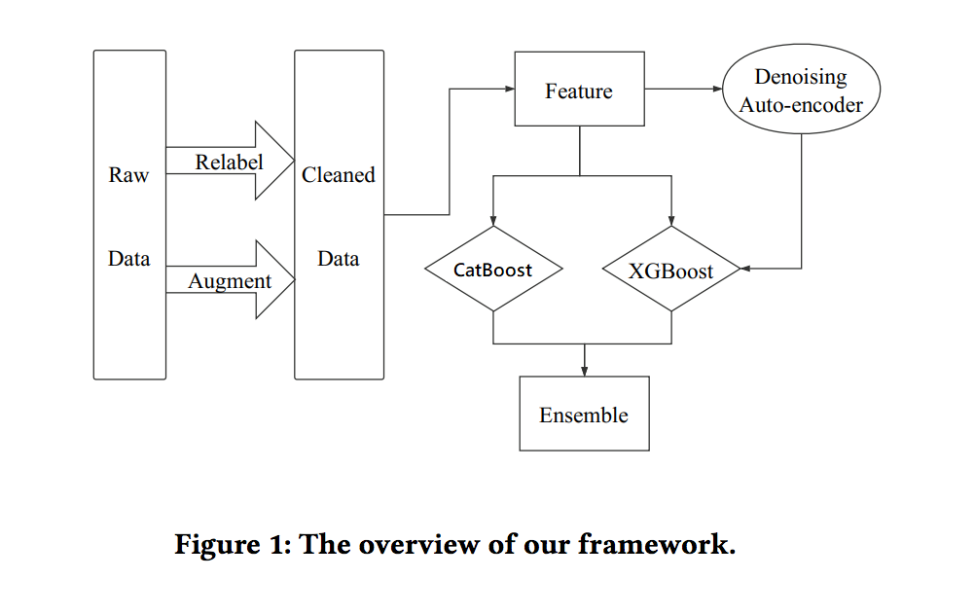
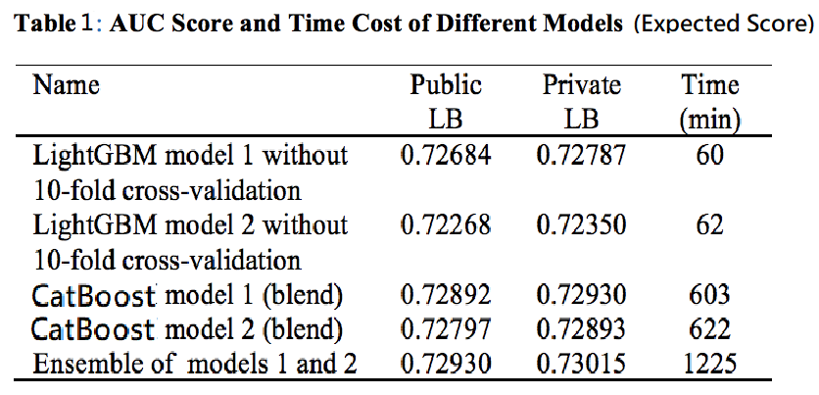
KKBox’s Music Recommendation Challenge Team 2, Yi-Shao Chien 1213187727, Tseng Te-Hung 1213139887 , HusanTing Kao 1213386848
Innovative Claims
Team organization, milestones and schedule
Project goal: KKBox’s Music Recommendation Challenge
The task is evaluated on area under the Receiver Operating Characteristic (ROC) curve between the predicted probability and the observed target.
Tseng Te-Hung : Data engineer, paper writing
Yi-Shao Chien: Data analysis, paper writing
HsuanTing Kao : Model developer, paper writing
Milestone: 10/10: Finishing paper reading 10/17: model selection 10/24: Data preprocessing 10/31: Model building first attempt 11/21: Fine-tuning model
11/21: Result evaluating
11/28: Paper formulating, preparing presentaion
Technical Rationale and Approach(es)
Expected project outcome
Demonstrated ideas/approaches:
Alternatives if applicable : XGboost, Catboost ,Light GBM, ANN.
Predict 2556790 rows of recommended songs to users pair.
Following the rule under the ROC curve between the predicted probability and the observed target providing by Kaggle.

Slide 2
Project Timeline
Current project timeline
We have already built a XGBoost and a CatBoost model for the giving dataset. Our next step is to fine-tune the models.

Slide 3
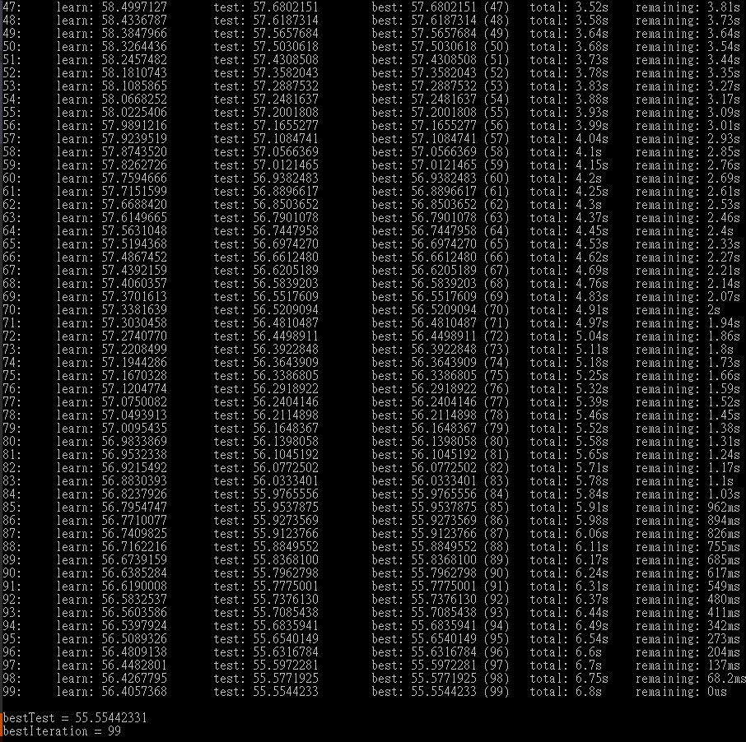
Recent Results
The result of using CatBoost model.
Currently, we use all the parameter in training and tuning.
We will run the Principal component analysis (PCA) to decide which parameters are low correlation with the result and discard them and train the model again.

