Slide 1
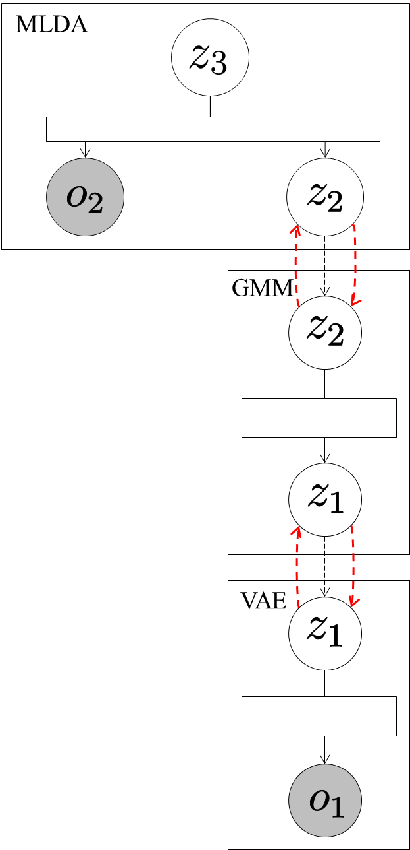
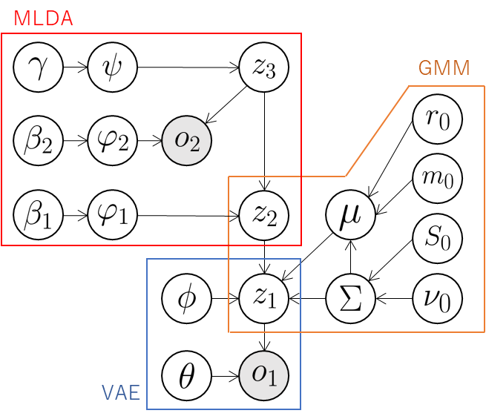




Send .
Send .
Send latent variables .
Send means of
distribution of classes.

