Slide 1
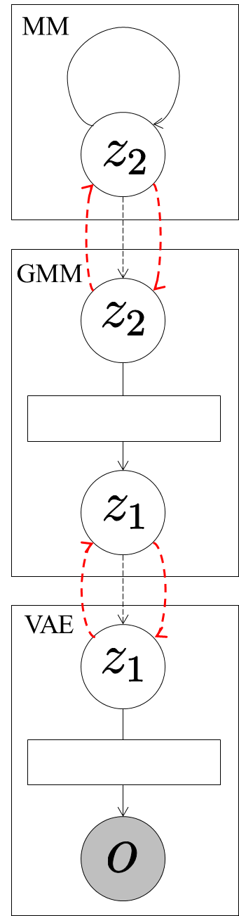
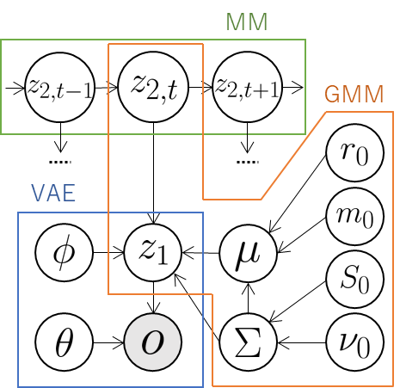



Send .
Send probabilities of
considering transition.
Send means of
distribution of classes.
Send latent variables .

