Slide 1
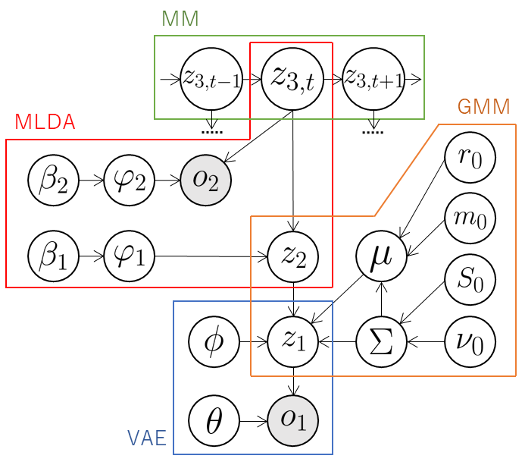

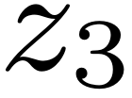




Send .
GMM
MM
Send probabilities
of considering
transition.
Send .
Send latent
variables .
Send mean of
distribution of classes.
MLDA
VAE
Send .

