Slide 1

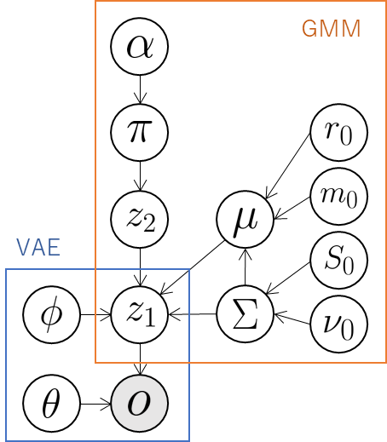


Send latent variables .
Send means of distribution of classes.

