Slide 1
ML BASED WAF
ML-Based Anomaly Detection and Decision Module for Web Application Firewall Integration
Presentation by :
Tejashwini R Teli
MTech 2nd year
IIIT Pune.

Slide 2
Problem Statement
DEVELOPMENT OF A MACHINE LEARNING ENABLED NETWORK ANOMALY DETECTION MODULE FOR FUTURE INTEGRATION WITH WEB APPLICATION FIREWALL (WAF)
Why Traditional WAF fails:
Rule-based WAFs rely on static signatures
High false positives on legitimate traffic
Ineffective against zero-day or unseen attacks
Difficult to adapt to evolving attack patterns
Need for adaptive, behavior-based traffic analysis

Slide 3
Proposed Solution
Multiclass attack classification using ML
ML-Based Behavioral WAF
Learn normal vs malicious behavior from data
Multiclass attack classification using ML
Convert ML output into WAF decisions (ALLOW / BLOCK)
Provide real-time visibility via live dashboard
Key design goal: Modular, explainable, and extensible architecture

Slide 4

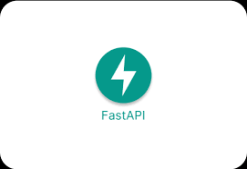

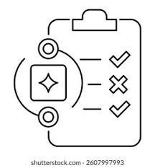

System Architecture
Backend and frontend decoupled
ML inference isolated for scalability
Test Dataset
Fast API Inference
Pre Trained Model
ML decision/Rule Recommendation
Dashboard for Visuals

Slide 5
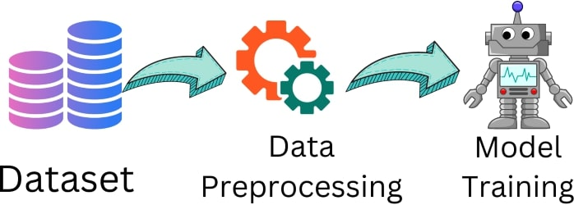
Machine Learning Model
ML Model Overview
Dataset: UNSW-NB15
Model: RandomForest (multiclass)
Feature selection to reduce noise & false alarms
Trained to balance detection and false positives
Decision Mapping:
Normal → ALLOW
Any attack class → BLOCK

Slide 6
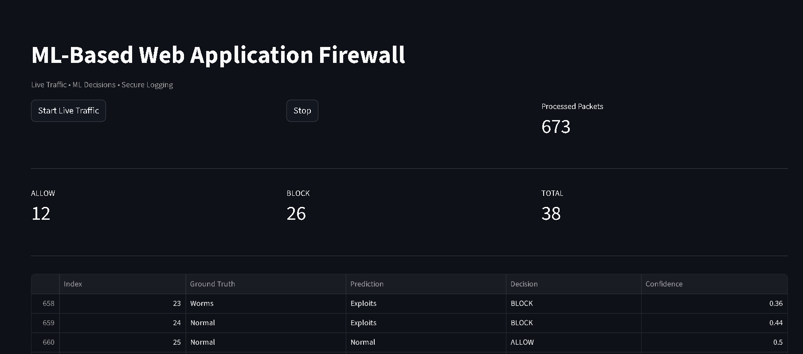
Live Dashboard
Real-Time Monitoring Interface

Slide 7
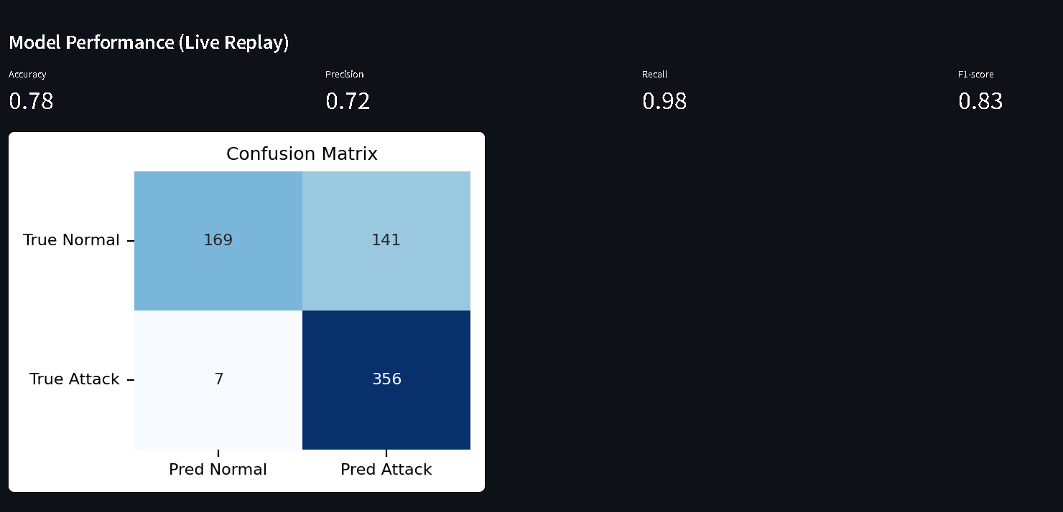
Live traffic replay (packet-by-packet)
Current decision & confidence
Traffic logs
Live metrics and confusion matrix
NOTE : The accuracy and other metrics are calculated for live traffic analysis so they are based on incoming traffic (not the actual model trained metrics)

Slide 8
Zero Day handling logic
Handling Unknown Attacks
No static signatures
Behavioral deviation–based detection
Unseen patterns classified as attacks if anomalous
Bot labeling not explicitly available in dataset
Detection is Probabilistic , not signature based Hence , can handle zero day attacks.

Slide 9
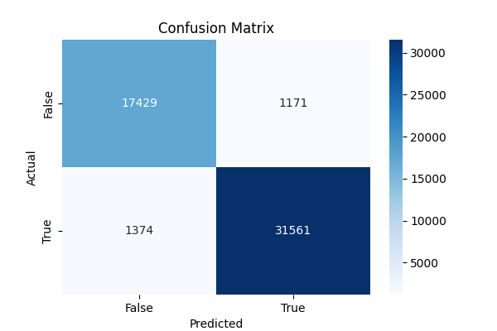
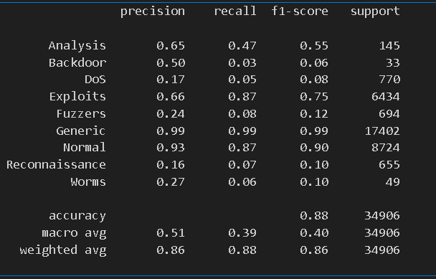
Results
Results for Model Training
NOTE: Testing is done using Live dashboard and its results are also pasted in fig 2

Slide 10
Conclusion
This project demonstrates a machine learning–based WAF decision and anomaly detection module designed to integrate with existing Web Application Firewalls that enhances traditional security mechanisms through behavioral traffic analysis rather than static rule matching. By integrating a multiclass RandomForest model with a FastAPI inference backend and a real-time Streamlit dashboard, the system enables live anomaly detection, actionable ALLOW/BLOCK decisions, and continuous visibility into traffic behavior and performance metrics. The modular architecture ensures ease of integration with existing WAF engines and provides a scalable foundation for practical deployment. As future work, the system can be extended to support live packet capture and adaptive confidence-based decision thresholds to further reduce false positives in real-world environments.

