Slide 1

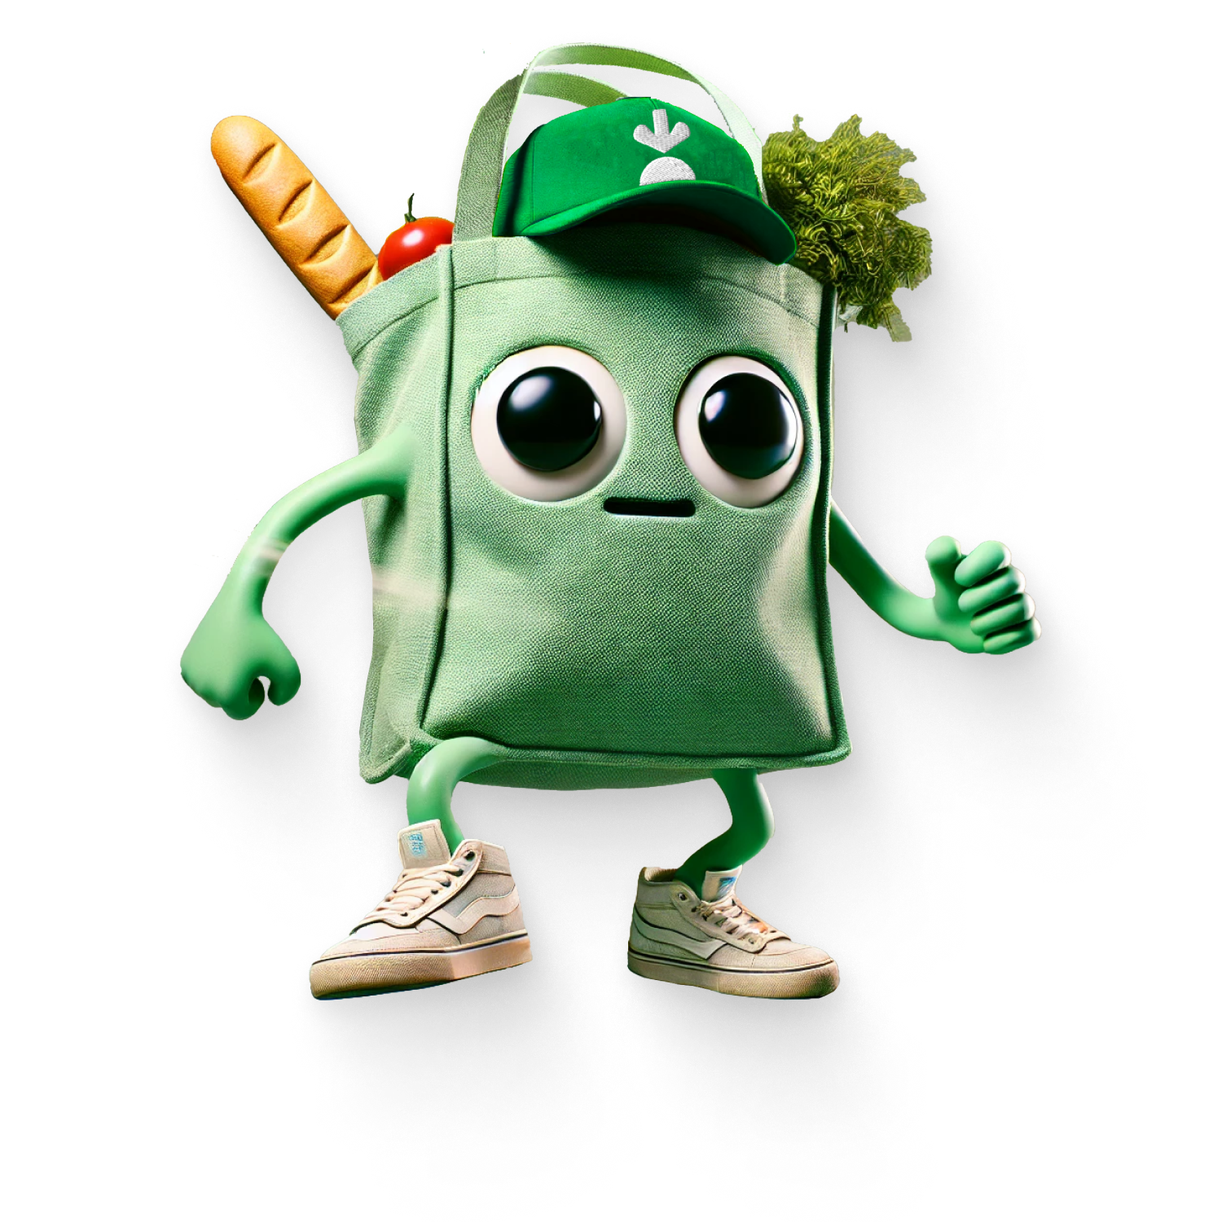
Tejus Manoharan
2023A1PS0181P
BITS Pilani
Case Study
Instacart Agent Readiness – Product
Where I think the work is
Finding products is the easy part for an agent. The hard part is the small calls a person makes while shopping: which oat milk to take when theirs is sold out, whether “2” means two bags or two kilos, whether a fifth order this month was actually wanted. Most of my answers come back to writing those calls down so an agent can read them, then giving it more freedom as the data supports it.
1
Why start with groceries?
2
The flashy board demo
3
Checkout or substitutions?
The job repeats every week, customers already save their replacement choices, and a mistake usually means refunding one item.
Build a demo on top of the substitution feature from Q3. Scripted parts stay under 5 engineer-days.
Substitutions. It's the step where the agent has to make a call while a shopper waits, and agents can't read those preferences today.
Loyal users order 3.9×/month · 3 saved replacement options · top category people would let AI buy (28%)
ChatGPT's in-chat checkout was pulled after about 6 months; Walmart saw it convert about 3× worse
Instacart's public agent tools: 2, none for replacements · my scoring 4.8 vs 1.8
4
“quantity: 2” read two ways
5
Orders per user per month
6
“Should we be worried?”
Mostly our API contract. Require a unit, check the total against what the agent expected, and send back what we understood.
4 a month, at most one in any 7 days. A fifth order goes through after one tap from the user.
Some worry is fair. I'd show the client the main risks, what we've done about each, and the points where we'd pause.
Instacart itself replaced its bare quantity field with a measurements list in 2026
Loyal users average 3.9/month · 300 clean orders put the unwanted-order rate under 1% (95% confidence)
Gartner expects 40%+ of agent projects to be cancelled by 2027 · Instacart's own $60M FTC consent case
90.3M
orders last quarter, +9% YoY
$115
average order value
1.6B
orders ever placed
2B+
catalog items, 2,200 retailers
3
AI platforms: ChatGPT, Claude, Gemini
1
own agent: Clementine
Figures: Instacart Q2 2026 results [5]; Clementine launch coverage [4]; ChatGPT, Claude and Gemini integrations [1][2][3]. Sources are listed in the appendix.
1 / 8

Slide 2
Question 1 Make the case for why groceries are a good place to start.
Groceries are a good first job for an agent: people repeat the same shop, their preferences are already saved, and mistakes are cheap to fix
Which kinds of shopping could an agent take over first?
What makes grocery a safe place to start
START HERE
LATER, WITH LIMITS
IT REPEATS
Instacart's monthly customers order 2.1 times a month in their first year and 3.9 by year six [7]. US shoppers make 1.6 grocery trips a week [23], and Instacart's own assistant already handles “order my usuals” [4].
Groceries
28%
Subscription
renewals
19%
3.9×
Household
essentials
21%
orders / month
RULES EXIST
For each item, customers can already name up to three backups, let the shopper pick the best match, or ask for a refund. Approved replacements are saved for next time, with tags like same brand or gluten-free [10].
How often do you buy it? →
3
NOT WORTH IT
KEEP A HUMAN IN CHARGE
options on file
Luxury /
financial 6%
Clothing
(no data)
Travel
9%
EASY TO UNDO
Orders with a replacement get 95% satisfaction, and replacements per order are at their lowest since 2022 [6]. A wrong item gets refunded; a wrong flight usually can't be.
95%
happy with a replacement
How bad is a mistake? →
refund one item
can't undo / regulated
MEASURABLE
2B+ catalog items across 2,200 retailers [4], and order quality has improved 16 quarters in a row [5]. Agent orders can be compared with normal orders from the first week.
Bubble size is the share of US adults who'd let AI buy in that category [17]. ACI's survey ranks them the same way (groceries 41%, household 31%) [18]. Where each one sits on the axes is my judgment.
1.6B
Stock-outs are where the agent earns its keep
orders ever
About two-thirds of Instacart orders include meat or produce [5], and stock changes all day (10M+ inventory signals daily [4]). Typing the list is easy; handling the missing item the way the customer would is the real test, which is why I pick substitutions in Q3. I'd start with one opt-in job, “refill my usual basket within my rules”, and track how many of those baskets arrive with no edits and no issues.
Why now
The catch
Gemini can already operate Android apps on its own [24], and a US appeals court ruled that an agent acting for a user counts as the user [16]. Agents will show up either way, so it's better to give them a proper way in.
Only 22% of people who use AI to shop trust an agent to decide purchases [19]. So I'd make it opt-in, limited to the usual basket, and start with drafts (Q5).
[4] Clementine launch · [5] Instacart Q2 2026 results · [6] Q2 2026 earnings call · [7] Instacart S-1 / Q3 2023 call · [10] Instacart Help Center · [16] Ninth Circuit, Amazon v. Perplexity · [17] Supermarket News · [18] ACI Worldwide · [19] FoodNavigator · [23] FMI Trends · [24] 9to5Google
2 / 8

Slide 3
Question 2 The product team wants a flashier feature for a board demo in 6 weeks. I expect it to be thrown out within 3 months of real agent traffic. Build it, or push back and delay?
I'd give the board a demo, but build it on the substitution feature we need anyway, so it's still in use by month 4
Two ways to spend the same six weeks (2 engineers, about 60 engineer-days)
Where I'd give way, and where I wouldn't
board demo ◆
W1
W2
W3
W4
W5
W6
Month 4
Screens, narration and demo data are easy to change later, so I'd build them quickly and cap the time.
The API contract, data model and public agent tools are hard to undo. I wouldn't change any of them just for the demo, and that's the one point I'd hold firm on.
The demo should be a thin version of the real feature that the team keeps building on, so nothing needs rebuilding after the board meeting.
AS ASKED
Demo-only feature
New endpoints and a scripted “agent taps Buy in chat” flow, built around the demo
✗ rewritten
or binned
WHAT I'D DO
Demo on the real feature
Substitution rules + decision log
production code, same build as Q3
Stage the demo
≤5 eng-days scripted
✓ same code
serves agents
real agent traffic
Why I think the flashy version won't last
Before building anything, I'd sort each demo piece by what happens to it afterwards
Instacart was first to launch checkout inside ChatGPT [1]. OpenAI retired that checkout about six months later and sent shoppers back to merchants' own sites [12].
Walmart said purchases made inside ChatGPT converted at about a third of the rate of its own site, and called the experience “unsatisfying” [11].
Gartner expects over 40% of agent projects to be cancelled by 2027, mostly over cost, unclear value or weak risk controls [13].
KEEP · real, stays
WRAP · scripted, calls the real API
THROW · only for the stage
~48 eng-days · 80%
~7 eng-days · 12%
≤5 eng-days · 8% (cap)
Substitution rules API
Decision log (what it saw, the rule, the choice)
Timeout and refund fallback
Agent tools (MCP)
Fake stock-out in the inventory feed
Demo family and usual basket
Presenter screen on real responses
Stage animation and narration
Hard-coded timing for the big moment
Anything that would change the real API is out
How I'd put it to the team
“Let's show the board something that's still running in month four. Pick the moment you want on stage, I'll build it on the real feature, and we'll say which parts are scripted.” If they still want the original, I'd write my concern down and go with their call, and only escalate if it meant changing the real API.
What the board would see (only the stock-out is scripted)
Weekly basket placed by the agent
Oat milk sold out mid-shop
Agent reads the saved rule
Backup #1 out, takes #2 (+6%, limit +10%)
Board sees what it saw and why it chose
[1] Instacart × ChatGPT launch · [11] Search Engine Land, Walmart ChatGPT checkout · [12] CNBC, OpenAI revamps ChatGPT shopping · [13] Gartner. The effort split and 5-day cap are my proposals, to agree with the team.
3 / 8

Slide 4
Question 3 You have 2 engineers and 4 weeks. Make the checkout API agent-readable, or the substitution-preference API?
Substitutions first. That's where an agent gets stuck in the middle of an order, and checkout already has workable options
Where an agent-run order gets stuck
Why checkout can wait
1 Build cart
2 Checkout
3 Shopping
4 Delivery
Standard ways for agents to pay already exist or are on the way: ACP from OpenAI and Stripe, UCP and AP2 from Google, and Visa and Mastercard agent tokens with spending limits [21][22].
Checkout has moved back to merchants. ChatGPT's in-chat checkout was retired [12], and the Claude and Gemini integrations send people to Instacart to pay [2][3].
Proper checkout work means payments, fraud and chargebacks, which is more than two engineers can do safely in four weeks.
LOW
PREDICTABLE
HARDEST
MEDIUM
barcode match, saved lists [8]; no clock
slot and payment; hand-off works today [2][3]
live stock, partial prefs, shopper waiting
refunds and issue tracking exist [5]
How I scored the two options (weights and scores are my judgment)
What matters
Weight
Checkout
Substitutions
Why substitutions
Agent has to make a judgment call
25%
2
5
Instacart's public agent tools can create recipes and shopping lists [9], but nothing reads or sets replacement preferences.
When an item is out, a person answers the shopper's message in the aisle. An agent can only do that if the preference is written down somewhere it can read.
Instacart already has the options [10] and a new replacement model that takes diet into account [6]; the work is making them readable by agents.
A person is waiting on the answer
20%
1
5
Not already covered by payment standards
15%
1
5
Needs Instacart's own data (1.6B orders)
15%
2
5
Cost of shipping it late
15%
2
4
Fits 2 engineers × 4 weeks (no PCI / fraud)
10%
3
4
Plan for the 4 weeks
Weighted total (out of 5)
1.8
4.8
W1
Audit what exists; design the rule format and limits
W2
Agents can read and set rules (API and agent tools)
Draft of the rule an agent would read and set, per item in the usual basket (built from the 3 options Instacart already offers)
W3
Log every decision with a reason; no answer means rule, else refund
{ "item": "upc:0001111041600", "mode": "specific_backups", // or best_match / refund
"backups": ["upc:…", "upc:…"], "max_price_change_pct": 10, "must_match": ["dairy_free"],
"if_no_answer_after_s": 300, "fallback": "refund", "set_by": "agent:phone-assistant" }
W4
Test: all backups out, +40% price, allergy, two agents clash
If agents had no way at all to pay or hand the customer over, I'd do checkout first instead.
[2] Claude integration · [3] Gemini integration · [5] Q2 2026 results · [6] Q2 2026 call · [8] developer docs · [9] Instacart MCP docs · [10] Help Center · [12] CNBC · [21] Google Developers, UCP/AP2 · [22] PYMNTS, Visa and Mastercard agent tokens
4 / 8

Slide 5
Question 4 Two agent platforms read “quantity: 2” differently: one orders 2 units, the other 2 × 1 kg packs of wheat. Where is the problem, and how would you fix it?
Most of the ambiguity comes from our API contract, so that's where I'd fix it
Five places “2” can lose its meaning, most likely first
First step: compare the two requests
Agent A → 2 units (any pack size)
SAME REQUEST
Agent B → 2 × 1 kg packs = 2 kg
Replay both requests from the logs. Are they identical?
{"name": "wheat flour", "quantity": 2}
Yes: our side, resolver or catalog (layers 2–3)
No: their side, tool text or parsing (layers 4–5)
Layer
What goes wrong
Likelihood
Evidence
1
API / agent contract
A bare number with an optional unit, so “2” has no kind (item, pack, weight).
HIGHEST
Instacart replaced quantity + unit on another endpoint in 2026 [8]
Changes I'd make to the contract
2
Server resolver
Given several measures, the server quietly picks the “best” one and the agent never sees which.
HIGH
Same changelog: “Instacart can choose the best one” [8]
Replace the bare number with a typed measure: item, pack, weight or volume. The 2026 MCP spec supports this kind of either/or schema [20].
Identify products by barcode. Instacart already prefers barcodes when they're sent [8].
Have the agent state the total it expects, and reject the order if ours differs.
Reply with what we understood (“2 × 1 kg pack = 2 kg”) so a mismatch shows up before shopping starts.
If it's still unclear, ask the user through the protocol's form feature [20].
3
Catalog
“Wheat flour 1 kg” could be a pack, loose weight or a multipack, and it varies by store.
HIGH
2B+ items, 2,200 retailers [4]
4
Tool description
The tool text never says what quantity counts, so each platform guesses.
MEDIUM
Public tools: create-recipe, create-shopping-list [9]
5
Agent parsing
Each model turns “2 bags of atta” into data its own way. We can't control this part.
MEDIUM
My inference
Today
Proposed request
Instacart's reply
{
"name": "wheat flour",
"quantity": 2
}
// 2 what? item? pack?
// kg? server guesses
{ "product": {"upc": "8901725…"},
"measure": {
"kind": "pack", "count": 2,
"pack_size": {"value":1,"unit":"kg"}},
"expect_total": {"value":2,"unit":"kg"},
"on_mismatch": "reject" }
{ "resolved": "2 × Atta 1 kg pack",
"total": {"value":2.0,"unit":"kg"},
"matched_by": "barcode",
"check": "MATCH",
"status": "OK" }
// shown to user + saved in log
Keeping it fixed
A shared list of about 100 tricky products (multipacks, loose produce, dual units) that every agent partner runs before release. I'd track the read-back mismatch rate and add a “wrong quantity” support tag. The new format runs alongside the old one for 90 days before agents lose the bare field.
[4] Clementine launch (catalog size) · [8] Instacart developer changelog and shopping-list docs · [9] Instacart MCP docs · [20] Model Context Protocol spec, 2026 (tool schemas, asking the user). Test-list size and notice period are my proposals.
5 / 8

Slide 6
Question 5 Agent orders raise volume but risk “I didn't mean to order that” complaints, with no history for agent purchases. What monthly threshold per user, and why?
I'd start at 4 agent orders per user per month, with no more than one in any 7 days
4
orders a month without asking (launch limit)
one per rolling 7 days · a 5th order goes through after one tap · within the user's spend limit · opt-in
Why 4
Instacart's most loyal customers average 3.9 orders a month, first-year customers 2.1 [7]. Most people won't reach 4, so reaching it is worth a check.
Months with five weekly slots come round about four times a year. The extra tap works as a regular re-consent, which matters after the FTC's 2025 order on consent for recurring charges [14].
Order 5 still ships after the tap, so very few sales are lost.
An unwanted order costs about $115 [5], mostly fresh food that gets refunded or thrown away. A tap costs the user a couple of seconds.
The weekly rule matters most for bugs. With only a monthly cap, a looping agent could place 4 orders in an afternoon; the weekly rule stops it at the second.
At 5, weekly shoppers would never re-confirm. At 10 (2.5× even loyal customers), a 10th order is more likely a bug than a need.
How a user moves from drafts to ordering on its own
R3 PERSONAL
R2 ON ITS OWN
Limit set to the user's own usual pace + 1 (max 8), which they can raise.
R1 ORDER + HOLD
4 a month, one a week, inside the spend limit and substitution rules (Q3).
R0 DRAFT
Agent orders, with a 60-minute cancel window before shopping starts.
Agent builds the basket; the user presses Order.
Learn: edit rate
Move up after opting in and 4 drafts with under 10% of lines edited
Learn: cancel rate
Move up after 300 orders with no “didn't mean to” (under 1% at 95%)
Learn: problems vs normal orders
Move up after 90 days at or below normal orders
Learn: long-run trust
A tripwire sends anyone back to R0
Other limits on every order
Spend
within the user's limit (default about 1.25× their usual basket)
95% bound ≈ 3 / n (rule of three)
New items
anything never bought before needs a tap
Substitutions
only inside the Q3 rules
Payment
limit also set on the card token [22]
When I'd pull back (proposed)
“Didn't mean to order” above 0.5% of agent orders over 30 days sends that group back to R0. Cancels above 5%, or more problems than normal orders, pause promotions.
[5] Instacart Q2 2026 results ($115 average order) · [7] Instacart S-1 / Q3 2023 call (2017–22 cohorts) · [14] FTC v. Instacart settlement · [22] PYMNTS, Visa and Mastercard agent tokens. All thresholds are starting values to tune.
6 / 8

Slide 7
Question 6 A competitor's agent project stalled publicly after four months, and the client blamed its consultants. Our Instacart contact asks: “Will this happen to us?”
The risks are real, but they're ones we can see coming, and we'd agree up front on when to slow down
How projects like this usually fail, and where ours stands after the work in Q2–Q5
What I'd say to them
“It's a fair worry. From the outside we can't tell why their project stopped, so I won't guess. What I can show you is where projects like this usually go wrong, what we've already done about each of those, and three signals we'd act on. If any of them trips, I'll tell you straight away and bring the data.”
High
3
Agents misread fields
Instacart's own quantity change [8]
Medium
Built the flashy step
In-chat checkout, OpenAI / Walmart [11][12]
6
Blame lands on us
The competitor's headlines
1
5
Cost, unclear value
Gartner: 40%+ cancelled [13]
2
“I didn't order this”
Instacart's $60M FTC case [14]
Low
4
Access / legal fights
Amazon v. Perplexity [16]
Three signals we'd agree on in week 2
Agent orders have more problems than normal orders, beyond an agreed margin: no one moves up the ladder.
“Didn't mean to order” complaints pass the agreed rate: that group goes back to drafts.
A quantity mismatch reaches a shopper: we stop releases until it's fixed.
↑ Likelihood
Low
Medium
High
Impact on Instacart →
What's already in place for each one
1
Substitutions first, demo built on top (Q2, Q3)
4
Agents come in through official tools with login scopes
What we don't know yet
How often agent orders are unwanted, and how many people want this at all: only 22% of AI shoppers trust an agent to buy [19]. About four weeks of draft orders would give us the first real numbers.
2
Drafts before autonomy, plus a monthly limit (Q5)
5
Four-week slices, each with a written definition of done
3
Required units and read-back (Q4)
6
A shared log of assumptions and who decided what
[8] developer changelog · [11] Search Engine Land · [12] CNBC · [13] Gartner · [14] FTC · [16] Cooley, Ninth Circuit ruling · [19] FoodNavigator
7 / 8

Slide 8
Appendix
Sources. The numbers in square brackets on each slide point to this list.
1
Instacart · 2025 · company.instacart.com/pressreleases
14
FTC · 2025 · ftc.gov
Instacart app launches in OpenAI ChatGPT, with Instant Checkout
Instacart to pay $60 million in consumer refunds
2
Supermarket News · 2026 · supermarketnews.com
15
Consumer Reports · 2025 · consumerreports.org
Instacart connects with AI platform Claude
Instacart stops AI pricing tests
3
Instacart · 2026 · company.instacart.com/updates
16
Cooley · 2026 · cooley.com
Instacart brings agentic grocery shopping to Gemini
Ninth Circuit rules on AI agent access (Amazon v. Perplexity)
4
TechCrunch / PYMNTS · 2026 · techcrunch.com
17
Supermarket News · 2026 · supermarketnews.com
Instacart launches AI shopping assistant Clementine
AI agents gaining the most trust with grocery shoppers
5
Instacart · 2026 · investors.instacart.com
18
Retail Dive / ACI Worldwide · 2026 · retaildive.com
Second quarter 2026 financial results and prepared remarks
Consumers trust AI to advise, but don't consent to it purchasing
6
Instacart · 2026 · investors.instacart.com
19
FoodNavigator · 2026 · foodnavigator.com
Q2 2026 earnings call: replacement model, 95% satisfaction
Grocery shoppers use AI, but trust in AI buying agents lags
7
Maplebear (Instacart) · 2023 · sec.gov
20
Model Context Protocol · 2026 · modelcontextprotocol.io
S-1 filing and Q3 2023 earnings call: order frequency by cohort
Specification, 2026-07-28 release: tools and elicitation
8
Instacart Docs · 2026 · docs.instacart.com/developer_platform_api
21
Google Developers Blog · 2026 · developers.googleblog.com
Developer Platform changelog and create-shopping-list page
Under the hood: Universal Commerce Protocol (with AP2)
9
Instacart Docs · 2026 · docs.instacart.com/developer_platform_api
22
PYMNTS · 2026 · pymnts.com
Connect your AI agent to Instacart with MCP
Visa and Mastercard put tokens in charge of AI commerce
10
Instacart Help Center · instacart.com/help
23
FMI · 2026 · fmi.org
Adding item and replacement instructions
U.S. Grocery Shopper Trends 2026
11
Search Engine Land · 2026 · searchengineland.com
24
9to5Google · 2026 · 9to5google.com
Walmart: ChatGPT checkout converted 3× worse than website
Gemini Android app automation rolls out
12
CNBC · 2026 · cnbc.com
25
PYMNTS · 2026 · pymnts.com
OpenAI revamps shopping experience in ChatGPT after Instant Checkout
Anthropic debuts commerce agent blueprint with Visa and Mastercard
13
Gartner · 2025 · gartner.com/en/newsroom
A note on limits: everything here comes from public sources. Cohort data covers 2017–22 customers and isn't agent-specific, and surveys measure trust differently. The thresholds I propose (4 a month, 0.5%, 5 engineer-days, 300 orders) are starting points I'd expect to change once real data comes in.
Over 40% of agentic AI projects will be cancelled by end of 2027
Tejus Manoharan · 2023A1PS0181P · BITS Pilani
8 / 8

