Slide 1


Here's your outline to get started
Key facts about your topic
A facial recognition system is a technology capable of identifying or verifying a person from a digital image or a video frame from a video source. There are multiple methods in which facial recognition systems work, but in general, they work by comparing selected facial features from given image with faces within a database. It is also described as a Biometric Artificial Intelligence based application that can uniquely identify a person by analysing patterns based on the person's facial textures and shape.
See more: Open the Notes below for more information.
Notes:
QuickStarter has created an outline to help you get started on your presentation. Some slides include information here in the notes to provide additional topics for you to research.

Slide 2

Related topics to research
Closed-circuit television
Optical character recognition
Prosopagnosia (Face Blindness)
Automatic number-plate recognition
Super recogniser
Use Smart Lookup to learn more
1
Highlight one of the related topics
Right-click on the topic
Choose "Smart Lookup"
2
3

Slide 3
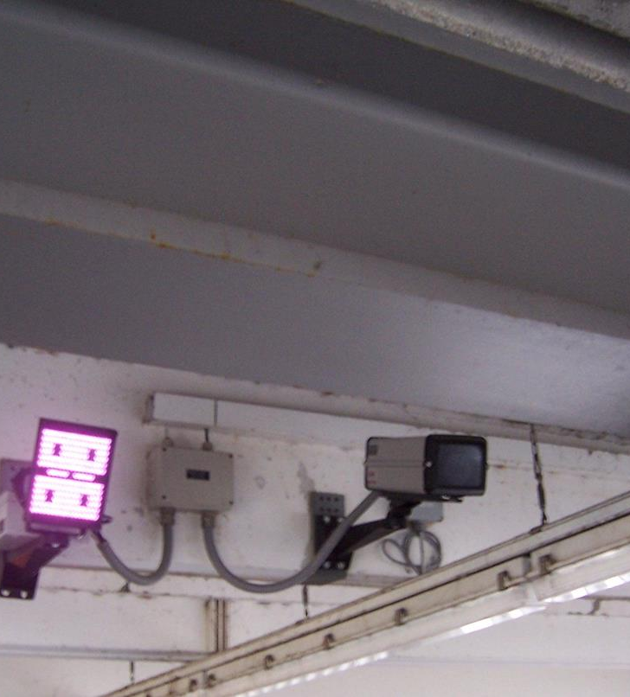
Emotion Detection in Facial Recognition Systems
By: Thoa Le, Anas Hadiouche, Tej Patel

Slide 4
Contents
Importance of Emotion Detection
Technical Challenges
Related Works
Our Approach
Results
Broader Impact
Notes:
Contents of our presentation

Slide 5
Importance of emotion detection
Facial expression analysis will accomplish what facial recognition systems fails to do
Emotion analysis can give systems a better understanding of who the individual is
Allows for a more accurate reading of individuals combined with detection of pattern matching of other facial features
Notes:
This statement goes hand in hand with the first bullet point - >> Read the interior of a person off the surface of the face, using the face itself as a field of classifiable information about the individual

Slide 6
Technical challenges
Issues within datasets
Imbalance Problem
Intra—class Variations
Contrast Variation
Increased abstractness of emotion
Similar distinctness between patterns of two different emotions

Slide 7
Related Works
Adjust images in data set as needed
Distinguish between patterns using other important facial points
Apply a combination of other techniques to draw a more accurate detection
Notes:
In regard to the previous slide on the technical issues that arises during emotion recognition, there have been published works that have dealt with them and solved them. Some of the issues in data sets can be adjusted as needed. For example, if there is an imbalance problem, their solution was to augment the data image. Or if there is an intra-class variation such as different types of pictures like sketches, cartoon, etc the solution there would be to avoid overfitting the data.
In our experiment, we dealt with occlusion in our data when we decided to include images with masks. Although the mouth is a valued dictator of facial expression, we were able to distinguish patterns using other points of the face such as eyes and eyebrows.
Other ways that published works have solved some of the technical challenges was to simply combine other techniques to draw a more accurate detection.

Slide 8
Our approach
Pre-existing deep learning library known as DeepFace
Uses a nine-layer neural network to accurately identify and detect main emotion
Could also train a model using own dataset and determine the emotion that way
Notes:
Our approach for our problem to use a method that applies neural networking. We used a pre existing deep learning library called DeepFace that consists of algorithms for facial detection. The algorithms included a way to detect the facial patterns and then input those patterns into a neural network consisting of 9 layers. That will ultimately determine the main emotion of a face in a digital image. Even though DeepFace consists of millions of pre trained images, we can use our own images as the training set to determine emotion as well.

Slide 9
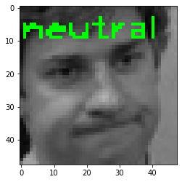
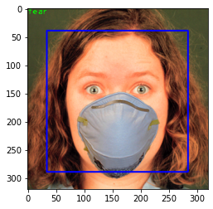
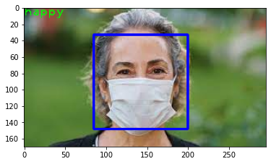
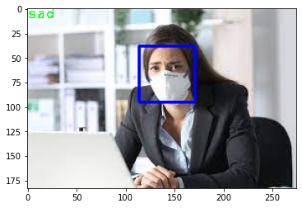
Results
common failure mode
Hyperparameters: Masks
Notes:
On this slide, you’ll see part of our results of the experiment. The first image displays the common failure of the experiment, which is when the system detects a pattern of the emotion that is different from the emotion it actually is. The result emotion was supposed to be “sad” but the system displayed neutral.
The next 3 images are the ones we used in our experiment to add a hyperparameter. It displays the common problem in datasets, occlusion where the mouth is covered. As you can see, even though the mouth is covered, the system was still able to determine emotion based on other facial features like the eyes and eyebrows.

Slide 10
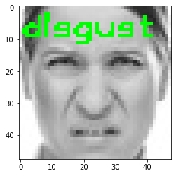
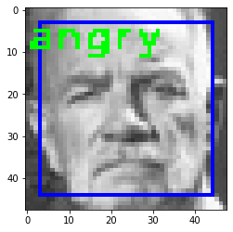
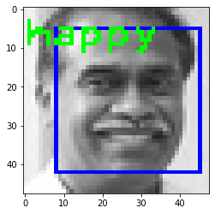
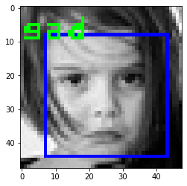
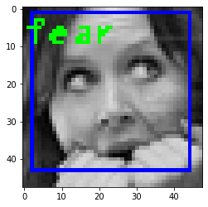
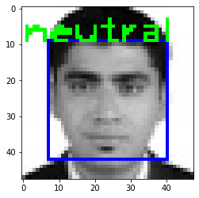
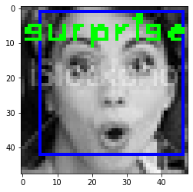
Results Contd.
*Glimpse into some of our results for facial emotion recognition*

Slide 11
Broader Impact
Facial recognition systems can better identify people’s identities by corresponding the emotion with the emotion that is saved on the database
Ex: People who’re saved on a facial database with a specific emotion can be matched even if they may be holding a different expression.
Notes:
Broader Impact: How do you expect the impact of your work to be? What can others learn from it or how can they apply it to solve their problems?
What are the limitations of your work? What are areas for future improvements?

Slide 12
Conclusion
Learned how to apply class lessons into understanding how to solve the problem
Using verified datasets to create a model is an efficient way to improve the algorithm’s accuracy
Neural Networks are only as effective as how well they’re trained
Algorithm was accurate and precise, but could have been better with a consistent 85%+ hit percentage

Slide 13
Works Cited
Gates, Kelly A. Our Biometric Future : Facial Recognition Technology and the Culture of Surveillance . New York University Press, 2011, https://doi.org/10.18574/9780814733035.
H. Zhang and M. Xu, "Weakly Supervised Emotion Intensity Prediction for Recognition of Emotions in Images," in IEEE Transactions on Multimedia, vol. 23, pp. 2033-2044, 2021, doi: 10.1109/TMM.2020.3007352.
https://news.utdallas.edu/science-technology/racial-bias-facial-recognition-2020/

