Slide 1
Introduction to Clustering
Clustering involves grouping a set of objects in such a way that objects in the same group (called a cluster) are more similar to each other than to those in other groups.
Unlike supervised learning where the algorithm learns from labeled data, clustering is a type of unsupervised learning where the algorithm learns from unlabeled data

Slide 2
Importance of Unsupervised Learning and Clustering
Unsupervised learning is a type of machine learning that works by identifying patterns in data without the need for labeled outcomes. It is particularly useful when dealing with large amounts of unlabeled data.
Clustering is one of the main techniques used in unsupervised learning. It involves grouping similar instances together based on their characteristics.
Clustering can be used in various fields like market segmentation, document clustering, image segmentation, etc. It helps in understanding the structure of data and extracting meaningful insights

Slide 3
Definition and purpose of clustering
Clustering is a technique used to group similar instances together.
The purpose of clustering is to identify structures or patterns in unlabeled data.
Clustering algorithms create clusters, where each instance belongs to the cluster with the nearest mean
Why is it important that similar data points are grouped together ?

Slide 4
Key concepts:
Distance Metrics:
Distance metrics are crucial in clustering as they determine how close or far apart instances are from each other.
Common distance metrics include Euclidean distance, Manhattan distance, and Minkowski distance.
Centroids:
A centroid is the center point of a cluster.
It is calculated as the mean of all the points in a cluster.
Centroids are used in clustering algorithms like k-means to determine the cluster assignment.

Slide 5
Key concepts:
Clustering Criteria:
Clustering criteria are used to evaluate the quality of a clustering solution.
Commonly used criteria include silhouette score, elbow method, and gap statistic.
These criteria consider factors like compactness (how closely the points in a cluster resemble each other), separation (how far apart different clusters are), and cohesion (how well each cluster contains points that are similar to each other)

Slide 6
Types of Clustering
Broadly speaking, clustering can be divided into two subgroups:
Hard Clustering: In this, each input data point either belongs to a cluster completely or not. For example, in the above example, each customer is put into one group out of the 10 groups.
Soft Clustering: In this, instead of putting each input data point into a separate cluster, a probability or likelihood of that data point being in those clusters is assigned. For example, from the above scenario, each customer is assigned a probability to be in either of the 10 clusters of the retail store.

Slide 7
Different Types of Clustering Models
Connectivity models base their 'similarity' definitions on proximity in data space. They can either start with all data points in separate clusters and aggregate them as distance decreases, or start with all data points in a single cluster and partition them as distance increases. Hierarchical clustering algorithms fall under this category. However, these models lack scalability for large datasets.
Centroid models define similarity through closeness to the centroid or cluster center. K-Means clustering algorithm is a popular example of this type. The number of clusters must be specified beforehand, requiring prior knowledge of the dataset. These models run iteratively to find local optima.
Distribution models base their definitions on the probability that all data points in a cluster belong to the same distribution (e.g., Normal, Gaussian). These models often suffer from overfitting. The Expectation-maximization algorithm is a popular example of this type.
Density models search for areas of varied data point density in the data space. They isolate different dense regions and assign data points within these regions to the same cluster. DBSCAN and OPTICS are popular examples of density models. These models are useful for identifying clusters of arbitrary shape and detecting outliers.

Slide 8
Clustering Algorithms: K Means Clustering
K-Means Clustering is an Unsupervised Learning algorithm, used to group the unlabeled dataset into different clusters/subsets.
What does ‘k’ and ‘means’ in the k-means Clustering means?
‘k’ defines the number of pre-defined clusters that need to be created in the process of clustering say if k=2, there will be two clusters, and for k=3, there will be three clusters, and so on.
As it is a centroid-based algorithm, ‘means’ in k-means clustering is related to the centroid of data points where each cluster is associated with a centroid. The concept of a centroid based algorithm will be explained in the working explanation of k-means.
k-means clustering algorithm performs two tasks:
1. Determines the most optimal value for K center points or centroids by a repetitive process.
2. Assigns each data point to its closest k-center. Cluster is created with data points which are near to the particular k-center.

Slide 9
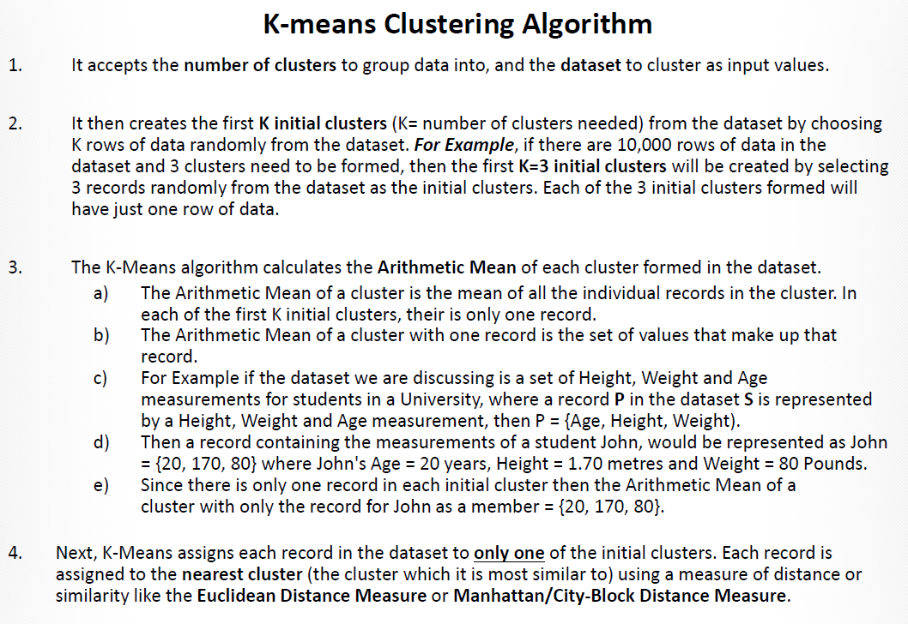

Slide 10
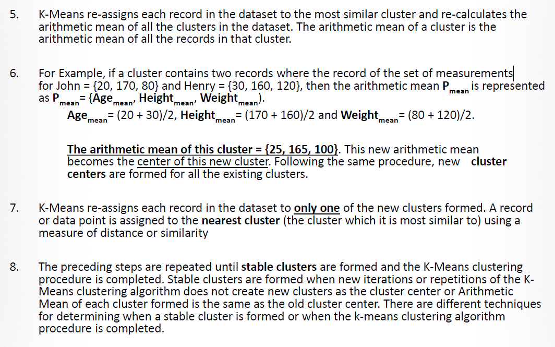

Slide 11
IRIS dataset
The dataset we will use is –
https://archive.ics.uci.edu/dataset/53/iris

Slide 12
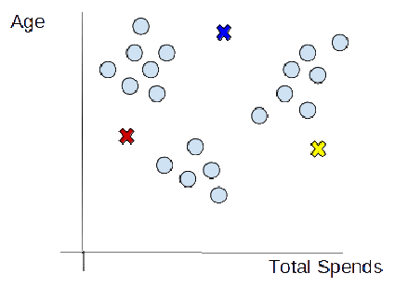
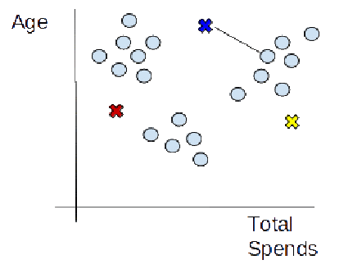
How does k-means Clustering work?
Choosing the number of clusters
The first step is to define the K number of clusters in which we will group the data. Let’s select K=3.
Initializing centroids
Centroid is the center of a cluster but initially, the exact center of data points will be unknown so, we select random data points and define them as centroids for each cluster. We will initialize 3 centroids in the dataset.
Assign data points to the nearest cluster
Now that centroids are initialized,
the next step is to assign
data points Xn to their closest cluster centroid Ck

Slide 13
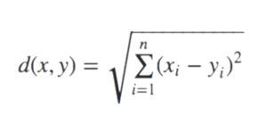
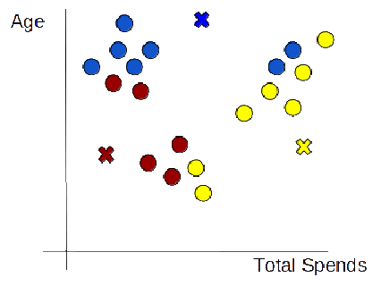
How does k-means Clustering work?
In this step, we will first calculate the distance between data point X and centroid C using Euclidean Distance metric.
And then choose the cluster for data points where the distance between the data point and the centroid is minimum.

Slide 14

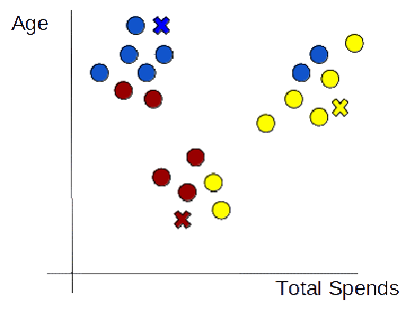
How does k-means Clustering work?
Re-initialize centroids
Next, we will re-initialize the centroids by calculating the average of all data points of that cluster.

Slide 15
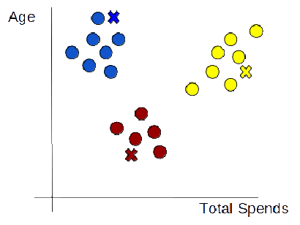
How does k-means Clustering work?
Repeat steps last 2 steps

Slide 16
Pros and Cons of K-Means
Advantages of K-Means
K-Means is simple to implement and computationally efficient.
It handles large datasets well.
It's effective in high dimensional spaces.
It's easy to interpret and visualize.
Disadvantages of K-Means
Requires the user to specify the number of clusters in advance.
Assumes that clusters are convex and isotropic.
Sensitive to the initial positioning of centroids.
Can be affected by the presence of outliers.
Not suitable for clusters of different sizes and densitie
Time complexity of
where K is the number of clusters, n is the number of data points, D is the number of dimensions, and M is the number of iterations.

Slide 17
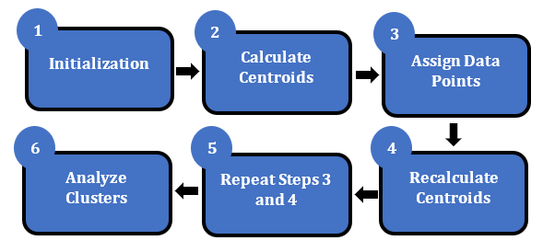
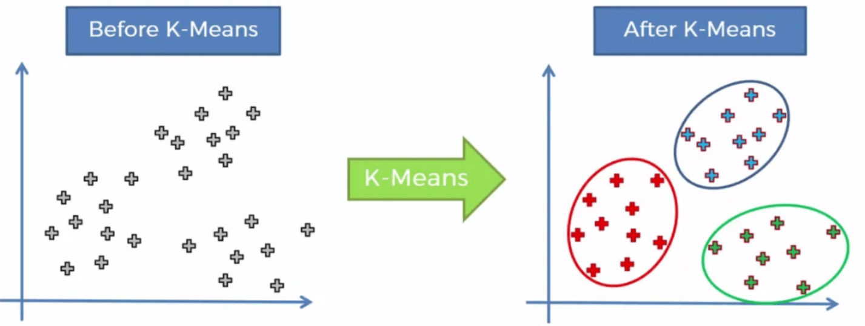
Uses of K-Means
K-Means is widely used in image segmentation, document clustering, market research, customer segmentation, etc.

Slide 18
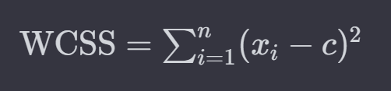
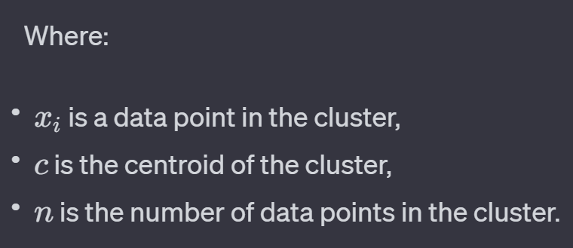
WCSS (Within cluster sum of square)
Within Cluster Sum of Squares (WCSS) is a key metric used in clustering, especially in methods like k-means, to measure the compactness of the clusters formed.
It quantifies the variance or spread of the data points within each cluster, with a lower WCSS indicating that the data points are closer to their respective cluster centroids, thus forming tighter clusters.
WCSS is defined as the sum of the squared distances between each data point in a cluster and the centroid of that cluster. The formula for calculating WCSS for a single cluster is:

Slide 19
WCSS (Within cluster sum of square)
For all clusters in the dataset, the total WCSS is the sum of the WCSS values of all individual clusters.
Importance in Clustering
Cluster Evaluation: WCSS is primarily used to evaluate the quality of the clusters formed by a clustering algorithm. Lower WCSS values indicate that the members of each cluster are closer to each other, suggesting better clustering where each cluster is more homogeneous.
Determining Optimal Number of Clusters: In the context of the k-means algorithm, WCSS is crucial for the elbow method, a technique used to determine the optimal number of clusters. By plotting the WCSS against the number of clusters, one can observe where the rate of decrease in WCSS significantly slows down (forming an "elbow" shape in the plot), indicating a suitable number of clusters beyond which the improvement in compactness is minimal.
Algorithm Objective: In k-means clustering, the objective is to minimize the WCSS. The algorithm iteratively assigns data points to the nearest cluster centroid, then recalculates the centroids based on the current cluster memberships, with the goal of reducing the WCSS.

Slide 20
Limitations of WCSS (Within cluster sum of squares)
Sensitivity to Outliers: WCSS can be heavily influenced by outliers since it involves squaring the distances. A few data points that are far away from the cluster centroid can significantly increase the WCSS.
Not a Comparative Metric Across Datasets: WCSS is useful for comparing clustering configurations within the same dataset but not across different datasets, as the scale of the data influences the WCSS value.
Diminishing Returns with More Clusters: As the number of clusters increases, the WCSS naturally decreases because there are fewer data points per cluster. This can lead to overfitting, where adding more clusters doesn't necessarily provide more meaningful segmentation but continues to lower the WCSS.

Slide 21
Hierarchical Clustering
Hierarchical clustering is a method of cluster analysis which seeks to build a hierarchy of clusters.
Agglomerative (Bottom-Up): This is the more common type of hierarchical clustering. It starts by treating each data point as a single cluster. Then, iteratively, the two closest clusters are merged into a single cluster. This process continues until all data points are merged into a single cluster or a stopping criterion is met. The result can be visualized as a dendrogram - a tree-like diagram that shows the sequence of cluster merges and the distance at which each merge occurred.
Divisive (Top-Down): This approach starts with all data points in a single cluster. At each step, a cluster is divided into smaller clusters, typically using a flat clustering method like K-Means. This process continues until each data point forms a cluster on its own or until a stopping criterion is met. Divisive clustering is less common due to its higher computational complexity compared to agglomerative clustering.

Slide 22
How Hierarchical Clustering Works
Distance Metrics: It uses distance metrics like Euclidean, Manhattan, or Cosine distance to compute the similarity between data points. The choice of distance metric can significantly affect the clustering results.
Linkage Criteria: It determines how the distance between clusters is calculated. Common linkage criteria include:
Single Linkage: The distance between two clusters is defined as the shortest distance from any member of one cluster to any member of the other cluster.
Complete Linkage: The distance between two clusters is defined as the longest distance from any member of one cluster to any member of the other cluster.
Average Linkage: The distance between two clusters is defined as the average distance between each member of one cluster to every member of the other cluster.
Ward’s Method: The distance between two clusters is defined by the increase in the sum of squares as a result of merging them.

Slide 23
Pros and Cons of Hierarchical Clustering
Advantages:
No Need to Specify Number of Clusters: Unlike K-Means, hierarchical clustering does not require the user to specify the number of clusters beforehand.
Flexibility in Shapes and Sizes of Clusters: Hierarchical clustering can identify clusters of various shapes and sizes, making it suitable for complex datasets.
Dendrogram: The dendrogram provides a visual summary of the clustering process, offering insights into the data structure and the relationships between clusters.
Disadvantages:
Scalability: Hierarchical clustering can be computationally intensive, especially for large datasets, due to the need to compute and update distances between all pairs of clusters in each iteration.
Sensitivity to Outliers: The presence of outliers can significantly distort the distance calculations, affecting the overall clustering structure.
Irreversibility: Once a step (merge or split) is done, it cannot be undone, which may lead to suboptimal clustering if early steps are not ideal.

Slide 24
Hierarchical Clustering
Hierarchical clustering is a method of cluster analysis which seeks to build a hierarchy of clusters.
Imagine sorting friends into groups: Hierarchical clustering starts with everyone alone, then gradually merges similar groups based on how close they are (like shared interests). You keep merging until you have the desired number of big groups, like "music lovers" or "sports fanatics." It's like building a family tree of data!
Two types (Agglomerative and Divisive).
Agglomerative is a bottom-up approach starting with each data point as a single cluster and merging them until one cluster remains
Divisive hierarchical clustering is a "top-down" approach to cluster analysis that starts with all observations in a single cluster and iteratively splits the cluster into smaller clusters. This process continues until each observation ends up in its own cluster or a termination condition is met, such as a desired number of clusters is reached
Dendrograms in hierarchical clustering to visualize the process of cluster agglomeration.

Slide 25
Dendrogram Interpretation
Vertical lines represent clusters being merged
The height of the merge (y-axis) indicates the distance between merging clusters
The color threshold (if applied) indicating the suggested number of clusters

Slide 26
Dendrogram Interpretation
Potential applications of hierarchical clustering include –
customer segmentation
biological taxonomy
document clustering
Key considerations:
The choice of distance metric (Euclidean, Manhattan, etc.) and linkage criterion (Ward, complete, average) can significantly affect the results
Hierarchical clustering is computationally intensive for large datasets
Interpretation of dendrograms can be subjective, especially in complex datasets

Slide 27
Divisive Clustering with Python
How Divisive Hierarchical Clustering Works:
Initialization: Start with one cluster that includes all the data points.
Splitting: At each step, split a cluster into smaller clusters. The choice of which cluster to split and how to split it can vary. A common approach is to use a flat clustering method like k-means to split a single cluster into two at each step.
Recursion: Repeat the splitting process recursively on each newly created cluster until each data point is its own cluster or another stopping criterion is met.

Slide 28
DBSCAN clustering
DBSCAN (Density-Based Spatial Clustering of Applications with Noise) is a popular clustering algorithm that is primarily used in machine learning and data mining.
Unlike partitioning methods like k-means, DBSCAN is a density-based clustering algorithm that can find arbitrarily shaped clusters and identify outliers in the data.
This makes DBSCAN particularly well-suited for applications where the clusters are not spherical or have varying densities.

Slide 29
DBSCAN clustering
Key Concepts of DBSCAN:
Density: The algorithm defines a cluster as a high-density area surrounded by a low-density region. It relies on a density-based notion of clusters and is designed to discover clusters of varying shapes and sizes.
Core Points: A point is considered a core point if it has more than a specified number of points (MinPts) within a given radius (ε or "epsilon"). This radius defines the neighborhood around a point.
Border Points: A border point is not a core point but falls within the neighborhood of a core point. Border points are included in the cluster of the neighboring core point but do not possess enough density to be considered core points themselves.
Noise Points: Points that are neither core points nor border points are considered noise points or outliers. These points do not belong to any cluster.
Please open notebook DBSCAN.ipynb

Slide 30
How DBSCAN works
Start with an arbitrary point not visited yet: Determine if it is a core point by checking if there are MinPts within ε distance.
Expand Cluster: If the point is a core point, form a cluster around it by recursively adding all directly reachable points in the neighborhood. Directly reachable points include core points and border points within ε distance. This process continues until no new points can be added to the cluster.
Handle Noise and Border Points: If the initial point is not a core point, it's either marked as noise (temporarily) or later found to be a border point of another cluster.
Iterate: Repeat the process for all points in the dataset until every point has been processed, belongs to a cluster, or is marked as noise.

Slide 31
Advantages of DBSCAN
Advantages of DBSCAN –
No Need to Specify Number of Clusters: Unlike k-means, DBSCAN does not require pre-specifying the number of clusters to find.
Flexibility in Cluster Shapes: DBSCAN can find clusters of arbitrary shapes, making it suitable for datasets where the cluster structure is not spherical or is irregular.
Handling of Noise: DBSCAN is capable of identifying and separating noise or outlier points, which is a significant advantage in many real-world datasets where outliers are common.
Minimal Assumptions: The algorithm makes minimal assumptions about the form and structure of the clusters, making it versatile across various applications.

Slide 32
Disadvantages of DBSCAN
Disadvantages of DBSCAN:
Parameter Sensitivity: The results of DBSCAN depend heavily on the distance threshold (ε) and the minimum number of points (MinPts) parameters. Choosing appropriate values for these parameters can be challenging without domain knowledge.
Density Variation: In cases where clusters have varying densities, DBSCAN might not perform well since a single ε and MinPts setting might not be suitable for all clusters.
High-Dimensional Data: In high-dimensional spaces, distance metrics can become less meaningful due to the curse of dimensionality, potentially reducing the effectiveness of DBSCAN in such contexts.
DBSCAN is widely used in anomaly detection, spatial data analysis, image segmentation, and many other areas where the data exhibits complex structures and the presence of noise

Slide 33
DBSCAN in IRIS example
Code Logic:
Data Loading: The Iris dataset is loaded from Scikit-learn's dataset library.
DBSCAN Clustering: DBSCAN is applied to the dataset with an eps value of 0.5 and min_samples set to 5.
These parameters may need to be adjusted based on the dataset and the distance metric used.
Dimensionality Reduction: Since the Iris dataset has four features, and we want to visualize the clusters,
we use PCA (Principal Component Analysis) to reduce the dataset to two dimensions.
Visualization: The clusters are plotted using Matplotlib, with different colors representing different clusters. Points labeled as '-1' are considered noise by DBSCAN.
Notes:
The choice of eps and min_samples can greatly affect the resulting clusters. Finding the right values often requires experimentation and domain knowledge.
DBSCAN might identify some points as outliers (noise), which are not assigned to any cluster. In the visualization, these can be seen as points colored differently (if present).
Since PCA is used for visualization, the axes of the plot represent principal components and do not correspond to specific features of the Iris dataset.

