Slide 1
Artificial Neural Networks &
Deep Learning

Slide 2
Agenda
Biological & Artificial Neurons
Perceptron
Activation Function
Gradient Descent
Backpropagation of errors
MLP
CNN
RNN
LSTM

Slide 3
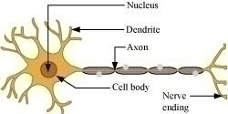
Biological Inspiration and the Perceptron
Brief overview of the connection between artificial neural networks and biological neurons.
Biological Neuron
Biological neurons are the cells that make up our brains.
They receive signals (inputs) through branching structures called dendrites.
The cell body processes signals and decides whether to "fire."
If it fires, a signal (output) is sent through a long projection called the axon to other neurons.

Slide 4
Biological Inspiration and the Perceptron
Brief overview of the connection between artificial neural networks and biological neurons.
Biological Neuron
Biological neurons are incredibly complex, but the core idea is simple:
They take in information, process it, and can pass on an altered version of that information to other neurons.
Artificial neural networks borrow this fundamental concept to create computational models.

Slide 5
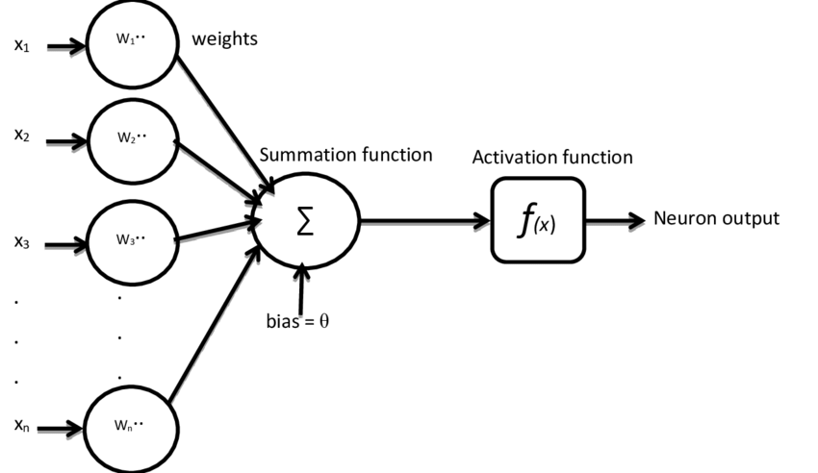
Artificial Neuron
Terms used -
Inputs: Data represented as numerical values enter the neuron as inputs.
Weights: Each input is multiplied by a "weight," indicating its importance.
Summation: Weighted inputs are summed together.
Activation Function: This function acts as a "decision filter"—it takes the summed input and decides if the neuron should produce an output or "fire."
Output: If activated, the neuron generates an output, which can feed into other neurons.

Slide 6
Artificial Neuron
How an Artificial Neuron Works
An artificial neuron acts like a tiny calculator.
It takes in a bunch of numbers, performs some fairly simple math, and uses a rule (the activation function) to decide whether to produce an output signal.
It may send its output to other neurons in the network.
Just like with biological neurons, this input-processing-output pattern forms the foundation of the vast interconnected artificial neural networks used for solving complex problem

Slide 7
Structure of Artificial Neuron

Slide 8
Why bias ?
Including a bias term in the model helps in –
Capturing Shifts in Data:
A bias term allows the model to capture shifts or offsets in the data.
Without a bias term, the decision boundary of the model would always pass through the origin, which may not be suitable for many real-world datasets where the data is not centered around zero.
Flexibility in Model Representation:
The bias term provides additional flexibility to the model, enabling it to represent a wider range of functions.
It allows the model to fit more complex patterns in the data by controlling the vertical shift of the activation function.

Slide 9
Why bias ?
Including a bias term in the model helps in –
Improving Model Performance:
Including a bias term can lead to improved model performance by enabling the model to learn more accurate and robust representations of the data.
It helps the model generalize better to unseen data and reduces the risk of underfitting.
Please open file With_WO_bias.ipynb

Slide 10
Elaborating on Artificial Neuron
Inputs (x1, x2, ... xn): Arrows labeled from left to right, representing numerical values entering the neuron. These arrows can connect to outputs of other neurons or raw data input. Can be pixel values, sensor data etc
Weights (w1, w2, ... wn): Numerical values attached to each input arrow.
Circle: Represents the artificial neuron. Inside, you could label it with:
"Σ" (symbol for summation), representing the addition of weighted inputs.
"ƒ" (representing the activation function).
Bias (b): An additional input (often fixed at +1) with its own weight, represented by a separate arrow connected to the neuron.
Output (y): An arrow pointing away from the neuron to the right, representing the result of the neuron's calculation. This will likely connect to other neurons in a subsequent layer.

Slide 11
Structure of Artificial Neuron
Linear Combination: The neuron first calculates a weighted sum of its inputs
(w1x1 + w2x2 + ... + wn*xn + b)
Activation Function: The function (e.g., sigmoid, ReLU) performs a non-linear transformation on the summed input, controlling if the neuron "fires."
Network Structure: An artificial neural network comprises many interconnected neurons like this, arranged in layers.

Slide 12
Understanding the Foundation of Neural Networks
The perceptron is one of the earliest and simplest artificial neuron models.
Inspired by the structure of biological neurons.
Forms the basis for more complex neural network architectures.
The perceptron is where the history of neural networks truly begins.
While incredibly simple by today's standards, understanding how it works lays the foundation for understanding the advanced deep learning models that are capable of such amazing things.

Slide 13
How the Perceptron Works
Inputs: Numerical data enters the perceptron (e.g., pixel values, sensor readings).
Weights: Each input connection has a "weight" adjusting its importance.
Summation: Weighted inputs are summed. Often, a bias term is added (like an intercept).
Activation Function: The step function is classic: If the sum exceeds a threshold,
output is 1 (it "fires"), otherwise 0.
The perceptron acts like a tiny decision-maker.
It looks at the combined strength of its inputs, and decides whether or not to pass a signal onward.
It can only produce two distinct outputs (0 or 1), classifying data into two categories.

Slide 14
Perceptron – Learning through Updates
How the Perceptron Learns
Supervised learning: The perceptron trains on labeled data (like images labeled "cat" or "not cat")
Prediction: Given an input, it makes a prediction (the classification).
Error Correction: If it incorrectly predicts the class, weights are adjusted slightly, aiming to minimize these errors. This idea was further refined by Geoffrey Hinton and coined as backpropagation which we shall see later.
Repetition: This learning process iterates over many training examples, gradually refining weights.
The magic of the perceptron isn't in a single decision, but in how it uses feedback to improve. Small weight updates with each misclassification nudge the perceptron towards becoming better at what it does.

Slide 15
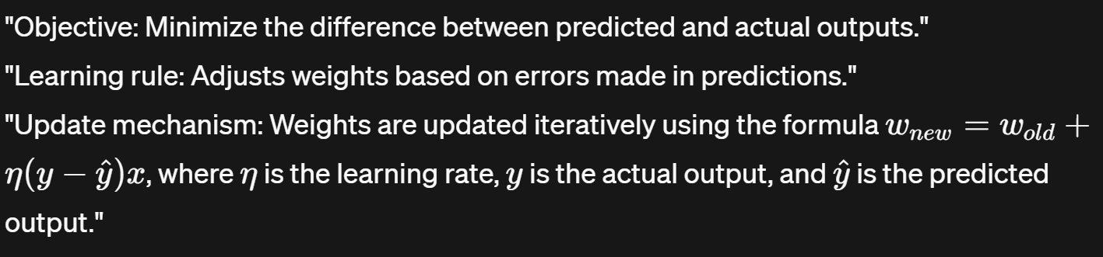
Perceptron – Learning Rule
Perceptron learns from its errors and adjusts the weights at each node to ensure that the misclassification does not happen in the output.

Slide 16
Perceptron & Artificial Neuron
Artificial Neuron:
An artificial neuron is a more generalized concept that represents the basic unit of a neural network, mimicking the functionality of biological neurons.
Artificial neurons can use a variety of activation functions, such as sigmoid, tanh, ReLU (Rectified Linear Unit), and others, allowing them to model nonlinear relationships.
They are used in constructing multi-layer neural networks (including deep learning models), enabling the learning of complex, non-linear patterns and decision boundaries.
The concept of artificial neurons forms the basis for more advanced neural network architectures beyond the simple perceptron, including convolutional neural networks (CNNs), recurrent neural networks (RNNs), and others.

Slide 17
Perceptron & Artificial Neuron
Perceptron is a specific type of artificial neuron with a binary step function and limitations in learning,
The term "artificial neuron" refers to the more general concept used in various neural network architectures with diverse activation functions and capabilities.

Slide 18
Tools of the trade
Deep Learning Frameworks
Tensorflow - https://www.tensorflow.org/learn
Pytorch - https://pytorch.org/docs/stable/index.html
Keras - https://keras.io/about/
OpenCV - https://docs.opencv.org/4.x/d2/d96/tutorial_py_table_of_contents_imgproc.html

Slide 19
Feedforward Neural Networks
A feedforward neural network is a fundamental type of artificial neural network where connections between nodes do not form cycles.
Information flows in one direction: from the input nodes, through the hidden layers (if any), and finally to the output nodes.
Each node in a layer is connected to every node in the subsequent layer.
Please open file FeedForward_NN.ipynb
Again we can visualize NN at - https://alexlenail.me/NN-SVG/index.html

Slide 20
Multi-Layer Perceptron
What is MLP and usage in Deep Learning ?
A Multi-Layer Perceptron (MLP) is an advanced type of neural network that consists of more than one layer of neurons, unlike the single-layer perceptron.
These layers are divided into three types: an input layer, one or more hidden layers, and an output layer.
Each neuron in one layer is connected to every neuron in the next layer, making it a fully connected network.
Unlike the basic perceptron, which can only learn linear decision boundaries, MLPs can learn non-linear relationships thanks to their multiple layers and non-linear activation functions (like ReLU, sigmoid, or tanh) used in the hidden layers.

Slide 21
Building Multi-Layer networks; stacking perceptrons
A multi-layer network is composed of multiple layers of perceptrons (also known as neurons or nodes), organized in a feedforward manner.
Structure: Typically consists of an input layer, one or more hidden layers, and an output layer.
Importance: Multi-layer networks can learn complex patterns and relationships in data, making them powerful tools for various machine learning tasks.
Navigate to https://alexlenail.me/NN-SVG/index.html
to visualize this

Slide 22
What is Gradient Descent ?
Gradient - > Slope (or dy/dx)
Descent -> Going Down the loss curve to achieve a minimum value
Gradient descent is an optimization algorithm used to minimize the loss function of a neural network by iteratively updating the parameters (weights and biases) in the direction of the steepest descent of the loss surface.

Slide 23
What is Gradient Descent ?
Intuition:
Imagine standing on a hill and trying to find the lowest point.
We take small steps downhill, guided by the slope of the hill, until we reach the bottom.
Similarly, gradient descent adjusts the parameters(nodes/neurons) of the neural network in small steps, guided by the gradient of the loss function, until it finds the minimum.

Slide 24
What is Gradient Descent ?
Steps:
Compute the gradient of the loss function with respect to each parameter.
Update the parameters in the opposite direction of the gradient, scaled by a learning rate.
Repeat the process until convergence or a specified number of iterations.
Please open file gradient_decent.ipynb

Slide 25
Variants of Gradient Descent
Batch Gradient Descent: Computes the gradient of the loss function using the entire training dataset in each iteration. Suitable for small datasets but computationally expensive for large datasets.
Stochastic Gradient Descent (SGD): Computes the gradient using a single randomly selected sample from the training dataset in each iteration. Faster convergence but high variance in parameter updates.
Mini-Batch Gradient Descent: Computes the gradient using a small random subset of the training dataset (mini-batch) in each iteration. Balance between the efficiency of SGD and stability of batch gradient descent.

Slide 26
Variants of Gradient Descent
Please open file Variants_Gradient_Descent.ipynb

Slide 27
Activation Functions and Their Significance
Definition: Activation functions introduce non-linearity to the output of each neuron in the network, enabling it to learn complex patterns and relationships in data.
Why is it important to capture Non-Linearity in Data ?
Neural networks with non-linear activation functions can learn complex patterns and relationships in data that linear models cannot capture.
Real-Life Example: Handwriting Recognition
Linear Model: Consider a linear model attempting to recognize handwritten digits. It may struggle to distinguish between digits like 6 and 9, which have similar linear representations.
Non-Linear Model: In contrast, a neural network with non-linear activation functions (e.g., ReLU) can learn to recognize subtle differences in handwritten digits by capturing non-linear relationships between pixels.

Slide 28
Activation Functions and Their Significance
Activation functions introduce non-linearity to the output of each neuron in the network, enabling it to learn complex patterns and relationships in data.
Types of Activation Functions:
Sigmoid: S-shaped curve squashes input values between 0 and 1, suitable for binary classification tasks.
ReLU (Rectified Linear Unit): Linear for positive values and zero for negative values, helps in faster convergence and avoids vanishing gradients.
Tanh (Hyperbolic Tangent): Similar to sigmoid but squashes input values between -1 and 1, helpful for deeper networks.
Softmax: Converts raw scores into probabilities, useful for multi-class classification tasks.
Significance:
Choice of activation function impacts the model's capacity to learn and convergence speed.

Slide 29
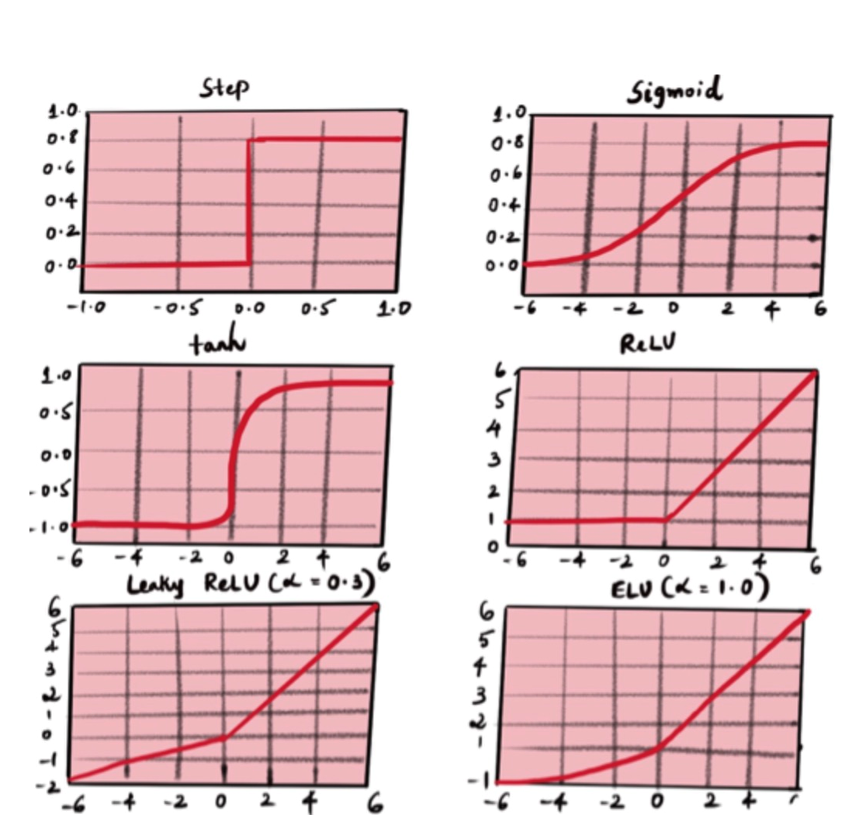
Activation Functions and Their Significance
Sigmoid: S-shaped curve squashes input values
between 0 and 1, suitable for binary classification tasks.
ReLU (Rectified Linear Unit): Linear for positive values
and zero for negative values, helps in faster
convergence and avoids vanishing gradients.
Tanh (Hyperbolic Tangent): Similar to sigmoid but
squashes input values between -1 and 1, helpful for deeper networks.
Softmax: Converts raw scores into probabilities,
useful for multi-class classification tasks.

Slide 30
Python Code Example with Different Activation Functions
Please open ActivationFunction.ipynb
Implementation with Various Activation Functions
Import necessary libraries and load California housing dataset.
Define the architecture of the neural network with different activation functions for hidden layers.
Train the model using different activation functions and evaluate performance.
Compare and analyze the results to understand the impact of activation functions on model performance.

Slide 31
What is Backpropagation?
Backpropagation is a fundamental algorithm used to train neural networks by adjusting the weights and biases of the network based on the error between predicted and actual outputs.
It involves two main steps:
Forward Pass: Input data is passed forward through the network, and predictions are generated.
Backward Pass: The error between predicted and actual outputs is calculated, and this error is propagated backward through the network to update the weights and biases.
Backpropagation iteratively adjusts the parameters of the network to minimize the error, allowing the network to learn complex patterns and relationships in the data.

Slide 32
Importance of Backpropagation
Why is Backpropagation Important?
Backpropagation is crucial for training neural networks because:
Enables Learning: By iteratively adjusting the weights and biases based on the error, backpropagation allows neural networks to learn from data and improve their performance over time.
Facilitates Deep Learning: Backpropagation enables training of deep neural networks with multiple layers, allowing them to learn hierarchical representations of data and solve complex tasks.
Versatility: Backpropagation can be applied to various types of neural networks and tasks, including classification, regression, and reinforcement learning.
Without backpropagation, neural networks would be unable to learn complex patterns and relationships in the data, limiting their effectiveness in solving real-world problems.

Slide 33
Importance of Backpropagation
Please open file With_WO_backpropagation.ipynb

Slide 34
What is an epoch ?
An epoch refers to one complete pass through the entire training dataset during the training phase of a deep learning model.
Importance: During each epoch, the model updates its parameters (weights and biases) based on the gradient descent algorithm, aiming to minimize the loss function and improve performance.
Iterative Process: Training a deep learning model typically involves multiple epochs, where the model learns from the data in successive iterations, gradually improving its ability to generalize and make accurate predictions.

Slide 35
What is an epoch ?
An epoch refers to one complete pass through the entire training dataset during the training phase of a deep learning model.
Control Overfitting:
The number of epochs is a hyperparameter that can be adjusted to control the trade-off between underfitting and overfitting.
Increasing the number of epochs may lead to better performance on the training data but could result in overfitting if the model learns to memorize the training examples instead of generalizing to unseen data.
Please open Epochs_Impact.ipynb

Slide 36
What is Training Loss and Validation Loss?
Training Loss:
The training loss, also known as the empirical loss or the objective function, measures the error between the predicted output of the model and the actual target values on the training dataset.
Purpose:
The training loss is used to optimize the parameters (weights and biases) of the neural network during the training process.
The goal is to minimize the training loss by adjusting the model's parameters through techniques such as gradient descent.
Interpretation:
A decreasing training loss indicates that the model is learning and improving its performance on the training data.
However, it does not necessarily reflect how well the model will generalize to unseen data.

Slide 37
What is Training Loss and Validation Loss?
Validation Loss:
The validation loss measures the error between the predicted output of the model and the actual target values on a separate validation dataset that is not used for training.
Purpose:
The validation loss serves as an estimate of the model's performance on unseen data.
It helps to assess how well the model generalizes to new examples and identifies issues such as overfitting or underfitting.
Interpretation:
Monitoring the validation loss allows us to determine whether the model is learning useful patterns in the data or if it is overfitting by memorizing the training examples.
A decreasing training loss accompanied by a stable or decreasing validation loss indicates that the model is generalizing well to unseen data.

Slide 38
So how is a Neural Network trained
Or how does it learn patterns from the data ?
Loss functions (mean squared error, cross-entropy etc)
Calculation of gradients to update network weights using backpropagation of errors
Practical Implementation

Slide 39
Loss Functions
Loss functions are used to quantify the difference between the predicted output of a neural network and the actual output (ground truth).
Different tasks require different loss functions and some commonly used loss functions in deep learning are -
Mean Squared Error (MSE): Used for regression tasks.
Binary Cross-Entropy (BinaryCE): Used for binary classification tasks.
Categorical Cross-Entropy (CategoricalCE): Used for multi-class classification tasks.
Please open file Loss_func.ipynb

Slide 40
Binary Cross Entropy
Binary Cross-Entropy (also known as Log Loss) is a loss function used for binary classification tasks, where the model predicts either of the two classes (0 or 1).
Binary Cross-Entropy measures the difference between the predicted probability distribution and the actual binary labels.
Example:
Consider a spam email classifier. For each email, the model predicts the probability of it being spam (e.g., 0.7) or not spam (e.g., 0.3). The actual label is either 1 (spam) or 0 (not spam). Binary Cross-Entropy quantifies how well the predicted probabilities match the actual labels.

Slide 41
Categorical Cross Entropy
Categorical Cross-Entropy is a loss function used for multi-class classification tasks, where the model predicts one of multiple classes (e.g., cat, dog, bird).
Categorical Cross-Entropy measures the difference between the predicted probability distribution and the actual categorical labels.
Example:
Consider a handwritten digit classifier. For each image, the model predicts the probability of it being each digit (e.g., [0.1, 0.8, 0.05, 0.05, 0.0, 0.0, 0.05, 0.0, 0.0, 0.0] for the digit 1).
The actual label is a one-hot encoded vector ([0, 1, 0, 0, 0, 0, 0, 0, 0, 0] for the digit 1).
Categorical Cross-Entropy quantifies how well the predicted probabilities match the actual one-hot encoded vectors.

Slide 42
Why did Multi-Layer Perceptron Hit a Wall ?
Limited Generalization: MLPs may struggle to generalize well to unseen data, especially when dealing with small datasets or datasets with complex patterns. This can lead to overfitting, where the model performs well on the training data but poorly on new, unseen data.
Sensitivity to Hyperparameters: MLPs require careful tuning of hyperparameters such as the number of hidden layers, the number of neurons per layer, activation functions, learning rate, etc. Finding the optimal set of hyperparameters can be challenging and time-consuming.
Slow Convergence: Training MLPs can be computationally intensive, especially for large datasets or deep architectures. MLPs may converge slowly or get stuck in local minima during training, leading to longer training times.
Vulnerability to Local Minima: MLPs are trained using gradient-based optimization techniques such as stochastic gradient descent (SGD). However, these optimization algorithms may converge to local minima, resulting in suboptimal solutions.

Slide 43
Why did Multi Layer Perceptron Hit a Wall ?
Black Box Nature: MLPs are often considered black box models, meaning that it's difficult to interpret how they arrive at predictions. Understanding the inner workings of MLPs and interpreting the learned representations can be challenging, especially in complex architectures.
Data Preprocessing Requirement: MLPs are sensitive to the scale and distribution of input features. Preprocessing steps such as feature scaling, normalization, and handling missing values are often required to ensure optimal performance.
Memory and Computational Resources: Training large MLPs with many layers and neurons requires significant memory and computational resources. Deploying such models in production environments may be impractical or expensive, especially in resource-constrained settings.

Slide 44
Why did Multi Layer Perceptron Hit a Wall ?
Lack of Robustness to Noisy Data: MLPs are sensitive to noisy data and outliers, which can negatively impact model performance. Robustness to noisy data can be improved with regularization techniques, but it may still be a challenge in some cases.
Interpretability: MLPs lack interpretability compared to simpler models like linear regression or decision trees. Understanding how the model makes predictions and explaining its decisions to stakeholders or end-users can be difficult.
Limited Transfer Learning: Transfer learning, where knowledge gained from training one model is transferred to a different but related task, may be less effective with MLPs compared to other architectures like convolutional neural networks (CNNs) or recurrent neural networks (RNNs).

Slide 45
What is CNN ?
Convolutional Neural Networks (CNNs) are a class of deep learning models designed for processing structured grid-like data, such as images.
CNNs are particularly effective in computer vision tasks like image classification, object detection, and image segmentation.
CNNs leverage the concept of convolutions to extract spatial hierarchies of features from input images.

Slide 46
What are Convolutions ?
Convolutions are the fundamental building blocks of CNNs.
Convolution operation involves sliding a filter (also known as a kernel) over the input image and computing element-wise multiplications and summations.
Key terms:
Filter/Kernel: Small matrix used for feature extraction.
Stride: Step size of the filter as it moves across the input image.
Padding: Technique used to preserve spatial dimensions of the input image.

Slide 47
What are Convolutions exactly?
Convolution is a mathematical operation that involves combining two sets of information to produce a third set of information.
In the context of image processing and convolutional neural networks (CNNs), convolutions are used to extract features from images.
Simpler explanation
Imagine we have a flashlight and a stencil with a specific pattern (e.g., a circle or a square).
When we shine the flashlight through the stencil onto a surface, we create a shadow that represents the pattern of the stencil.
Now, if we move the flashlight across the surface, the shadow will change based on the position of the flashlight relative to the surface.
This process of shining the flashlight through the stencil and moving it across the surface is analogous to convolution.

Slide 48
What are Convolutions exactly?
Simpler explanation
Imagine we have a flashlight and a stencil with a specific pattern (e.g., a circle or a square).
When we shine the flashlight through the stencil onto a surface, we create a shadow that represents the pattern of the stencil.
Now, if we move the flashlight across the surface, the shadow will change based on the position of the flashlight relative to the surface.
This process of shining the flashlight through the stencil and moving it across the surface is analogous to convolution.
In Image processing
In image processing, the flashlight represents a filter or kernel, and the surface represents the input image.
The filter is a small matrix (e.g., 3x3 or 5x5) with specific values.
When we convolve the filter with the input image, we compute element-wise multiplications between the filter and the overlapping pixels of the image, and then sum up the results to produce a single output value.
By sliding the filter across the entire image, we generate a new output image called the feature map, which highlights certain patterns or features present in the original image.
Please open file Filter_Kernels_CNN.ipynb

Slide 49
Key Terms in CNNs
Pooling: Downsampling technique used to reduce spatial dimensions of feature maps, such as max pooling and average pooling.
Activation Function: Non-linear function applied to the output of convolutional layers to introduce non-linearity, such as ReLU, Sigmoid, or Tanh.
Convolutional Layer: Layer consisting of multiple filters applied to input images, responsible for feature extraction.
Fully Connected Layer: Traditional neural network layers used for classification/regression tasks after feature extraction in CNNs.

Slide 50
Architecture of CNNs
CNNs typically consist of multiple convolutional layers followed by pooling layers and fully connected layers.
Feature maps extracted from convolutional layers capture low-level to high-level features of input images.
CNN architectures may vary based on the specific task and dataset, with popular architectures like LeNet, AlexNet, VGG, ResNet, and more.
CNNs are trained using backpropagation and optimization algorithms like gradient descent to minimize the loss function.
Open web page – https://alexlenail.me/NN-SVG/index.html to visually see the LeNET and AlexNet Architectures

Slide 51
LeNET and AlexNET
LeNET
LeNet, short for LeNet-5, was developed by Yann LeCun, Léon Bottou, Yoshua Bengio, and Patrick Haffner in the late 1990s.
It was one of the earliest CNN architectures and was designed for handwritten digit recognition tasks, particularly for recognizing digits in postal codes on envelopes.
LeNet consists of several layers, including convolutional layers, pooling layers, and fully connected layers. It follows a simple and elegant architecture with alternating convolution and pooling layers followed by fully connected layers.
LeNet significantly contributed to the adoption of CNNs in computer vision tasks and laid the groundwork for subsequent architectures like AlexNet.

Slide 52
LeNET and AlexNET
ALexNet
AlexNet is a deeper and more complex CNN architecture developed by Alex Krizhevsky, Ilya Sutskever, and Geoffrey Hinton in 2012.
It was the winner of the ImageNet Large Scale Visual Recognition Challenge (ILSVRC) in 2012, demonstrating a significant improvement in image classification accuracy compared to previous methods.
AlexNet consists of eight layers, including five convolutional layers and three fully connected layers. It also incorporates techniques such as ReLU activation functions, dropout regularization, and data augmentation.
AlexNet introduced several innovations, including the use of Rectified Linear Units (ReLU) as activation functions and GPU acceleration, which allowed for faster training of deep neural networks on large datasets.
AlexNet's success popularized deep learning and paved the way for the development of even more powerful CNN architectures.

Slide 53
What is Dropout regularization?
First the problem:
Deep neural networks, with their immense number of parameters(neurons/nodes), are prone to overfitting.
Overfitting occurs when the model learns the training data too precisely, including noise and random fluctuations, leading to poor performance on new, unseen data.
What is Regularization?
A set of techniques that explicitly discourage overly complex models during training.
The goal is to improve the model's ability to generalize to new data.

Slide 54
Common regularization techniques in DL
L1 Regularization (LASSO [Least Absolute Shrinkage and Selection Operator]): Adds a penalty term proportional to the sum of absolute weights. Promotes sparsity (many weights become zero).
L2 Regularization (RIDGE[Regularization using L2 Norm]): Adds a penalty term proportional to the sum of squared weights. Prevents weights from becoming too large.
Dropout: Randomly sets a percentage of neuron activations to zero during training. Forces the network to learn redundant representations by the neurons present to make up for those that have been dropped out
Key Idea
Regularization introduces a slight bias but significantly reduces variance, leading to better overall performance on unseen test data.

Slide 55
What is Dropout regularization?
Dropout regularization is a technique used to prevent overfitting in deep learning models.
It works by randomly dropping (i.e., setting to zero) a proportion of neurons during training, effectively removing them from the network.
By randomly dropping neurons, dropout introduces noise into the network and prevents neurons from co-adapting, thus reducing the model's reliance on specific neurons and features.
Dropout is typically applied to hidden layers during training and is not used during inference.

Slide 56
Benefits of Dropout regularization?
Dropout regularization helps in improving the generalization ability of deep learning models by reducing overfitting.
Key benefits of dropout :
Prevents co-adaptation
Reduces reliance on individual neurons
Acts as an ensemble
Simple and effective
Please open file With_WO_Dropout.ipynb

Slide 57
Benefits of Dropout regularization?
Randomly Deactivating Neurons:
During each training iteration, dropout randomly deactivates (sets to zero) a proportion of neurons in the network with a certain probability (dropout rate).
By deactivating neurons, dropout effectively removes them from the network for that particular iteration.
Forced Redundancy:
Because neurons can be randomly deactivated during training, other neurons in the network must compensate for their absence.
Neurons in the network are forced to learn more robust and redundant representations of the input data. This redundancy ensures that even if certain neurons are dropped out during inference, the network can still make accurate predictions.

Slide 58
Benefits of Dropout regularization?
Acts as an Ensemble :
Dropout can be viewed as training multiple subnetworks within the main network, each with a different subset of active neurons.
During training, the network learns to adapt to the absence of certain neurons by distributing the learning across the remaining active neurons.
This ensemble effect leads to the network learning more generalized representations of the data, which improves its robustness and generalization ability.
Reduction of Co-Adaptation:
Dropout discourages neurons from co-adapting or relying too heavily on each other.
Neurons become more independent and learn to extract different features or representations of the input data, reducing the risk of overfitting to specific patterns in the training data.

Slide 59
Image processing using CNN
Image classification - Image classification focuses on a global image label.
Object detection - Object detection needs bounding boxes and individual object classes.
Image segmentation - Segmentation requires pixel-level masks.
Image style transfer - Style transfer needs artistic style blending.
Please open Image_Classification_ResNet.ipynb

Slide 60
What are Recurrent Neural Networks ?
RNNs are a type of neural network architecture designed to handle sequential data by capturing temporal dependencies.
Unlike feedforward neural networks, RNNs have connections that form directed cycles, allowing them to exhibit temporal dynamics.
RNNs are well-suited for tasks such as time series prediction, natural language processing, and speech recognition, where the input data has a sequential or temporal structure.

Slide 61
Recurrent Connections and Memory
RNNs have recurrent connections that allow information to persist over time steps, creating a form of memory.
At each time step, the output of the RNN is influenced not only by the current input but also by the previous hidden state, which contains information from previous time steps.
This recurrent architecture enables RNNs to capture long-term dependencies in sequential data, making them capable of processing input sequences of variable length.

Slide 62
Intuition behind RNN
Humans don’t start their thinking from scratch every second. As we read this, we understand each word based on our understanding of previous words. We don’t throw everything away and start thinking from scratch again. Our thoughts have persistence.
Traditional Neural Networks can’t do this, and it looks like a major shortcoming.
For example, imagine we want to classify what kind of event is happening at every point in a movie. It’s unclear how a traditional neural network could use its reasoning about previous events in the film to inform later ones.
Recurrent neural networks address this issue. They are networks with loops in them, allowing information to persist.

Slide 63
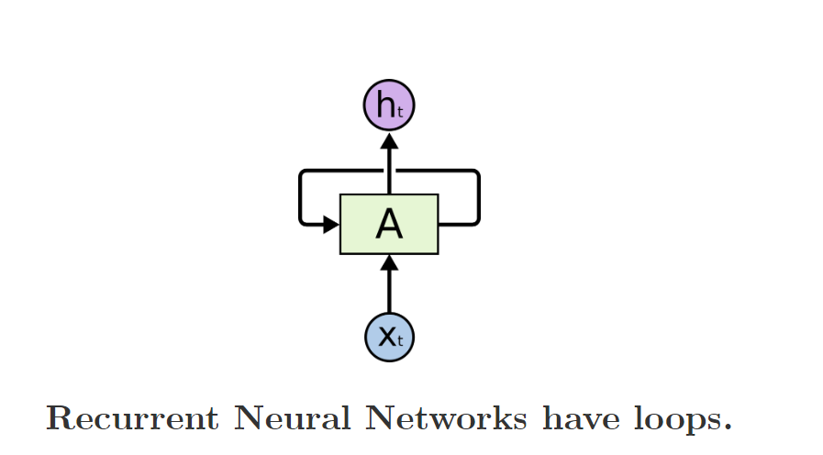
Intuition behind RNN
Recurrent neural networks address this issue. They are networks with loops in them, allowing information to persist.

Slide 64
Intuition behind RNN
In the above diagram, a chunk of neural network, A , looks at some input x_{t} and outputs a value h_{t}
A loop allows information to be passed from one step of the network to the next.
A recurrent neural network can be thought of as multiple copies of the same network, each passing a message to a successor. Consider what happens if we unroll the loop:

Slide 65
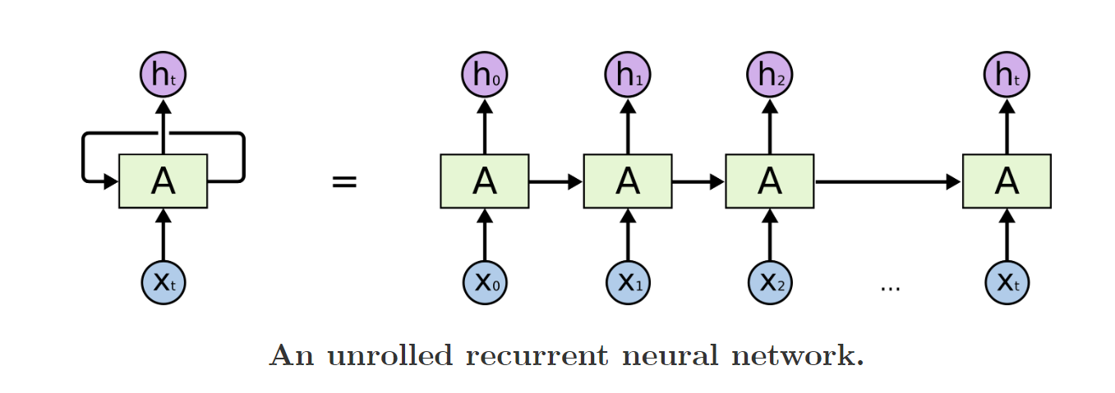
Intuition behind RNN
If we unroll the loop this chain-like nature reveals that recurrent neural networks are intimately related to sequences and lists. They’re the natural architecture of neural network to use for such data.

Slide 66
Applications and Limitations
RNNs have found applications in a wide range of tasks, including:
Language modeling
Machine translation
Speech recognition
Stock market prediction
However, RNNs suffer from certain limitations, such as:
Difficulty in learning long-range dependencies
Vanishing and exploding gradient problems during training
Limited memory capacity due to the fixed-size hidden state making it difficult to learn long-term dependencies
Despite these limitations, RNNs remain a powerful tool for sequential data analysis and continue to be actively researched and developed.

Slide 67
Vanishing Gradients and Exploding Gradients
The vanishing and exploding gradients problems are common issues encountered during the training of Recurrent Neural Networks (RNNs), particularly when dealing with long sequences or deep architectures.
These problems occur due to the propagation of gradients through multiple time steps or layers, leading to either very small (vanishing gradients) or very large (exploding gradients) gradient values.

Slide 68
Vanishing Gradients and Exploding Gradients
Vanishing Gradients Problem:
In the vanishing gradients problem, gradients become very small as they are backpropagated through many time steps or layers.
As a result, the weights associated with earlier time steps or layers receive very little or no updates during training, leading to slow or stalled learning.
This problem is especially prominent in RNNs with long sequences or deep architectures, where the effect of vanishing gradients accumulates over time.

Slide 69
Vanishing Gradients and Exploding Gradients
Vanishing Gradients Problem:
One real-life example where gradients can become very small or vanish is in training Recurrent Neural Networks (RNNs) for long-term dependencies in sequential data, such as predicting stock prices or generating text.
Consider the task of training an RNN to predict future stock prices based on historical data. In this task, the model takes a sequence of historical stock prices as input and predicts the next price in the sequence. During training, the model learns to minimize the difference between its predicted prices and the actual prices.

Slide 70
Vanishing Gradients and Exploding Gradients
Vanishing Gradients Problem:
Now, imagine a scenario where the training data consists of very long sequences of historical stock prices, spanning several years or decades. As the model processes each price in the sequence, gradients are computed and backpropagated through time to update the model parameters. However, in long sequences, gradients can diminish or vanish as they are propagated backward through many time steps.
For example, consider a situation where the model needs to predict the stock price for tomorrow based on prices from several years ago. The relationship between the historical prices and the future price may be very complex and involve long-term dependencies. As the gradients are backpropagated through time, they may become very small or vanish altogether, especially if the model struggles to capture these long-term dependencies.

Slide 71
Vanishing Gradients and Exploding Gradients
Vanishing Gradients Problem:
When gradients vanish, the model's parameters receive little or no updates during training, leading to slow or stalled learning. As a result, the model may fail to capture long-term dependencies in the data and perform poorly on predicting future stock prices.
To address the problem of vanishing gradients in such scenarios, techniques like gradient clipping, using alternative architectures like Long Short-Term Memory (LSTM) or Gated Recurrent Unit (GRU), or using skip connections in the network can be employed. These techniques help the model to better capture long-term dependencies and mitigate the issue of vanishing gradients during training.

Slide 72
Vanishing Gradients and Exploding Gradients
Exploding Gradients Problem:
In the exploding gradients problem, gradients become very large as they are backpropagated through many time steps or layers. How ?
This causes weight updates to become extremely large, leading to instability and divergence in the training process.
Exploding gradients can cause the model to overshoot the optimal solution, resulting in poor convergence or even NaN (Not a Number) errors.

Slide 73
Vanishing Gradients and Exploding Gradients
Exploding Gradients Problem:
One real-life example where gradients can become very large or explode is in training Recurrent Neural Networks (RNNs) for natural language processing (NLP) tasks, such as machine translation or text generation.
Consider the task of training an RNN language model to generate text. In this task, the model takes a sequence of words as input and predicts the next word in the sequence. During training, the model learns to minimize the difference between its predicted word probabilities and the actual next word in the sequence.

Slide 74
Vanishing Gradients and Exploding Gradients
Exploding Gradients Problem:
Now, imagine a scenario where the training data consists of very long sentences or documents. As the model processes each word in the sequence, gradients are computed and backpropagated through time to update the model parameters. However, in long sequences, gradients can accumulate over many time steps, potentially leading to very large or exploding gradients.
For example, consider a sentence with 100 words. During backpropagation through time, gradients are computed and multiplied by each other at each time step. If the gradient values are larger than 1, they can quickly grow exponentially as they are multiplied together over many time steps, leading to exploding gradients.

Slide 75
Vanishing Gradients and Exploding Gradients
Exploding Gradients Problem:
Exploding gradients can cause the model's parameters to update by very large amounts, which can destabilize the training process and lead to numerical overflow issues. As a result, the model may fail to converge or exhibit unstable behavior during training.
To mitigate the problem of exploding gradients in such scenarios, techniques like gradient clipping can be used. Gradient clipping limits the magnitude of gradients during training, preventing them from becoming too large and destabilizing the training process.

Slide 76
Vanishing Gradients and Exploding Gradients
Please open Vanising_Exploding_gradients.ipynb
In the code:
We generate synthetic data similar to the previous example.
We define an RNN model with two SimpleRNN layers and a Dense output layer.
We train the model with different learning rates (0.01, 0.1, and 1.0) for 10 epochs.
We plot the loss over epochs for each learning rate to visualize the effect on training.
We can observe that for higher learning rates, the loss decreases more quickly initially but may become unstable or diverge later on, indicating the presence of exploding gradients.
Gradient clipping, can help mitigate this issue by limiting the magnitude of gradients during training.
We can enable gradient clipping by setting the clipnorm parameter in the optimizer

Slide 77
The Problem of Long-Term Dependencies
One of the appeals of RNNs is the idea that they might be able to connect previous information to the present task, such as using previous video frames might inform the understanding of the present frame.
If RNNs could do this, they’d be extremely useful. But can they? It depends.

Slide 78
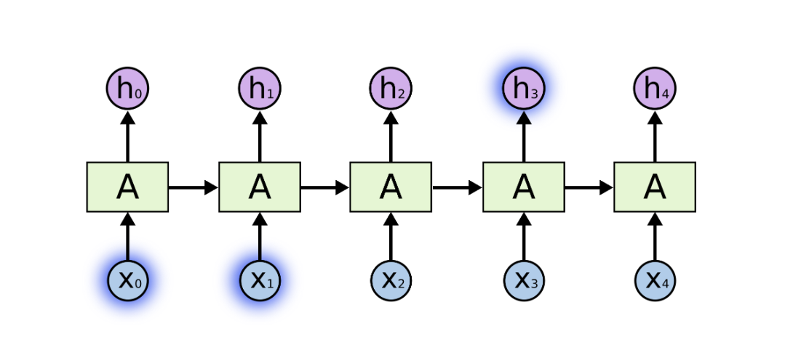
The Problem of Long-Term Dependencies
Sometimes, we only need to look at recent information to perform the present task.
For example, consider a language model trying to predict the next word based on the previous ones -
If we are trying to predict the last word in “the clouds are in the sky,” we don’t need any further context – it’s pretty obvious the next word is going to be sky. In such cases, where the gap between the relevant information and the place that it’s needed is small, RNNs can learn to use the past information.

Slide 79
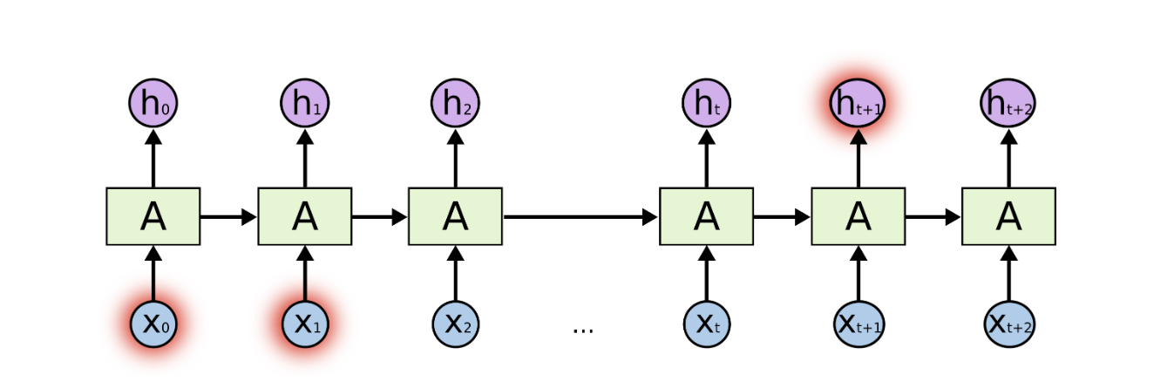
The Problem of Long-Term Dependencies
But there are also cases where we need more context.
Consider trying to predict the last word in the text “I grew up in France… I speak fluent French.”
Recent information suggests that the next word is probably the name of a language, but if we want to narrow down which language, we need the context of France, from further back.
It’s entirely possible for the gap between the relevant information and the point where it is needed to become very large.
Unfortunately, as that gap grows, RNNs become unable to learn to connect the information.

Slide 80
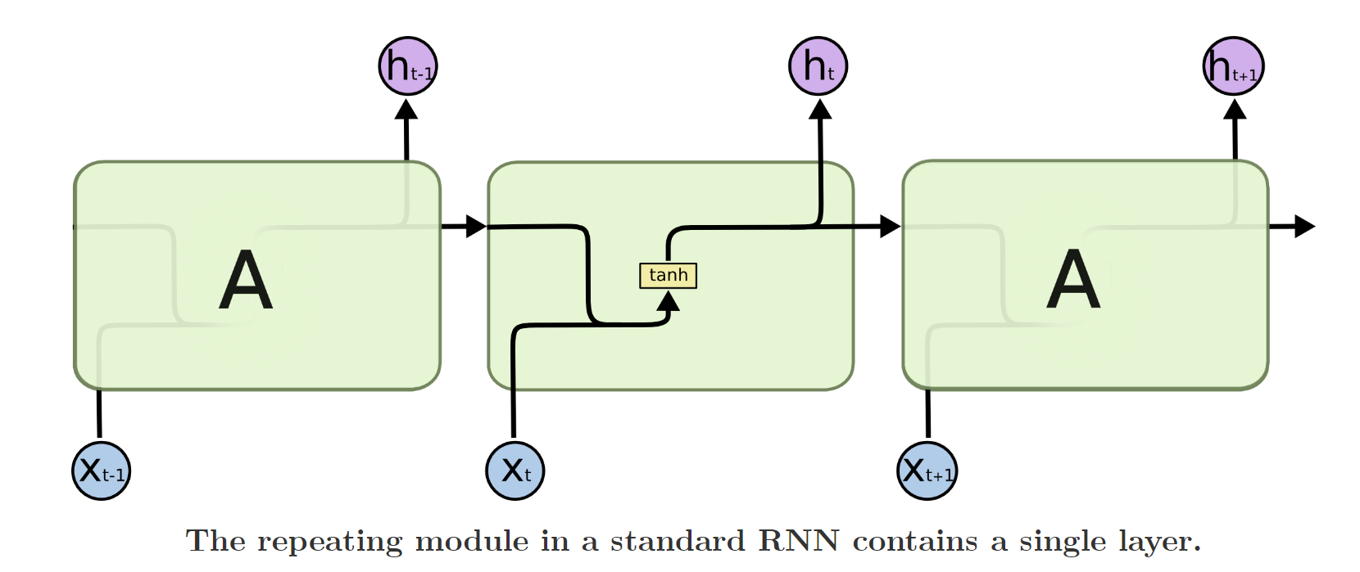
Enter LSTM (Long-Short Term Memory) Networks
Long Short Term Memory networks (“LSTMs”) – are a special kind of RNN, capable of learning long-term dependencies. They were introduced by Hochreiter & Schmidhuber (1997), and were refined and popularized by later on
LSTMs are explicitly designed to avoid the long-term dependency problem. Remembering information for long periods of time is practically their default behavior, not something they struggle to learn!
All recurrent neural networks have the form of a chain of repeating modules of neural network. In standard RNNs, this repeating module will have a very simple structure, such as a single tanh layer.

Slide 81
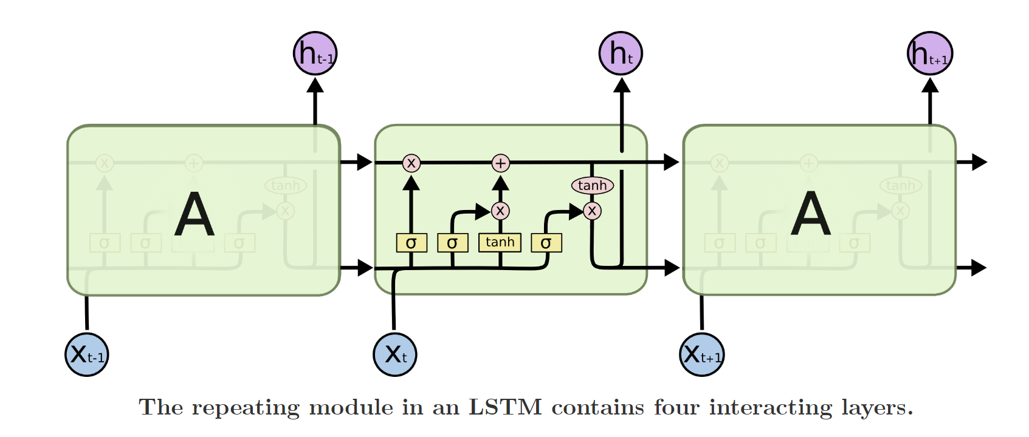
Enter LSTM (Long-Short Term Memory) Networks
LSTMs also have this chain like structure, but the repeating module has a different structure. Instead of having a single neural network layer, there are four, interacting in a very special way.

Slide 82
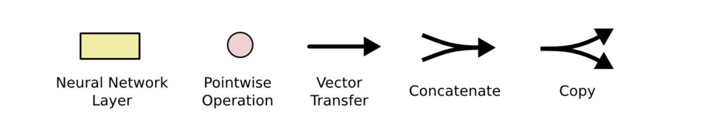
What’s going on here ?
Let’s understand the notations first –
In the above diagram, each line carries an entire vector, from the output of one node to the inputs of others.
The pink circles represent pointwise operations, like vector addition, while the yellow boxes are learned neural network layers.
Lines merging denote concatenation, while a line forking denote its content being copied and the copies going to different locations.

Slide 83
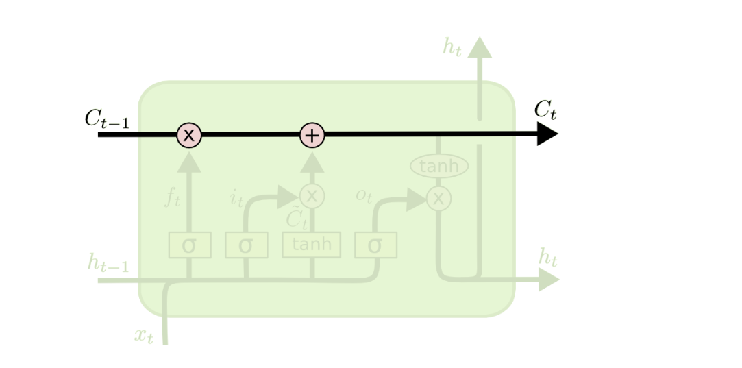
Core Idea Behind LSTMs
The key to LSTMs is the cell state, the horizontal line running through the top of the diagram.
The cell state is kind of like a conveyor belt. It runs straight down the entire chain, with only some minor linear interactions. It’s very easy for information to just flow along it unchanged.
The LSTM does have the ability to remove or add information to the cell state, carefully regulated by structures called gates.
Gates are a way to optionally let information through. They are composed out of a sigmoid neural net layer and a pointwise multiplication operation.

Slide 84
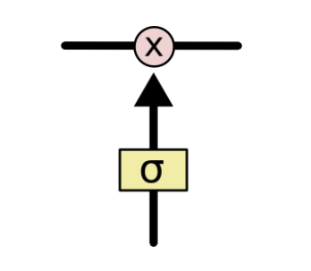
Gates in LSTM
Gates are a way to optionally let information through. They are composed out of a sigmoid neural net layer and a pointwise multiplication operation.
The sigmoid layer outputs numbers between zero and one, describing how much of each component should be let through. A value of zero means “let nothing through,” while a value of one means “let everything through!”
An LSTM has three of these gates (input, forget, output), to protect and control the cell state.

Slide 85
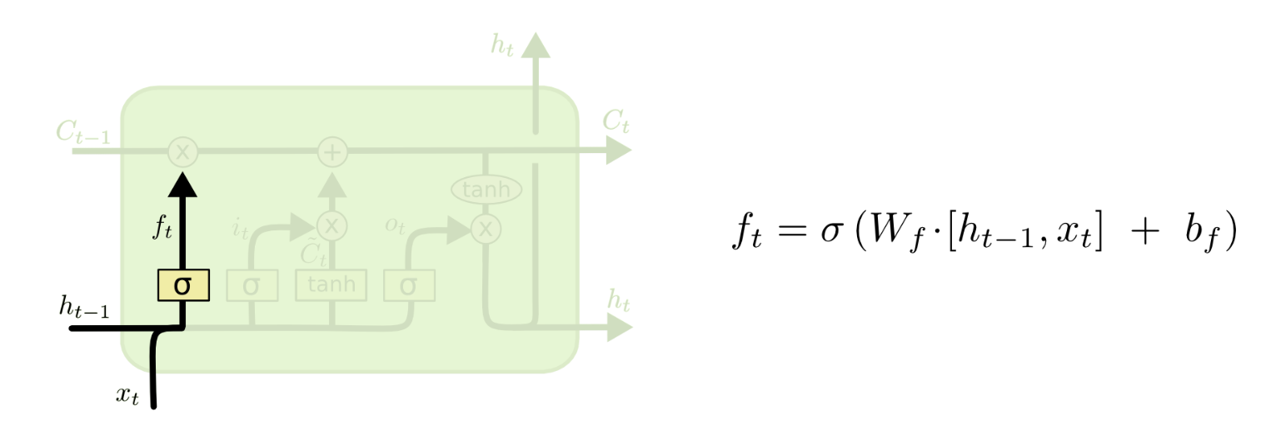
Step-by-Step LSTM Walk Through
The first step in our LSTM is to decide what information we’re going to throw away from the cell state.
This decision is made by a sigmoid layer called the “forget gate layer.” It looks at h_{t−1} and x_{t} , and outputs a number between 0 and 1 for each number in the cell state C_{t−1} .
A value of 1 represents “completely keep this” while a 0 represents “completely get rid of this.”
Let’s go back to our example of a language model trying to predict the next word based on all the previous ones. In such a problem, the cell state might include the gender of the present subject, so that the correct pronouns can be used. When we see a new subject, we want to forget the gender of the old subject.

Slide 86
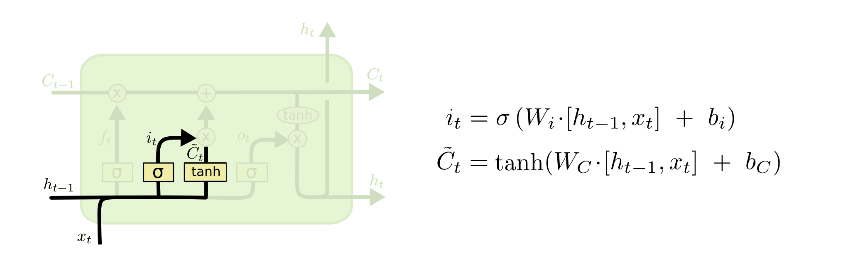
Step-by-Step LSTM Walk Through
The next step is to decide what new information we’re going to store in the cell state.
This has two parts. First, a sigmoid layer called the “input gate layer” decides which values we’ll update. Next, a tanh layer creates a vector of new candidate values, C~t , that could be added to the state.
In the next step, we’ll combine these two to create an update to the state.
In the example of our language model, we’d want to add the gender of the new subject to the cell state, to replace the old one we’re forgetting.

Slide 87
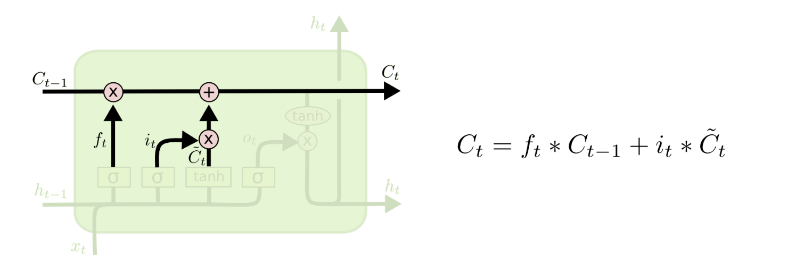
Step-by-Step LSTM Walk Through
It’s now time to update the old cell state, C_{t−1}, into the new cell state C_{t}
The previous steps already decided what to do, we just need to actually do it.
We multiply the old state by f_{t} , forgetting the things we decided to forget earlier. Then we add i_{t}∗C~t
This is the new candidate values, scaled by how much we decided to update each state value.
In the case of the language model, this is where we’d actually drop the information about the old subject’s gender and add the new information, as we decided in the previous steps.

Slide 88
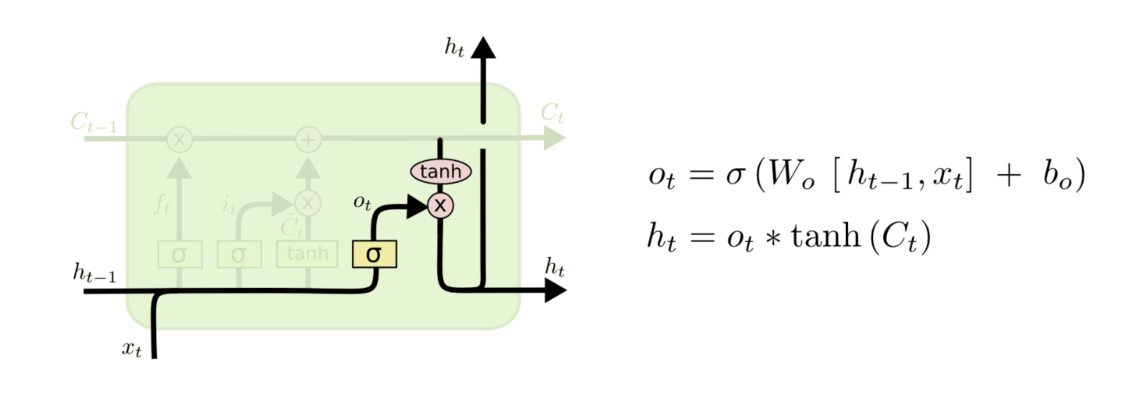
Step-by-Step LSTM Walk Through
Finally, we need to decide what we’re going to output. This output will be based on our cell state, but will be a filtered version determined by the “output gate layer”.
First, we run a sigmoid layer which decides what parts of the cell state we’re going to output. Then, we put the cell state through tanh (to push the values to be between −1 and 1 ) and multiply it by the output of the sigmoid gate, so that we only output the parts we decided to.
For the language model example, since it just saw a subject, it might want to output information relevant to a verb, in case that’s what is coming next. For example, it might output whether the subject is singular or plural, so that we know what form a verb should be conjugated into if that’s what follows next.

Slide 89
Role of LSTM Gates in Long-Term Dependency
The Gates of LSTM - Managing Memory
Explanation of Gates:
Input Gate: Controls how much new information flows into the cell state.
Forget Gate: Decides what information to discard from the cell state.
Output Gate: Determines what part of the cell state makes it to the output.
Role in Long-Term Dependency: These gates collectively enable the LSTM to add or remove information to the cell state, crucial for learning long-term patterns.
Please open LSTM_Example.ipynb

Slide 90
Visualizing Memorization in RNNs
https://distill.pub/2019/memorization-in-rnns/
https://joshvarty.github.io/VisualizingRNNs/

