Slide 1

Intro to Machine Learning
Tej Gorde

Slide 2
Index
How Models Work
Basic Data Exploration
Your First Machine Learning Model
Model Validation
Underfitting & Overfitting
Random Forests
Machine Learning Competitions
Tej Gorde

Slide 3
How Models Work
The Real Estate Prediction Challenge 🏠
Imagine this scenario : Your cousin is a successful real estate investor who has made millions by buying and selling houses. He wants to partner with you because of your interest in data science.
The deal? He provides the money, and you create models to predict house prices accurately.
How Do We Predict House Prices? 🤔
When you ask your cousin how he predicts house prices, he says it's "just intuition." But after talking more, you discover that he's actually:
Observed patterns in house prices from past sales
&
Used these patterns to make predictions about new houses
This is exactly how machine learning works!
Understanding Decision Trees 🌳
We'll start with a simple but powerful model called a Decision Tree. While there are more sophisticated models out there, decision trees are:
Easy to understand
Great for learning the basics
Building blocks for advanced machine learning models
Tej Gorde

Slide 4
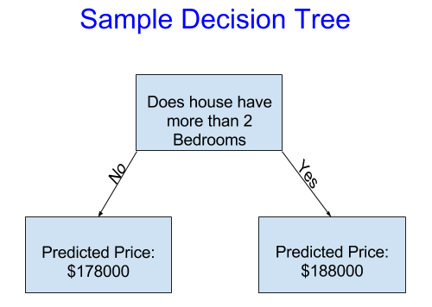
Understanding Decision Tress
This model asks just ONE question: "Does the house have more than 2 bedrooms?"
Makes predictions based on TWO possible answers:
  If NO → Predicts $178,000
  If YES → Predicts $188,000
Key Concepts Explained 📚
Predicted Prices
The predicted price ($178,000 or $188,000) is not random
It's the historical average price of all houses in that category
Example: $178,000 is the average price of all houses with ≤2 bedrooms in our data
Important Terms to Remember for Modeling
Fitting or Training: The process of teaching our model to recognize patterns in data
Training Data: The historical data we use to teach our model
Prediction: Using our trained model to estimate prices for new houses
Tej Gorde

Slide 5
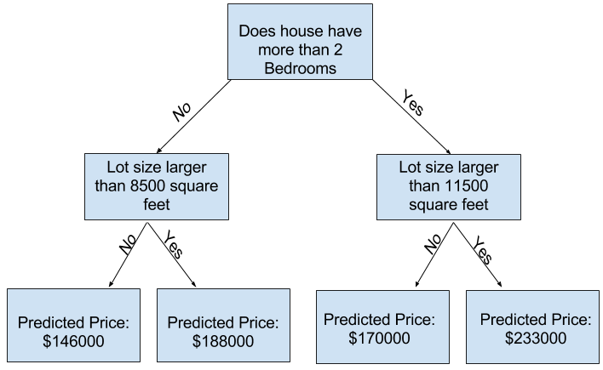
Improving Decision Tree
We can capture more factors of a house using a tree that has more "splits." These are called "deeper" trees.
A decision tree that also considers the total size of each house's lot might look like this:
Leaf
The end points at the bottom of the tree
Where we make our final price predictions
In this tree, we have 4 leaves ($146K, $188K, $170K, $233K)
Split
The decision points in the tree
Where we ask questions about features
This tree has 3 splits (1 bedroom split, 2 lot size splits)
Considers multiple factors
Provides more specific predictions
Better reflects real market conditions
Tej Gorde

Slide 6
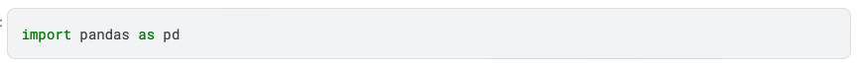
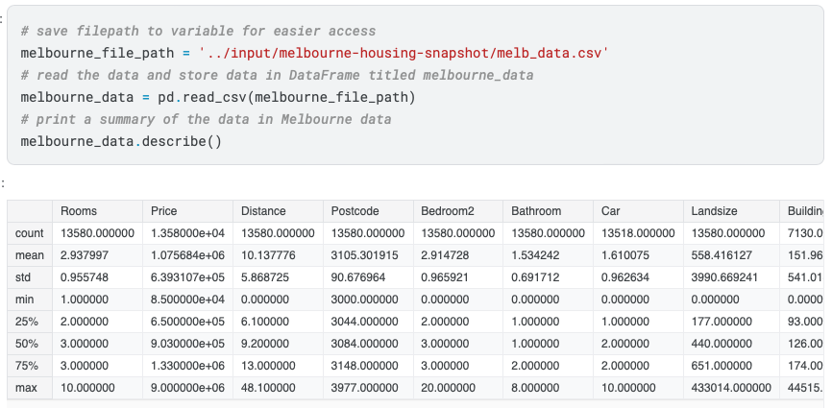
Basic Data Exploration
Pandas is the primary tool data scientists use for exploring and manipulating data. Most people abbreviate pandas in their code as pd.
.describe() is a function form Pandas
Generates automatic statistical summaries
Works on numerical columns by default
Gives you a quick overview of your data
Key Statistics It Shows
count: Number of non-missing values
mean: Average value
std: Standard deviation
min: Minimum value
25%: First quartile
50%: Median
75%: Third quartile
max: Maximum value
Common Use Cases:
Quick data exploration
Checking data quality
Finding outliers
Understanding data distribution
Tej Gorde

Slide 7
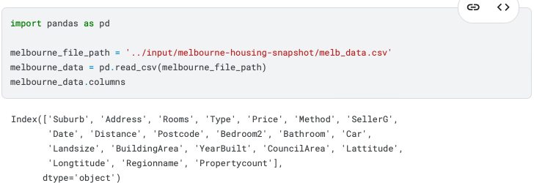
First Machine Learning Model
We will start by selecting data for modeling. When you have a dataset that's too big and confusing, you need a way to make it simpler.
This shows you all the possible things you can look at (like number of rooms, price, location, etc.)
Start Small:
Pick just a few important things to look at first
Use common sense - like picking room count to predict house prices, or the year it’s built in etc.
Don't try to use everything at once
Keep It Simple: Instead of looking at 20+ different things about each house, maybe start with just 3-4 that you think matter most, like:
Number of rooms
Location
Size of the house
Number of bathrooms
Think of it like this: If you were buying a house, what are the first 3-4 things you'd want to know? Start with those!
Later on, you'll learn fancy mathematical ways to pick the best features, but starting with your intuition is often a good first step.
Tej Gorde

Slide 8
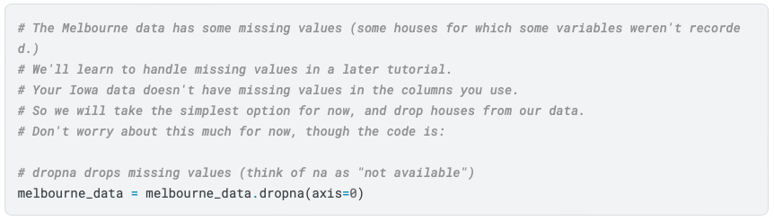
Handling Missing Values 🧹
The code uses dropna() to handle missing values:
Key points about dropna():
axis=0 means drop rows with any missing values
Think of "na" as "not available"
This is the simplest (though not always best) way to handle missing data
Tej Gorde

Slide 9
Best Practices for Feature Selection 📝
Start Simple
  Begin with a few meaningful variables
  Choose features that intuitively affect the target
  Add complexity gradually
Consider Data Quality
  Check for missing values
  Look at data types
  Consider the reliability of each feature
Avoid Redundancy
  Don't select multiple columns that represent the same information
  Example: 'Rooms' and 'Bedroom2' might be redundant
Think About Relevance
  Select features that likely influence your target
  Example for house prices:
    ✅ Rooms, Location, Size
    ❌ House Color, Street Name
Tej Gorde

Slide 10
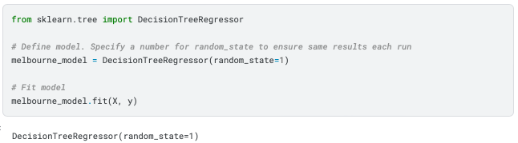
Building your Model 🤖
You will use the scikit-learn library to create your models.
The steps to building and using a model are:
Define: What type of model will it be? A decision tree? Some other type of model? Some other parameters of the model type are specified too.
Fit: Capture patterns from provided data. This is the heart of modeling. It feed your data in to the model
Predict: Just what it sounds like to predict our values. Use trained model on new data
Evaluate: Determine how accurate the model's predictions are. Compare predictions to actual values
Many machine learning models allow some randomness in model training. Specifying a number for random_state ensures you get the same results in each run. This is considered a good practice. You use any number, and model quality won't depend meaningfully on exactly what value you choose.
Tej Gorde

Slide 11
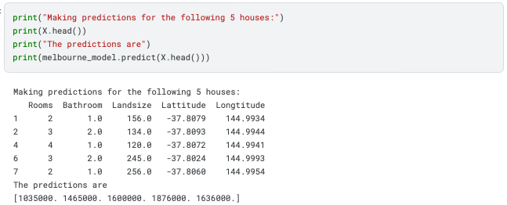
Building your Model 🤖
Predict
This means:
First house (2 rooms): Predicted price $1,035,000
Second house (3 rooms): Predicted price $1,465,000
And so on...
We train on all data (fit)Then can predict for any houses. Usually predict for new houses. Here we predicted existing ones as example
This is a basic model. Real-world applications might need more sophisticated approaches, but these same four steps (Define, Fit, Predict, Evaluate) apply to all machine learning models!
Tej Gorde

Slide 12

Model Validation
You've built a model. But how good is it?
We will perform Model validation to understand our model accuracy
It's tempting to test your model by making predictions on your training data (the data you used to build the model) and comparing those predictions to the actual values, that’s is a major mistake. This approach can be misleading because your model has already seen this data during training.
Think of it like memorizing answers to a test instead of understanding the material. Sure, you'll do well on questions you've seen before, but you'll struggle with new questions. The same applies to our model - we want to know how it performs on houses it hasn't "seen" before.
When evaluating model quality, we need a systematic way to measure accuracy. If you have predictions and actual values for 10,000 houses, it would be overwhelming to look at each one individually. This is why we use metrics like Mean Absolute Error (MAE). Here's how MAE works…
For example, if a house actually costs $150,000 and your model predicted $100,000, the error is $50,000.
Tej Gorde

Slide 13
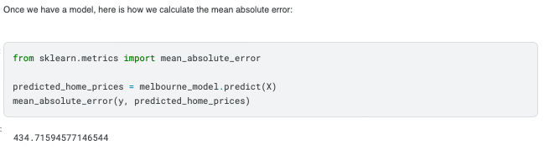
MAE
The resulting number tells you, on average, how far off your predictions are. For example, if the MAE is 434.715 (as shown in the output), this means your model's predictions are typically off by about $434.715. In real estate terms, this helps you understand if your model is making reasonable predictions or if it needs improvement.
This metric is particularly useful because:
It's easy to understand - it's in the same units as your prediction (dollars, in this case)
It treats all sizes of errors proportionally
It gives you a clear benchmark for model improvement
Tej Gorde

Slide 14
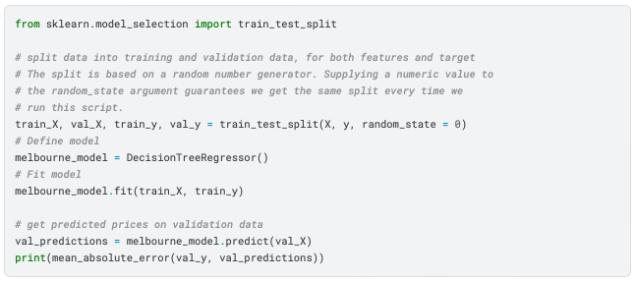
The Problem with "In-Sample" Scores¶
Training Data (train_X, train_y):
Used to teach/train the model
Typically about 70-80% of your data
train_X: Features (rooms, size, etc.)
train_y: Target (prices)
Validation Data (val_X, val_y):
Used to test the model
Typically about 20-30% of your data
val_X: Features for testing
val_y: Actual prices to compare with predictions
The Door Color Example:
Let's say all expensive houses in your data happened to have green doors
Your model learns: "Green door = Expensive house"
This works great on your training data
But in real life, door color doesn't affect house prices!
So the solution is to split the data into TRAINING and TESTING / VALIDATION data
Never use validation data for training!
Tej Gorde

Slide 15
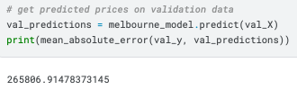
Validation
The mean absolute error for the in-sample data aka Training Data was about 500 dollars. That means our model is almost perfect! Like getting 99% on a practice test.
Out-of-sample aka Testing data is more than 250,000 dollars. That means our mode is poor. Yikes! Like failing the test badly
To Put This in Perspective:
Average house price: $1.1 million
Error on new houses: $250,000
This means we're off by about 25% (quarter) of a house's value
That's like guessing a $400,000 house could be anywhere from $150,000 to $650,000!
Why This is Bad:
Imagine telling a home buyer: "This house costs somewhere between $850,000 and $1,350,000"
That's too uncertain to be useful
No one would trust predictions with such large errors
Tej Gorde

Slide 16
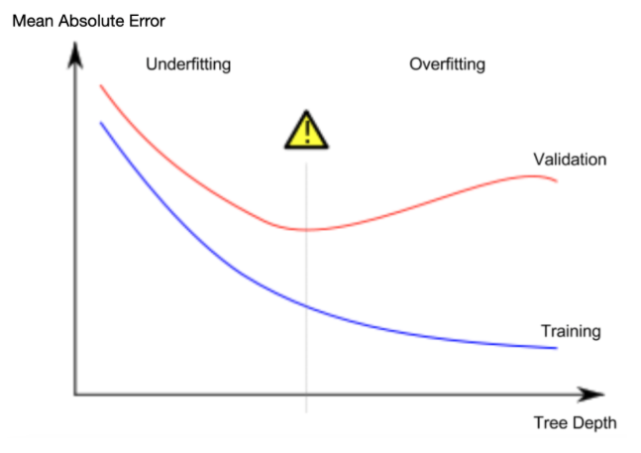
Overfitting and Underfitting
Tree Depth & Groups:
With 1 split: 2 groups
With 2 splits: 4 groups
With 4 splits: 8 groups
With 10 splits: 1024 groups!
The Problem:
Deep Trees (Overfitting)
  Too many splits = too many small groups
  Like memorizing instead of learning
  Perfect on training data, bad on new houses
Shallow Trees (Underfitting)
  Too few splits (like 2-4 groups)
  Too simple, misses important patterns
  Bad on both training and new houses
The Solution:
Find the "sweet spot" between too deep and too shallow
Use validation data to find the best depth
Look for where validation accuracy is best –
let’s look at this in next slide
Tej Gorde

Slide 17
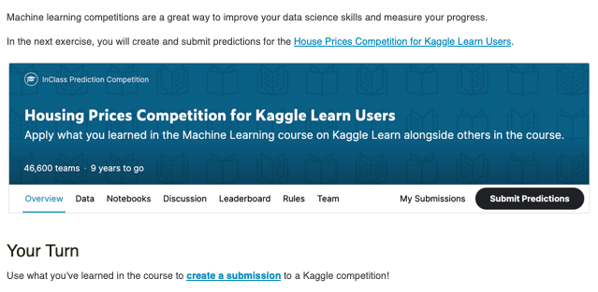
YOUR TURN
https://www.kaggle.com/code/alexisbcook/machine-learning-competitions
Tej Gorde

