Slide 1
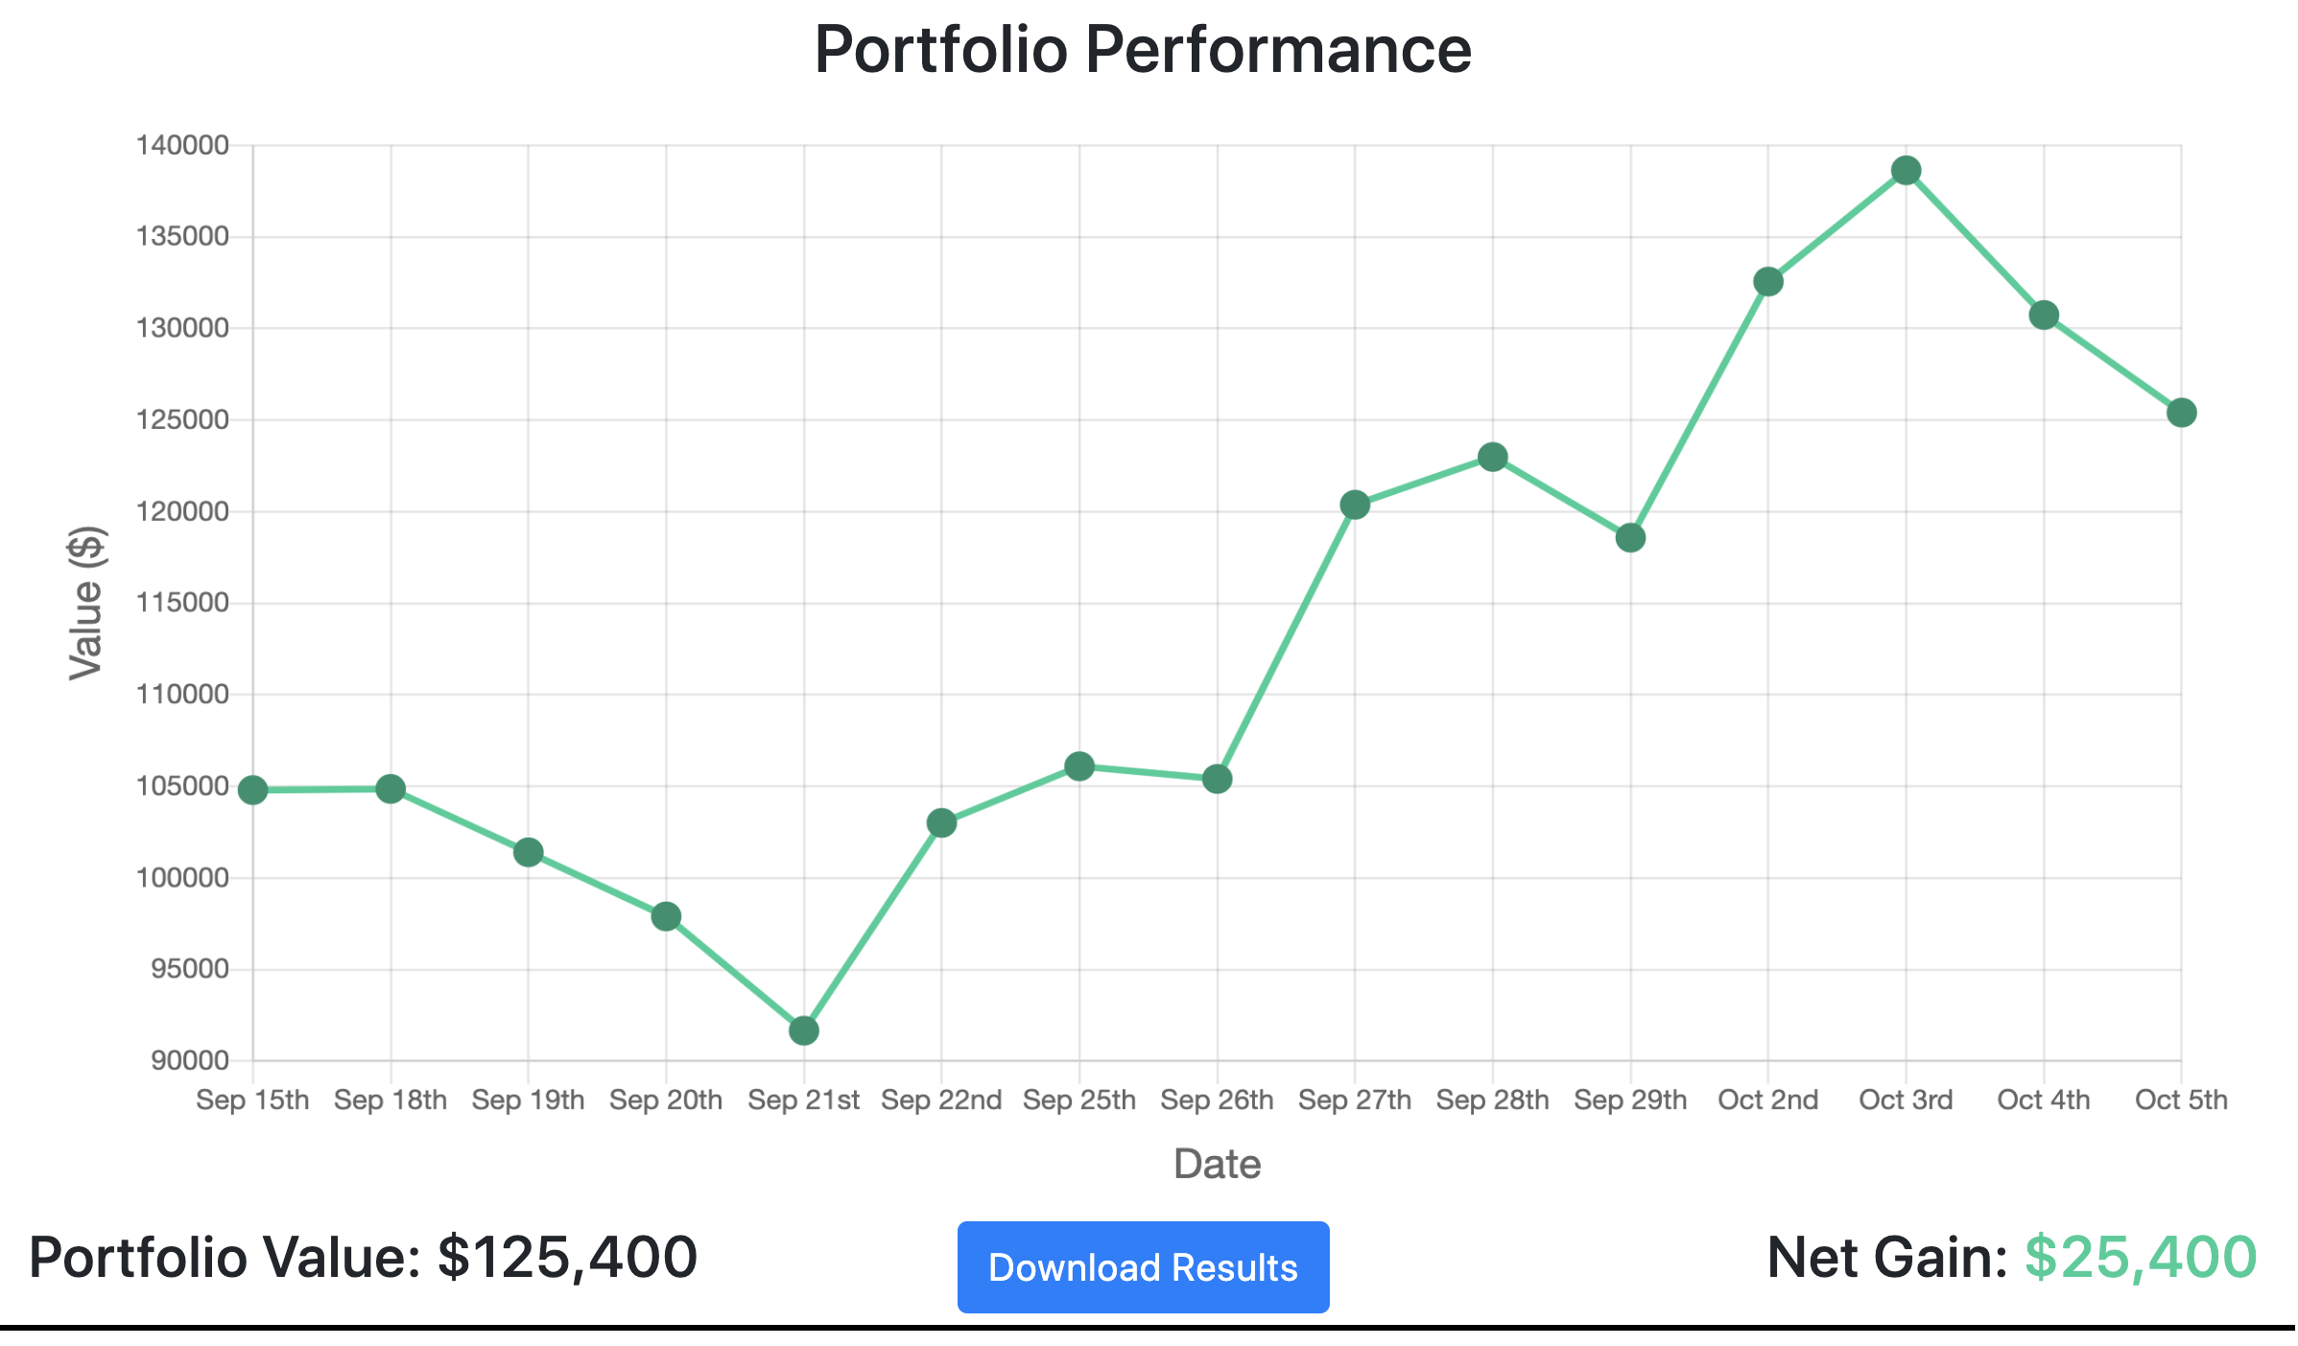

Options Trading Simulator
Tom Busby
Tej Patel
Blake Sweet
Josh Luttrell
Justin Luttrell

