Slide 1

Options Trading Simulator
Tej Patel
blake sweet
josh Luttrell
justin Luttrell
tom busby

Slide 2
Overview
Our Project
Live Demo
Architecture
Testing
Metrics
Lessons Learned
Conclusion

Slide 3
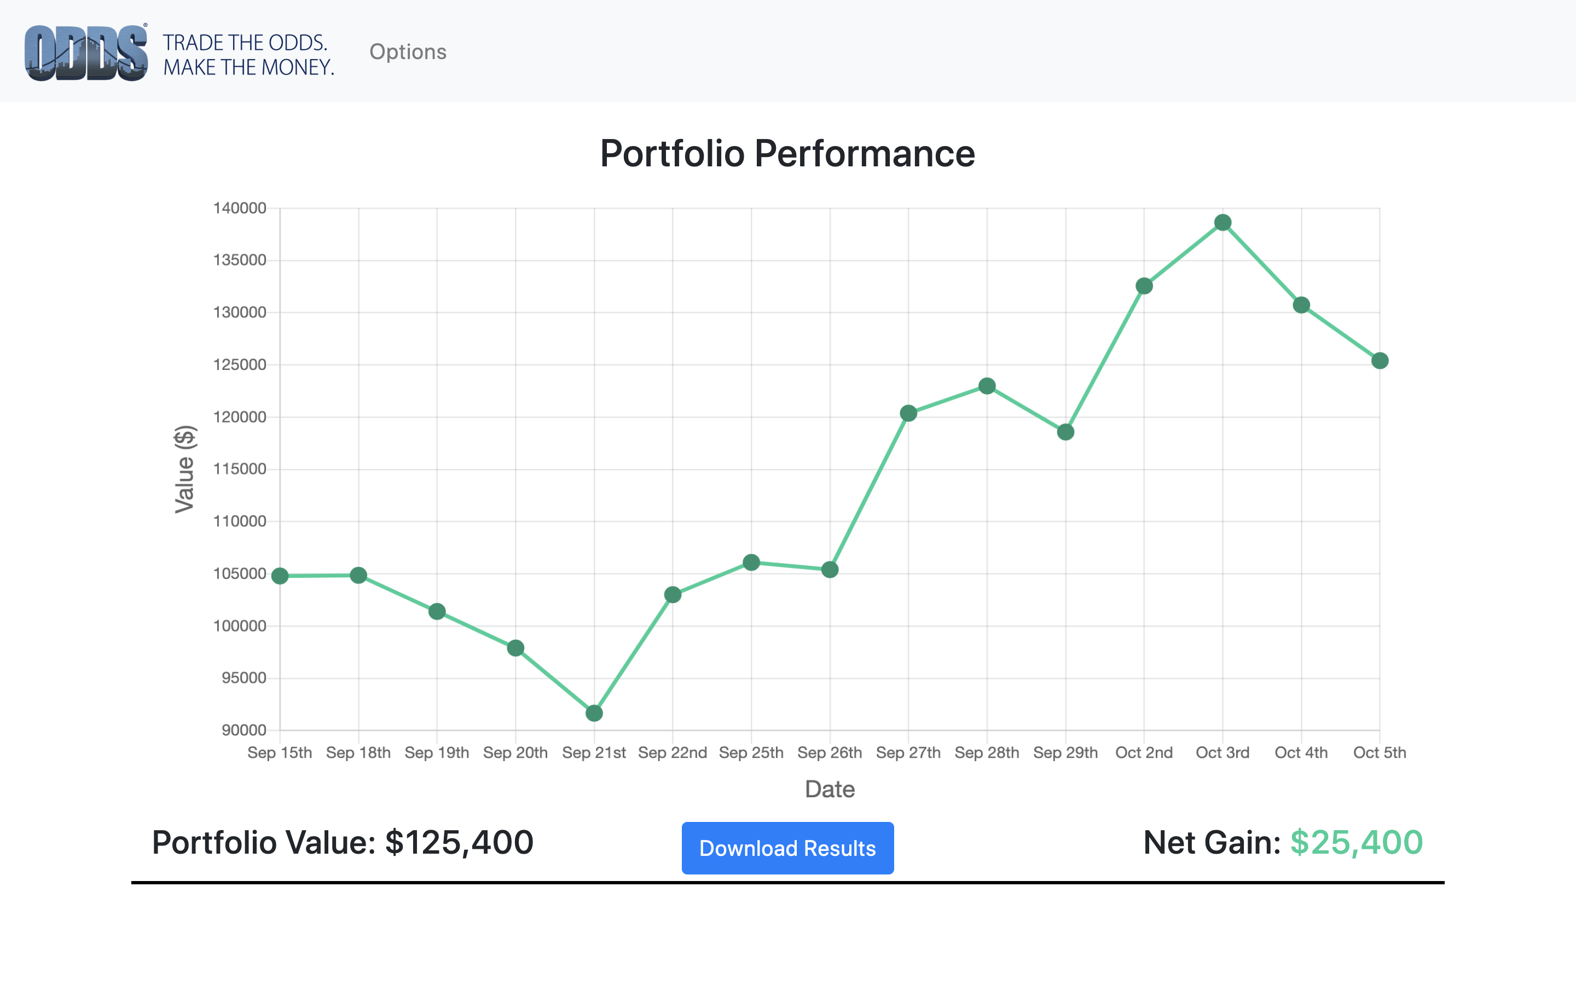
Options Trading Simulator
Our Project

Slide 4

Live Demo
http://ukfl2019.donfishback.com/stock
https://www.youtube.com/watch?v=PMGGfI5pp_4&fbclid=IwAR3Ht8zyMbwRbH_FB4JlUWMk4bRDqj-hYJfAxglF6NAwcQ4ygyjx3HchSp8

Slide 5
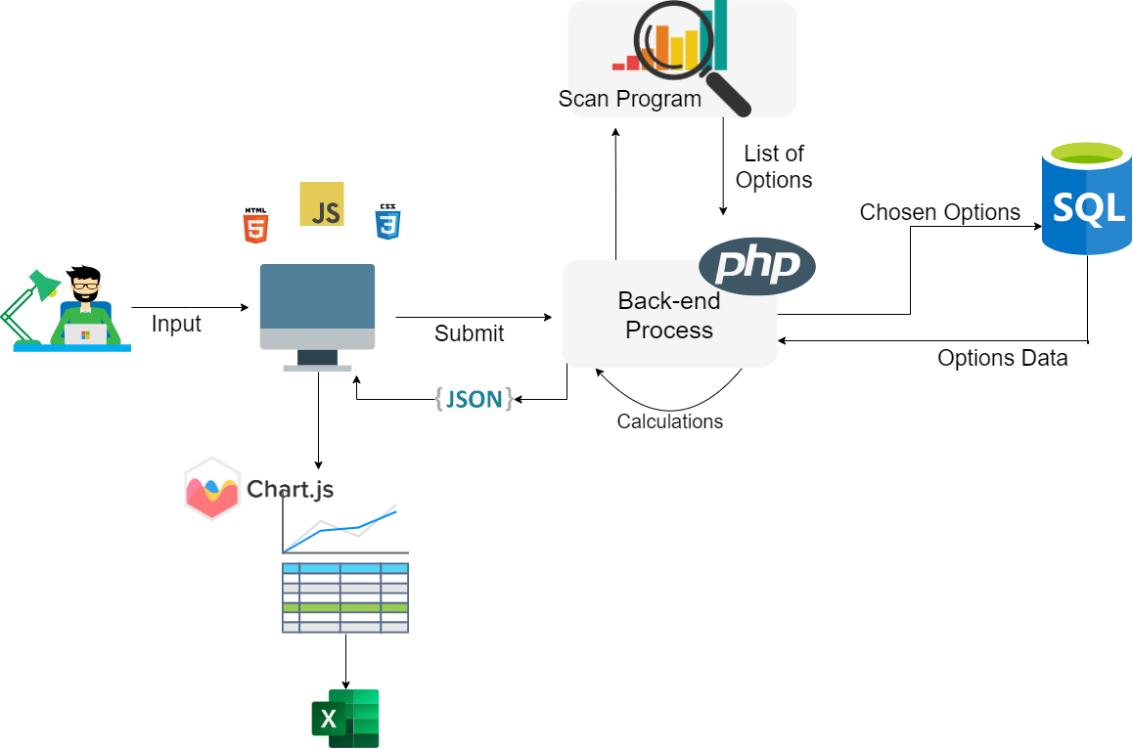
Architecture Design

Slide 6
Unit Testing: Stocks Class
Methods
GetPriceHistory()
- Correct number of days
- Correct days in history
GetPortfolioValues()
GetSpecificDayValues()

Slide 7
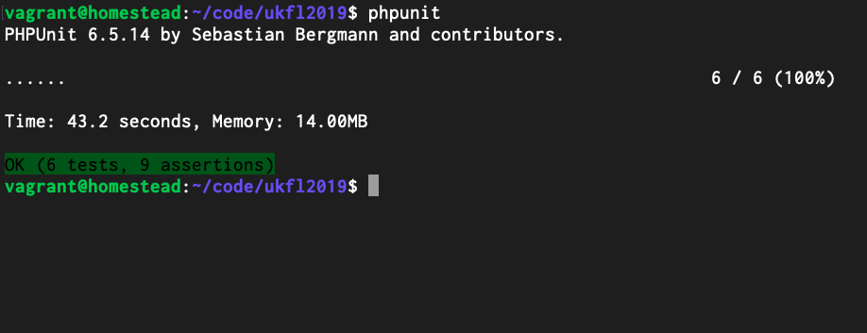
Unit Test Example: Output

Slide 8
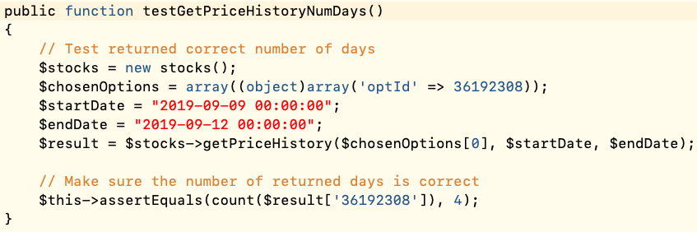
Unit Test Example: GetPriceHistory()

Slide 9
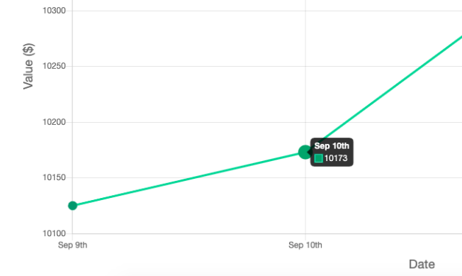
Acceptance Testing
Black Box Testing:
Options navigation tab takes user to portfolio setup page
User inputs calendar dates to begin a scan before 02/01/2015
Hovering over a point in the graph
SubmitSelection($data) gives incorrect data to parameter

Slide 10
Metrics: Story Points
Old
New
User Story | Story Points
Portfolio Setup | 5
Date Range Option | 3
Daily Portfolio Performance | 21
Strategy Selection | 13
Net Gain or Loss | 3
Graphical Portfolio Trend | 13
Total | 58
User Story | Story Points
Portfolio Setup | 13
Date Range Option | 3
Daily Portfolio Performance | 8
Strategy Selection | 13
Net Gain or Loss | 3
Graphical Portfolio Trend | 8
Total | 48

Slide 11
Maintenance
Follow Laravel Documentation
Use Artisan Command Line Interface
Recommend following 2-week development cycle

Slide 12
Lessons Learned
Gained financial knowledge
Software Engineering isn’t just coding

Slide 13
Conclusion
Thank you
Don, James, and Dr. Hayes

Slide 14

Questions

