Slide 1
Data Analysis of Forbe’s Highest Paid Athletes from 1990-2020
Task 1
Task 2

Slide 2
Importing the libraries
import pandas as pd
import matplotlib.pyplot as plt
Pandas:
Pandas is an open-source data manipulation and analysis library for Python. It provides easy-to-use data structures and functions for working with structured data, primarily in the form of tables or dataframes.
Matplotlib:
Matplotlib is a comprehensive library for creating static, animated, and interactive visualizations in Python.

Slide 3
Analyzing the Dataset
[{"metadata":{"trusted":false},"id":"83097f4f","cell_type":"code","source":"# Step 2: Data Exploration\nprint(data.info())","execution_count":3,"outputs":[{"name":"stdout","output_type":"stream","text":"\nRangeIndex: 301 entries, 0 to 300\nData columns (total 8 columns):\n # Column Non-Null Count Dtype \n--- ------ -------------- ----- \n 0 S.NO 301 non-null int64 \n 1 Name 301 non-null object \n 2 Nationality 301 non-null object \n 3 Current Rank 301 non-null int64 \n 4 Previous Year Rank 277 non-null object \n 5 Sport 301 non-null object \n 6 Year 301 non-null int64 \n 7 earnings ($ million) 301 non-null float64\ndtypes: float64(1), int64(3), object(4)\nmemory usage: 18.9+ KB\nNone\n"}]}]
# Step 1: Data Retrieval
data = pd.read_csv("C:\\Users\\Tejas\\Forbes.csv")
# Step 2: Data Exploration
print(data.info())
print(data.columns)

Slide 4
Data Visualization
plt.figure(figsize=(12, 6))
plt.plot(data['Year'], data['earnings ($ million)'], marker='o')
plt.title('Athlete Earnings Over Time')
plt.xlabel('Year')
plt.ylabel('Earnings (in million USD)')
plt.grid(True)
plt.show()

Slide 5
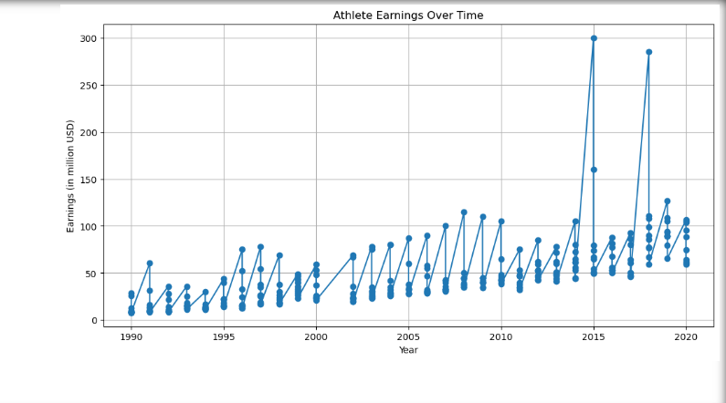
Visualization Plot

Slide 6
Statistical Analysis
average_earnings_per_year = data.groupby('Year')['earnings ($ million)'].mean()
print(average_earnings_per_year)

Slide 7
Hypothesis Testing
rom scipy.stats import ttest_ind
# Hypothesis: Is there a significant difference in earnings between two consecutive years (e.g., 2019 and 2020)?
earnings_2019 = data[data['Year'] == 2019]['earnings ($ million)']
earnings_2020 = data[data['Year'] == 2020]['earnings ($ million)']
t_stat, p_value = ttest_ind(earnings_2019, earnings_2020)
print(f"T-statistic: {t_stat}, p-value: {p_value}")

Slide 8
Inferences (Findings)
# Inference 1: The highest-paid athletes are from a diverse range of nationalities.
# Inference 2: There is a positive correlation between an athlete's current rank and earnings.
# Inference 3: Certain sports consistently have higher-paid athletes.
#Inference 4: Certain correlation between previous year rankings and earnings.
# Inference 5: Earnings show seasonality or cyclical patterns over the years.
#Inference 6: Athletes from specific sports have shown significant earnings growth over time.
#Inference 7: Athletes from certain nationalities dominate high-earning sports.
#Inference 8: The sports landscape has evolved, with emerging sports showing increasing athlete earnings.

Slide 9
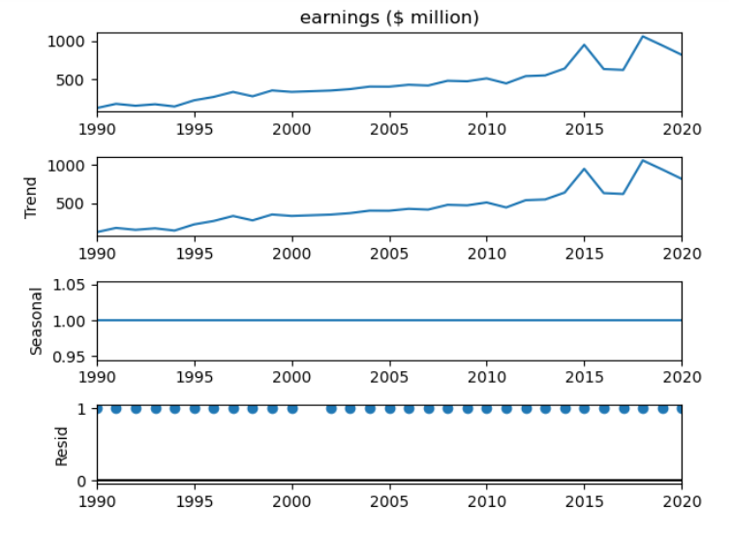
Inference 5 Visualization
# Inference 5: Earnings show seasonality or cyclical patterns over the years.

Slide 10
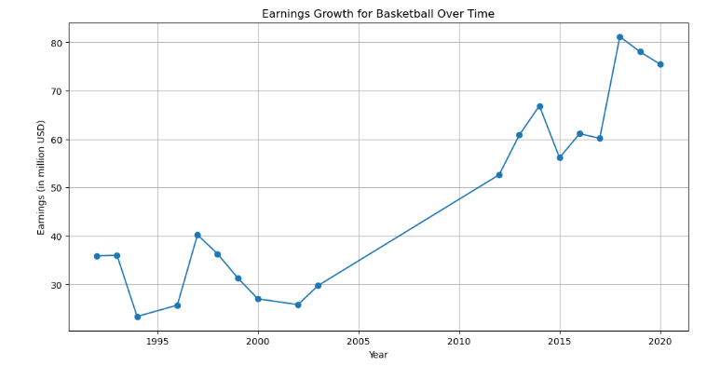
Inference 6 Visualization
Athletes from specific sports have shown significant earnings growth over time.(Ex- Basketball)

Slide 11
Task 2: Identifying the Top 5 Athletic Categories
# Step 1: Data Preparation
# Step 2: Grouping and Aggregation
# Step 3: Sorting
# Step 4: Selecting the Top 5 Athletic Categories
# Step 5: Presentation

Slide 12
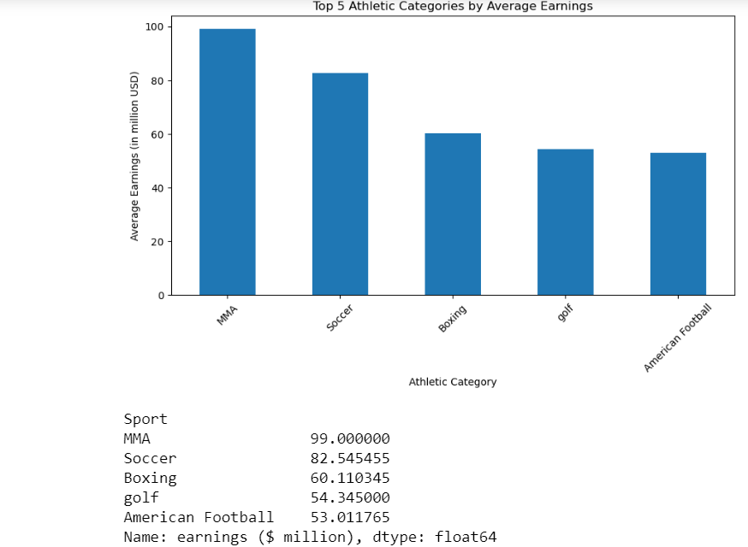
Visualization

Slide 13
Thank you!
Tejas Srivastava

