Slide 1

AI Hospital Readmission Risk Prediction
An Intelligent Machine Learning-Based Healthcare Prediction Platform
Technologies: React • FastAPI • Python • Machine Learning • MySQL • Power BI

Slide 2
Introduction
Introduction
Our Solution
Hospital readmission occurs when a patient returns to the hospital after discharge within a specific period.
Frequent readmissions can:
The proposed system uses Machine Learning to predict the risk of hospital readmission based on patient, admission, clinical, and healthcare-related information.
Increase healthcare costs
Increase the workload on healthcare professionals
Affect hospital resource utilization
Indicate that a patient may require additional post-discharge care

Slide 3
Problem Statement
Problem Statement
Goal
Traditional healthcare systems mainly depend on clinical judgment and historical information to identify patients who may be readmitted.
However:
Develop an intelligent system that can analyze patient and admission information and provide a readmission risk prediction.
Large amounts of patient data are difficult to analyze manually.
High-risk patients may not always be identified early.
Hospitals need better methods for prioritizing patients who require additional attention.
Historical admission information can be difficult to interpret efficiently.

Slide 4
Project Objectives
01
02
Collect and manage patient information.
Store hospital admission information.
03
04
Process clinical and demographic data.
Apply Machine Learning models for prediction.
05
06
Calculate readmission probability.
Classify patients into risk levels.
07
08
Display important risk factors.
Maintain prediction history.
09
10
Provide a doctor-friendly dashboard.
Support hospital data analysis through visualization.

Slide 5
Proposed System
The system provides an integrated platform for:
Patient Management
Admission Management
→ Patient registration and information management
→ Create and manage multiple hospital admissions
Clinical Data
Machine Learning
→ Capture important clinical measurements
→ Predict readmission risk
Risk Analysis
Dashboard
→ Probability score and risk classification
→ Monitor patients, admissions, predictions, and analytics

Slide 6
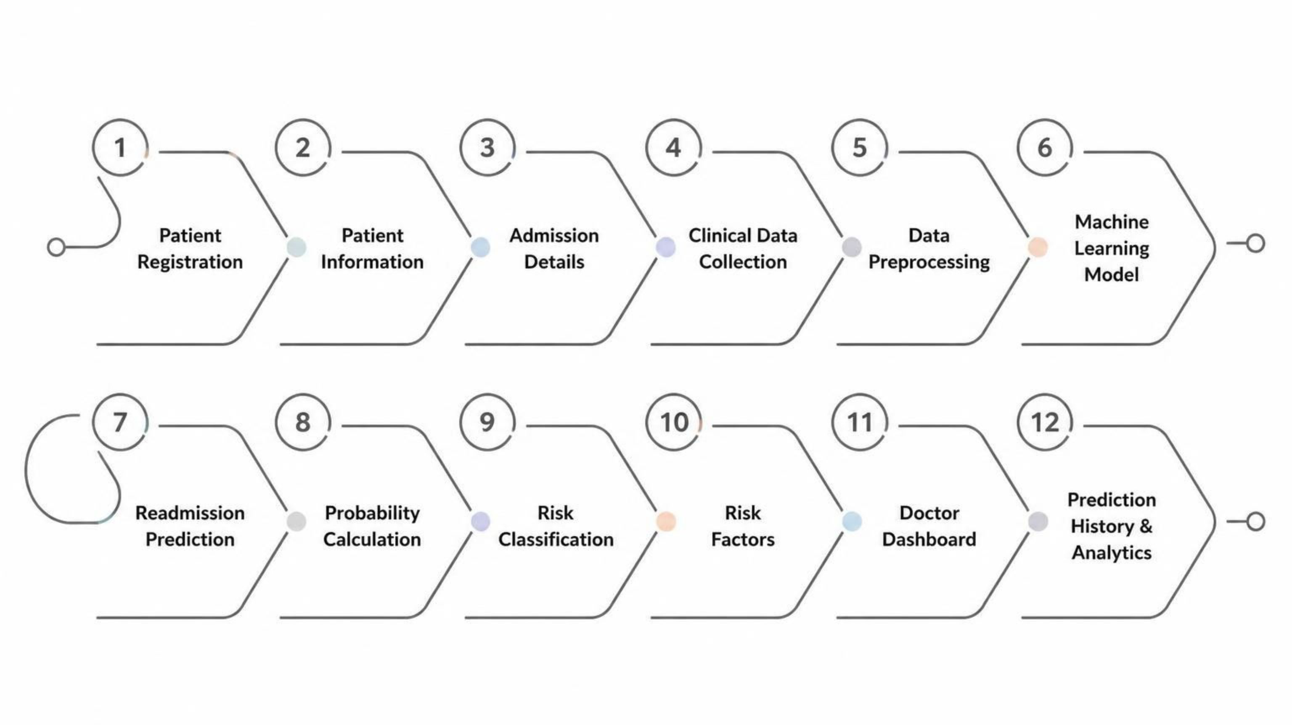
Overall Project Flow

Slide 7
System Architecture
USER
│
▼
┌─────────────────┐
│ React Frontend │
└────────┬────────┘
│
│ REST API
▼
┌─────────────────┐
│ FastAPI Backend │
└────────┬────────┘
│
┌────┴────┐
│ │
▼ ▼
┌──────────────┐ ┌───────────────┐
│ MySQL │ │ ML Prediction │
│ Database │ │ Service │
└──────────────┘ └───────┬───────┘
│
▼
Risk Prediction
│
▼
React Dashboard
Technologies
Frontend
Backend
React
FastAPI
Database
ML
MySQL
Python / Scikit-learn
Visualization
API Communication
Power BI
REST API

Slide 8
Patient & Admission Management
Patient Management
Admission Management
The system stores:
Each patient can have multiple admissions.
Admission information includes:
Patient ID
Age
Gender
State
BPL Card
Insurance Type
Comorbidity Count
Previous Admissions
Admission ID
Admission Type
Ward Type
Discharge Type
Length of Stay
Number of Procedures
Charlson Index
Automatic Admission ID
New admissions are automatically assigned sequential IDs.
Example:
A10067
A10068
A10069
A10070
This allows the system to support multiple admissions instead of being limited to the initial records.

Slide 9
Clinical Information
The prediction system uses important clinical measurements such as:
HbA1c
Creatinine
Haemoglobin
Systolic Blood Pressure
Length of Stay
Number of Procedures
Charlson Index
These values provide information about the patient's clinical condition and healthcare utilization.

Slide 10
Machine Learning Module
Machine Learning Models
Purpose
The project considers multiple Machine Learning algorithms:
The models learn patterns from historical hospital data and use those patterns to estimate the likelihood of readmission.
Logistic Regression
Decision Tree
Random Forest
Gradient Boosting
XGBoost
Prediction Output
The system produces:
Readmission Risk
Probability Score
Risk Classification
Risk Factors

Slide 11
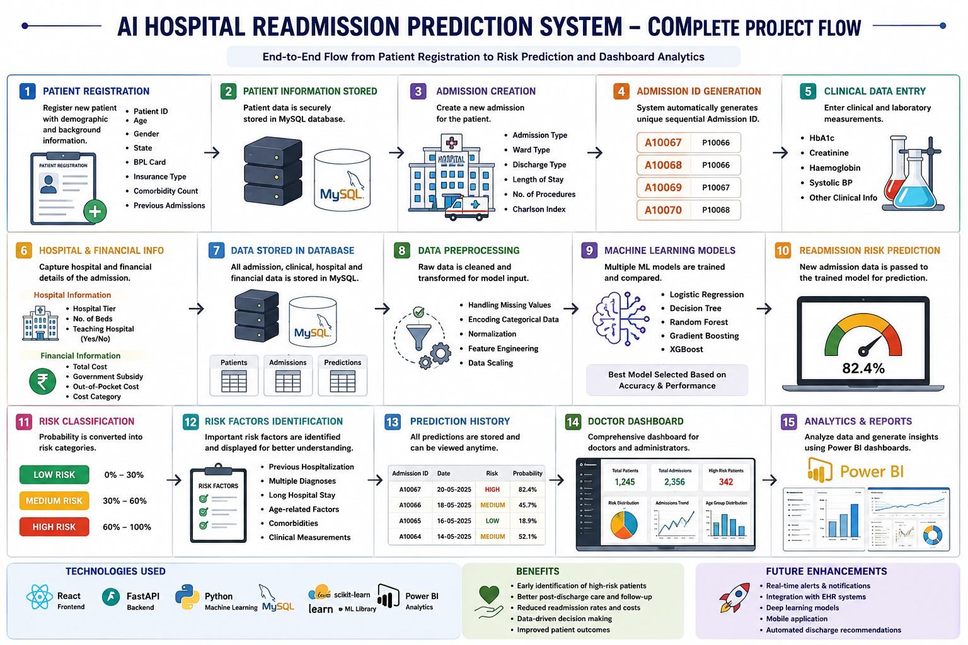

Slide 12
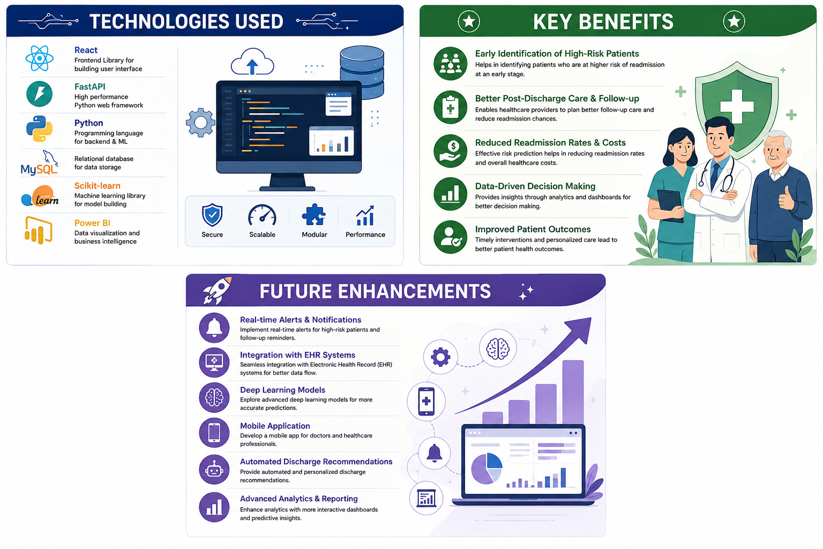

Slide 13
CONCLUSION:
The AI Hospital Readmission Prediction System provides an intelligent approach to identifying patients who may be at risk of hospital readmission.
The system combines patient information, admission details, clinical measurements, and medical history for prediction.
A machine learning model generates a readmission probability and classifies patients into Low, Medium, or High risk.
The application provides prediction history and dashboards to support healthcare professionals in monitoring patient risk.
Early identification of high-risk patients can support better follow-up care and timely intervention.
The system can be further enhanced with real-time alerts, EHR integration, mobile applications, and advanced machine learning models.

Slide 14
