Slide 1
SECURE DATA HIDING IN IMAGES USING STEGANOGRAPHY
Presented By: Teja Nalukurthi
College Name & Department : MCA, Pondicherry University

Slide 2
OUTLINE
Problem Statement
Technology used
Wow factor
End users
Result
Conclusion
Git-hub Link

Slide 3
Problem Statement
How can we securely transmit confidential information over potentially insecure channels without revealing the presence of the message, while ensuring that only authorized individuals can access and decrypt the hidden data?
This application implements image-based steganography, allowing users to hide a secret message inside an image file. The user can choose to either encrypt or decrypt the message by embedding it into the image’s pixel values and using a passcode for security. The encrypted image appears unchanged visually, preserving its quality. Only those with the correct passcode can extract the hidden message. This tool supports common image formats like JPG and PNG, ensuring secure communication through hidden messages in digital media.

Slide 4
System Requirements:
Operating System:Windows, macOS, or Linux (since Python is cross-platform).
OpenCV requires additional system setup, but it works well on most platforms.
Python Version:Python 3.x (since OpenCV and modern libraries require Python 3.x).
Required Libraries:OpenCV: You can install it via pip install opencv-python or pip install opencv-python-headless
Processor: A modern CPU (Intel Core i3 or higher, or equivalent).
RAM: At least 2GB of RAM (4GB or more recommended for large images).
Storage: Adequate free disk space (for storing images, which might be large depending on the resolution).

Slide 5
Technology used
Image Processing: Manipulating pixel values to embed and extract messages.
Steganography: Concealing messages within images without altering their visual appearance.
Cryptography: Using a passcode for securing encryption and decryption.
Python Programming Language: The language used to develop the application.
OpenCV (cv2): Library for reading, processing, and writing image files.
Command-line Interaction: User interaction through input and output prompts.

Slide 6
Wow factors
Security, adds an extra layer of protection by requiring a passcode for encryption and decryption.
The image remains unchanged, making the hidden message undetectable to the human eye.

Slide 7
End users
Individuals Seeking Privacy
Security Enthusiasts
Business Professionals
Researchers and Students in cryptography and data security
Whistleblowers and Activists
Developers and Technologists
Government Agencies
Military Organizations

Slide 8

Results
Test Image

Slide 9
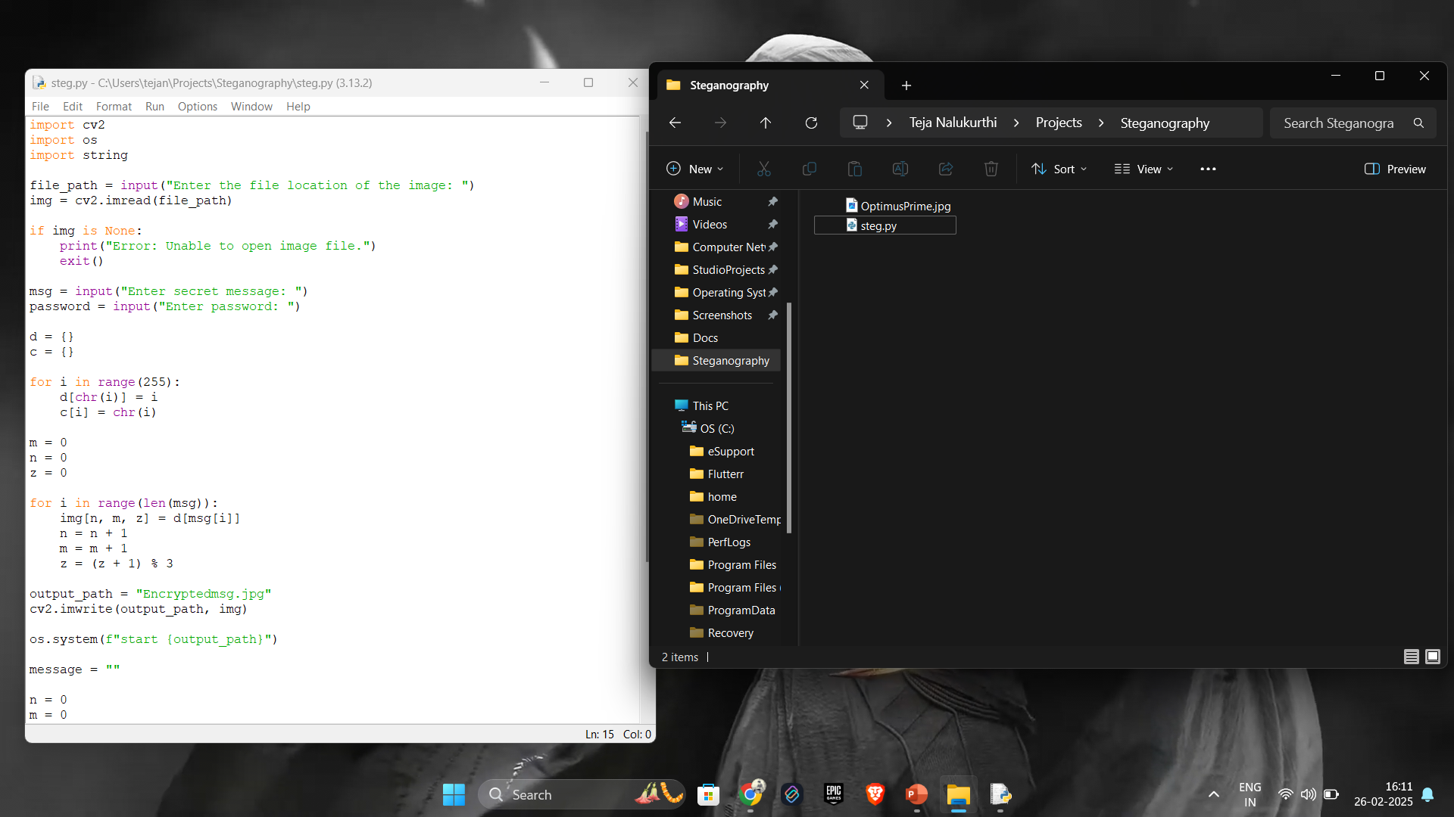
Results
Code and test image before Running program

Slide 10
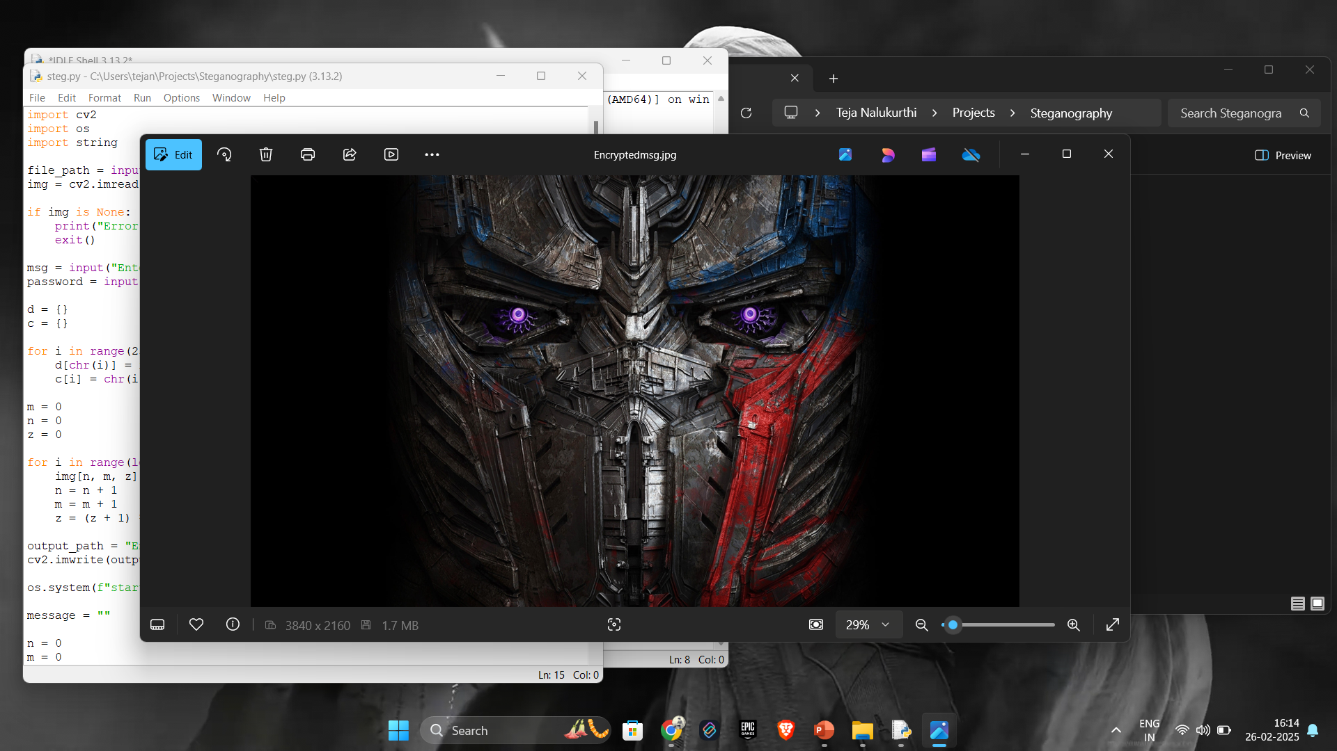
Results
Encrypted file create while running the program

Slide 11
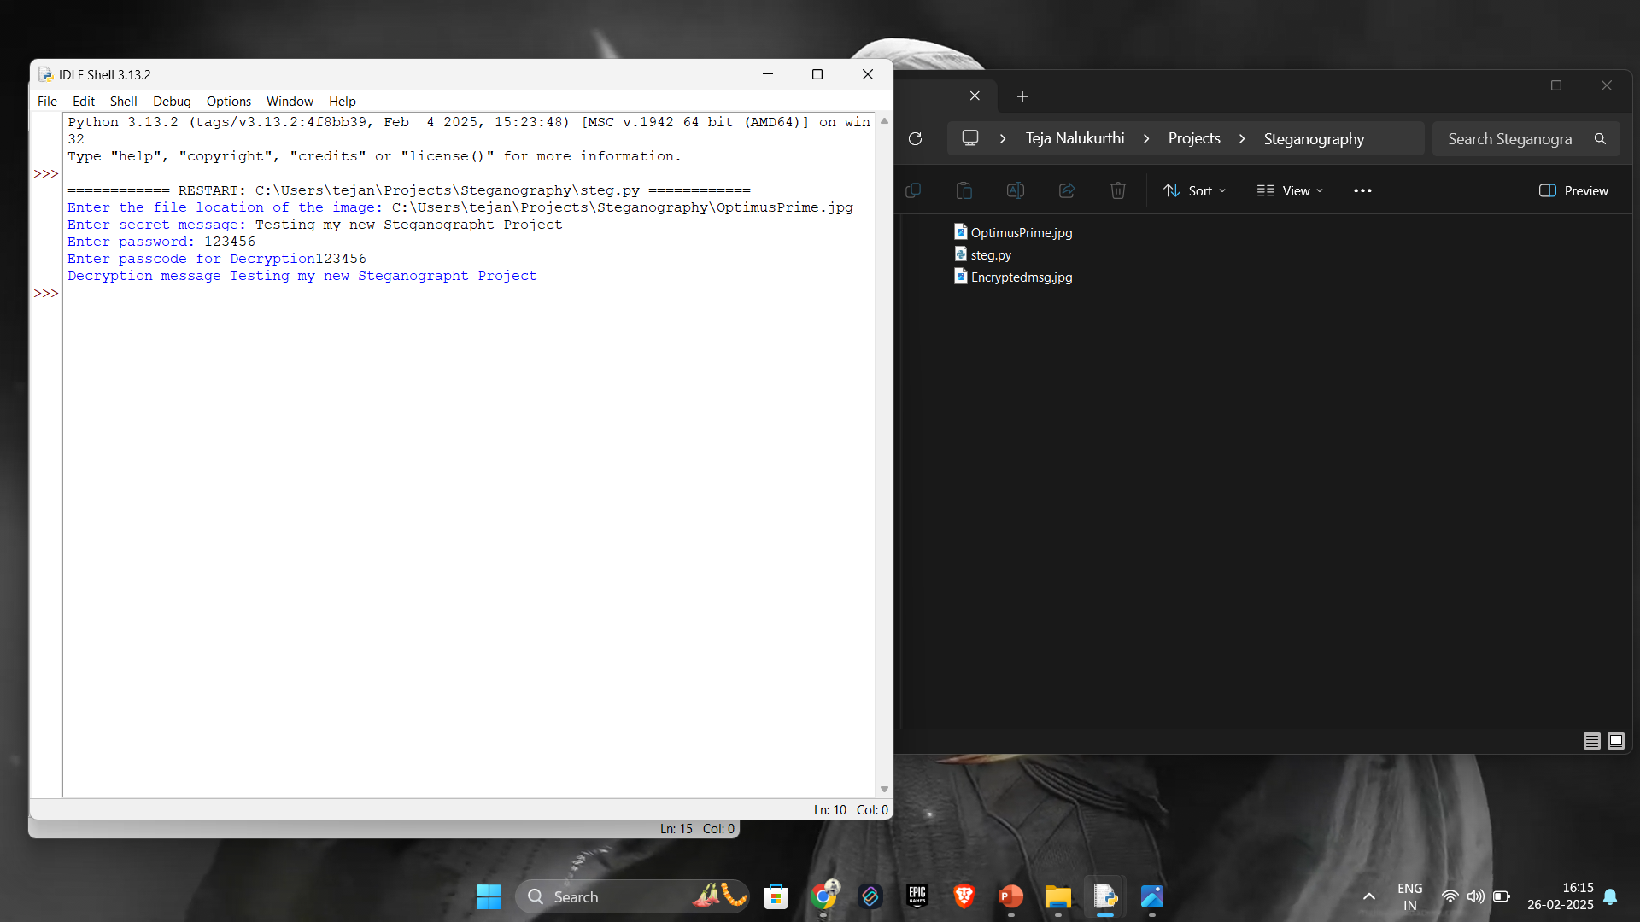
Results
After running the program

Slide 12
Conclusion
In conclusion, this project successfully addresses the problem of securely transmitting confidential information over potentially insecure channels. By utilizing image-based steganography, the application allows users to hide messages within image files in a way that is imperceptible to the human eye, ensuring that sensitive data remains protected.
The use of a passcode for encryption and decryption adds an additional layer of security, ensuring that only authorized individuals can access the hidden information. This solution offers a flexible, secure, and covert method of communication, making it suitable for individuals, organizations, and sectors that require privacy and data protection.

Slide 13
GitHub Link
https://github.com/Teja-Nalukurthi/Edunet-Final-Project.git

Slide 14
THANK YOU

