Slide 1




Integrated Program in Business Analytics
Part of
Predicting employee attrition in organization
IPBA-7B-Group E
Ponnam Rohini
Mintu Jakhar
Ankita Deverakonda
Maitri G
Ruturaj Kadam
Sumit Shekhar
Teja Padarthi

Slide 2
Agenda
Business Problem and Objectives
Executive Summary
Data Overview and Key Business Assumptions
Data Preparation and Pre-processing
Exploratory Data Analysis
Model Development
Model Comparison and Finalisation
Businesss Recommendations and Potential Business Impact
Appendix

Slide 3



Business Problem and Objectives
Companies spend lot of money, time and resources in hiring the potential candidate through job posting, training, interviews etc. We want to minimize the cost by building an effective model.
The objective of the study is to predict the chances of employees leaving the company
Secondary Objective is to determine the reasons that drive employee attrition.
The data has been collected through online sources. The information inside the dataset reveals the insights that will help in developing strategies for retaining talent in the organization and preventing the employee attrition.
Therefore, Machine Learning techniques like Logistic Regression, Random Forest & XGBoost will be used as tools for execution of the study.

Slide 4
Executive summary
We are in the final stage of certification course of IPBA, we did an end to end research on IBM HR dataset using ample technical and business skills learnt during the course as well as developing fruitful insights together with long term strategic vision.
The data set is sourced through Online. The dataset contains decent number of Observations and variables to help us with building the model.
We have used the IBM HR dataset for executing the Capstone project to predict the employee attrition.

Slide 5
Data overview and key business assumption
The IBM HR dataset contains 1470 observations and 35 variables. Within 35 variables “Attrition” is the dependent variable. We have 26 Integer Variables and 9 Categorical Variables.
There are no Null values. Mutli-collinearity checks have been performed. Further scaling has been done to normalize the data in one frame.
The Target variable classification ratio is 84%(No)-16%(Yes) and this variation will be treated using SMOTE during the modeling.
Assumption:
Outliers have been analyzed and all the outliers are assumed as Facts due to the HR nature of the data.
Daily Rate, Monthly Rate, Hourly Rate variables were assumed as non – importance to our dataset.

Slide 6
Data preparation and pre-processing
Null Values: Found no Null values in our dataset
Outliers: Found out potential outliers in 7 variables. But we haven’t treated them as per our assumption.
Multi – Collinearity: We have found the correlations between the independent variables using Pearson Correlation, Chi Square Test and VIF and removed those variables which have high correlation among them for Logistic Regression.
Redundant Variables: We removed redundant variables like Over18, Standard Hours, Employee Number, Employee Count in our project
Scaling: We have normalised the data using Standard Scaler
Target Class Imbalance: We have used Over Sampling technique SMOTE to treat the imbalance in ‘Attrition’.

Slide 7
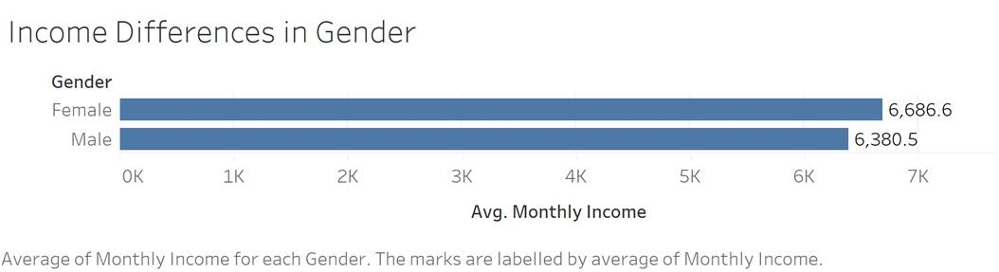
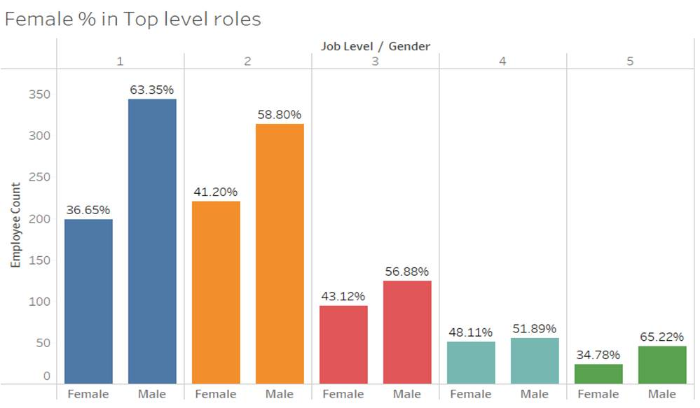
Exploratory data analysis- EDA
There is no discrimination in terms of
Gender – Monthly Income
Percentage of Females are lower in L5
when compared to Males but they share equal percentage in L4 Roles.

Slide 8
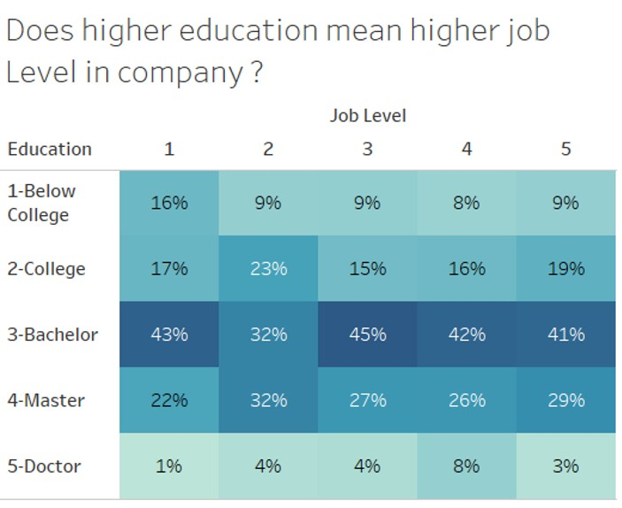
Majority of the employees have Bachelors followed by Masters. An interesting thing to note out is that 9% of L5 Leaders are Below College level.

Slide 9
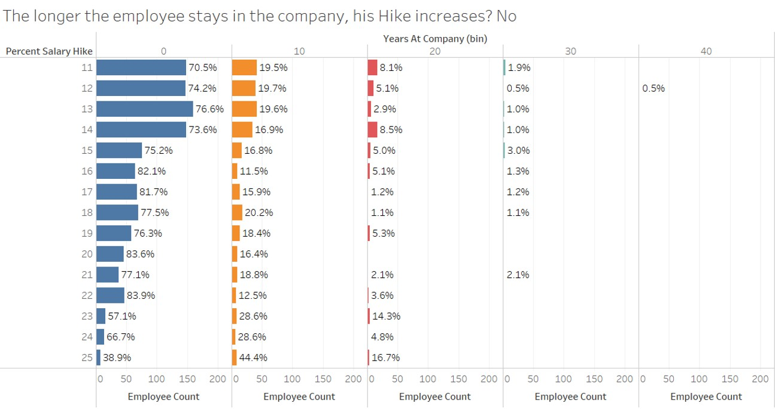
The longer the employee stays in the company, The Hike Percentage is actually decreased

Slide 10
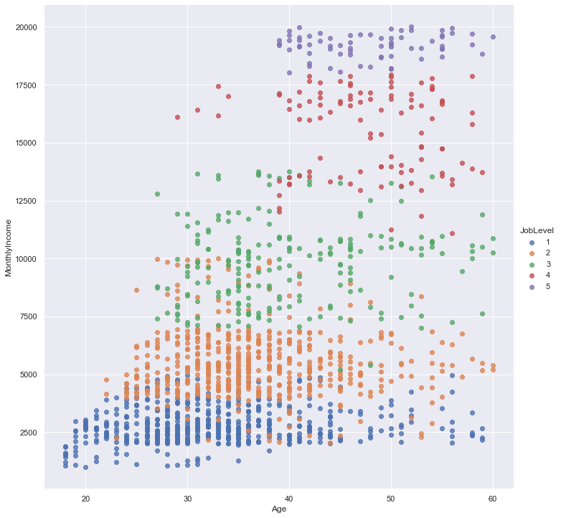
Job Level is highly correlated with Monthly Income.
Age is not considered for Monthly Income

Slide 11
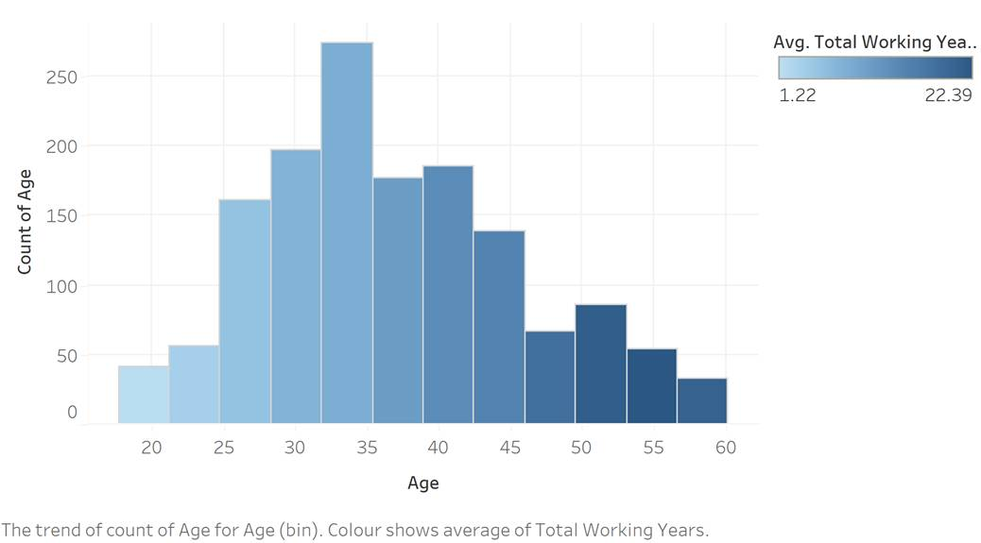
People with 30 – 40 years of Age are more in the company

Slide 12

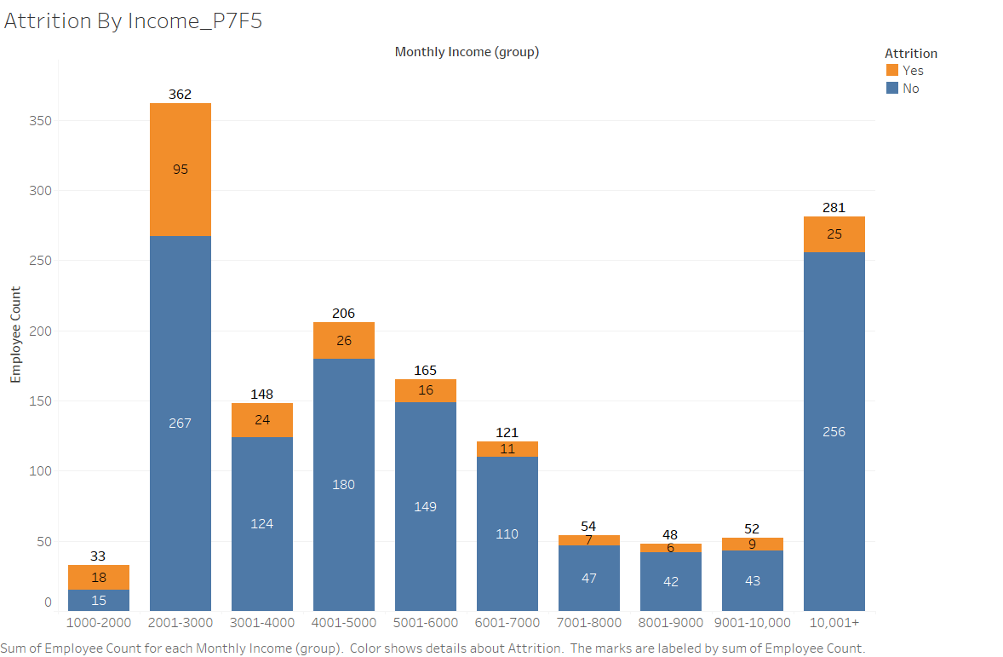
Employees with less Monthly Income tend to leave the Company more when compared to others
Notes:
Attrition By Income_P7F5

Slide 13

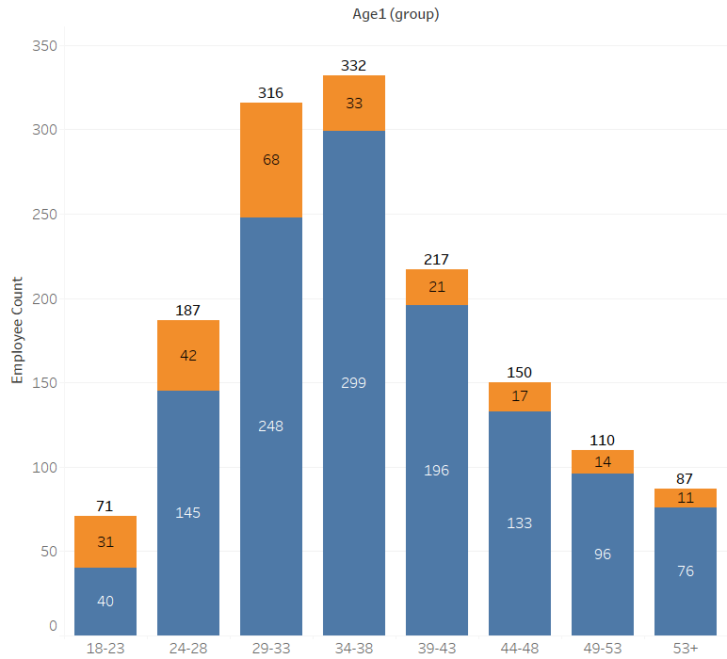
Employees with Age between 24 - 38 tend to leave the Company more when compared to others
Notes:
Attrition By Age_P8F6

Slide 14

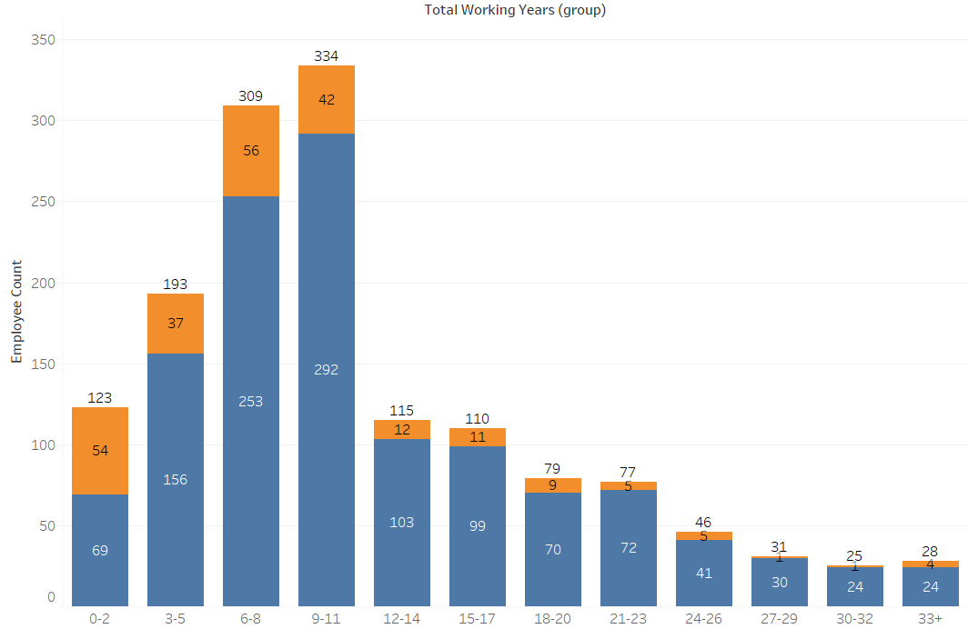
Employees with less Overall Working years usually shift between companies for growth Opportunities which the above graph is validating
Notes:
Attrition By Working Years_P10F8

Slide 15


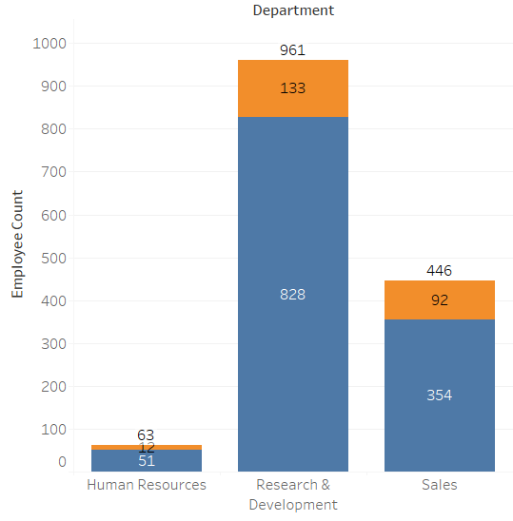
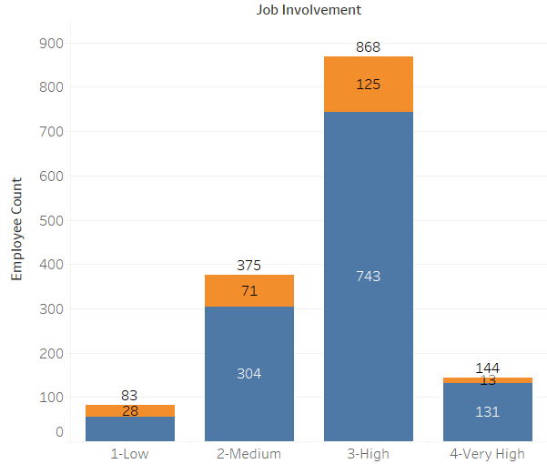
Employees with Medium – High Job Involvement have left the Organisation more when compared to others
More Attritions are from employees working in R&D Department
Notes:
Attrition by Job Involvment_P11F10D & Attrition by Department_P12F11

Slide 16
Model development – Logistic Regression
After using SMOTE, We have fitted our model with all the variables using logistic regression with 70-30 Train – test split.
We have used 2 methods
Scikit Learn
Statsmodels.api - Logit
To calculate the accuracy of the model, we have created the confusion matrix, ROC curves, Classification Report.
Training and testing accuracy are almost same for train and test dataset i.e. 87.94% and 87.16%.
AUC for given dataset is 0.94
Feature Importance is done through 4 different methods.

Slide 17
Model development – Random Forest
The 2nd Model is Random Forest from Bagged Trees
We have done a gridsearch twice to find out optimal n_estimators to get a good accuracy score.
OOB Score is 0.93
The accuracy score we achieved using Random Forest is 94.32%
The AUC is higher than other models with 0.98

Slide 18
Model development - XGBoost
The last Model is XGBoost from Boosted Trees
As you are aware, XGBoost stands for Extreme Gradient Boost.
We have done gridsearch twice to find out optimal n_estimators to get a good accuracy score.
The accuracy score we achieved using XGBoost is 93.51%
The Area under the curve is 0.97

Slide 19
Model Comparison and Finalisation
Model | Accuracy Score | AUC | Recall Value
Logistic Regression | 87.16% | 0.94 | 0.87
Random Forest | 94.32% | 0.98 | 0.94
XGBoost | 93.51% | 0.97 | 0.93
After Considering the above table, We have decided that Random Forest Model is a good fit for our project.
The Top 5 Features which are important according to Random Forest are as follows:
Stock Option Level
Job Level
Monthly Income
Age
Years with Current Manager

Slide 20
Business recommendation and potential business impact
Prepare an Organizational Health survey to find if any employee is dissatisfied with their Pay, Job and find out if there are any issues with reporting manager. The survey should take anonymous responses.
It seems employees are more interested in the Company’s stocks so the Management has to remap the Salary structure to fit in some Stock options.
While recruiting potential candidates, extra efforts has to be put on considering Pay quotes by candidates.

Slide 21
Appendix
IBM HR Dataset - https://www.kaggle.com/pavansubhasht/ibm-hr-analytics-attrition-dataset

Slide 22
Thank You

