Slide 1
Calories Burnt Prediction
UMBC Data Science Master Degree Dr. Chaojie (Jay) Wang
BY
TEJA SANAKA
GS40818

Slide 2
Introduction
Context: With the rise in fitness awareness, people seek ways to understand and track their calorie expenditure.
Motivation: Accurate calorie prediction helps in goal-setting for fitness, weight loss, and maintaining a healthy lifestyle.
Objective: Build a predictive model to estimate calories burned based on individual and activity features.

Slide 3
Problem Statement
Problem: Estimating calorie burn accurately is challenging due to various influencing factors (e.g., age, gender, activity intensity).
Why It's Important: Knowing calorie expenditure assists users in managing dietary intake, adjusting workout routines, and meeting health goals.

Slide 4
Data Collection
Data Source: Kaggle
The datasets include "exercise.csv" and "calories.csv" files
Features: Age, gender, height, weight, duration, body temperature, and heart rate.
Data Size:
exercise.csv: [662 KB]
calories.csv: [225 KB]
Data Shape:
exercise.csv: 15000 rows and 8 columns
calories.csv: 15000 rows and 2 columns

Slide 5
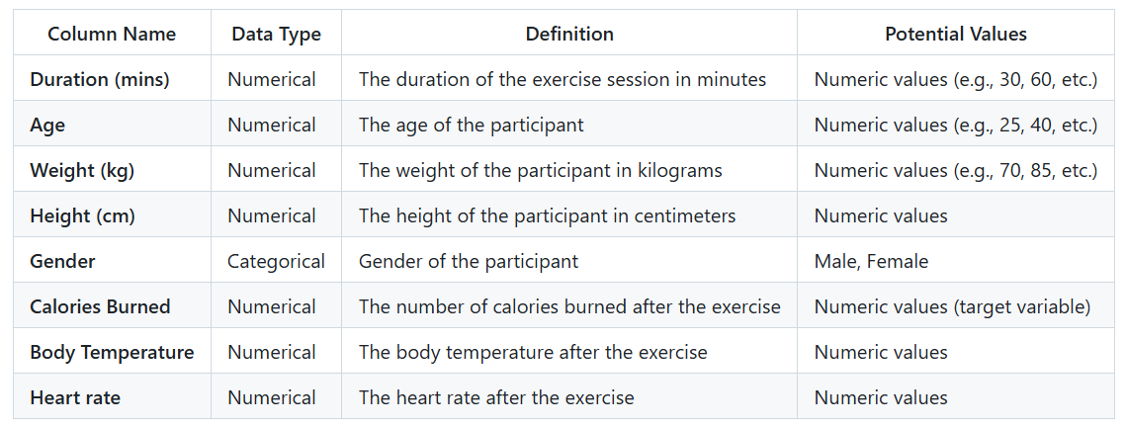
Data Dictionary:

Slide 6
Data Preprocessing
Handling Missing Values: Removed missing values and irrelevant columns.
Feature Scaling: Normalized or standardized data to improve model performance.
Merging Datasets: Combined calories.csv and exercise.csv on User_ID.
Feature Engineering: One-hot encoded Gender and scaled numerical features.

Slide 7
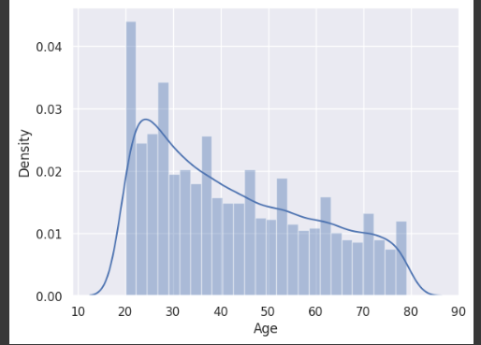
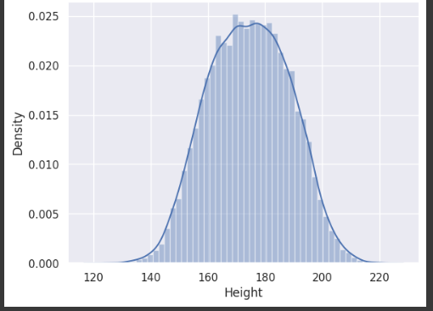
Exploratory Data Analysis (EDA)
Distribution of features in the dataset

Slide 8
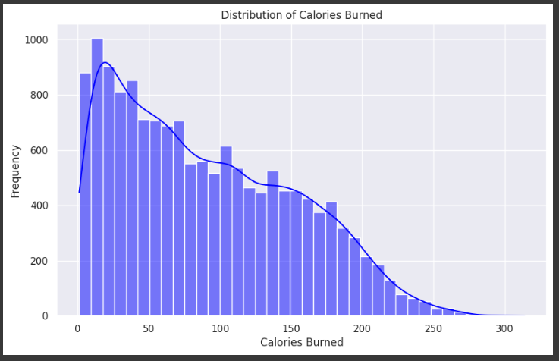
Target Variable Distribution
Target Variable: Calories Burned
Insight: Provides a view of typical calorie burn values, with some variation in higher ranges.

Slide 9
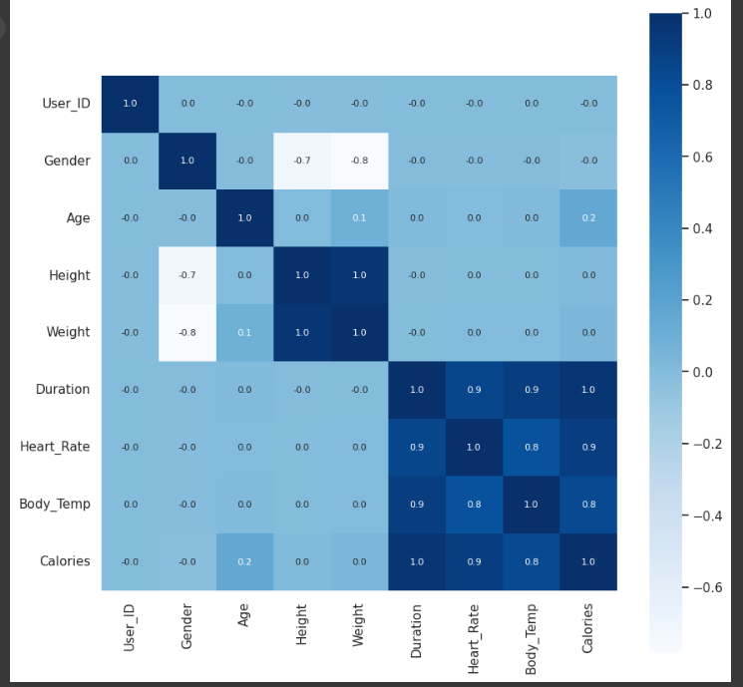
Correlation Matrix
Correlation Matrix: Strong correlations found between Calories Burned and features like Duration, Heart Rate, and Body Temperature.

Slide 10
Model Selection
Linear Regression provides a simple baseline.
Lasso Regression contributes feature selection insights, helping to identify the most influential factors in calorie burn.
Random Forest manages data complexity, addressing potential non-linear patterns in calorie-burning factors.
XGBoost might provide good results with boosting techniques.

Slide 11
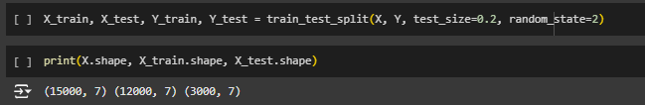
Model Training
Training Data: Split into 80% training and 20% testing.
Training Approach: Used cross-validation to optimize model performance.

Slide 12
Model Evaluation
Python Packages:
pandas and numpy: For data preprocessing.
matplotlib and seaborn: For data visualization and insight generation.
scikit-learn: Primary library for model building, tuning, and evaluation.
Streamlit: For application development.
Development Environments:
Google Colab: For cloud-based development with GPU access.
Jupyter notebook: For Streamlit User Interface

Slide 13
Model Evaluation
Model Accuracy: XGBoost showed high predictive accuracy, suitable for calorie prediction.
Model | Training Accuracy(%) | Testing Accuracy(%)
Linear Regression | 86.3 | 85.9
Lasso Regression | 86.1 | 85.6
Random Forest | 89.1 | 88.2
XgBoost Regression | 96.6 | 91.2

Slide 14
User Interface Using Streamlit
Streamlit allows for easy deployment, making the app accessible to a wide audience without complex setup.
Features
Calorie Burn Prediction: Users input personal details (such as age, gender, weight, height, duration of exercise, heart rate, and body temperature) to receive a prediction of calories burned.
BMI Calculation: The app also calculates Body Mass Index (BMI) based on user inputs, providing an additional metric for users.

Slide 15
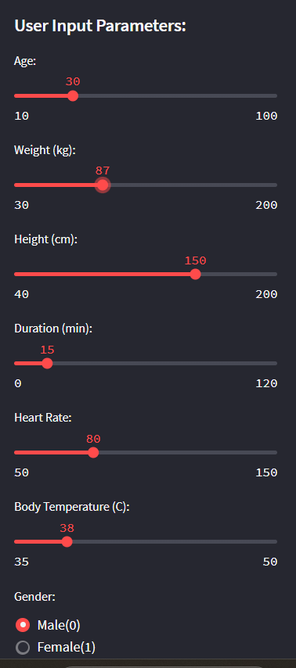
User Interface Using Streamlit
User Journey
Input Stage: Users select or input details in the sidebar, including personal and exercise-related parameters.

Slide 16
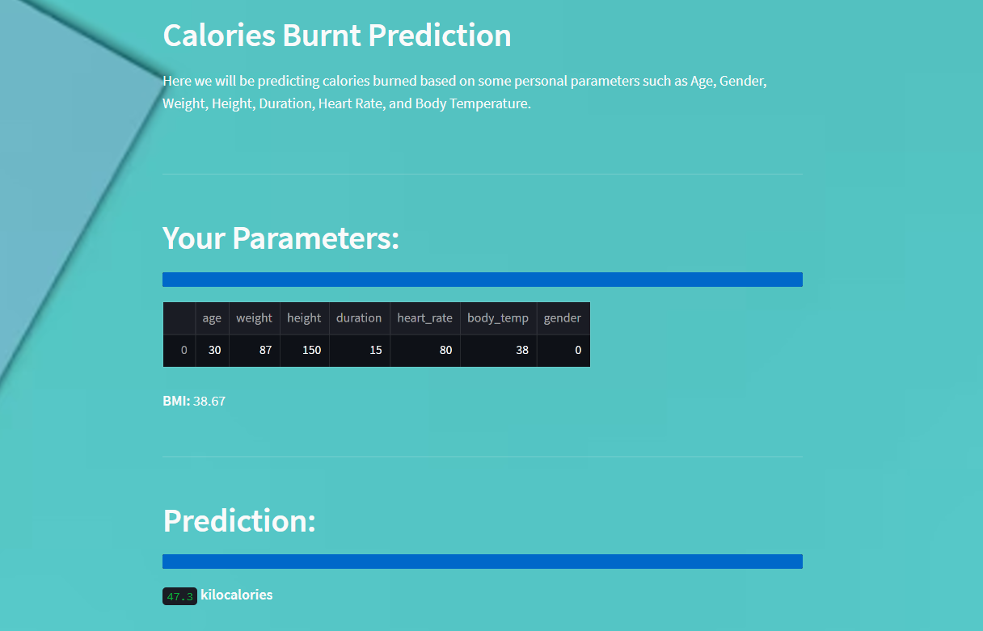
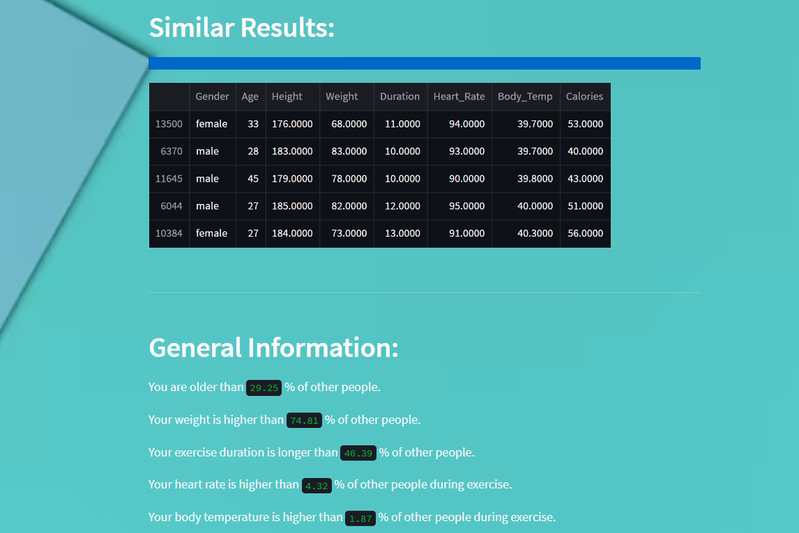
User Interface Using Streamlit
Prediction Output: The app displays a calculated prediction in kilocalories, along with comparisons to similar data points.
Additional Insights: Includes visual feedback, such as progress bars and BMI details, to enrich the user's experience.

Slide 17
Conclusion
Objective Achieved: Created a user-friendly app to predict calorie burn based on personal parameters using XGBoost and Streamlit.
Impact: Provides accurate, personalized calorie burn insights, enabling users to better understand their exercise impact.
User-Centric Design: Simple interface with intuitive inputs and BMI calculation

Slide 18
Future Work
Model Improvement: Plan to incorporate more advanced models (e.g., neural networks) to improve accuracy.
Expanding Dataset: Gathering more diverse data for wider applicability.
Additional App Features: Possible additions like integrating real-time fitness tracking data from wearables.

Slide 19
Thank You….!

