Slide 1
LangChain
Build Powerful AI Apps with Language Models

Slide 2
What is LangChain?
An open-source framework for building LLM-powered applications in Python or JavaScript or Typescript.
Provides reusable components to create custom AI workflows.
Works seamlessly with many LLMs without changing your core code.

Slide 3
Why Use LangChain?
Real‑time data integration: Easily connects models to internal and external data sources, so responses stay fresh and accurate.
Model flexibility: Swap models in and out effortlessly to test which one performs best for your specific use case.
Faster development: Abstracts away boilerplate for certain components, allowing you to prototype and iterate quickly.

Slide 4
Key Components
Chat Models: Language models (like GPT-4).
Prompt Templates: Formats your inputs clearly.
Retrievers: Retrieve relevant data (e.g., APIs, Web search).
Document Loaders: Load structured or unstructured data.
Embeddings & Vector Stores: Convert text to vectors and store them.
Tools: Prebuilt or custom functions (e.g., Database).
Chains: Sequences of steps combined into workflows.
Agents: Decide which tool or action to use based on user input.
More…

Slide 5
Prompt Templates
Prompt templates help structure inputs to the LLM, making prompts reusable, clear, and less error-prone.
They include placeholders that get filled in at runtime, and you can add context as needed.
Example:
Here is my data: {data}
Here is my question: {question}
Explain it in 2 points.

Slide 6
Embeddings & Vector Stores
Embeddings turn text into high-dimensional decimal vectors that capture the meaning of the text.
These embeddings are stored in vector stores (like FAISS or Pinecone, which are optimized for fast similarity searches.
When a user asks a question, it gets converted to an embedding and sent to the vector store to find the most relevant documents.
This process is called Retrieval-Augmented Generation (RAG) and helps LLMs generate accurate, context-aware answers using your own data.

Slide 7
Tools
Tools are external or custom functions that the LLM can call to perform actions or fetch information.
They include features like web search, APIs, database queries and more.
They are used by agents or chains to extend the LLM’s capabilities beyond text generation.
Example:
Instead of guessing, the LLM can use a News API tool to fetch the latest headlines.

Slide 8
Chains
A chain is a sequence of steps such as LLM calls, prompts, and tools that connected to perform a specific task.
Chains can be simple (one prompt + LLM) to complex (multiple models, tools, branching logic), depending on the application's needs.
Chains promote reusable, modular design letting you plug components together cleanly and maintain workflows more easily over time.

Slide 9
Agents
Agents use an LLM as a reasoning engine, choosing which tools or actions to execute based on the prompt.
They follow a cycle of deciding, observing, and repeating. This makes interactions dynamic and iterative.
Agents dynamically select and invoke tools. This allows them to adapt to varying user needs in real time.
Example:
Prompt: Send a summary of today’s news to my email.
The agent calls the news API, summarizes the content, and sends an email, deciding each step as needed.

Slide 10
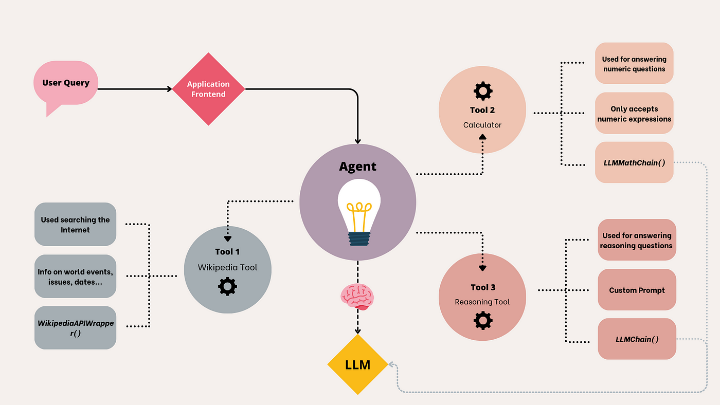
Putting It All Together
Source: Medium

Slide 11
Limitations
Steep Learning Curve: Understanding of chains, agents, tools may feel complex for simple tasks like direct LLM call.
Debugging Complexity: Hard to trace issues across steps, especially with agents.
Performance Overhead: Can be slower and costlier due to multiple LLM or tool calls.
Rapidly Evolving: Frequent updates may cause breaking changes or require rewrites.

Slide 12
Applications
Chatbots & Virtual Assistants
Document Summarization
Question Answering
Code Assistance
Automated Content Creation
Finance & Data Analysis
RAG Systems

Slide 13
Any Questions?

