Slide 1
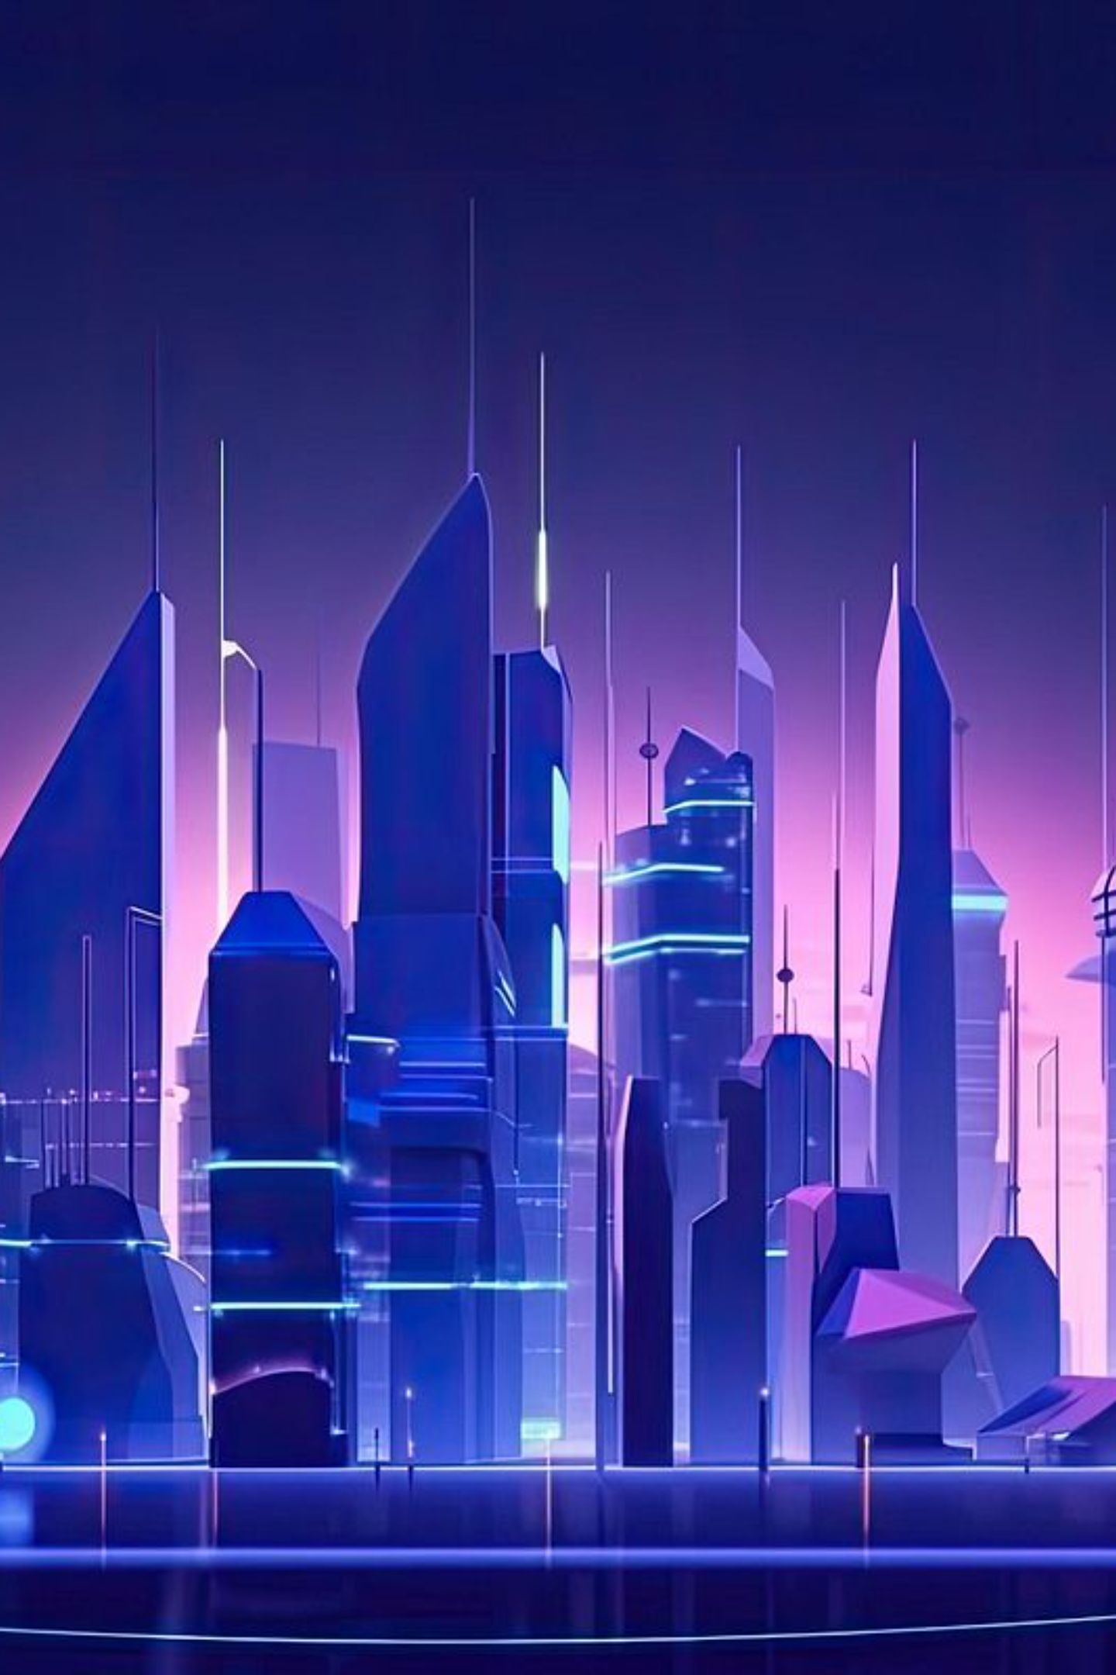
Designing Clean Green Cities: Sustainable Urban Layouts for the Future
As urbanization accelerates globally, the need for sustainable city design has never been more critical. Clean green cities represent the future of urban development, where environmental consciousness meets innovative design to create livable, resilient communities. This presentation explores the essential principles, technologies, and real-world examples that are shaping the next generation of urban spaces.

Slide 2
Why Clean Green Cities Matter
75%
70%
68%
Global Resources
CO2 Emissions
Urban Population
Urban areas consume three-quarters of the world's resources despite occupying just 3% of Earth's land surface
Cities produce the majority of global carbon dioxide emissions, making urban sustainability crucial
By 2050, this percentage of the global population will live in cities, amplifying environmental challenges
According to UN Habitat, urban areas are simultaneously the problem and the solution to our global environmental crisis. The concentration of people, resources, and economic activity in cities creates unprecedented opportunities for sustainable innovation. Green city layouts don't just reduce pollution and improve public health – they fundamentally transform how we experience urban living.
The concept of clean green cities goes beyond adding parks and trees. It involves reimagining urban systems to work in harmony with natural processes, creating environments where human activity enhances rather than degrades the ecosystem. This holistic approach to city design recognizes that environmental health, economic prosperity, and social well-being are interconnected and mutually reinforcing.

Slide 3



Core Principles of Green City Layouts
Integrated Green Spaces
Sustainable Mobility
Smart Resource Management
Seamless integration of parks, green corridors, and natural areas within residential and commercial zones creates continuous ecological networks that support biodiversity while providing recreation and wellness opportunities for residents.
Comprehensive public transport systems, dedicated cycling lanes, and pedestrian-friendly streets reduce car dependency, lower emissions, and create more livable neighborhoods where people can walk, bike, and connect with their community.
Renewable energy systems, intelligent waste management, and circular economy principles ensure efficient use of resources while minimizing environmental impact through innovative technology and sustainable practices.
These foundational principles work synergistically to create urban environments that are not only environmentally sustainable but also economically viable and socially equitable. The integration of green infrastructure with built environments creates microclimates that naturally regulate temperature, improve air quality, and manage stormwater runoff.
Successful green cities also prioritize density done right – compact, mixed-use developments that reduce sprawl while providing high-quality living spaces. This approach maximizes the efficiency of infrastructure investments while preserving natural areas outside the urban core.

Slide 4
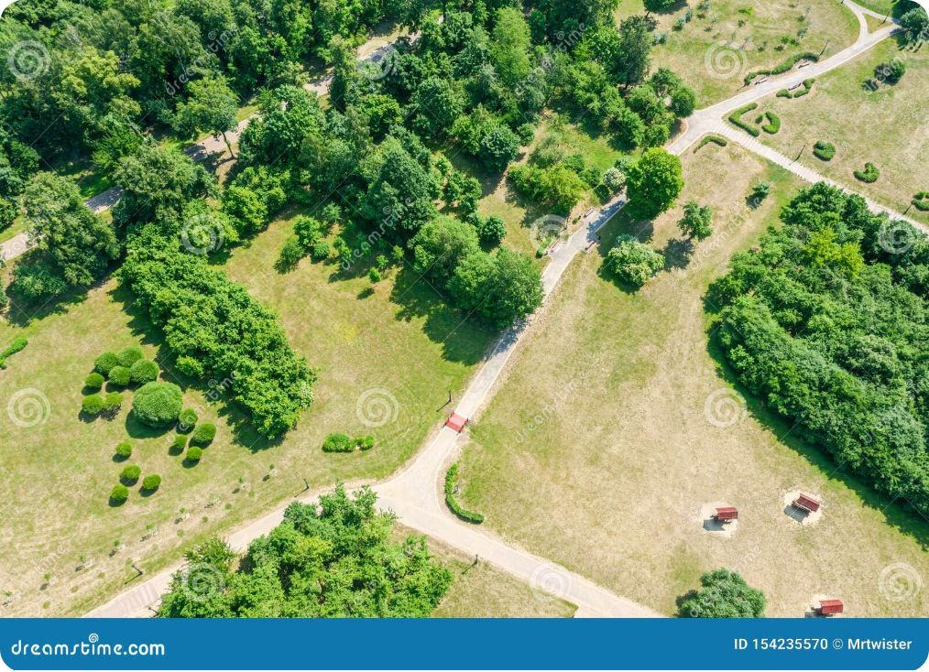
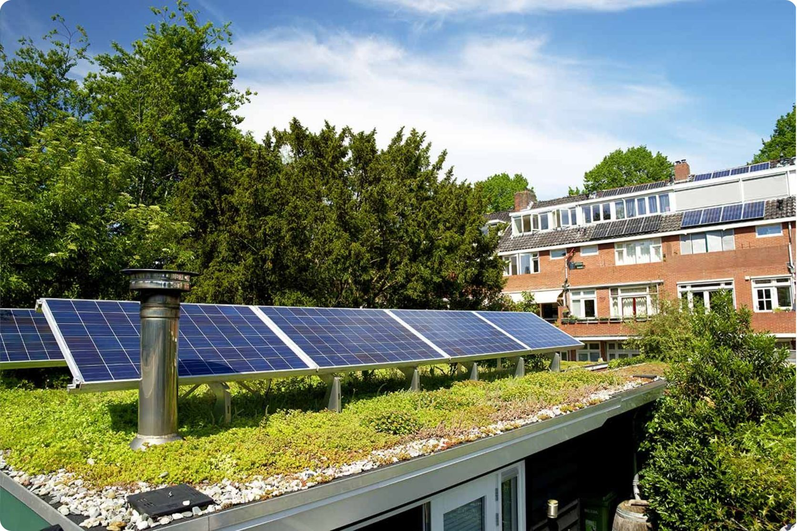

Two Content Pictures: Urban Green Spaces & Mixed-Use Development
Green Corridor Networks
Interconnected park systems create wildlife corridors and provide residents with continuous access to nature throughout the urban landscape. These green arteries serve multiple functions: they filter air pollution, reduce urban heat island effects, and offer recreational pathways that encourage active transportation.
Vertical Green Integration
Mixed-use developments with integrated green infrastructure demonstrate how buildings can contribute to urban ecology. Rooftop gardens, living walls, and solar installations transform structures from environmental burdens into productive community assets that generate energy, food, and habitat.
Green corridors and mixed-use zones foster community and sustainability by creating spaces where environmental stewardship and human activity naturally intersect, building stronger neighborhoods while protecting urban ecosystems.
The transformation from traditional urban design to green city layouts requires reimagining how we use vertical and horizontal space. Green corridors act as the circulatory system of sustainable cities, connecting isolated green spaces into a cohesive network that supports both human and ecological health. When combined with thoughtful mixed-use development, these systems create neighborhoods where residents can live, work, and play within walking distance while maintaining deep connections to nature.

Slide 5
Smart Infrastructure for Clean Cities
01
02
03
IoT-Enabled Resource Management
Nature-Based Solutions
Energy-Efficient Building Systems
Green stormwater infrastructure including bioswales, permeable pavements, and constructed wetlands manage rainfall naturally while filtering pollutants. These systems reduce flooding risks, recharge groundwater, and create beautiful urban landscapes that enhance property values and community well-being.
Internet of Things sensors throughout the city monitor waste levels, water quality, air pollution, and energy consumption in real-time. This data enables city managers to optimize collection routes, prevent system failures, and respond quickly to environmental challenges, reducing costs while improving service quality.
Smart buildings with advanced automation, renewable energy integration, and sustainable materials minimize carbon footprints while maximizing occupant comfort. These structures use machine learning to optimize heating, cooling, and lighting based on usage patterns and environmental conditions.
The convergence of digital technology and environmental science is creating unprecedented opportunities for urban sustainability. Smart infrastructure systems don't just reduce environmental impact – they create more resilient, responsive cities that can adapt to changing conditions and citizen needs.
These intelligent systems work together to create feedback loops that continuously improve city performance. As sensors collect data on everything from traffic patterns to energy usage, machine learning algorithms identify optimization opportunities that human managers might miss, creating cities that literally learn and improve over time.

Slide 6
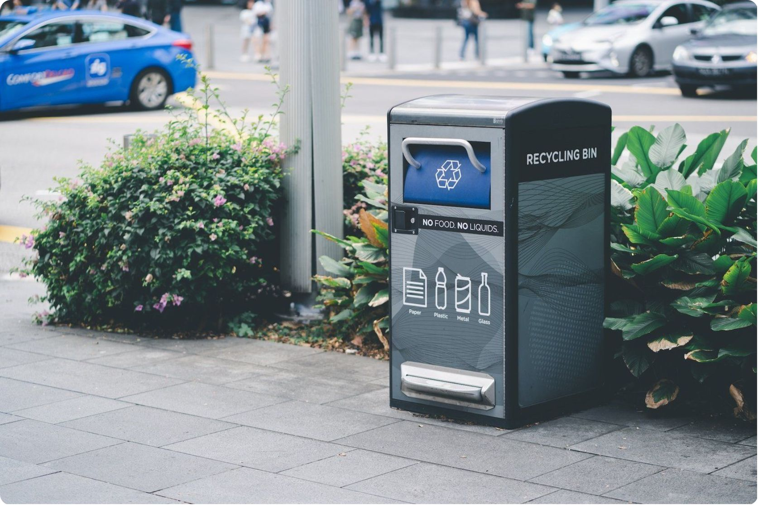
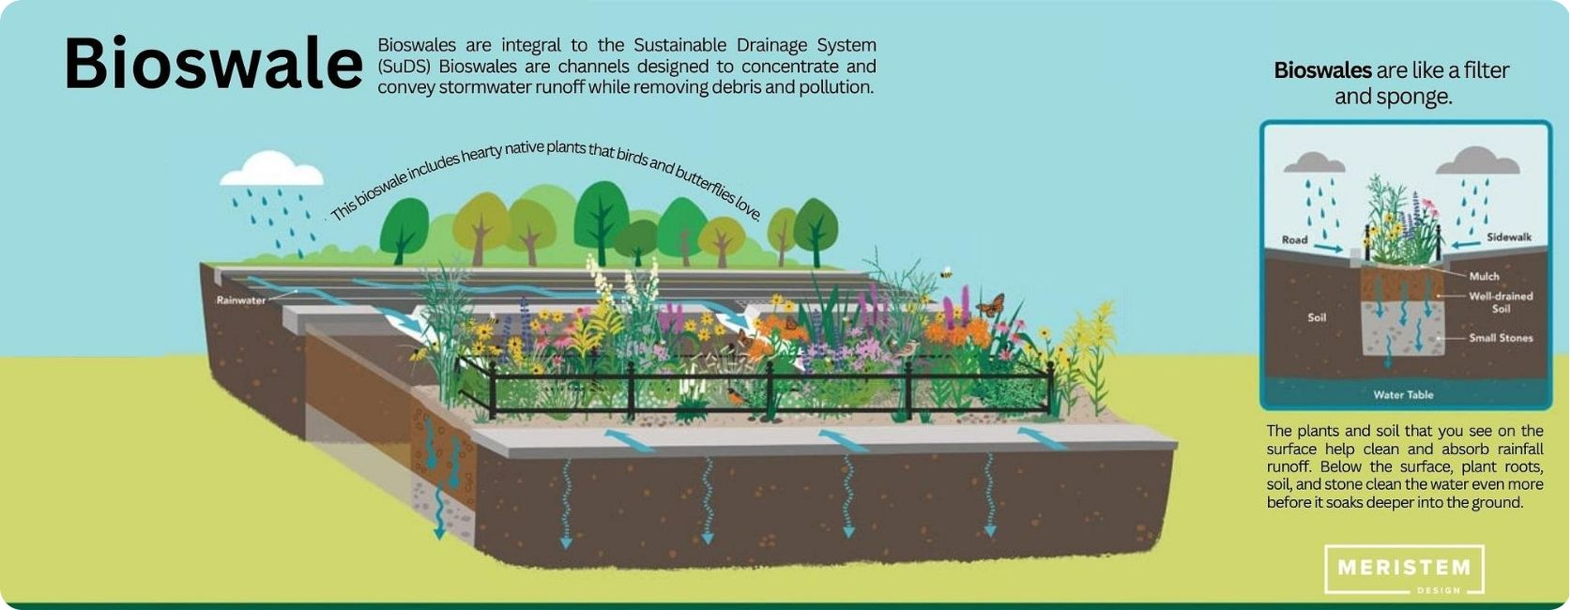

Two Content Pictures: Smart Waste Management & Green Stormwater Systems
Green Stormwater Infrastructure
Bioswales, rain gardens, and permeable surfaces replace traditional concrete drainage with living systems that naturally filter pollutants and manage runoff. These installations reduce strain on sewer systems by up to 85% during peak rainfall while creating habitat corridors and improving neighborhood aesthetics.
Intelligent Waste Systems
Smart bins equipped with fill-level sensors, compaction mechanisms, and solar-powered communication systems revolutionize waste collection. These systems reduce truck emissions by 30% through optimized routes, prevent overflow situations, and provide real-time data on waste generation patterns that inform recycling programs and policy decisions.
Technology and nature-based solutions work hand-in-hand for urban resilience, demonstrating that the most effective sustainability strategies combine digital innovation with ecological wisdom.
The integration of smart technology with natural systems represents a paradigm shift in urban infrastructure. Rather than fighting against natural processes, these solutions harness them to create more efficient, cost-effective city services. Smart waste management alone can reduce collection costs by 40% while improving cleanliness and public health outcomes.
Green stormwater systems provide multiple co-benefits beyond flood control. They cool urban temperatures, support pollinator populations, and create community gathering spaces that strengthen social bonds. When residents see technology and nature working together in their neighborhoods, it builds support for broader sustainability initiatives.

Slide 7
Case Study: Tiruvalla's Clean and Green City Initiative
Community-Driven Waste Programs
1
Tiruvalla implemented comprehensive waste segregation at source with resident training programs and community composting centers. This grassroots approach achieved 95% household participation and reduced landfill waste by 60%, proving that citizen engagement is essential for sustainable city initiatives.
2
"One Sapling Per House" Campaign
The city launched an ambitious urban greening program requiring each household to plant and maintain a tree. This initiative increased urban canopy cover by 35% over three years while fostering environmental stewardship and community pride in neighborhood beautification efforts.
"Sun Heart" Solar Initiative
3
Through subsidies, group purchasing programs, and technical support, Tiruvalla accelerated residential solar adoption. The campaign achieved 40% household solar coverage, reducing grid dependency and demonstrating how policy incentives can drive renewable energy transition at the community level.
Tiruvalla's success demonstrates that effective green city transformation requires more than top-down planning – it demands authentic community participation and locally-tailored solutions. The city's integrated approach addressing waste, greenery, and energy simultaneously created synergies that amplified the impact of each individual program.
What makes Tiruvalla's model particularly replicable is its focus on behavioral change alongside infrastructure development. By making environmental stewardship a source of community pride and social connection, the city created lasting cultural shifts that will sustain these initiatives for generations to come.

Slide 8

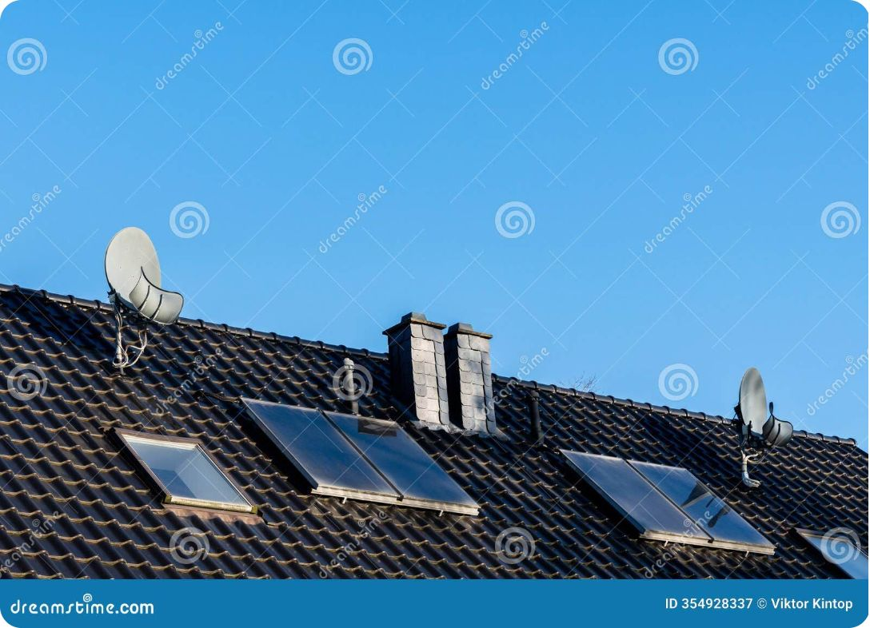

Two Content Pictures: Community Green Initiatives & Solar Panels on Homes
Grassroots Environmental Action
Distributed Renewable Energy
Community tree-planting events transform neighborhoods while building social cohesion. These initiatives demonstrate how environmental action can strengthen civic engagement, with residents taking ownership of their local environment and creating networks of environmental stewardship that extend far beyond individual households.
Rooftop solar installations create energy independence while reducing utility costs for families. The visual impact of solar panels throughout neighborhoods signals community commitment to sustainability and encourages additional adoptions through social influence and peer-to-peer learning about renewable energy benefits.
Citizen engagement and renewable energy power Tiruvalla's green transformation, showing that sustainable cities emerge from the intersection of community action and clean technology adoption.
Tiruvalla's experience reveals the powerful multiplier effect of combining community organizing with practical environmental solutions. When residents see their neighbors actively participating in tree planting and solar installation, it normalizes sustainable behaviors and creates positive peer pressure for broader adoption.
The city's success also highlights the importance of making environmental action visible and celebrated. Public recognition programs, community events, and neighborhood competitions transformed individual environmental choices into collective achievement, building momentum that sustained these initiatives even as political leadership changed.

Slide 9










Designing for People: Healthy, Active, and Inclusive Cities
Recreation Access
Walkable Neighborhoods
Parks and sports facilities within 10 minutes of every home
15-minute cities where daily needs are accessible by foot or bike
Affordable Housing
Green building standards for all income levels
Public Transit
Clean, efficient transportation reducing car dependency
Universal Access
Inclusive design for people of all ages and abilities
Human-centered design principles ensure that green cities serve all residents, not just the affluent. The most successful sustainable urban developments integrate affordable housing with high-quality green infrastructure, proving that environmental sustainability and social equity are mutually reinforcing goals rather than competing priorities.
Research consistently shows that access to green space and active transportation options improves physical and mental health outcomes while reducing healthcare costs. Cities designed for walking and cycling see significant reductions in obesity, cardiovascular disease, and depression rates, demonstrating that urban design is fundamentally a public health intervention.
The integration of affordable housing with green infrastructure also helps prevent the displacement that often accompanies urban environmental improvements. When sustainability initiatives are designed inclusively from the start, they strengthen rather than fragment existing communities, creating resilient neighborhoods where long-term residents can benefit from environmental improvements.

Slide 10



The Future is Green: Call to Action
Embrace Innovation
Build Partnerships
Transform Cities
Adopt integrated green city layouts that combine natural systems with smart technology for maximum environmental and social impact
Foster collaboration between governments, communities, businesses, and technology innovators to scale sustainable solutions
Create cleaner, healthier, and more vibrant urban environments that will thrive for generations to come
The transition to clean green cities represents one of humanity's greatest opportunities to address climate change while improving quality of life for billions of people. The technologies, design principles, and community engagement strategies needed for this transformation already exist – what's required now is the political will and social commitment to implement them at scale.
Every city has the potential to become a model of sustainability, but success requires moving beyond pilot projects to systemic change. This means updating zoning codes to encourage mixed-use development, investing in public transportation and green infrastructure, and ensuring that all residents can participate in and benefit from the green economy.
The cities of tomorrow will be defined not by what they consume, but by what they regenerate. By embracing integrated green design today, we're not just building more sustainable cities – we're creating the foundation for a more sustainable civilization.
The future is green, and it starts with the choices we make today in designing and building our urban communities. Together, we can create cities that serve as beacons of hope and models of possibility for a more sustainable world.

