Slide 1
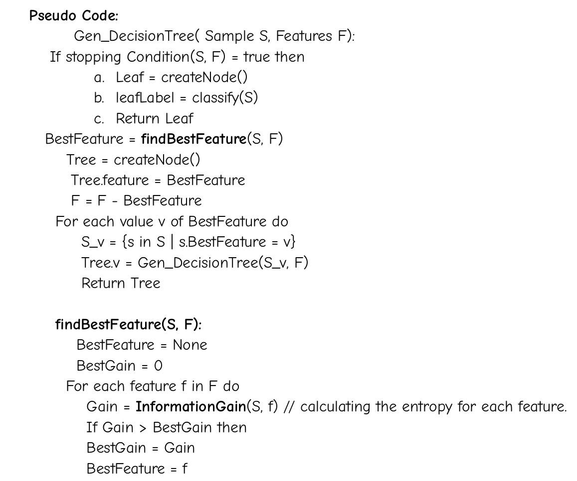
Decision Trees Algorithm:
Pseudo code:

Slide 2

Explanation of the key terms:
Gen_DecisionTree: It generates the decision tree with the given data recursively.
findBestFeature: It finds the best feature for splitting criteria.
InformationGain: It calculates the entropy of each feature.

Slide 3
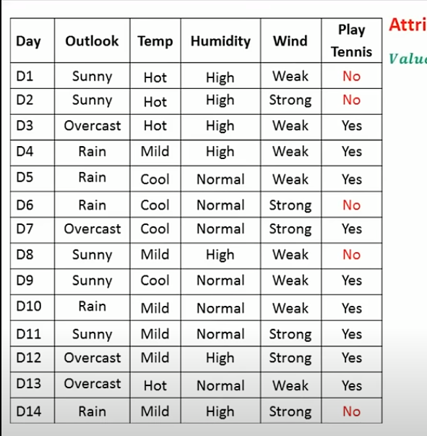
Explanation of Algorithm with an example
Given the data, Now we have to generate decision tree based upon the given data.

Slide 4
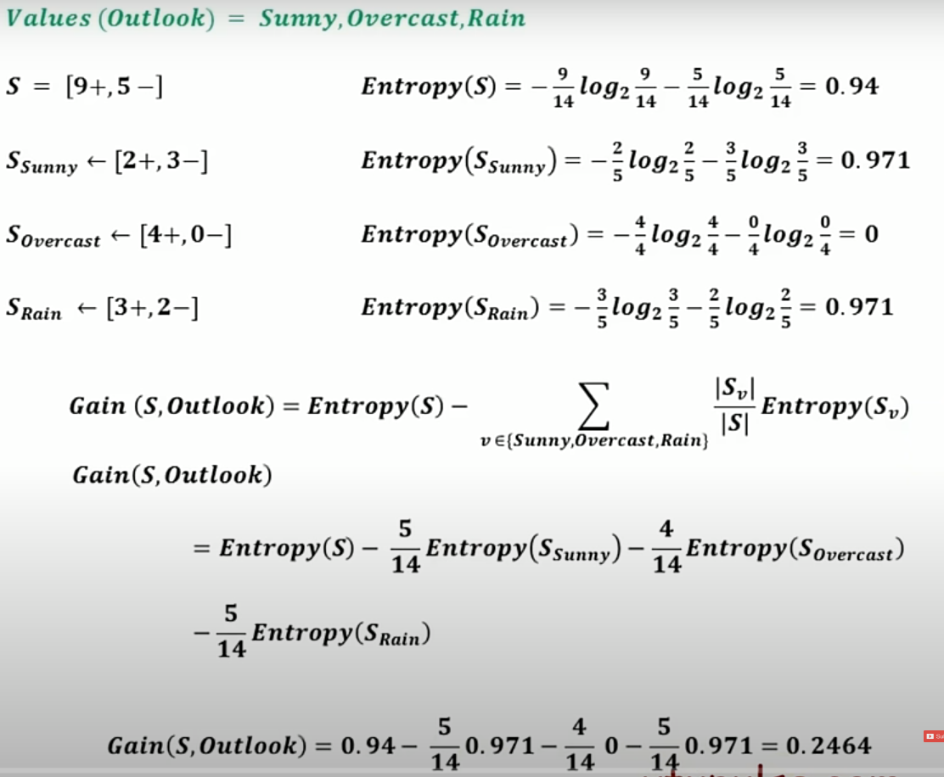
Step-1: Calculate the Information Gains for each feature

Slide 5
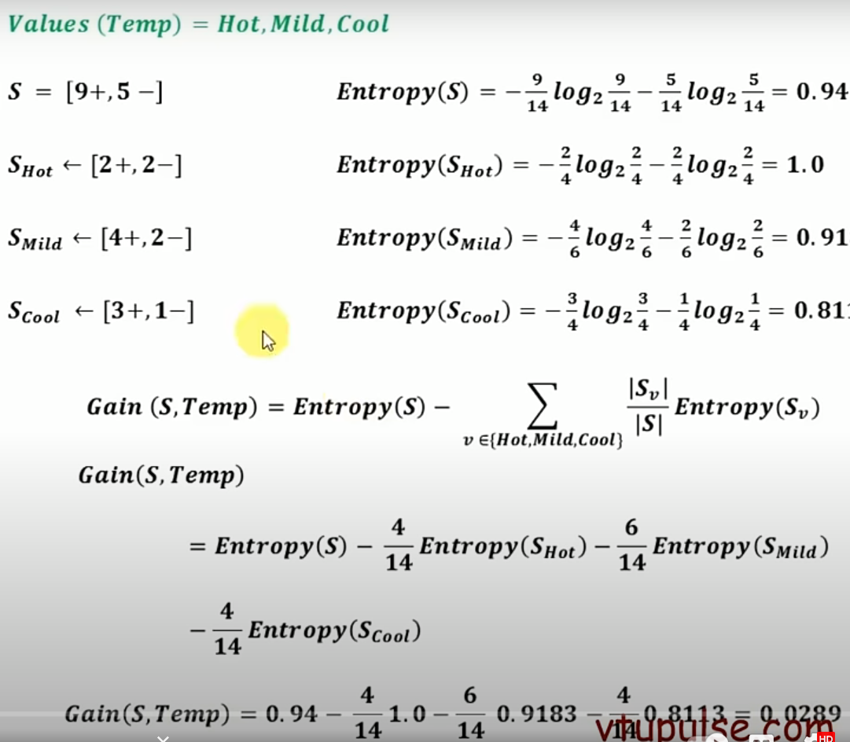

Slide 6
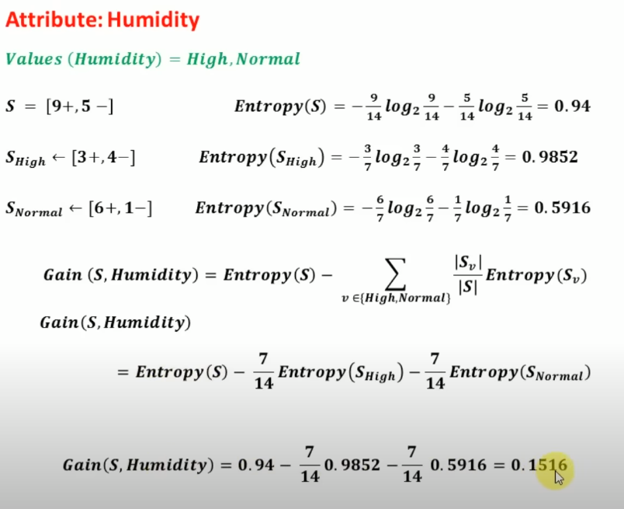

Slide 7
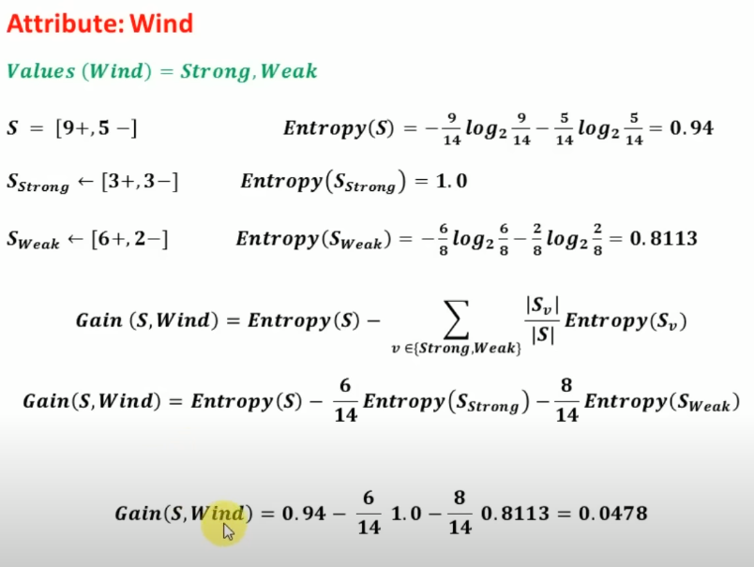

Slide 8
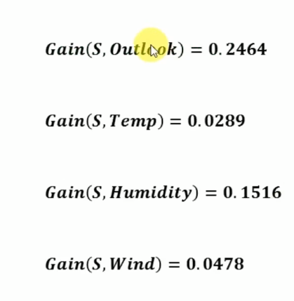
Now we check the values of intermediate gain for each feature.
Use the highest gain value feature for further splitting.
As this the first split, this node will be the root node of the decision tree i.e Outlook.

Slide 9
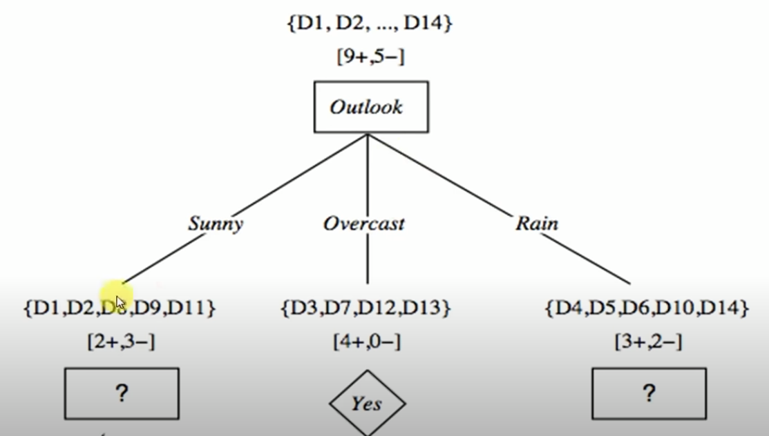
The tree will look something like this:

Slide 10
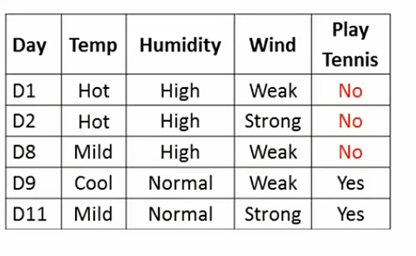
Step-2: Repeat the above method for rest of the subtrees and for the required tuples.
For the left subtree, we repeat the same steps.

Slide 11
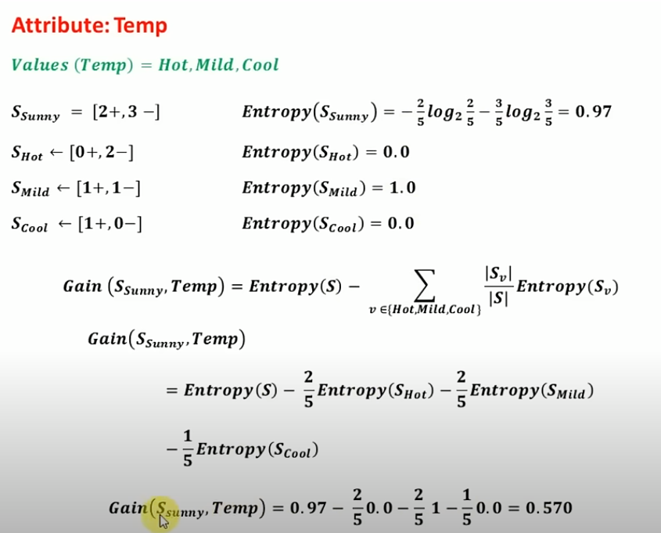
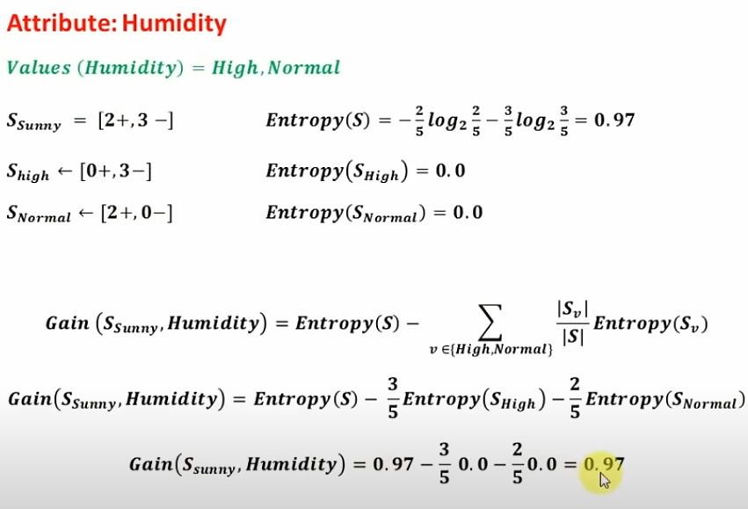

Slide 12
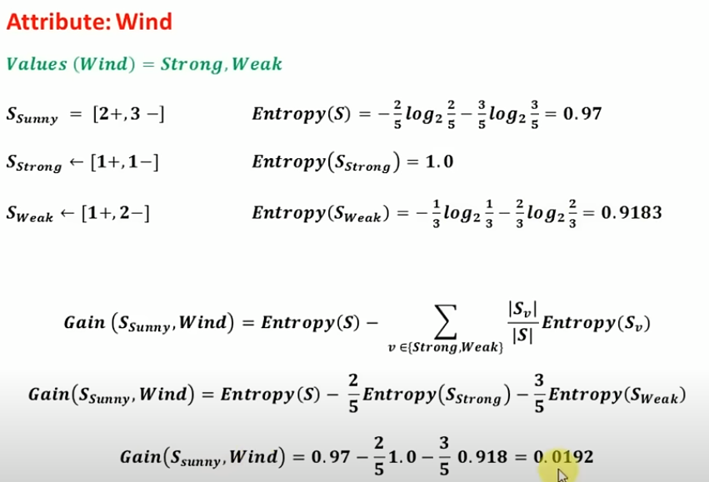
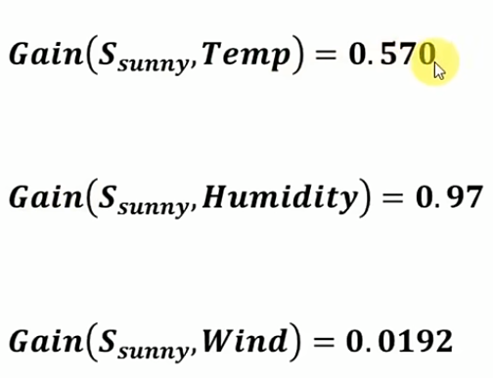

Slide 13
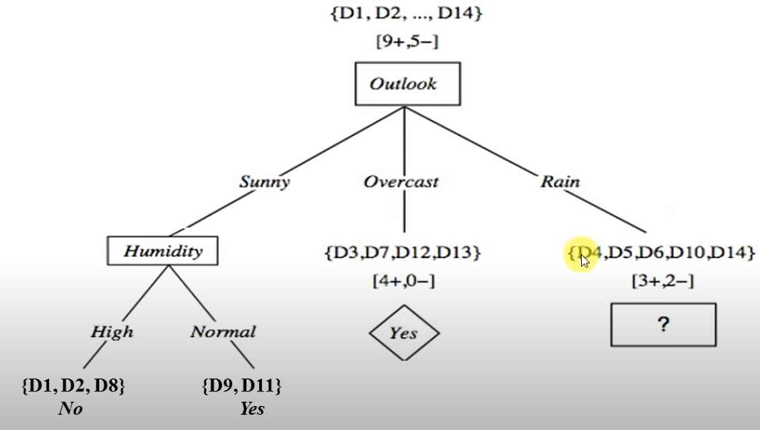
Left subTree:

Slide 14
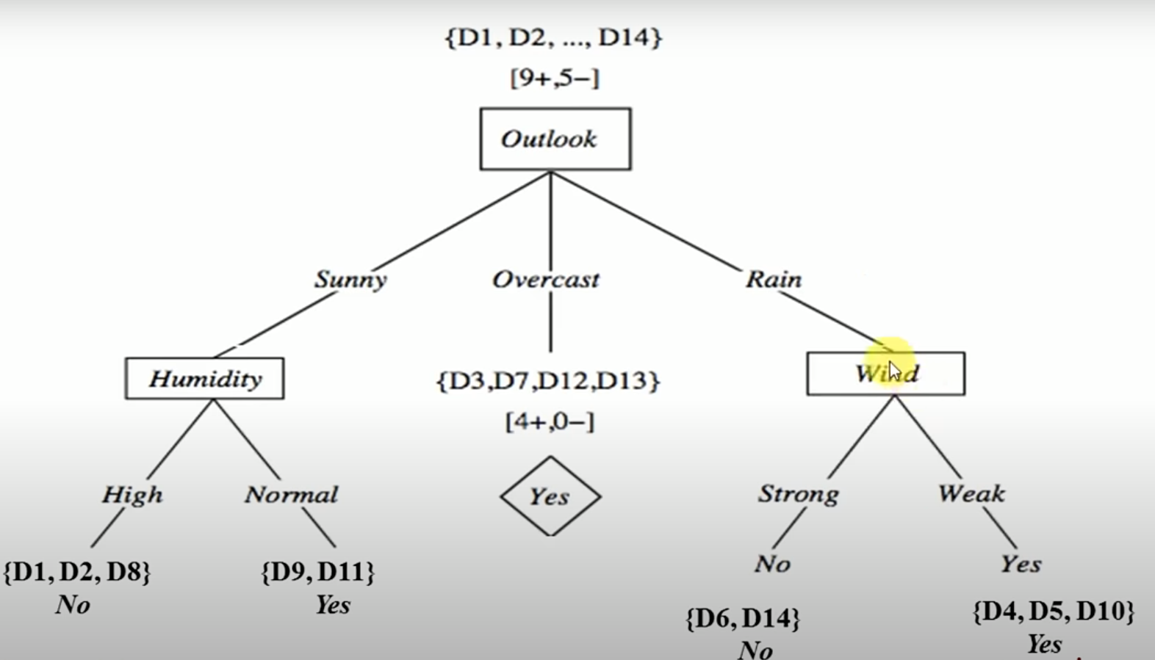
Final Tree

