Slide 1
Thyroid Detection
Using Decision Tree
Tejasriram Parvathaneni

Slide 2
Abstract
One of the most prevalent medical conditions, thyroid disease can cause a number of different health issues. According to recent studies, 42 million Indians suffer from thyroid dysfunction or disorders. Thyroid disorders, which can include hypothyroidism or hyperthyroidism, are brought on by the thyroid hormone.
TSH (Thyroid Stimulating Hormone), T3 (Triiodothyronine, T3-RIA), T4 (Thyroxine), and FTI (Free Thyroxine Index, FTI, T7) are important thyroid test components used to determine how thyroid hormone behaves. To diagnose and predict the disease, manual analysis of these parameters on massive databases is laborious. In the suggested system, a Decision Tree Classifier-based machine learning technique has been used to create a predictive model.
The decision tree appears to produce better outcomes, with the greatest training accuracy of 100% and validation accuracy of 97%, according to the performance evaluation. Additionally, this work may help researchers find a good model for detecting and classifying hypothyroidism.
According to our research, thyroid measures play a significant influence in predicting the clinical course of depression. To identify which patients most urgently require early or intensive therapies to stop continuing dysfunction, thyroid hormone assessment should be expanded to routine clinical settings.

Slide 3
Introduction
The task is to build a decision tree inorder to accurately predict the persons thyroid functioning. This model takes the blood test reports and splits the data into subtrees by using information gain and gini index, which forms the decision node

Slide 4
Innovative Idea
Nowadays the number of people opting for health insurance is growing in india and every company provides an annual body checkup, numerous amount of data is to be verified by the doctors in which most of them are negative with this interface we can easily detect the seriousness of the case and refer a doctor only when needed the most.
Furthermore, Blood testing centers can add this additional information to their patient reports for more accurate prediction of their disease.
Features:
Thyroid sickness ratio chart (to analyze the severity of the disease)
Confusion matrix (used by application programmers to check the deviations)

Slide 5
Implementation
Data Collection & Preparation
There are several techniques to collect the data, like web scraping, manual interventions. This data set is gathered from Kaggle, then preparation, randomization and visualization is done
Decision Tree Classification Algorithm
we use the CART algorithm, which stands for Classification and Regression Tree algorithm
Attribute Selection Measures
1. Information Gain:According to the value of information gain, we split the node and build the decision tree
2. Gini Index:Gini index is a measure of impurity or purity used while creating a decision tree in the CART algorithm.
Analyze and Prediction:In the actual dataset, we chose only 21 features
Saving the Trained Model: You can save the trained model by saving it as a .pkl file using pickle library

Slide 6
Requirement Gathering
SOFTWARE REQUIREMENTS:
OPERATING SYSTEM: WINDOWS 10
PROGRAMMING LANGUAGE : PYTHON (VERSION 3.8 )
LIBRARIES: NUMPY,PANDAS,SCIKIT LEARN, MATPLOTLIB, PICKLE
INTEGRATED DEVELOPMENT ENVIRONMENT (IDE): JUPYTER NOTEBOOK, PYCHARM,VS CODE, SUBLIME TEXT,SPYDER.
WEB FRAMEWORKS: FLASK

Slide 7
Requirement Gathering
HARDWARE REQUIREMENTS:
System : Pentium i3 Processor.
Hard Disk : 500 GB.
Monitor : 15’’ LED
Input Devices : Keyboard, Mouse
Ram :4 GB

Slide 8
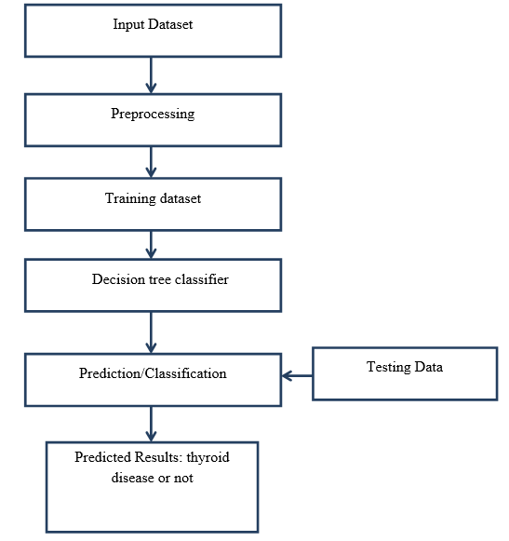
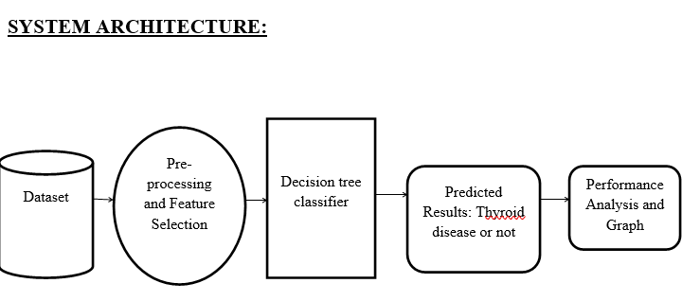
Architecture Diagram
Dataflow diagram

Slide 9
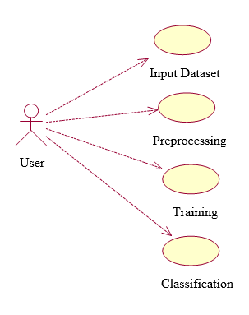
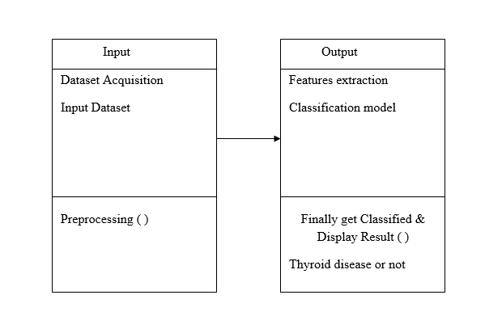
UML diagrams
Use Case Diagram
Class Diagram

Slide 10
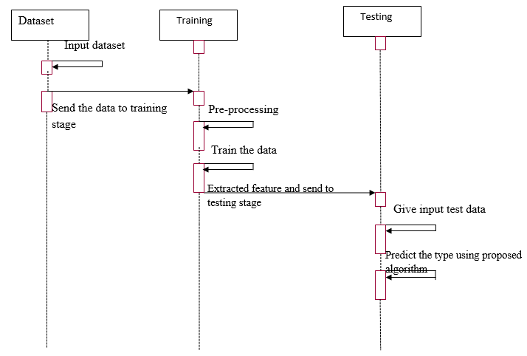
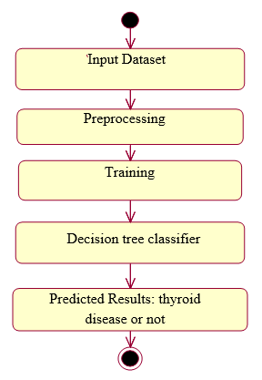
UML diagrams
Sequence Diagram:
Activity Diagram:

Slide 11
Code Description
Pandas: Python library for data manipulation and analysis.
Matplotlib: Tool for creating various types of plots.
Numpy: Efficient numerical data handling and computation.
Flask: Lightweight Python web framework for web apps.
scikit-learn (sklearn): can implement various machine learning models for regression, classification, clustering,
Pickle: converting a Python object into a byte stream to store it in a file/database

