Slide 1
PREDICTING ELIGIBILITY FOR NSAP SCHEMES USING Machine learning
CAPSTONE PROJECT
Presented By:
STUDENT NAME: MATTAPARTHI TEJA
COLLEGE NAME: SWARNANDHRA COLLEGE OF ENGINEERING & TECHNOLOGY
DEPARTMENT : MASTER OF COMPUTER APPLICATIONS(MCA)

Slide 2
OUTLINE
Problem Statement
Proposed Solution
System Development Approach
Wow Factors & End Users
Algorithm & Deployment
Results
Conclusion
Future Scope
Git-Hub Link
IBM Certifications

Slide 3
Problem Statement
Example:
The National Social Assistance Program (NSAP) is a critical social welfare initiative in India, providing financial assistance to the elderly, widows, and persons with disabilities. The manual process of verifying applications and assigning the correct sub-scheme is a significant bottleneck. The program consists of several sub-schemes each with specific criteria, This process is time-consuming, prone to human error, and can lead to delays or incorrect allocations, preventing deserving individuals from receiving timely benefits.
Your task is to design, build, and evaluate a multi-class classification model that can accurately predict the most appropriate NSAP scheme for an applicant based on their demographic and socio-economic data.

Slide 4
Proposed Solution
We propose building a multi-class classification machine learning model that takes in applicant data (age, income, gender, etc.) and outputs the most appropriate NSAP scheme. This model will be trained, deployed, and tested using IBM Cloud Watson Studio, enabling easy API access,
Data Collection:
1. Gather Data like scheme code, total benefits, genders, personal info data in the NSAP dataset from AI Kosh to IBM Cloud Object Storage.
2. This enables secure and scalable access to the data within Watson Studio.
Project Creation:
1. Create a new Watson Studio project to manage your assets and experiments. 2. This acts as the workspace where datasets, models, and deployments are organized.
Model Training:
1. Use AutoAI or a Python notebook to build a machine learning classification model. 2. The model learns patterns in applicant data to predict the correct NSAP scheme.
Evaluation:
1. Review model accuracy, confusion matrix, and feature importance to ensure quality. 2. If needed, retrain or tune hyper parameters to improve performance.
Deployment:
1. Promote the trained model to a Deployment Space and create a REST API. 2. This makes the model accessible for real-time predictions by external apps or users.
Prediction & Testing:
1. Use the Test tab or API to input sample applicant data in JSON format. 2. The model instantly returns the predicted NSAP scheme name as output.

Slide 5
System Approach
The "System Approach" section outlines the overall strategy and methodology for developing and implementing the Predicting Eligibility for schemes Here's a suggested structure for this section:
System requirements:
cloud platfrom: IBM cloud lite
Data Storage : IBM cloud object storage
Development Environment: IBM watsonx.ai Studio
AutoML: IBM AutoAI
Library required to build the model:
Programming Language: Python 3
ML Libraries: Pandas, scikit learn, matplotlib & seaborn
Deploment: IBM watson Machine Learning
Input format: JSON
Output: REST API Response

Slide 6
Wow Factors & End users:
Wow Factors:
1. AI-Driven Eligibility in Seconds
What typically takes hours of manual verification is reduced to real-time scheme prediction using AI.
2. Cloud-Based and API-Enabled
The entire solution is built and deployed using IBM Cloud, making it scalable, accessible from anywhere, and easily integrable into government systems.
4. Ready for Real-World Use
With its REST API, this project is not just theoretical but deployable in live government offices, CSCs
End Users:
Government Officers
Village or ward Secretaries
NGOs & Social Workers
State/National Welafre Departments
Pension Applicants

Slide 7
Algorithm & Deployment
In the Algorithm section, describe the machine learning algorithm chosen for predicting Eligibility schemes. Here's an example structure for this section:
Algorithm Selection:
Random Forest
Logistic Regression
In AutoAI, Random Forest or Logistic Regressions typically performs best in terms of accuracy and F1-score.
Data Input:
Specify The dataset includes socio-economic and demographic details of applicants across districts. It is in CSV format and contains both input features and the target label.
Training Process:
IBM Watson Studio (AutoAI or Notebook).
Prediction Process:
Detail The model is promoted to IBM Watson Machine Learning and deployed as a REST API.

Slide 8
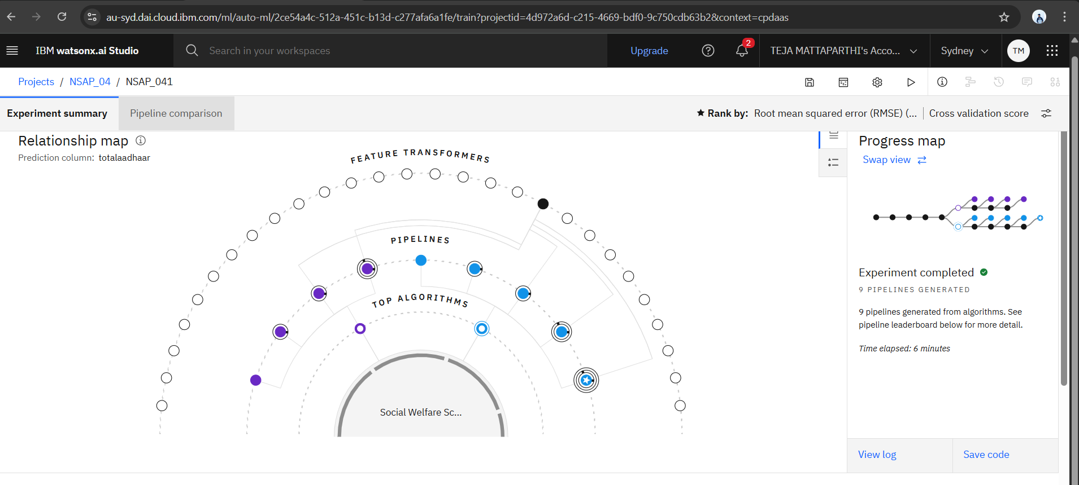
ResultS

Slide 9
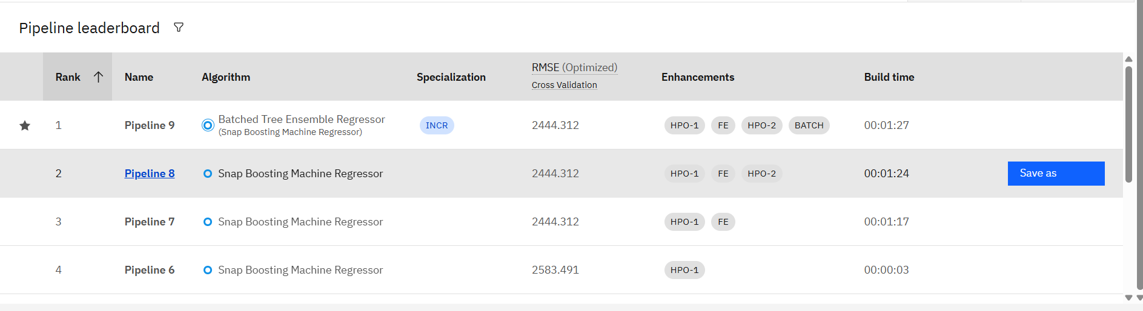

Slide 10
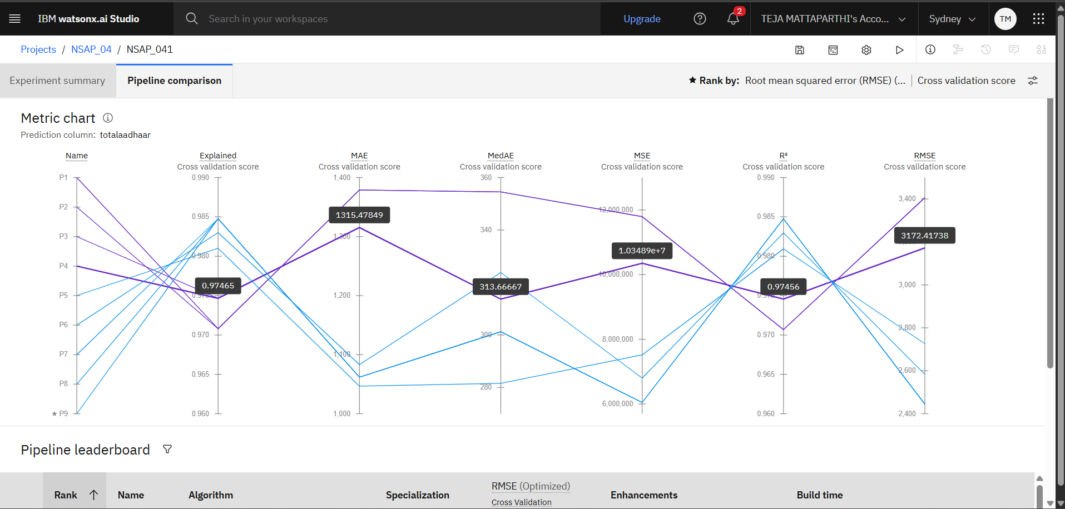

Slide 11
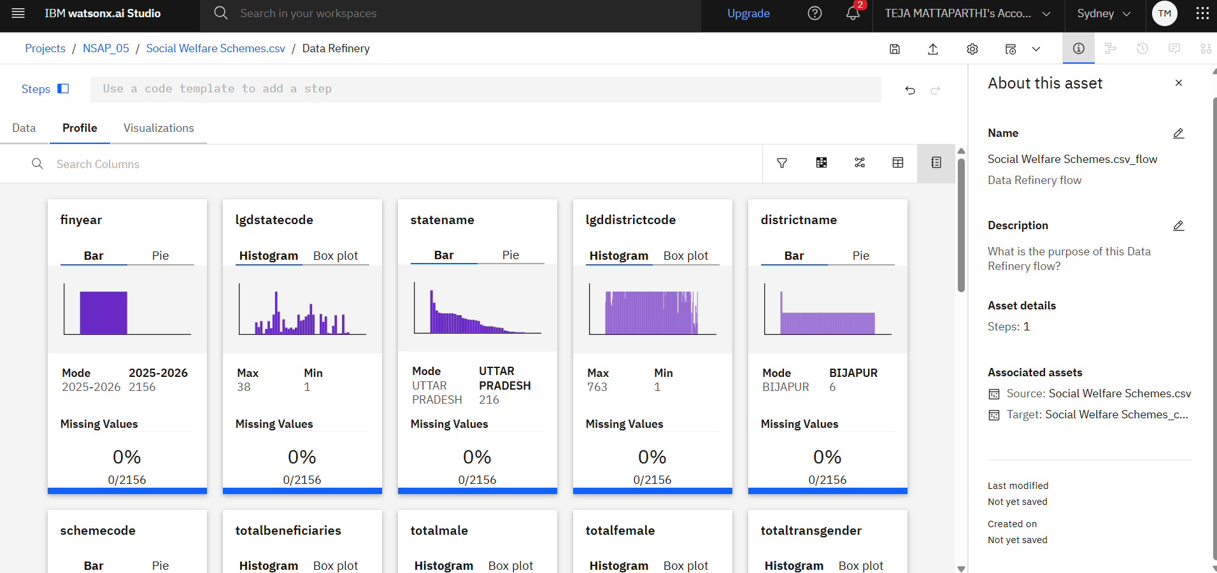

Slide 12
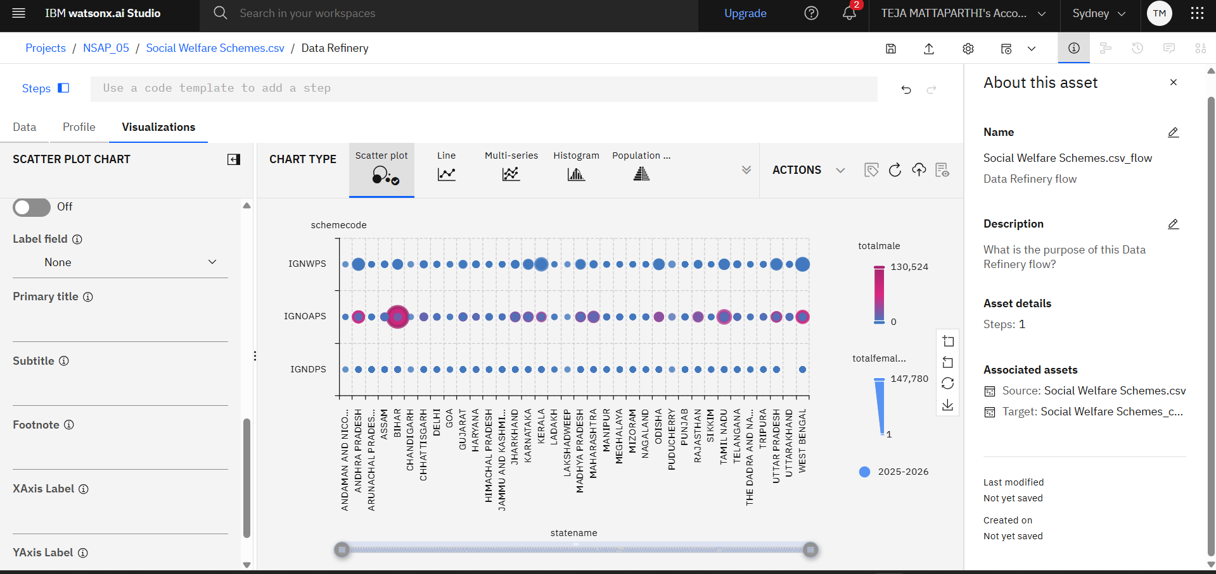

Slide 13
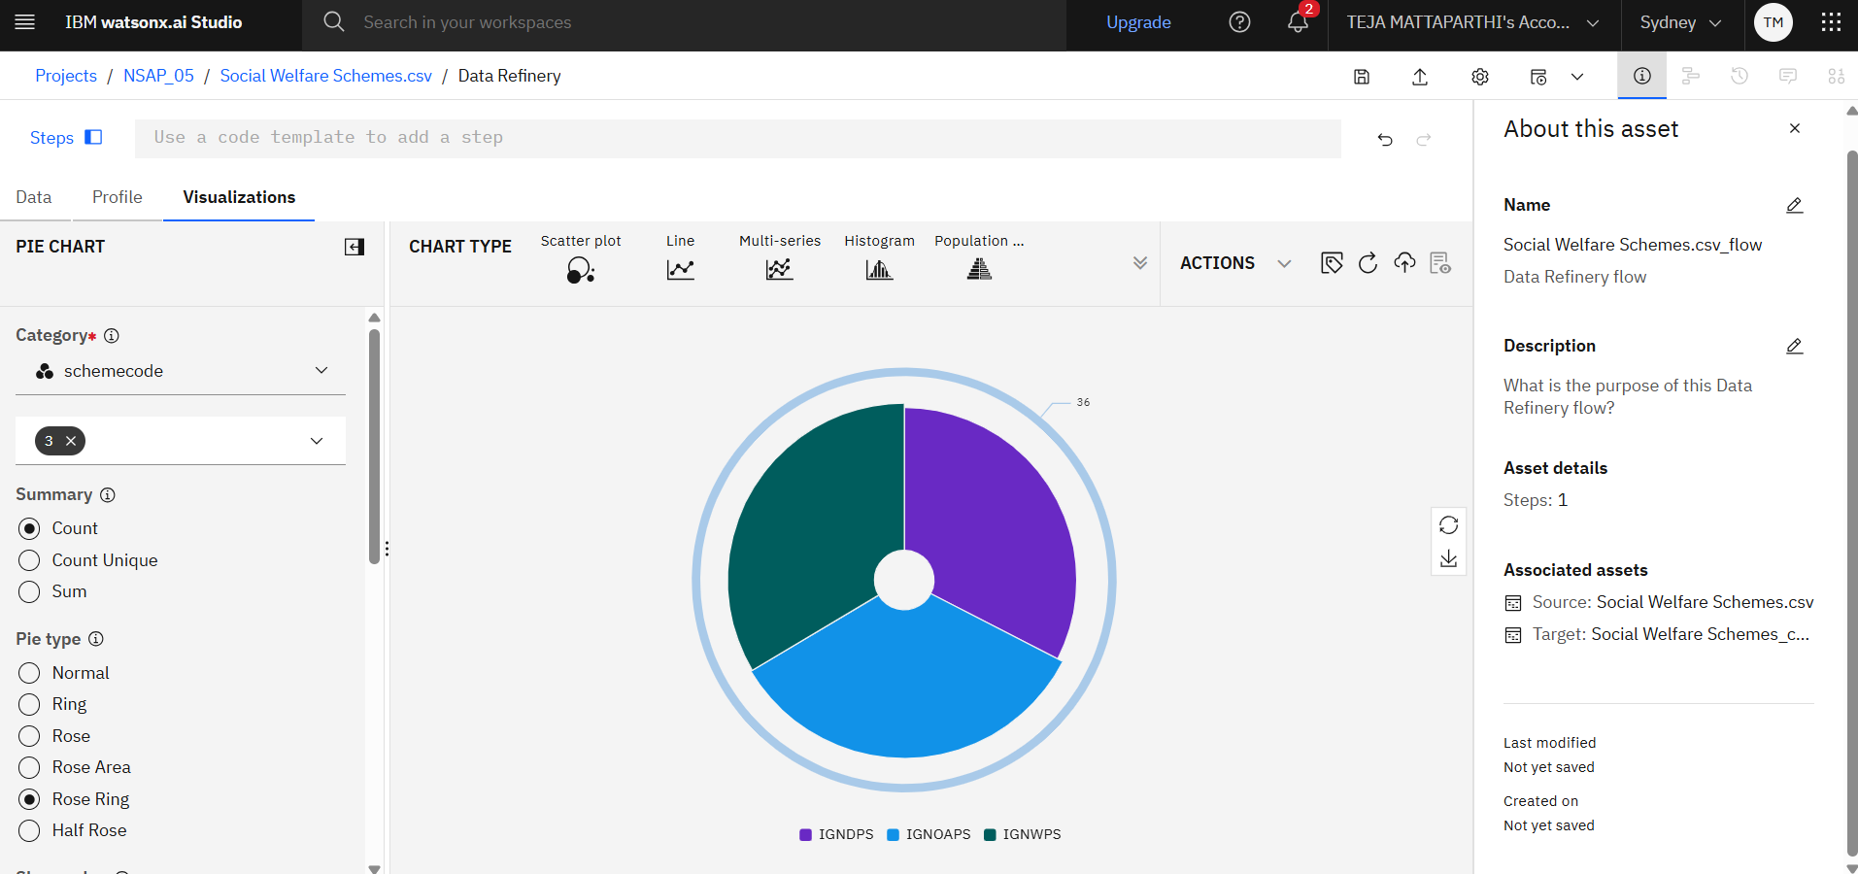

Slide 14
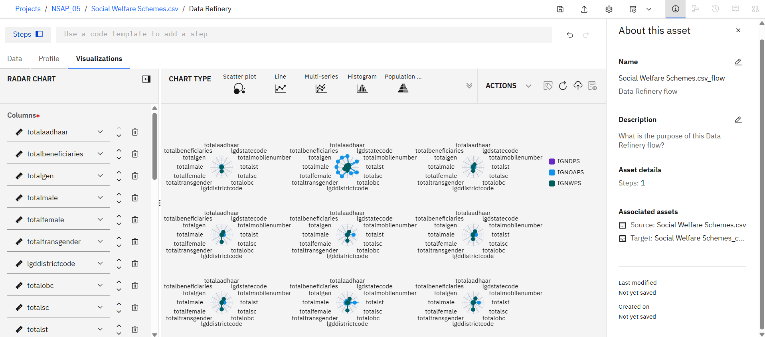

Slide 15
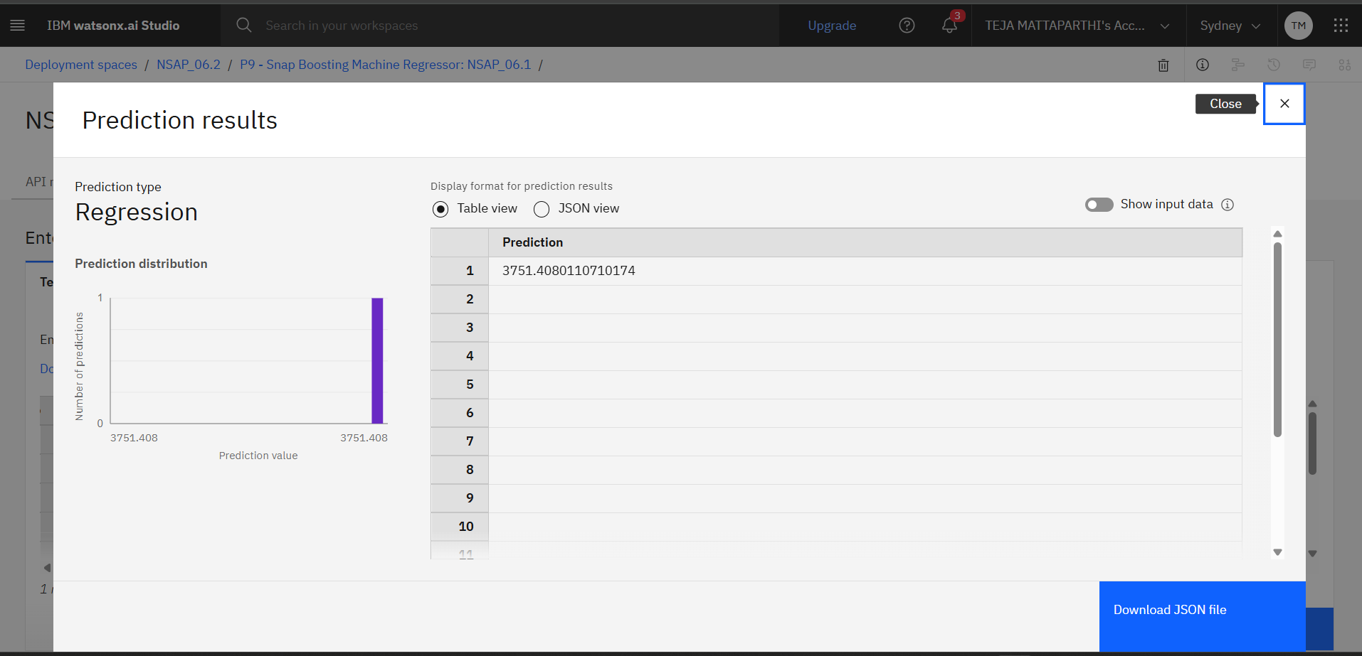

Slide 16
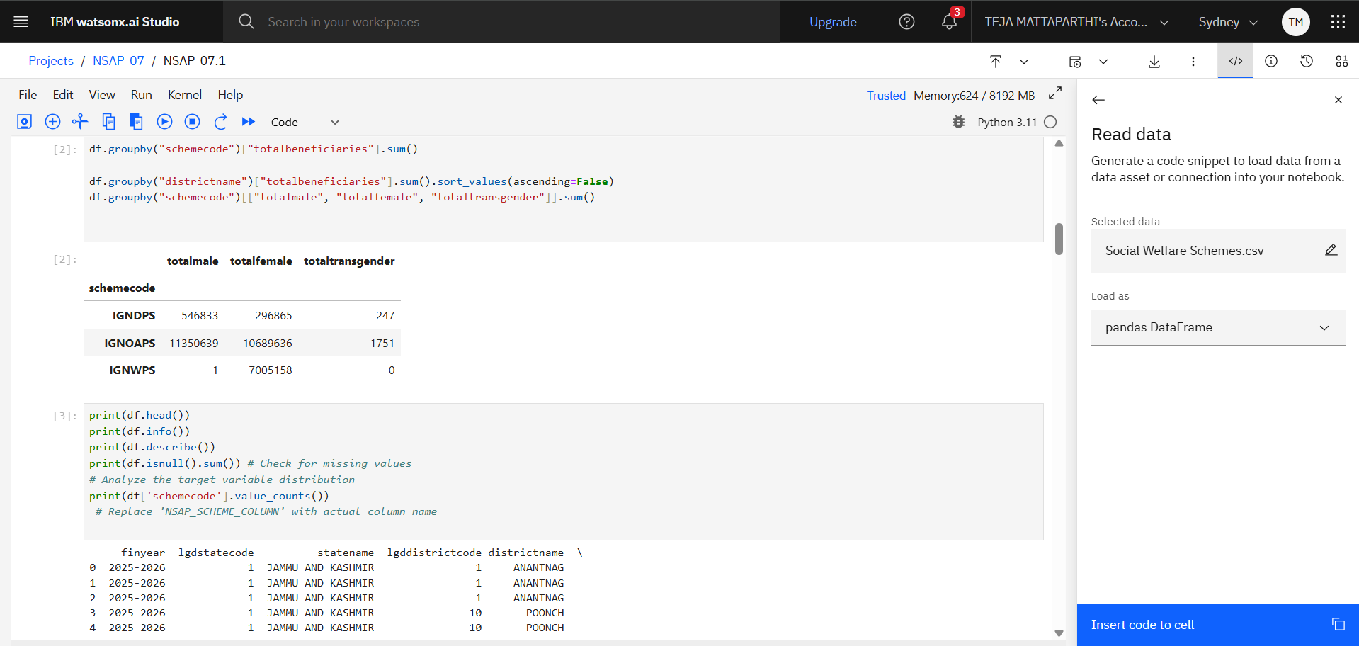

Slide 17
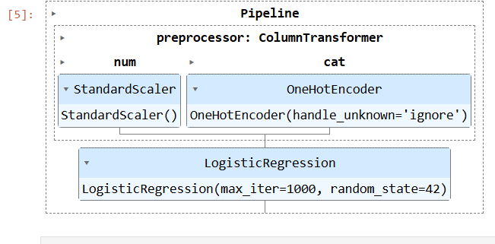

Slide 18
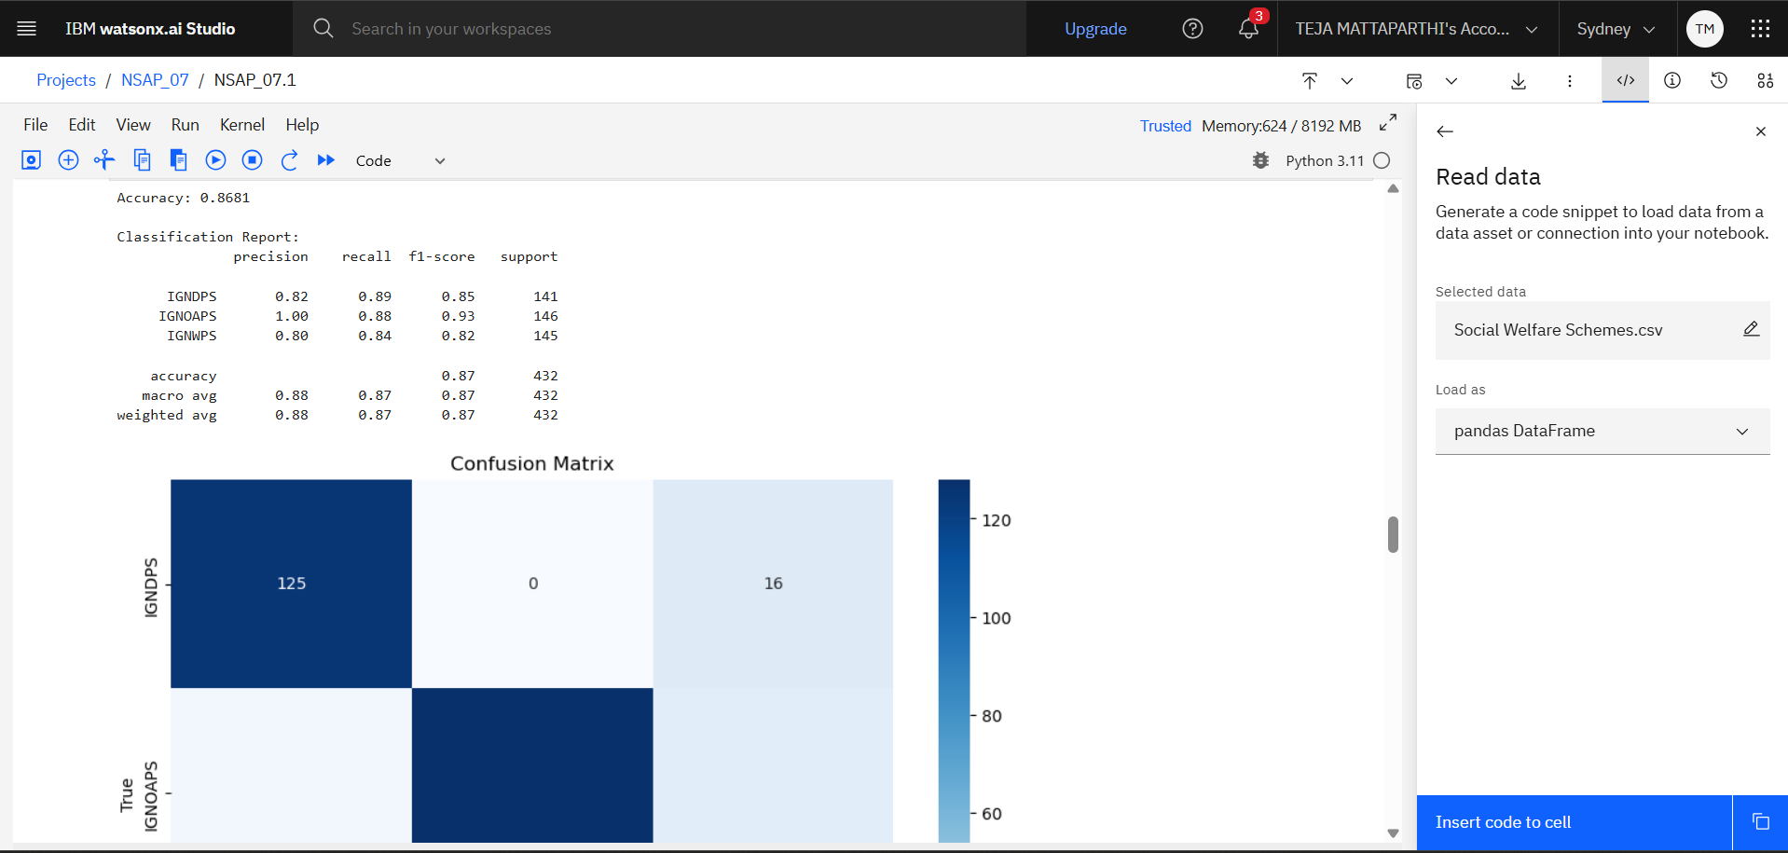

Slide 19
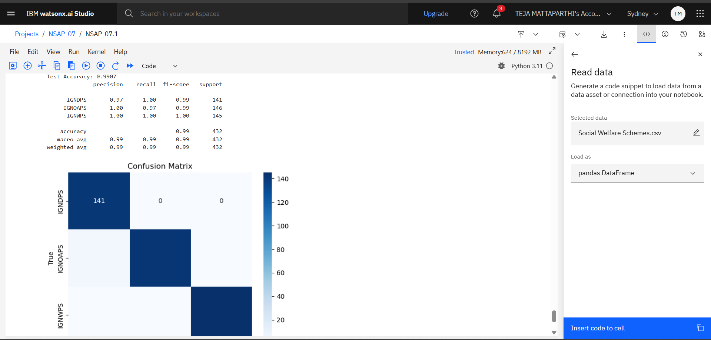

Slide 20
Conclusion
Summarize This project successfully demonstrates how AI and IBM Cloud can automate the eligibility prediction process for NSAP schemes, replacing manual verification with fast, accurate, and reliable classification. By training a machine learning model on real-world socio-economic data, we ensure that deserving individuals receive the right scheme on time.
The deployed model, accessible via a REST API, offers a practical, scalable, and ethical solution that can be integrated into government platforms. It improves efficiency, transparency, and fairness in welfare delivery — marking a meaningful step toward digitally empowered public service.

Slide 21
Future scope
Real time data streams: Integrate the model from government databases or application portals
Explainable AI : Incorporate tools like LIME or SHAP to provide a clear rationale for each prediction
Unstructured Data Analysis: Expand the model's capabilities to include unstructured data from applicant forms
Continuous Learning: Implement a system for model retraining and performance monitoring
Integration with Government Portals: The deployed REST API endpoint is the key to integration
Mobile Application Development: A mobile application could be developed for field workers
Fraud Detection: The model could be re-purposed or enhanced to identify anomalies
Examples: Mobile integration, multilingual input, periodic model retraining, expansion to other welfare schemes, fraud detection ad-on

Slide 22
GITHUB LINK & References
GITHUB LINK:
https://github.com/Teja1123-alt/Predict_Eligibility_For_NSAP_Schemes
References:
IBM Cloud Lite Cloud platform used for hosting, ML development, and deployment 🔗 https://cloud.ibm.com/
IBM Watson Studio Machine Learning and Data Science platform used to build and train the model 🔗 https://dataplatform.cloud.ibm.com
Scikit-learn Python machine learning library (used in manual modeling) 🔗 https://scikit-learn.org/
National Social Assistance Programme (NSAP) Ministry of Rural Development, Government of India 🔗 https://nsap.nic.in/

Slide 23
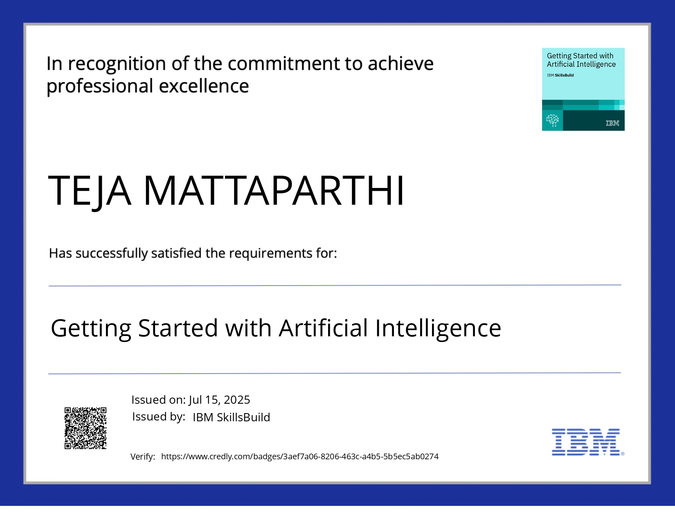
IBM Certifications: Getting started with artificial intelligence:

Slide 24
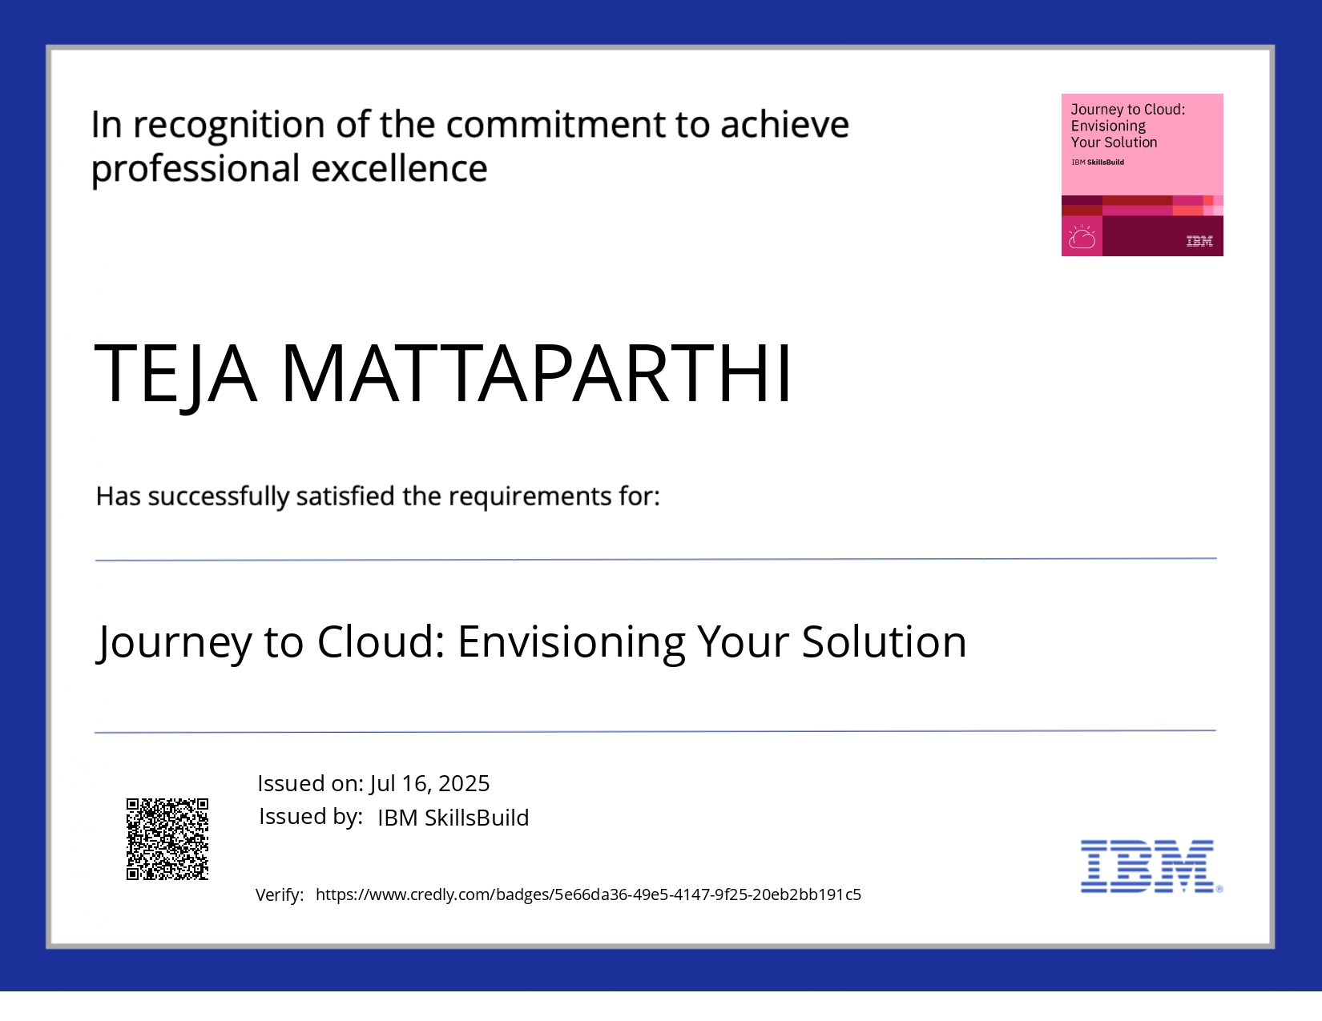
IBM Certifications Journey to cloud: envisioning your solution

Slide 25
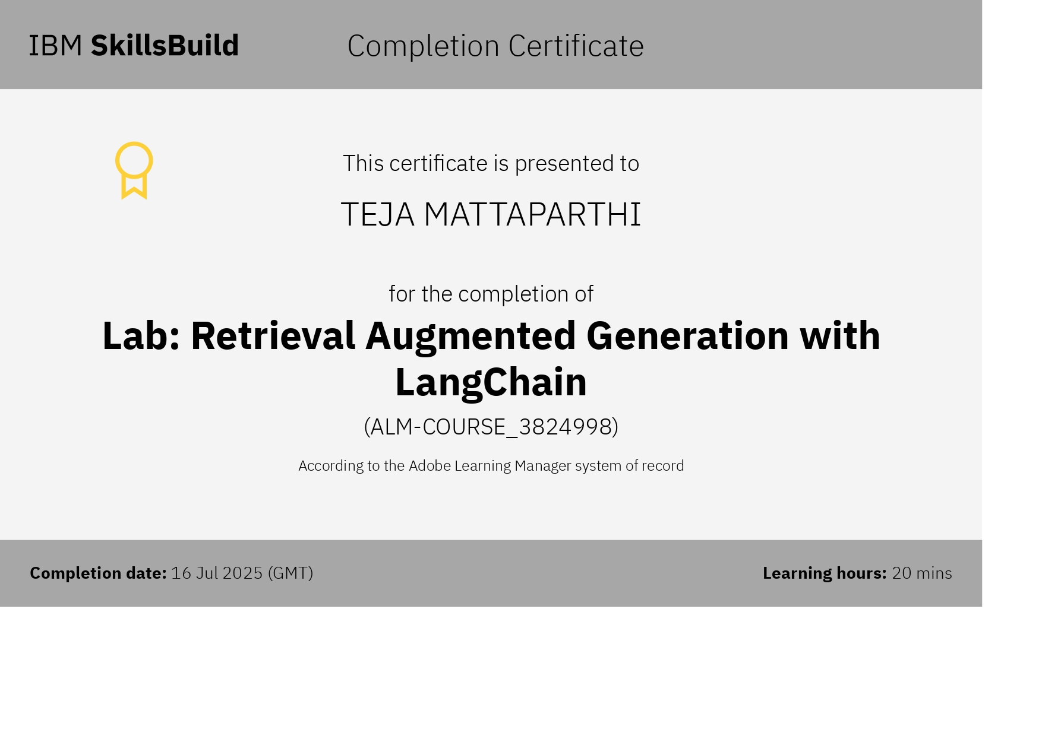
IBM Certifications: retrieval augmented generation with langchain

Slide 26
THANK YOU

