Slide 1
DESIGN OF A 4-BIT BINARY ARITHMETIC CALCULATOR
Add, Subtract, Multiply and Divide implemented in Logisim
Batch Number:1
Thummeti Teja-2620030003
Prakash Machgaiya-2620030067
ANANYA MALKAPURAM-2620030060
Sai Lakshmi Harshini Pemmaraju-2620030063

Slide 2
Introduction
Digital arithmetic is the core of every processor: the ALU performs add, subtract, multiply and divide on binary data.
Combinational building blocks (gates, full adders, multiplexers) are combined to build multi-function arithmetic units.
A 4-bit calculator is a compact model of a real ALU, ideal for learning datapath design and simulation.
Logisim allows the circuit to be built, tested and verified before any hardware realisation.
4
bit operands
4
operations
1
output bus
2

Slide 3
Problem Statement
Design a 4-bit binary arithmetic calculator capable of performing addition, subtraction, multiplication and division.
Limitations
Need
Challenge
Fixed 4-bit width (0–15); results can overflow; division gives integer quotient and remainder only; unsigned inputs.
Separate circuits per operation waste hardware. A single selectable unit is compact and easier to control.
Reusing one adder for both add and subtract, and merging four operation results onto one 4-bit output.
3

Slide 4
Objectives
1
Design a 4-bit adder using a ripple chain of four full adders.
2
Reuse the same adder for subtraction using B inversion and carry-in (2's complement).
3
Include a multiplier and a divider unit for the remaining operations.
4
Select the required result on a single 4-bit output using a multiplexer.
5
Simulate in Logisim and verify results against expected values.
4

Slide 5
Existing System
Existing approaches
Limitations
• Standalone ripple-carry adders and separate subtractor circuits
• Dedicated array multipliers and restoring dividers built as independent modules
• Commercial ALU ICs (e.g. 74181) with fixed function sets
• Software emulation on microcontrollers
• Add and subtract built as two circuits duplicate hardware
• No single interface to choose among all four operations
• Fixed ICs are hard to modify or study internally
• Software solutions are slower than combinational logic
5

Slide 6
Proposed System
Unified add / subtract
Ripple-carry adder
B is conditionally inverted per bit and a carry-in is applied, so one adder does both.
Four 1-bit full adders chained through their carry outputs (Cin to Cout).
Multiply and divide units
Mode-selected output
Dedicated multiplier and divider blocks operate on the same A and B inputs.
A multiplexer with a select input chooses which result reaches the 4-bit output.
6

Slide 7
Block Diagram
Mode select
Input A
(4-bit)
4-bit ripple adder
(4 full adders, Cin)
4:1 MUX
(output select)
Output
4-bit
Input B
(4-bit)
B inversion
(NOT / XOR + MUX)
Multiplier
Divider
7

Slide 8
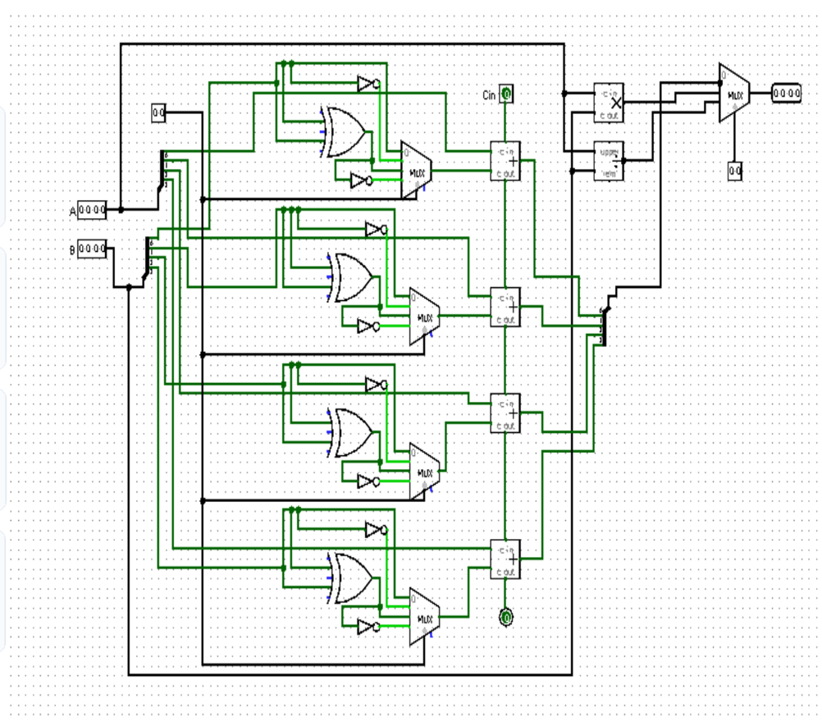
Logisim Implementation
Inputs: two 4-bit pins A and B, a 2-bit select pin and a Cin pin.
Four identical bit-slices: each has NOT gates, an XOR/OR gate and a 2:1 MUX to condition the B bit.
Each slice feeds a 1-bit adder; carries ripple from Cin at the top to the last Cout at the bottom.
A splitter merges the four sum bits into one 4-bit bus.
Multiplier and divider blocks receive A and B directly.
A final 4:1 MUX drives the 4-bit output pin.
8

Slide 9
Working Principle
1
Bit conditioning
For each bit, B passes through NOT gates and a MUX so it is either B or its complement, depending on the operation.
2
Addition
With B unchanged and Cin = 0, the ripple adder computes S = A + B.
3
Subtraction
With B inverted and Cin = 1, the adder computes A + (~B) + 1 = A − B (2's complement).
4
Multiply / divide
Dedicated blocks compute A × B and A ÷ B (quotient, remainder) in parallel.
5
Output selection
The select bits pick one of the results and route it to the 4-bit output.
9

Slide 10
Results and Discussion
Expected outputs for A = 0101 (5) and B = 0011 (3)
Operation | Expression | Decimal | 4-bit output
Addition | A + B | 8 | 1000
Subtraction | A − B | 2 | 0010
Multiplication | A × B | 15 | 1111
Division | A ÷ B | Q = 1, R = 2 | 0001 (Q)
Results match hand calculation for all four operations when the mode select is changed.
Outputs are 4-bit, so results above 15 wrap around (overflow), e.g. 9 × 3 = 27 shows as 1011.
Add screenshots of your Logisim runs here before submission.
10

Slide 11
Conclusion
Unified datapath
Complete calculator
Verified
One ripple adder handles both addition and subtraction.
Add, subtract, multiply and divide are available from one circuit.
Logisim simulation matched the expected results.
11

