Slide 1
Design and Optimization of a Four-Wheeler Suspension System
TEAM MEMBERS
D.TEJA-ME23BT049
M.PREM SAI -ME23BT037
N.MAHESH- ME23BT035

Slide 2
OBJECTIVE
Analyze and design a four-wheeler suspension consider static and dynamic loads. Perform fatigue and stress analysis using DME data. Propose an optimized design balancing strength and ride comfort.

Slide 3
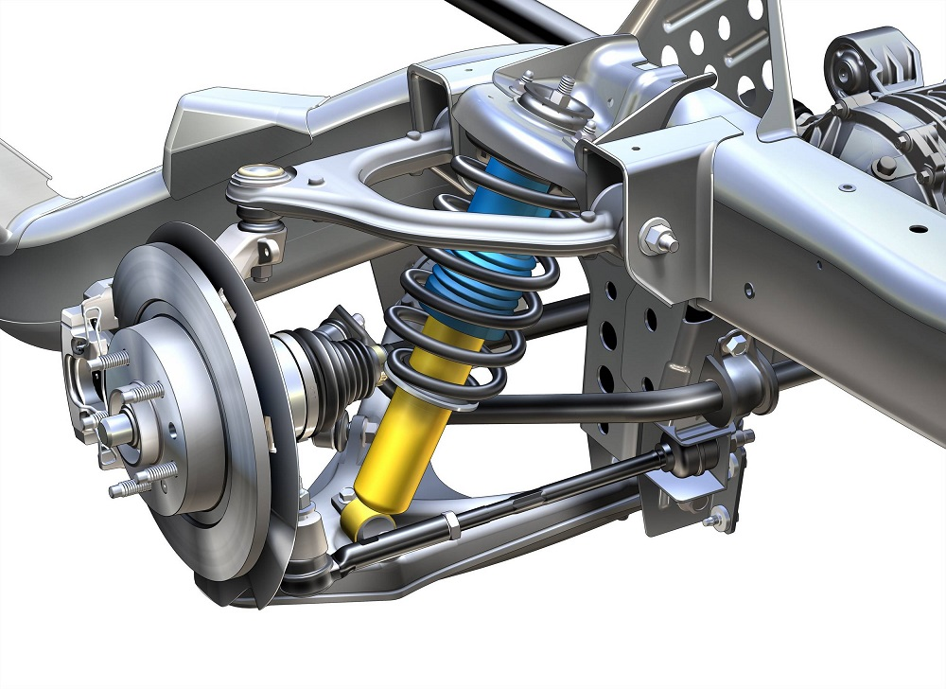
Project Overview &Problem Statement
This project focuses on analyzing and designing a helical coil spring suspension considering real loading conditions.
Both static (vehicle weight) and dynamic (road-induced shocks) loads are evaluated.
In this project, a helical coil spring integrated within a double-wishbone system is analyzed and designed.
Suspension performance must be enhanced without compromising comfort, safety, or manufacturability.
The project evaluates performance parameters such as stiffness, damping, stress, and fatigue life to improve overall suspension efficiency.

Slide 4
Project Overview &Problem Statement
The study focuses on a double wishbone suspension system integrated with a helical coil spring and damper, commonly used in passenger vehicles for stability and ride comfort.
Select materials for spring, damper, and wishbone arms that can safely carry vehicle loads while minimizing weight and cost.
Develop a CAD model and assembly that captures real-world constraints: suspension travel, clearances, and manufacturability.
Analyze and optimize the spring–damper–wishbone system to ensure structural integrity, ride comfort, and handling performance.

Slide 5
DESIGN CONSIDERATIONS
Structural Integrity
Use high-strength, fatigue-resistant materials for spring, damper, and wishbone.
Design joints and contacts to avoid stress concentrations.
Ensure adequate safety factors for static and fatigue loads
2. Ride Comfort:
Tune spring stiffness to absorb bumps.
Set damper coefficient to control oscillations without harshness.
3. Minimum Ride Height
Ensure the suspension allows proper ground clearance and ergonomically safe vehicle entry/exit without bottoming out.

Slide 6
DESIGN CONSIDERATIONS
4. Damper Ergonomics
Damper and spring response should provide smooth motion with minimal driver input force for comfort and control.
5. Wishbone Geometry
Dimensions of wishbone arms to achieve correct wheel travel and kinematics while keeping the system compact.
6. Link Geometry & Joint Placement
Proper geometry and pivot placement ensure smooth motion, uniform load distribution, and stable suspension operation.
7. Base & Wheel Stability
Suspension geometry and spring–damper tuning should maintain vehicle stability, center of gravity, and handling performance during turns, bumps, and braking.

Slide 7
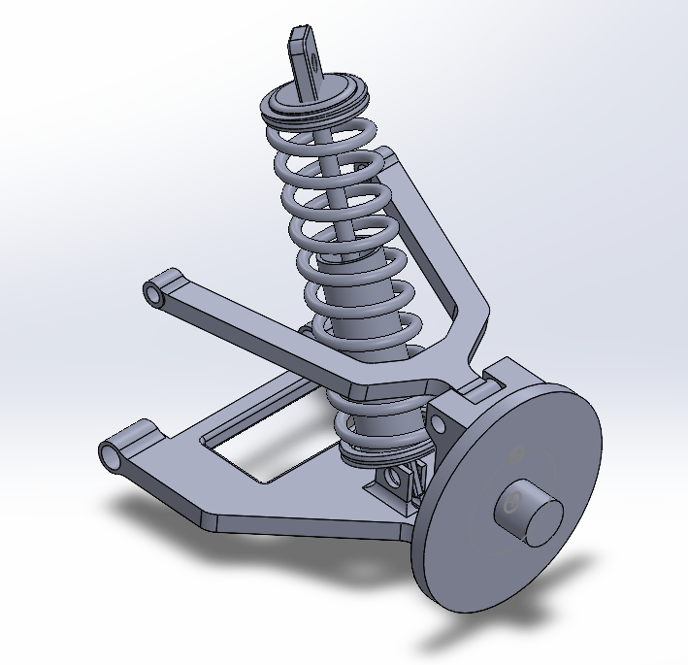
MODELING AND ASSEMBLY
Here are the CAD-modeled components that form the complete four-wheeler suspension assembly, including the helical coil spring, hydraulic damper, and double-wishbone arms.
These visuals help in understanding the geometry, mounting points, kinematics, and overall interaction between the spring–damper unit and the wishbone linkage.
They also illustrate how the spring and damper compress and extend during wheel movement,the upper and lower wishbones control wheel alignment and motion path

Slide 8
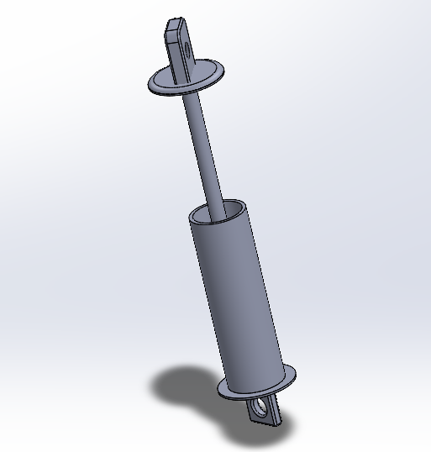
MODELING AND ASSEMBLY
Damper (Mono-Tube):
Material Selection:
High-strength steel or aluminum alloys
Polymer or rubber sealing materials
Function:
Controls spring oscillations
Improves ride stability and handling
Reduces Vibrations & Impacts

Slide 9
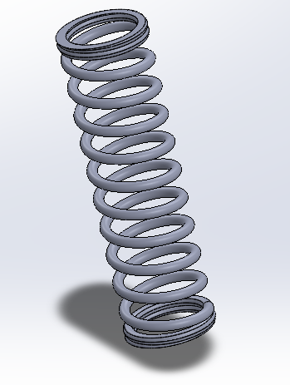
MODELING AND ASSEMBLY
Helical Spring:
Material Selection:
Chrome–Silicon (Cr–Si) Steel
High strength, excellent fatigue resistance, ideal for heavy-load and high-stress suspension springs.
Chrome–Vanadium (Cr–V) Steel
Good toughness, high endurance limit, better performance under repeated dynamic loads.
Spring Steel (High-Carbon Steel)
Cost-effective, reliable option with good elasticity and durability for standard suspension systems.
Function:
Supports Vehicle Weight
Absorbs Road Shocks
Maintains Suspension Geometry

Slide 10
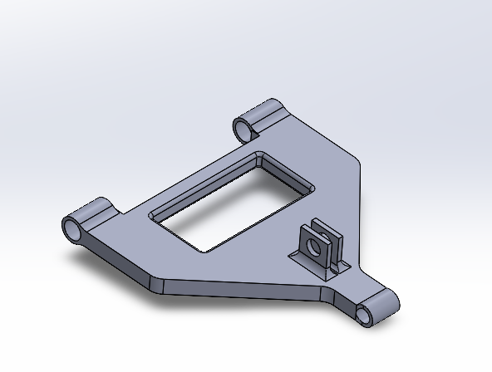
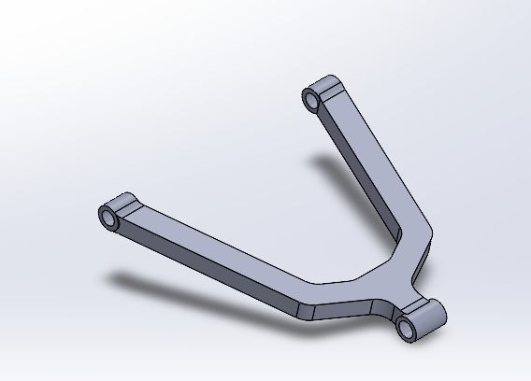
MODELING AND ASSEMBLY
Double Wishbone :
Material selection:
High-strength steel (mild steel or alloy steel)
Aluminum alloy (e.g., 6061-T6 or 7075-T6)
Forged steel (for high-performance)
Upper Wishbone (A-Arm):
Function:
Controls upper wheel movement
Provides mounting for damper/spring
Improves vehicle handling
Lower Wishbone (A-Arm):
Function:
Guides vertical wheel travel
Carries main suspension load
Ensures stable support and alignment of the shock absorber.

Slide 11
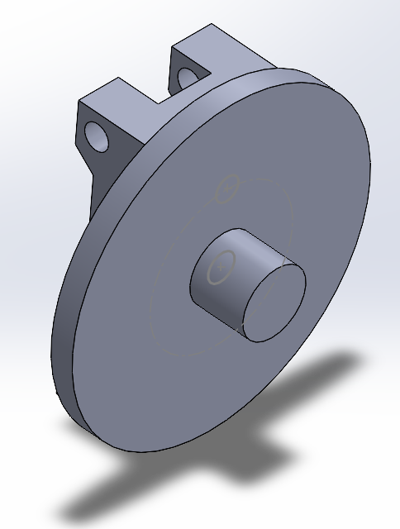
MODELING AND ASSEMBLY
HUB:
Material Selection:
High-strength steel (mild steel or alloy steel)
Aluminum alloy (e.g., 6061-T6 or 7075-T6)
Forged steel (for high-performance)
Function:
Supports and connects suspension components
Maintains wheel alignment and load distribution
Provides a rigid base for rotation and braking loads

Slide 12
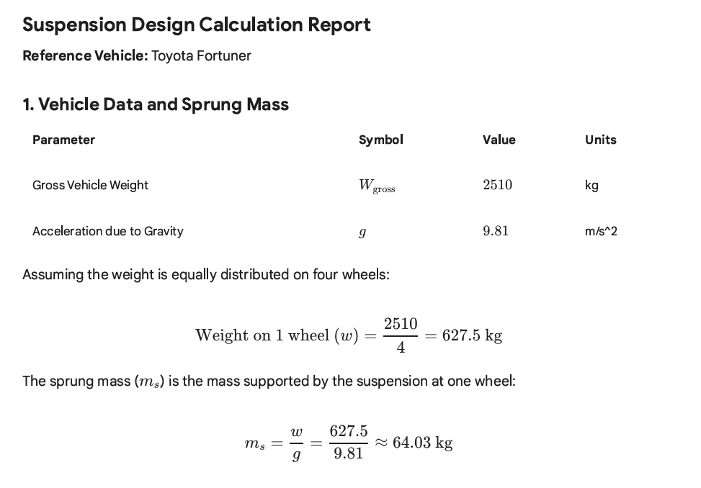
CALCULATIONS
-FOR SPRING

Slide 13
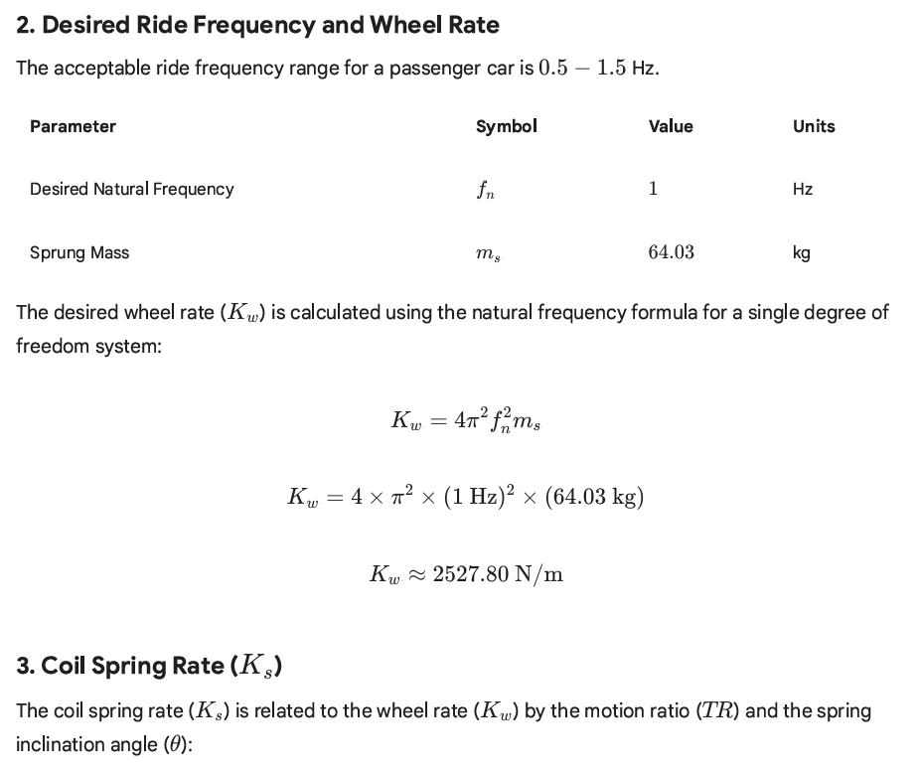
CALCULATIONS

Slide 14
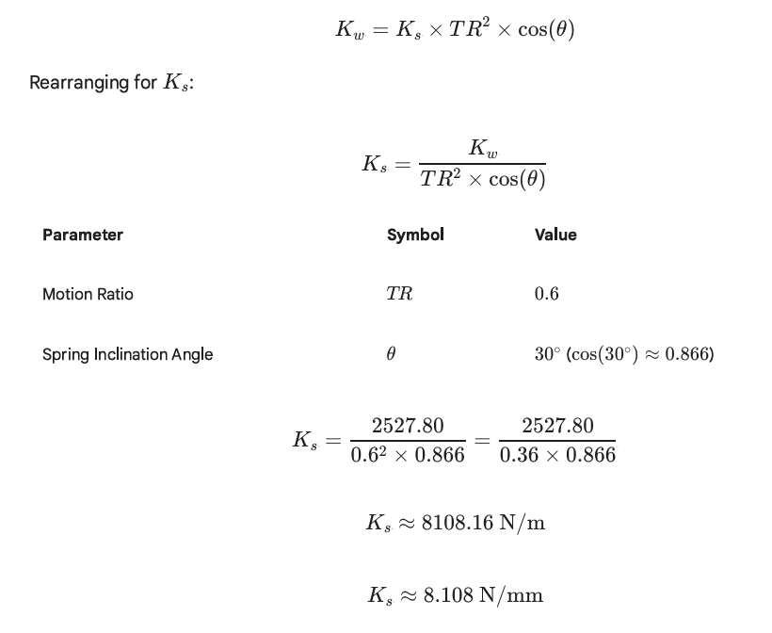
CALCULATIONS

Slide 15
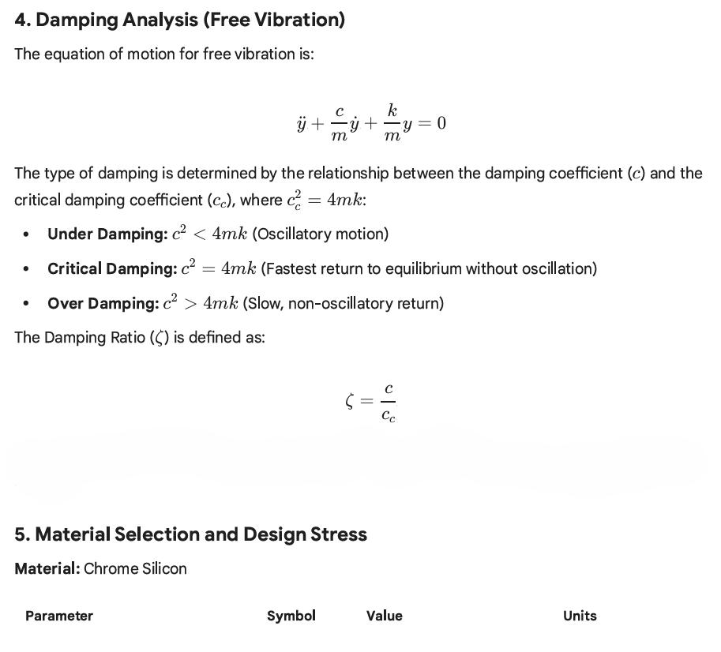
CALCULATIONS

Slide 16
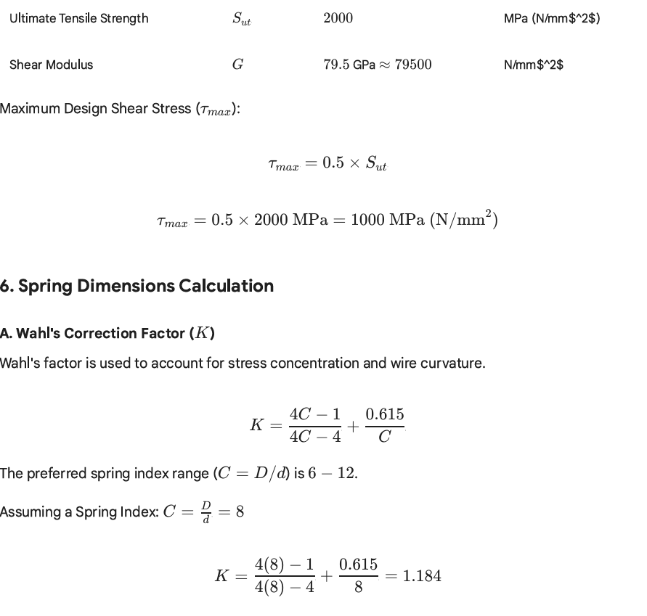
CALCULATIONS
according to tresca theory

Slide 17
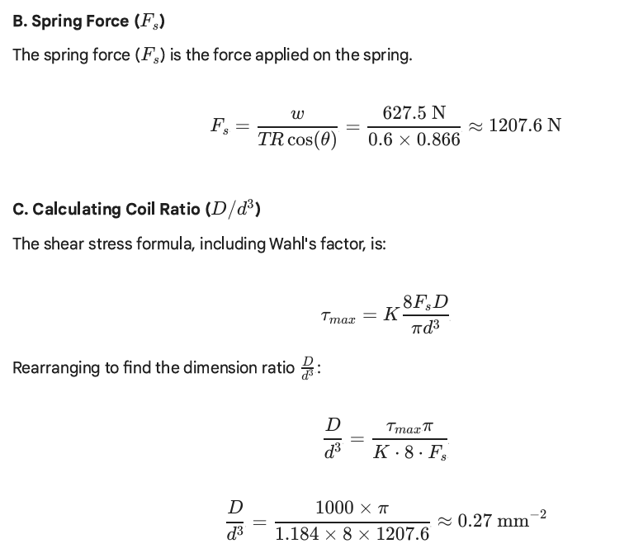
CALCULATIONS

Slide 18
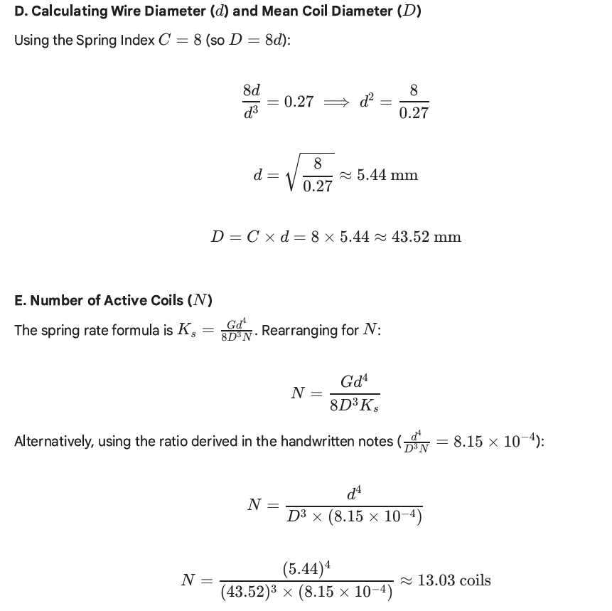
CALCULATIONS

Slide 19
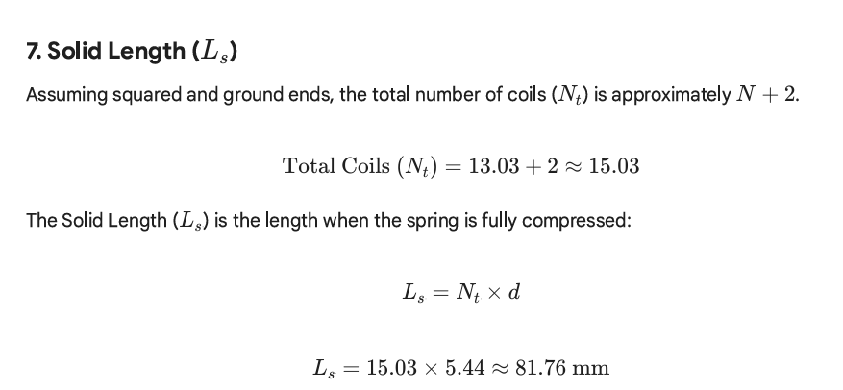
CALCULATIONS

Slide 20
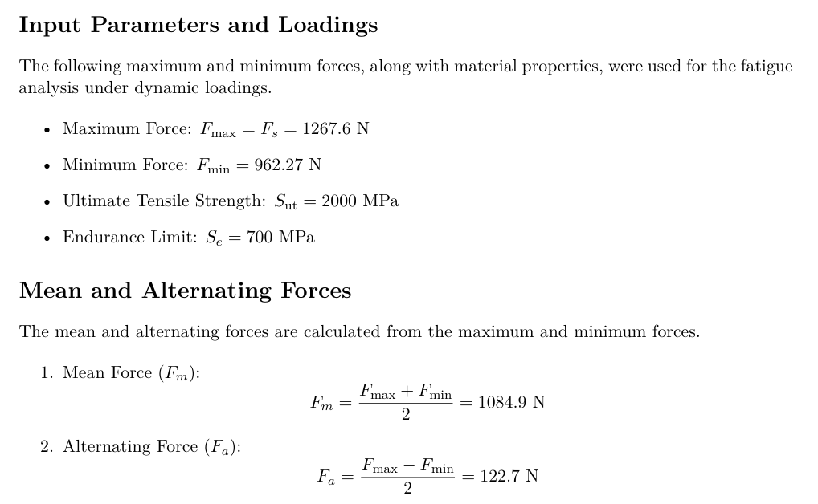
CALCULATIONS
-FOR FATIGUE

Slide 21
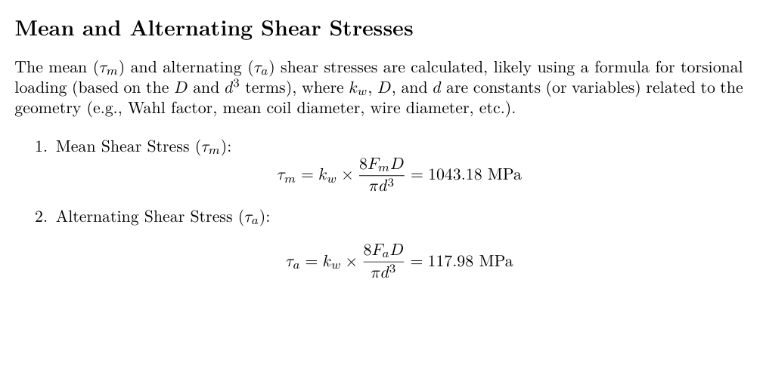
CALCULATIONS

Slide 22
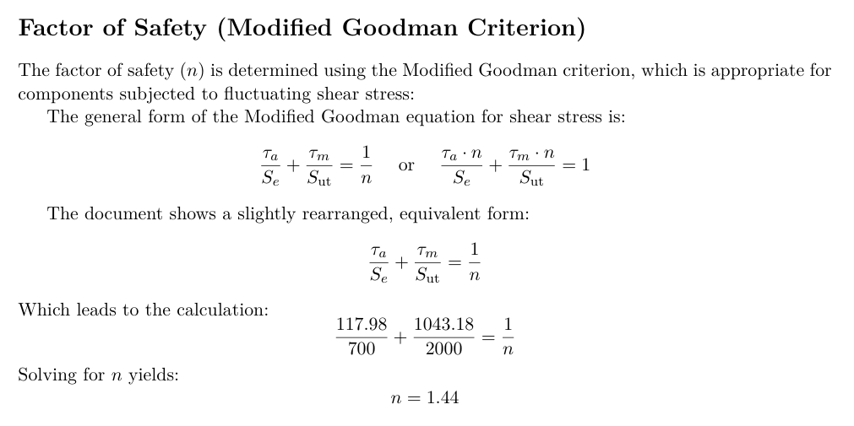
CALCULATIONS

Slide 23
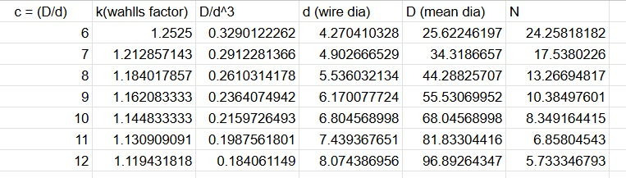
CALCULATIONS

Slide 24
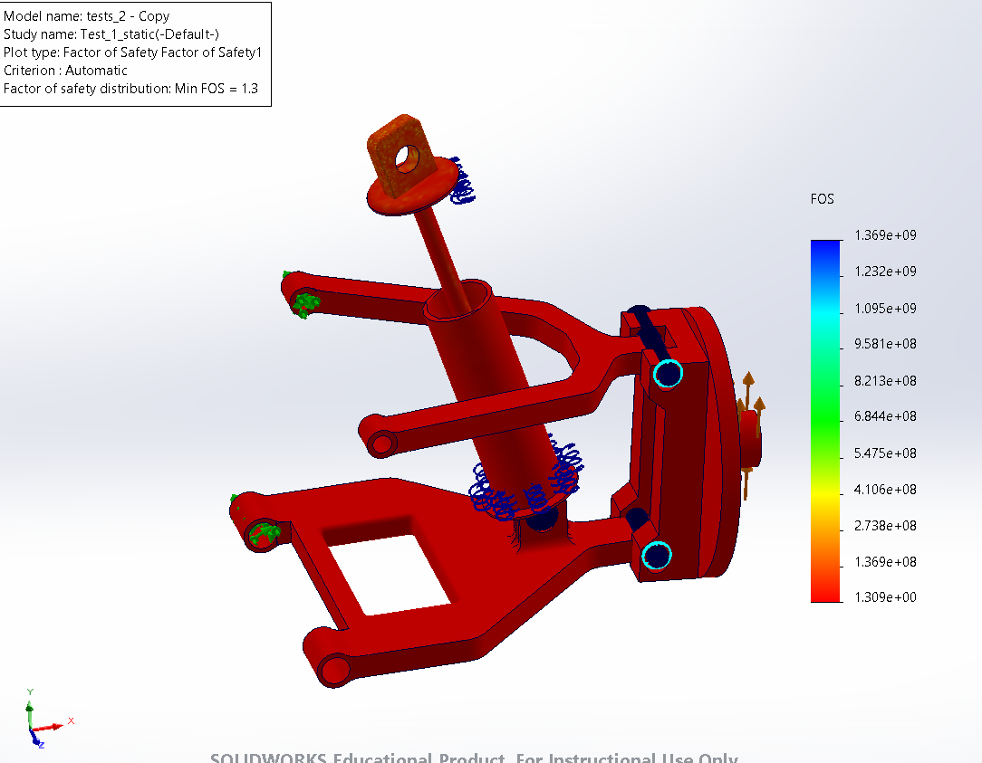
FEA

Slide 25
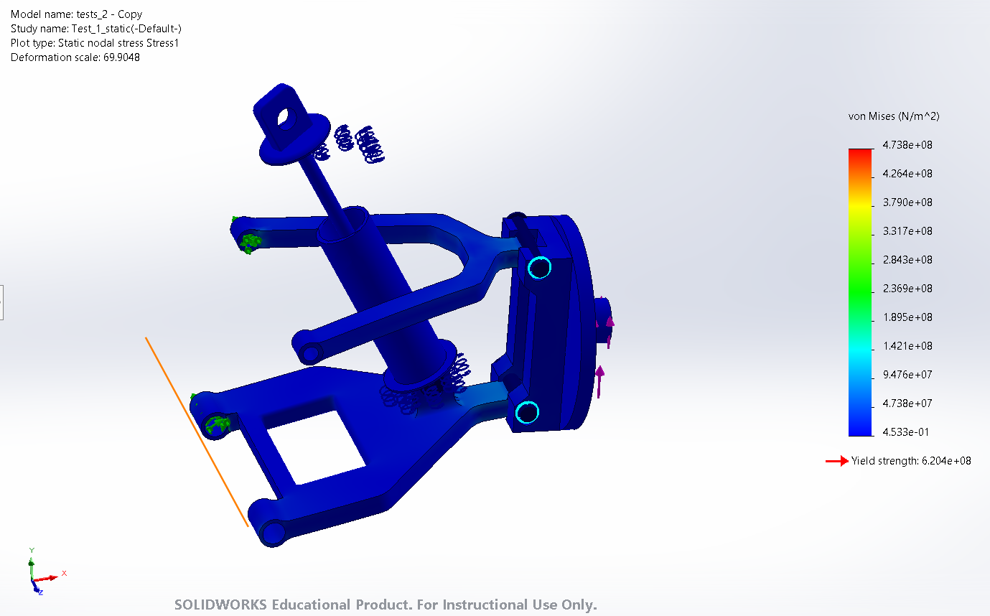
FEA

Slide 26
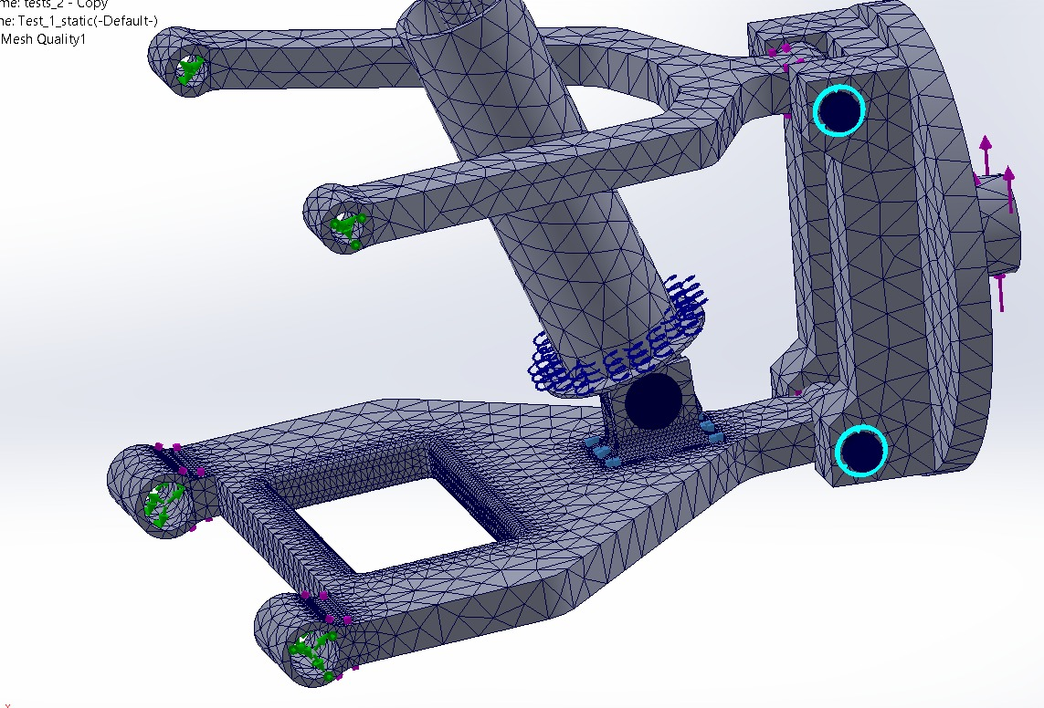
FEA

Slide 27
CONCLUSION
The suspension system was successfully designed and optimized using a helical spring, damper, and double-wishbone geometry. Material selection and FEA ensured safe stress limits, proper stiffness, and improved vibration control. The final design achieves a balanced combination of ride comfort, stability, and structural strength, making it suitable for real-world vehicle conditions.

Slide 28
References
• Shigley’s Mechanical Engineering Design
• Automotive Suspension Manuals-
https://www.toyotabharat.com/documents/brochures/fortuner-mmc/combined-specsheet.pdf
• Research papers
https://www.ijcrt.org/papers/IJCRT2502631.pdf
youtube-
1)https://youtu.be/S_GraRRbxLg?si=6J07aS1lmIBHZagr
2)https://youtu.be/3CmynYyGpnY?si=Gk4DMdzRS7vpd2nl

