Slide 1

Industrial Predictive Maintenance System Using IoT | Real-time Monitoring Galla Divya Teja B.Tech – ECE

Slide 2
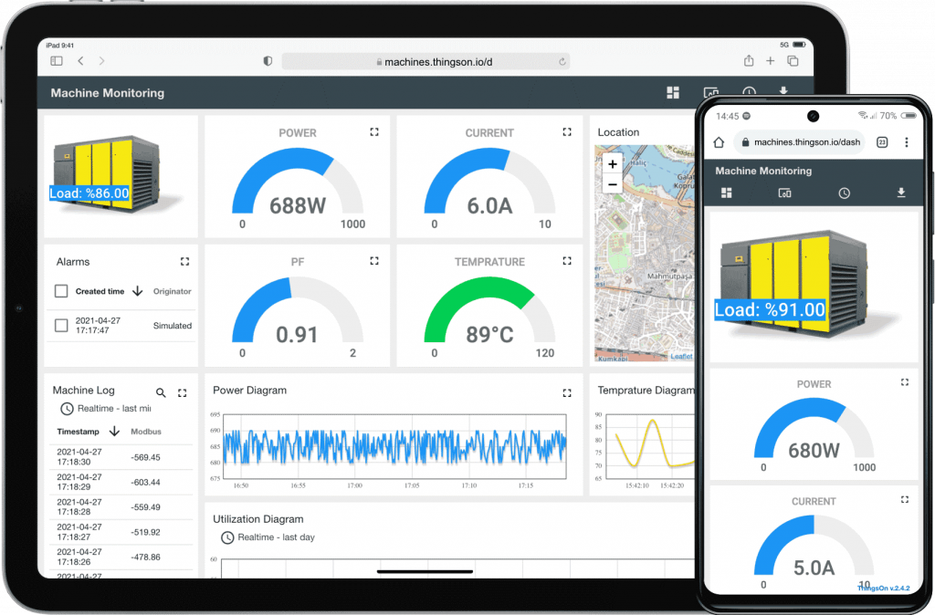
Introduction
IoT-based system for monitoring machine health
Uses real-time sensor data (temperature, vibration, pressure)
Detects abnormal conditions early
Improves efficiency and reduces downtime

Slide 3
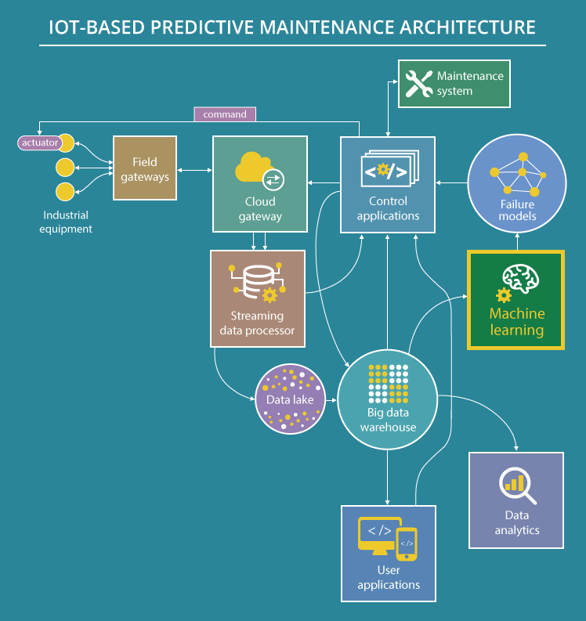
System Architecture
Sensors → NodeMCU → Data Processing → Decision → Alert

Slide 4
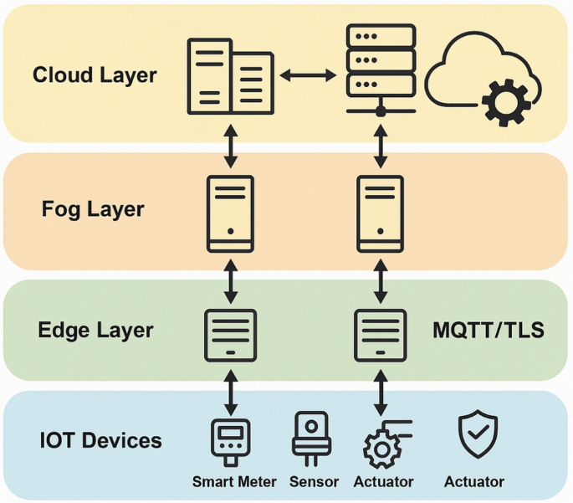
Proposed System
Continuous real-time monitoring
Threshold-based anomaly detection
Automatic alert generation
Scalable for industrial applications

Slide 5
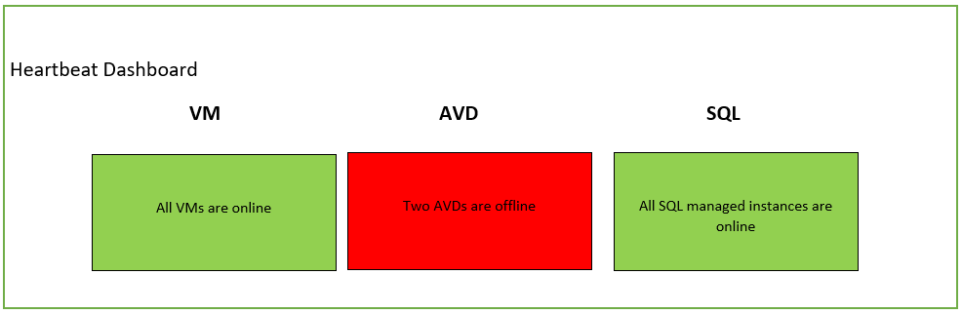
Output / Working
Threshold value = 70
Sensor > 70 → Maintenance Alert
Sensor ≤ 70 → System Normal
Example:
85 → Alert
45 → Normal

Slide 6
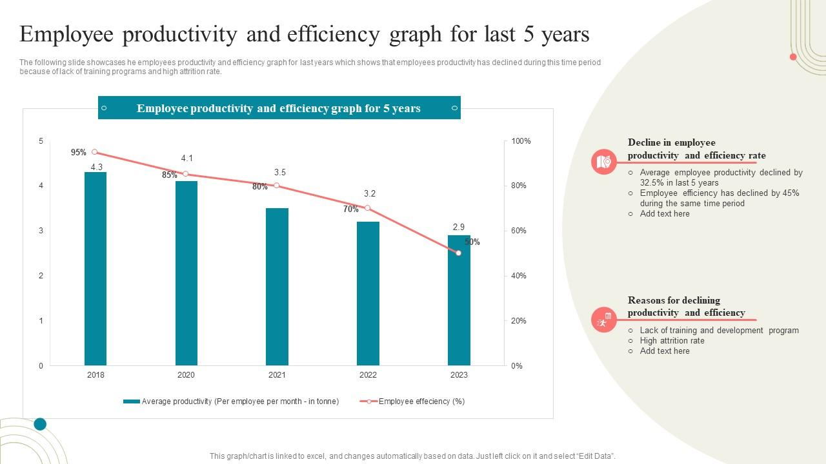
Advantages
Reduces downtime
Cost effective solution
Improves efficiency
Increases equipment life

Slide 7
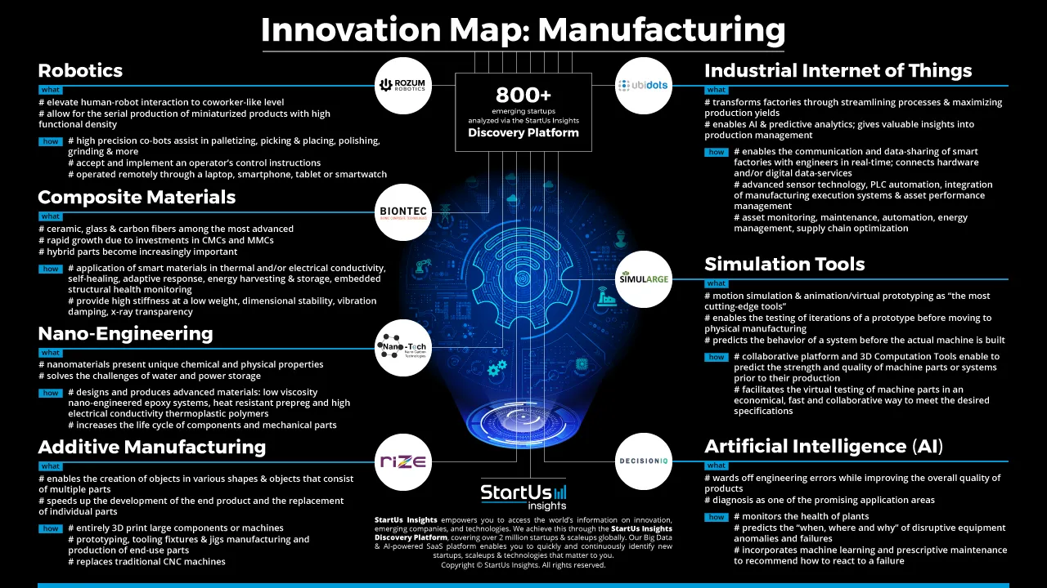
Future Scope
Integration with AI/ML for better prediction
Cloud-based remote monitoring
Advanced analytics and automation

