Slide 1

CHALAPATHI INSTITUTE OF ENGINEERING AND TECHNOLOGY(AUTONOMOUS) DEPARTMENT OF ELECTRONICS AND COMMUNICATION ENGINEERING
Industrial Predective Maintenance
Presented by
Batch 11
Galla Divya Teja Y21ECE036
Gottam Venkatesh Y21ECE048
Chintha Ramanji Y21ECE021
Induri Sivasai Lakshmi reddy Y21ECE054
Under the guidance of
T . Srinivasa Reddy Sir

Slide 2
ABSTRACT
Industrial predictive maintenance (PdM) is a proactive approach to equipment maintenance that uses advanced data analytics, machine learning, and sensor technologies to predict when machinery or assets are likely to fail. Unlike traditional reactive or preventive maintenance strategies, PdM aims to optimize maintenance schedules by detecting early signs of equipment degradation, enabling timely interventions that prevent unplanned downtime, reduce operational costs, and extend the life of machinery. The adoption of industrial predictive maintenance is transforming industries such as manufacturing, energy, and transportation, where equipment reliability is critical to operational success and safety.

Slide 3
INTRODUCTION
In the rapidly evolving world of industrial operations, the ability to predict and prevent equipment failures is crucial to maintaining optimal productivity and minimizing costly downtimes.
By using IoT sensors, data analytics, and machine learning, businesses can optimize their maintenance schedules and improve operational efficiency..
While this strategy helps mitigate unexpected failures, it can be wasteful, as it often involves replacing parts or conducting maintenance even when equipment is still in good working condition.

Slide 4
OBJECTIVE
The main objective of the Blockchain Based Digital Cheque Clearance and Verification system is to develop an alternative to the regular and traditional Cheque Clearance system to faster Digital Cheque Clearance in very less time by the help of blockchain system
The traditional CITS which use Magnetic ink character recognition(MICR) and Optical Character Recognition(OCR) technologies which focuses on the features of watermarks, ultraviolet light (UV) rays, pantographic images and various microscopic features on the scanned copy of the manual cheque has a limited functionality.

Slide 5
EXISTING SYSTEM
Current predictive maintenance systems face challenges related to sensor integration, data quality, cost, and scalability.
PdM systems rely on sensor networks, data acquisition systems, real-time monitoring, and predictive analytics.
Despite benefits, PdM systems face technological, financial, and operational challenges hindering widespread adoption and effective implementation.

Slide 6
PROPOSED SYSTEM
A new system is proposed to overcome these limitations, utilizing advanced technologies like IoT sensors, edge computing, cloud-based analytics, and AI models.
The proposed system aims to provide real-time, actionable insights to predict failures and optimize maintenance tasks, creating a more seamless and efficient predictive maintenance process.

Slide 7
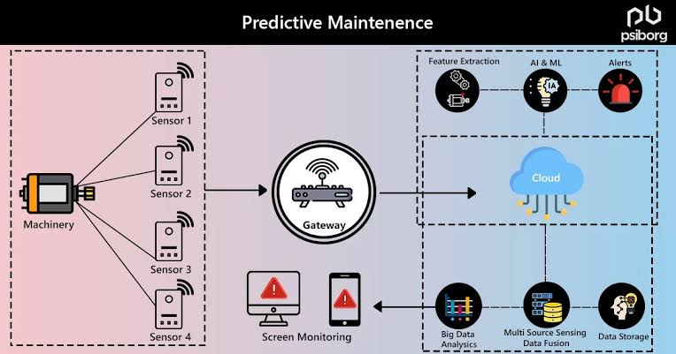
SYSTEM ARCHITECTURE

Slide 8
HARDWARE REQUIREMENTS
Processor - i5 or i7 processor
RAM -4 GB(min)
Hard Disk - 40 GB
Keyboard - Standard Windows Keyboard
Mouse - Two or Three Button Mouse
Monitor - SVGA 21

Slide 9
SORTWARE REQUIREMENTS
Operating system : Windows 7 Ultimate or above.
Coding Language : Python.
Front-End : HTML or CSS or Jupiter note .
Back-End : Flask or Stram

Slide 10
ANY QUERIES?

Slide 11
THANK YOU

