Slide 1
Flavour Fusion
TEAM MEMBERS:
IMT2020015 Pushkar Pawar
IMT2020056 Rudransh Dixit
IMT2020100 Teja Janaki Ram
IMT2020121 Manan Patel
IMT2020133 Darpan Singh

Slide 2
Novelty of the problem
Many people, when only a few ingredients are available in their homes, don’t think it is possible to make a dish that they like or atleast any dish.
Hence, they turn to ordering the food online
Our goal is to recommend dishes that they like with only the ingredients available to them.
Ultimately, we achieve making the user choose home-made food over restaurant-made food and also probably introduced him/her to new recipes and cuisines.

Slide 3
Dataset creation and preprocessing
Kaggle dataset - Crawled data from food.com (Formerly Genius Kitchen)
230K+ recipes and 1.1M+ ratings
Filtered users who didn’t give enough ratings from the Top-20 most common recipes

Slide 4
Data Analysis
Most of the features were in text form, therefore it does not contain any information that can be analysed statistically.
Only rating feature can be analysed statistically.
We have perform standard scaling of rating given by each user.

Slide 5
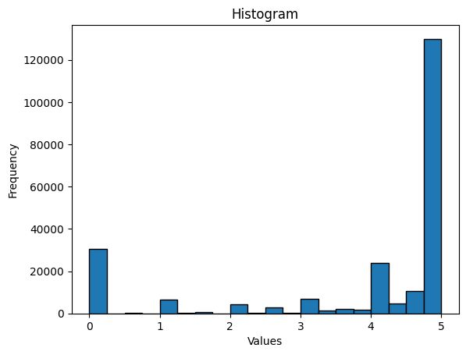
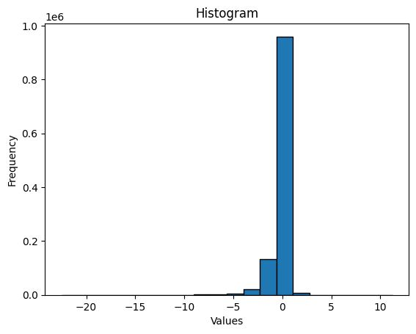
Before
After

Slide 6
Approach to solve
the problem

Slide 7
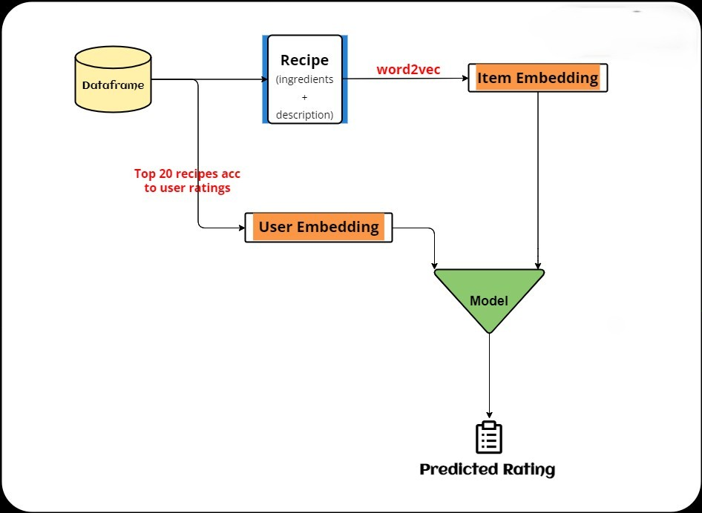

Slide 8
User embeddings
First we calculated top 20 most rated recipes
Now for each user we calculated its rating for the above top 20 recipes.
This list will act as user embedding.
For new user we first ask them to rate this top 20 recipes to get recommendation.

Slide 9
Item (recipes) embeddings
For each recipe we took its ingredient and description data
We applied word 2 vec to get its embeddings
Also tried BERT transformer but got poor results

Slide 10
Philosophy behind algorithm selection
Due to the huge dataset we used neural networks and tree based algorithms.
Got following results
Model | Train Accuracy | Test Accuracy
Light Gradient Boosting (LGBM) | 0.9056 | 0.8157
Xgboost | 0.8877 | 0.8413
Neural network | 0.8673 | 0.8562

Slide 11
Model Accuracy Using BERT
Model | Train Accuracy | Test Accuracy
Neural Network | 0.7410 | 0.6362

Slide 12
NN architecture
5 hidden layer
Relu activation function
Adam optimiser with MSE loss used
Added dropout after each layer for regularization
Gives rating as output

Slide 13
Algorithm Analysis
Neural Network (Regression Net) for different number of layers
Number of hidden layers | Training accuracy | Testing accuracy
3 | 0.79 | 0.69
4 | 0.801 | 0.72
5 | 0.86 | 0.85
6 | 0.87 | 0.77

Slide 14
NOVELTY

Slide 15
Nutrition Score
Calculating a “nutrition score” for each recipe and using it along with predicted recipes to rank the recipes.
Weighted addition over all values of the nutrition array based on the diet choice.
Normalizing all the values due to the huge difference in component values.

Slide 16
Nutrition sensitivity meter
A nutrition sensitivity meter which can adjusted according to user’s nutrition needs.
Has the range of (0,1)
More nutritional value Less focus on taste

Slide 17
Diet choice
Option to choose among diet types.
Can choose among balanced diet, high protein
Balanced diet has reasonably equal weights whereas high protein would have more weight for protein.

Slide 18
Time taken
Added option for user to view only recipes based on his time requirement.
Filter recipes which take more time than specified by the user.

Slide 19
THANK YOU

