Slide 1
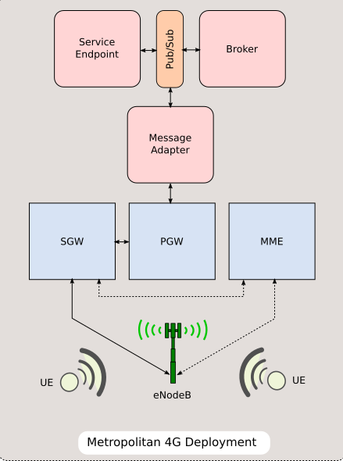
Implementation
Implemented Centralized Deployment Scenario.

Slide 2
Pub-Sub (Kafka)
Send
Reports to Broker
Alerts to Adapter
Receive
Reports from Adapter
Process
Partitions
Consumer Groups
Software
Python
Kafka
Events from Adapter
Alerts from Broker
Events to Broker
Message Q & Pub-Sub
Send
Events to Broker
Heart Beats
Receive
Beacons from Clients
Process
Maintain Session
Process Area of Interest
Alerts to Clients
Software
Python , UDP
Protocol Buffers
Alerts from Broker
Session Messages
Kafka
Send
Alerts to Adapter
Receive
Reports from Adapter
Process
Event Handlers
Event Schedulers
Software
Python
Kafka
Events from Adapter
AOI Calculation
Send
Reports
Sensed Event
Receive
Heart Beat
Mercury Alerts
Process
Broadcast Mode
Unicast Mode
Beacons
Software
Python
UDP
Protocol Buffers
Message Adapter
Message Broker
Vehicle
(UE)
Vehicle
(UE)

Slide 3
0 2 4 6 8 10 12 14 16 18 20
Pub-Sub (Kafka)
Message Broker
Message Adapter
(1,1) - 192.168. 1.1
(2,2) - 192.168. 2.1
C(3,3)
C(2,3)
(3,2) - 192.168. 2.3
(50,50) - 10.25. 2.3
(54,60) - 10.68. 4.3
Collision Handler
Congestion Handler
Vehicle
(UE)
Vehicle
(UE)
Collision Scheduler
Congestion Scheduler
C(1,1)
C(50,50)
C(2,1.6,3)
C(2,2)
C(3,2)
C(54,60)

Slide 4

Evaluation
Y-axis
V(1,6)
6
5
V(3,5)
V(8,5)
4
V(1,4)
V(5,4)
Simulator
3
V(5,3)
2
V(4,2)
V(6,2)
1
V(1,1)
V(7,1)
0
1
2
3
4
5
6
7
8
X-axis

Slide 5
Future Work
Direction based events
Integrating Trust
Multiple Deployment Scenarios
Retention Period
Performance

