Slide 1
Specific Architecture details
Topics/ Events
Collision
Congestion
Moving Objects
Lane Change Assistance
Emergency
Blocking
Message Broker
Area of Interest
(x,y,r) – (2,3,2)

Slide 2
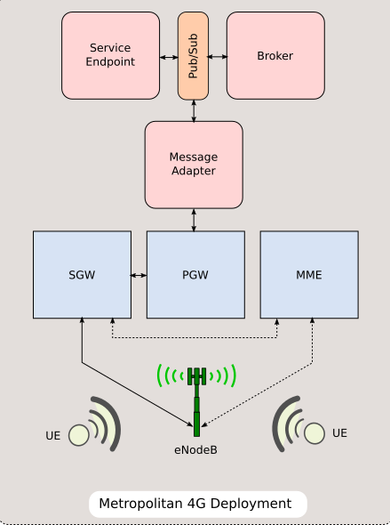
Implementation
Implemented Centralized Deployment Scenario.

Slide 3
Mercury - Work Flow
Pub-Sub (Kafka)
Message Broker
Message Adapter
123 - (1,1) - 192.168. 1.1
C(3,2)
456 - (2,2) - 192.168. 2.1
C(1,1)
C(2,2)
351 - (3,2) - 192.168. 2.3
769 - (50,50) - 10.25. 2.3
Collision Handler
Congestion Handler
V(1,1)
V(2,2)
C(1,1)
C(2,2)
Collision Scheduler
Congestion Scheduler
MB(2,1,3)
V(3,2)
V(50,50)
C(50,50)

Slide 4
Implementation Details
Python
UDP Sockets between Clients and Message Adapter
Apache Kafka
Protocol Buffers
Mercury Simulator

Slide 5

Evaluation
V(x,y)
Vehicles in the system which have not sensed any event or received event.
V(x,y)
Vehicles in the system which have
sensed an event
V(x,y)
Vehicles in the system which have
sensed an event and received the event
Y-axis
V(x,y)
Vehicles in the system which have
received the event
6
V(1,6)
V(8,5)
5
V(3,5)
Simulator
4
V(1,4)
V(5,4)
Collision(5,2,2)
3
V(5,3)
2
V(4,2)
V(6,2)
1
V(1,1)
V(7,1)
X-axis
0
1
2
3
4
5
6
7
8

Slide 6
Future Work
Direction based events
Integrating Trust
Multiple Deployment Scenarios
Retention Period
Performance

