Slide 1
Mercury: A Geo-Aware, mobility-centric messaging system
teja kommineni and kirk webb
Mentor: Kobus van der merwe
Cs6480 project – Fall 2016

Slide 2

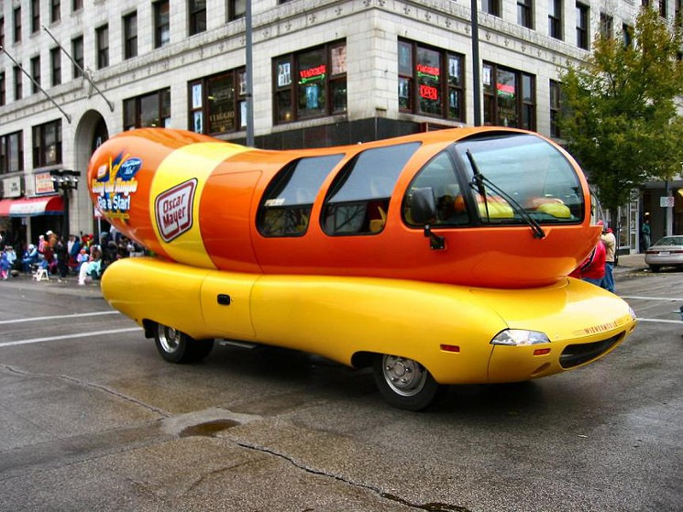
Introduction
Things move around; things with computers attached
Vehicles: on-board systems, or passenger’s devices
People: walking, riding bicycles, etc.
Intelligent Transportation Systems
Want: location- and trajectory-relevant communication

Slide 3

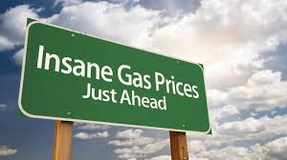
introduction
Types of communication
Road conditions:
Collisions
Congestion
Emergency vehicle
Unsafe conditions (ice)
Consumer: gas prices, flash sales, etc.

Slide 4
Introduction
Message latency requirements
High (> 1 second)
Consumer messages
Congestion, approaching emergency vehicle
Medium (< 50ms)
Lane change notification
Low (< 10ms)
Immediate control response (collision imminent)

Slide 5

introduction

Slide 6
Related work
Focuses on one end or the other
Vehicle Area Networks
Clustering, delivery resilience, with LTE bridging
VMaSC, MDMAC, NHop
Mobile pubsub
Tracking changes in association
MoPS
Deficiencies:
Little to no attention paid to mobile core network
No holistic systems (that we could find)

Slide 7
Enter: mercury
Breaking it down by the tagline:
A Geo-Aware, Mobility-Centric Messaging System

Slide 8
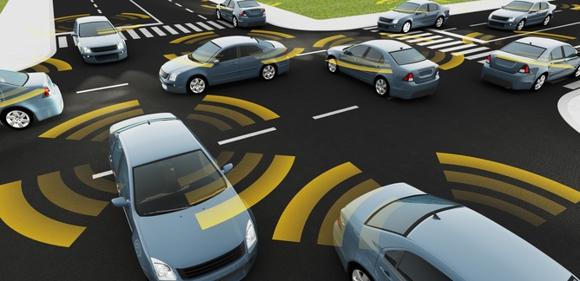
Enter: mercury
A Geo-Aware, Mobility-Centric Messaging System
Location matters. Trajectory matters. Context matters.
Address endpoints by location (geo-addressing)
Filter endpoints by context: Area of Interest

Slide 9
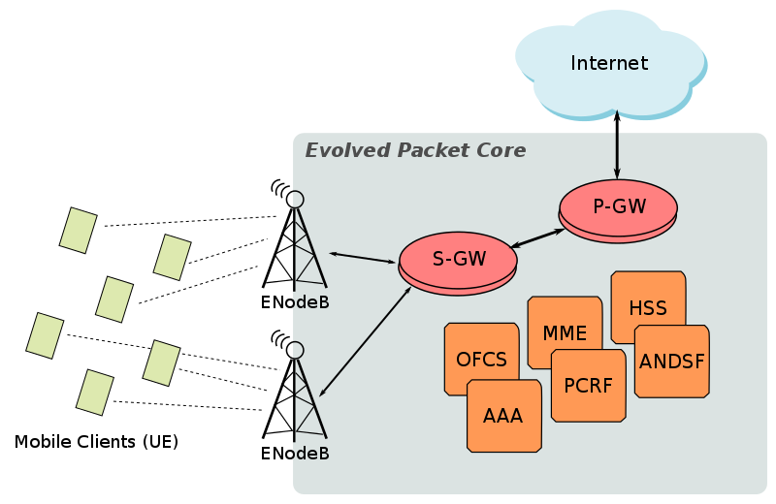
Enter: mercury
A Geo-Aware, Mobility-Centric Messaging System
The mobility core network is NOT A BLACK BOX!
Where to deploy components?
Work with provided mechanisms/facilities
Broadcasting in 3GPP: eMBMS
Location-agnostic endpoint addresses (MobilityFirst)

Slide 10
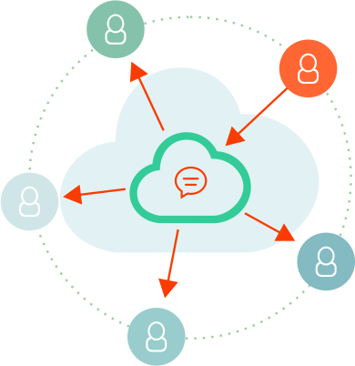
Enter: mercury
A Geo-Aware, Mobility-Centric Messaging System
Short, self-contained communication between actors (think: Tweets)
One message, potentially many clients (pubsub)

Slide 11
Enter: mercury
A Geo-Aware, Mobility-Centric Messaging System
An end-to-end message delivery ecosystem
Can incorporate related work

Slide 12
Mercury: design goals
Relevant content
Geo-addressing, context filtering
Robust, low-overhead, low-latency
Safety messages drive requirements
Flexible deployment
Existing or new mobile system deployments
Reuse of effective technologies
PubSub, communication mechanisms (eMBMS)

Slide 13


Mercury components
PubSub
Broker
Service Endpoint
Adapter
Client
Endpoint
Mobile Core
Access Point
Access Point

Slide 14
Deployment scenarios
New deployments
Metropolitan Intelligent Transportation System
CloudRAN Data Center
Existing deployments
Interpose at MTSO (a la SMORE)
Integrate into eNodeB, right at the edge
North of PGW, dedicated or default bearer

Slide 15
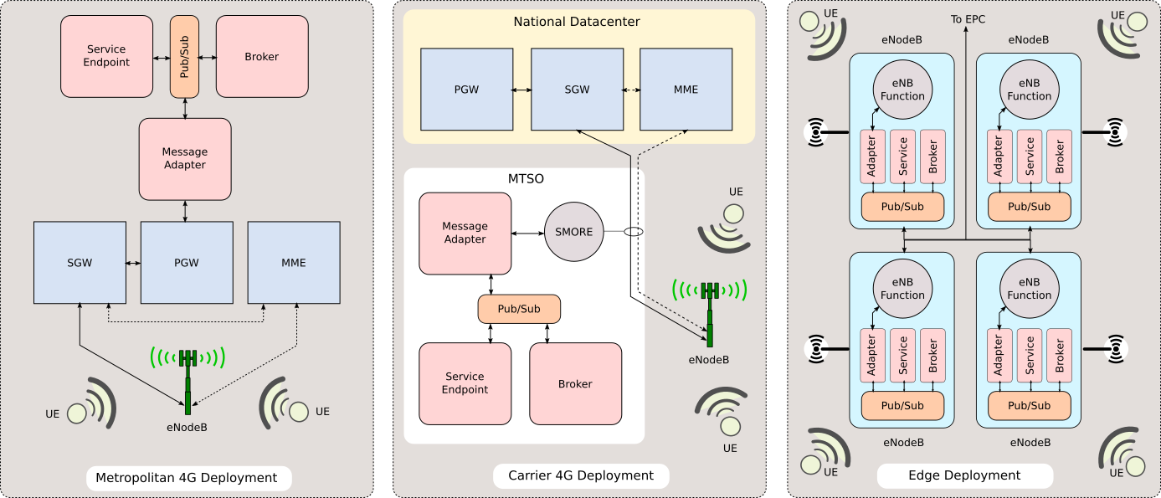
Deployment scenarios – Metro ITS

Slide 16
Deployment scenarios - MTSO

Slide 17
Deployment scenarios – enodeb

