Slide 1
Mercury: A Geo-Aware, mobility-centric messaging system
teja kommineni and kirk webb
Mentor: Kobus van der merwe
Cs6480 project – Fall 2016

Slide 2

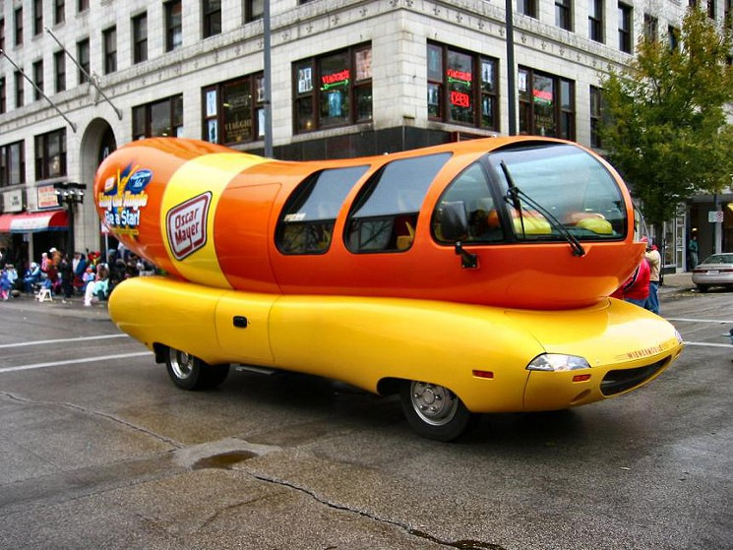
Introduction
Things move around; things with computers attached
Vehicles: on-board systems, or passenger’s devices
People: walking, riding bicycles, etc.
Intelligent Transportation Systems
Want: location-relevant communication
Problem: No such holistic messaging system exists…
Solution: Design and build one!

Slide 3

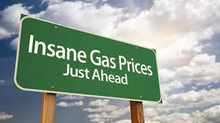
Types of messages
Road conditions:
Collisions
Congestion
Emergency vehicle
Unsafe conditions (ice)
Consumer: gas prices, flash sales, etc.

Slide 4
Message latency requirements
High (> 1 second)
Consumer messages
Congestion, approaching emergency vehicle
Medium (< 50ms)
Lane change notification
Low (< 10ms)
Immediate control response (collision imminent)

Slide 5

Consequences…

Slide 6
Our contribution: mercury
A Geo-Aware, Mobility-Centric Messaging System

Slide 7
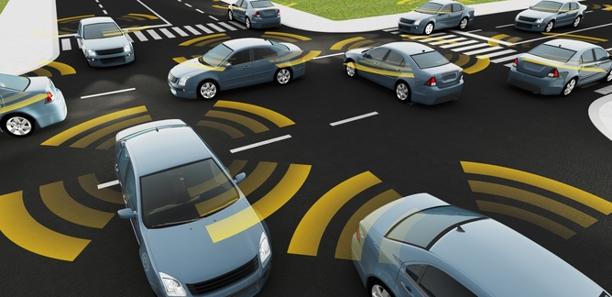
Geo-aware
Location matters. Trajectory matters. Context matters.
Address endpoints by location (geo-addressing)
Filter endpoints by context: Area of Interest

Slide 8
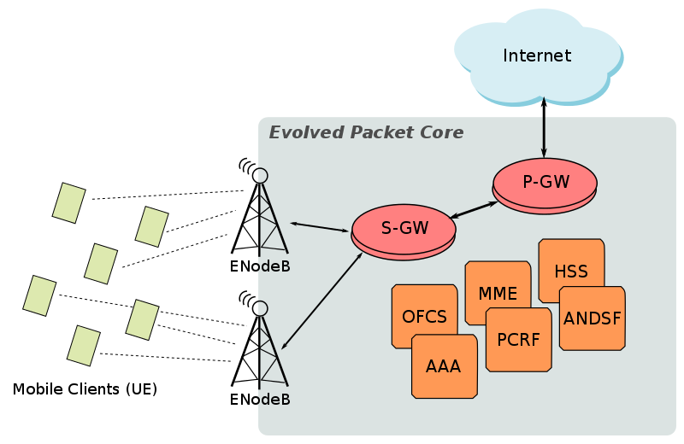
Mobility-centric
The mobility core network is NOT A BLACK BOX!
Where to deploy components?
Work with provided mechanisms/facilities
Broadcasting in 3GPP: eMBMS
Location-agnostic endpoint addresses (MobilityFirst)

Slide 9
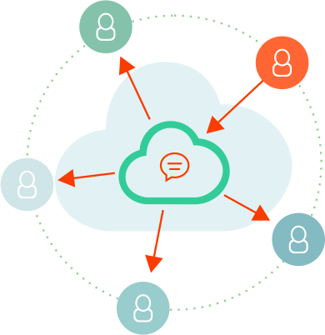
Messaging
Short, self-contained communication between actors (think: Tweets)
One message, potentially many clients (pubsub)

Slide 10
SysteM
An end-to-end message delivery platform
Can incorporate related work

Slide 11


Mercury components
PubSub
Broker
Service Endpoint
Adapter
Client
Endpoint
Mobile Core
Access Point
Access Point

Slide 12
Component: pubsub
Apache Kafka, Unmodified
Transports messages by topic
Queue for “going back in time”
PubSub
Broker
Service Endpoint
Adapter
Client Endpoint
Mobile Core
Access Point
Access Point

Slide 13
Component: broker
Aggregation services (AOI)
Data collection/analysis
Triggers and handlers
PubSub
Broker
Service Endpoint
Adapter
Client Endpoint
Mobile Core
Access Point
Access Point

Slide 14
Component: Adapter
Interface to Mobile Core
Manages Client Sessions
Client gateway
Scopes Geo-Addresses
PubSub
Broker
Service Endpoint
Adapter
Client Endpoint
Mobile Core
Access Point
Access Point

Slide 15
Component: Client endpoint
Agent on mobile device
Sends mobile telemetry
Interface for apps
PubSub
Broker
Service Endpoint
Adapter
Client Endpoint
Mobile Core
Access Point
Access Point

Slide 16
Component: Service endpoint
Service-specific processing
Likely uses Broker services
PubSub
Broker
Service Endpoint
Adapter
Client Endpoint
Mobile Core
Access Point
Access Point

Slide 17
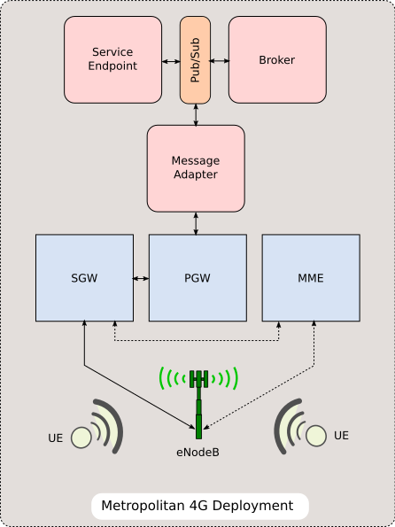
Deployment scenarios
Latency/complexity tradeoffs
“Within the City” (future / new) - ~10ms RTT
Metropolitan Intelligent Transportation System
CloudRAN Data Center
Existing mobile carrier deployments
“Tap in” at regional datacenter - ~25ms RTT
Integrate at the edge (eNodeB access point) – ~0ms RTT
National datacenter at client data egress - ~50ms RTT
Client Endpoint
Mercury in 4G Context

Slide 18
Specific Architecture details
Topics/ Events
Collision
Congestion
Moving Objects
Lane Change Assistance
Emergency
Blocking
Message Broker
Area of Interest
(x,y,r) – (2,3,2)

Slide 19
Mercury - Work Flow
Pub-Sub (Kafka)
Message Broker
Message Adapter
123 - (1,1) - 192.168. 1.1
C(3,2)
456 - (2,2) - 192.168. 2.1
C(1,1)
C(2,2)
351 - (3,2) - 192.168. 2.3
769 - (50,50) - 10.25. 2.3
Collision Handler
Congestion Handler
V(1,1)
V(2,2)
C(1,1)
C(2,2)
Collision Scheduler
Congestion Scheduler
MB(2,1,3)
V(3,2)
V(50,50)
C(50,50)

Slide 20
Implementation Details
Python - ~2,200 lines of code
UDP Sockets
Apache Kafka
Protocol Buffers
Mercury Simulator
PubSub
Broker
Service Endpoint
Adapter
Client Endpoint
Mobile Core
Access Point
Access Point

Slide 21

Functional Evaluation
V(x,y)
Vehicles in the system which have not sensed any event or received event.
V(x,y)
Vehicles in the system which have
sensed an event
V(x,y)
Vehicles in the system which have
sensed an event and received the event
Y-axis
V(x,y)
Vehicles in the system which have
received the event
6
V(1,6)
V(8,5)
5
V(3,5)
Simulator
4
V(1,4)
V(5,4)
Collision(5,2,2)
3
V(5,3)
2
V(4,2)
V(6,2)
1
V(1,1)
V(7,1)
X-axis
0
1
2
3
4
5
6
7
8

Slide 22
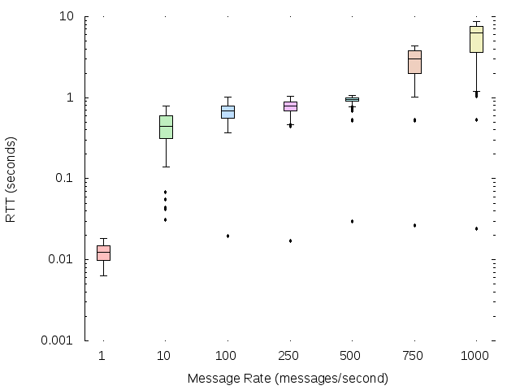
Performance evaluation: RTT latency

Slide 23
Future Work
Direction based events
Integrating Trust
Multiple Deployment Scenarios
Retention Period
Performance

Slide 24
Implementation
Implemented Centralized Deployment Scenario.
Client Endpoint
Mercury in 4G Context

Slide 25
Mercury: design goals
Relevant content
Geo-addressing, context filtering
Robust, low-overhead, low-latency
Safety messages drive requirements
Flexible deployment
Existing or new mobile system deployments
Reuse of effective technologies
PubSub, communication mechanisms (eMBMS)

Slide 26
Related work
Focuses on one end or the other
Vehicle Area Networks
Clustering, delivery resilience, with LTE bridging
VMaSC, MDMAC, NHop
Mobile pubsub
Tracking changes in association
MoPS
Deficiencies:
Little to no attention paid to mobile core network
No holistic systems (that we could find)

