Slide 1
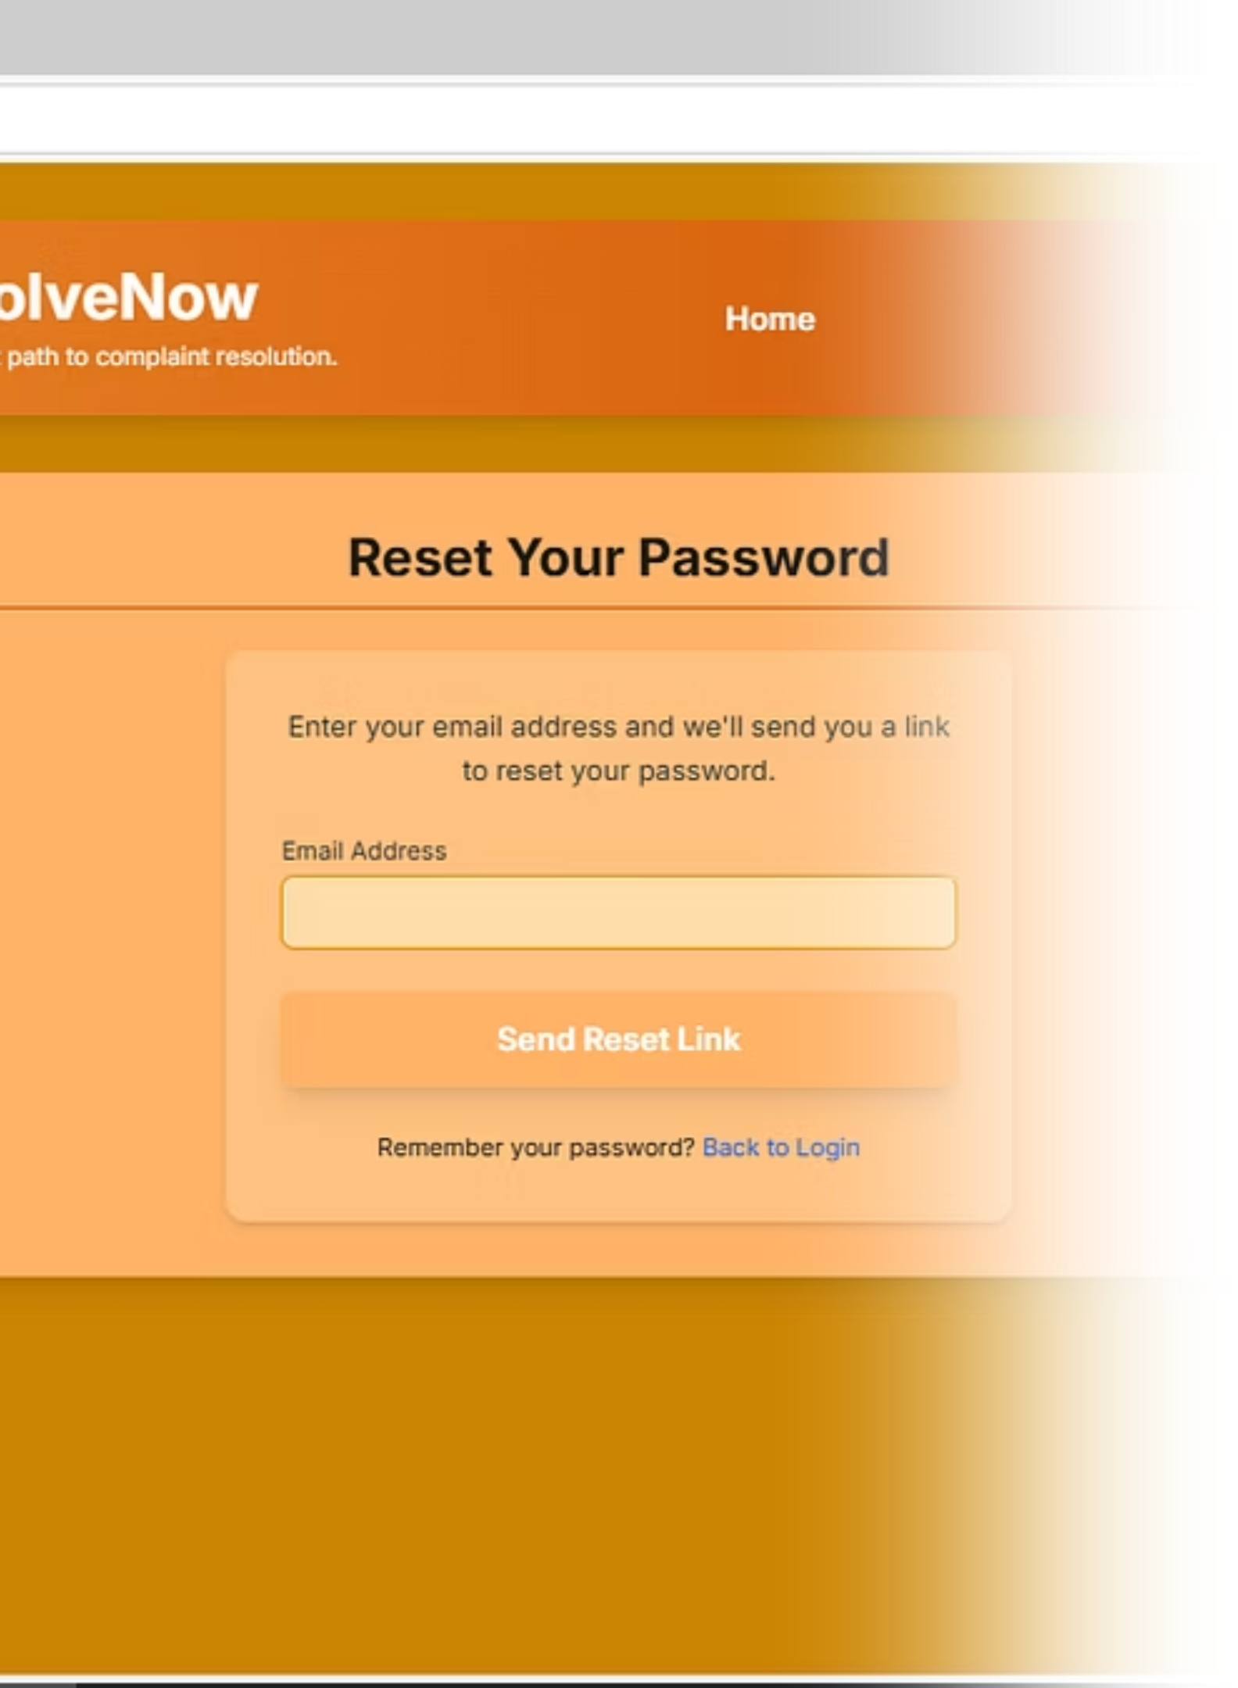
ResolveNow: Streamlining Complaint Resolution
Welcome to the ResolveNow project presentation. We're excited to introduce a revolutionary platform designed to transform how complaints are managed and resolved, ensuring transparency and efficiency for all users.
PV
by PRATAPA TEJA NAGA VENKAT

Slide 2
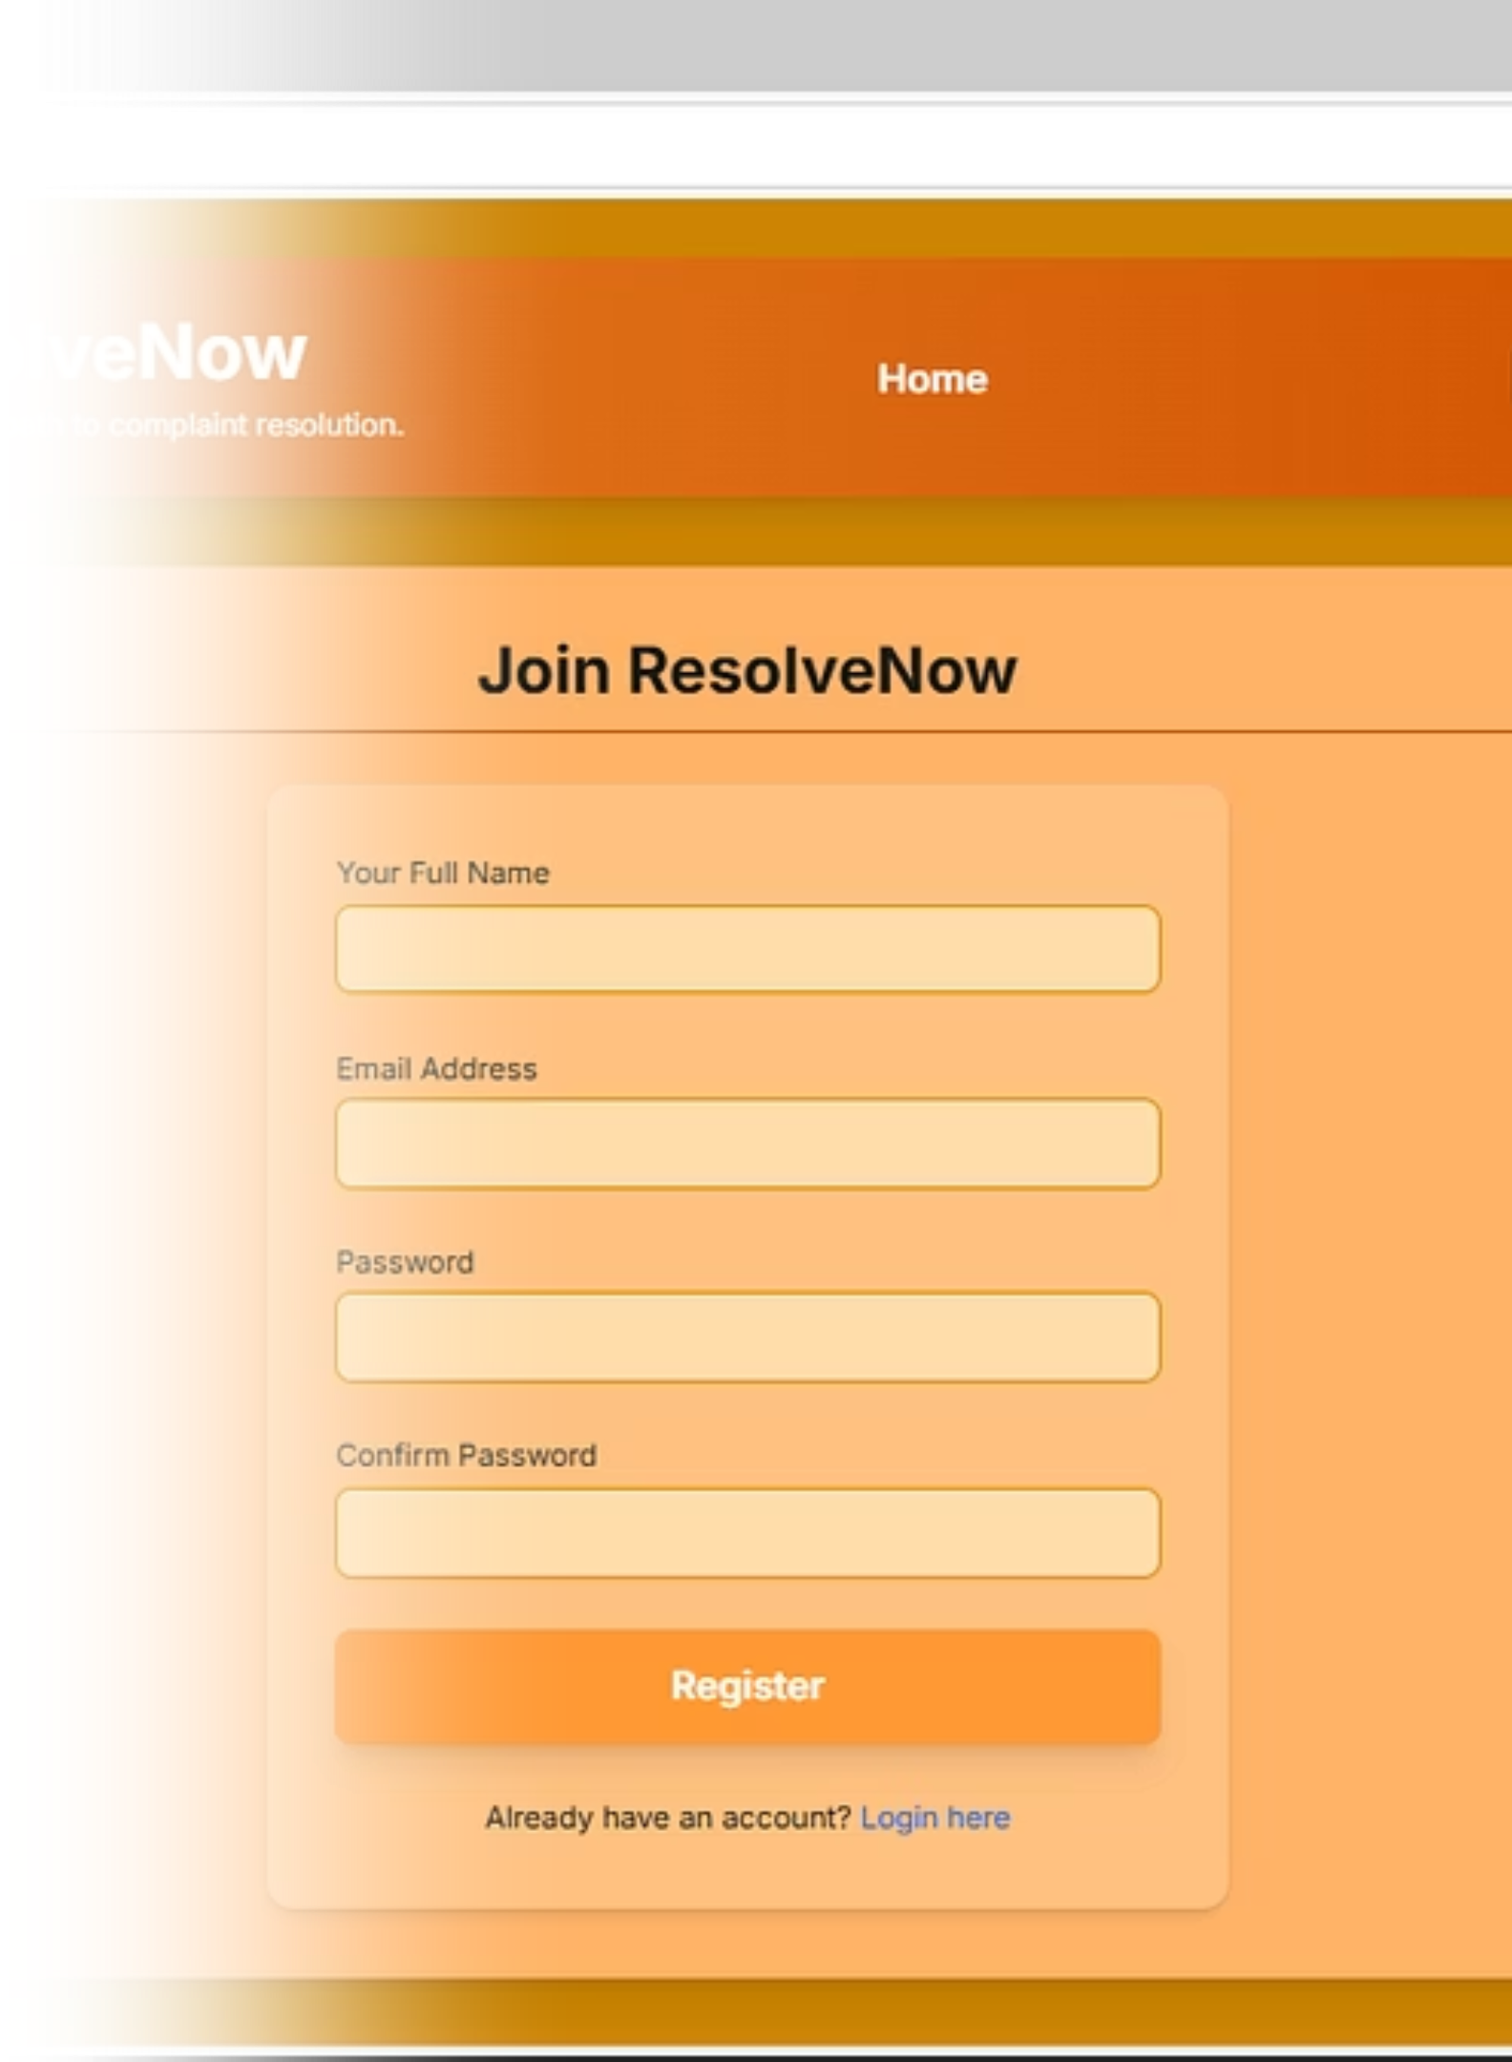
Project Overview & Purpose
Project Overview
ResolveNow is an innovative web-based platform focused on efficient complaint management and real-time tracking.
Core Purpose
To provide a transparent, accessible, and user-friendly system for submitting, tracking, and resolving complaints effectively.

Slide 3
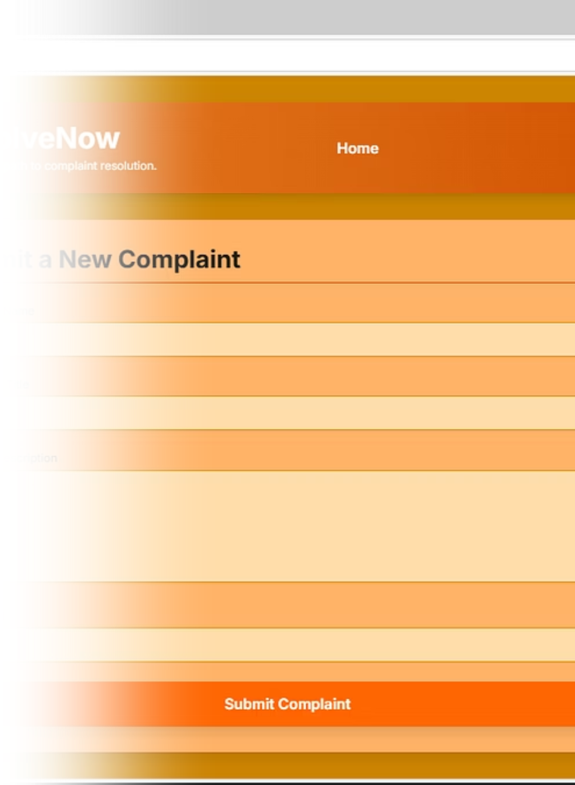



The Problem: Unaddressed Complaints
Lack of Transparency
Users often don't know the status of their complaints, leading to frustration and distrust.
Slow Resolution
Manual processes or disorganized systems can significantly delay complaint resolution times.
Inefficient Tracking
Without a centralized system, it's difficult to monitor, categorize, and analyze complaint trends.

Slide 4
Empathy Mapping & Brainstorming
Understanding User Needs
Brainstorming Solutions
We used empathy mapping to understand our users' thoughts, feelings, and pain points related to complaints.
Our brainstorming sessions generated innovative features:
Real-time status updates
Says: "I wish I knew what was happening."
Automated notifications
Thinks: "My complaint won't be heard."
User-friendly submission forms
Feels: Frustrated, ignored, helpless.
Categorization and tagging
Does: Gives up, complains to others.

Slide 5
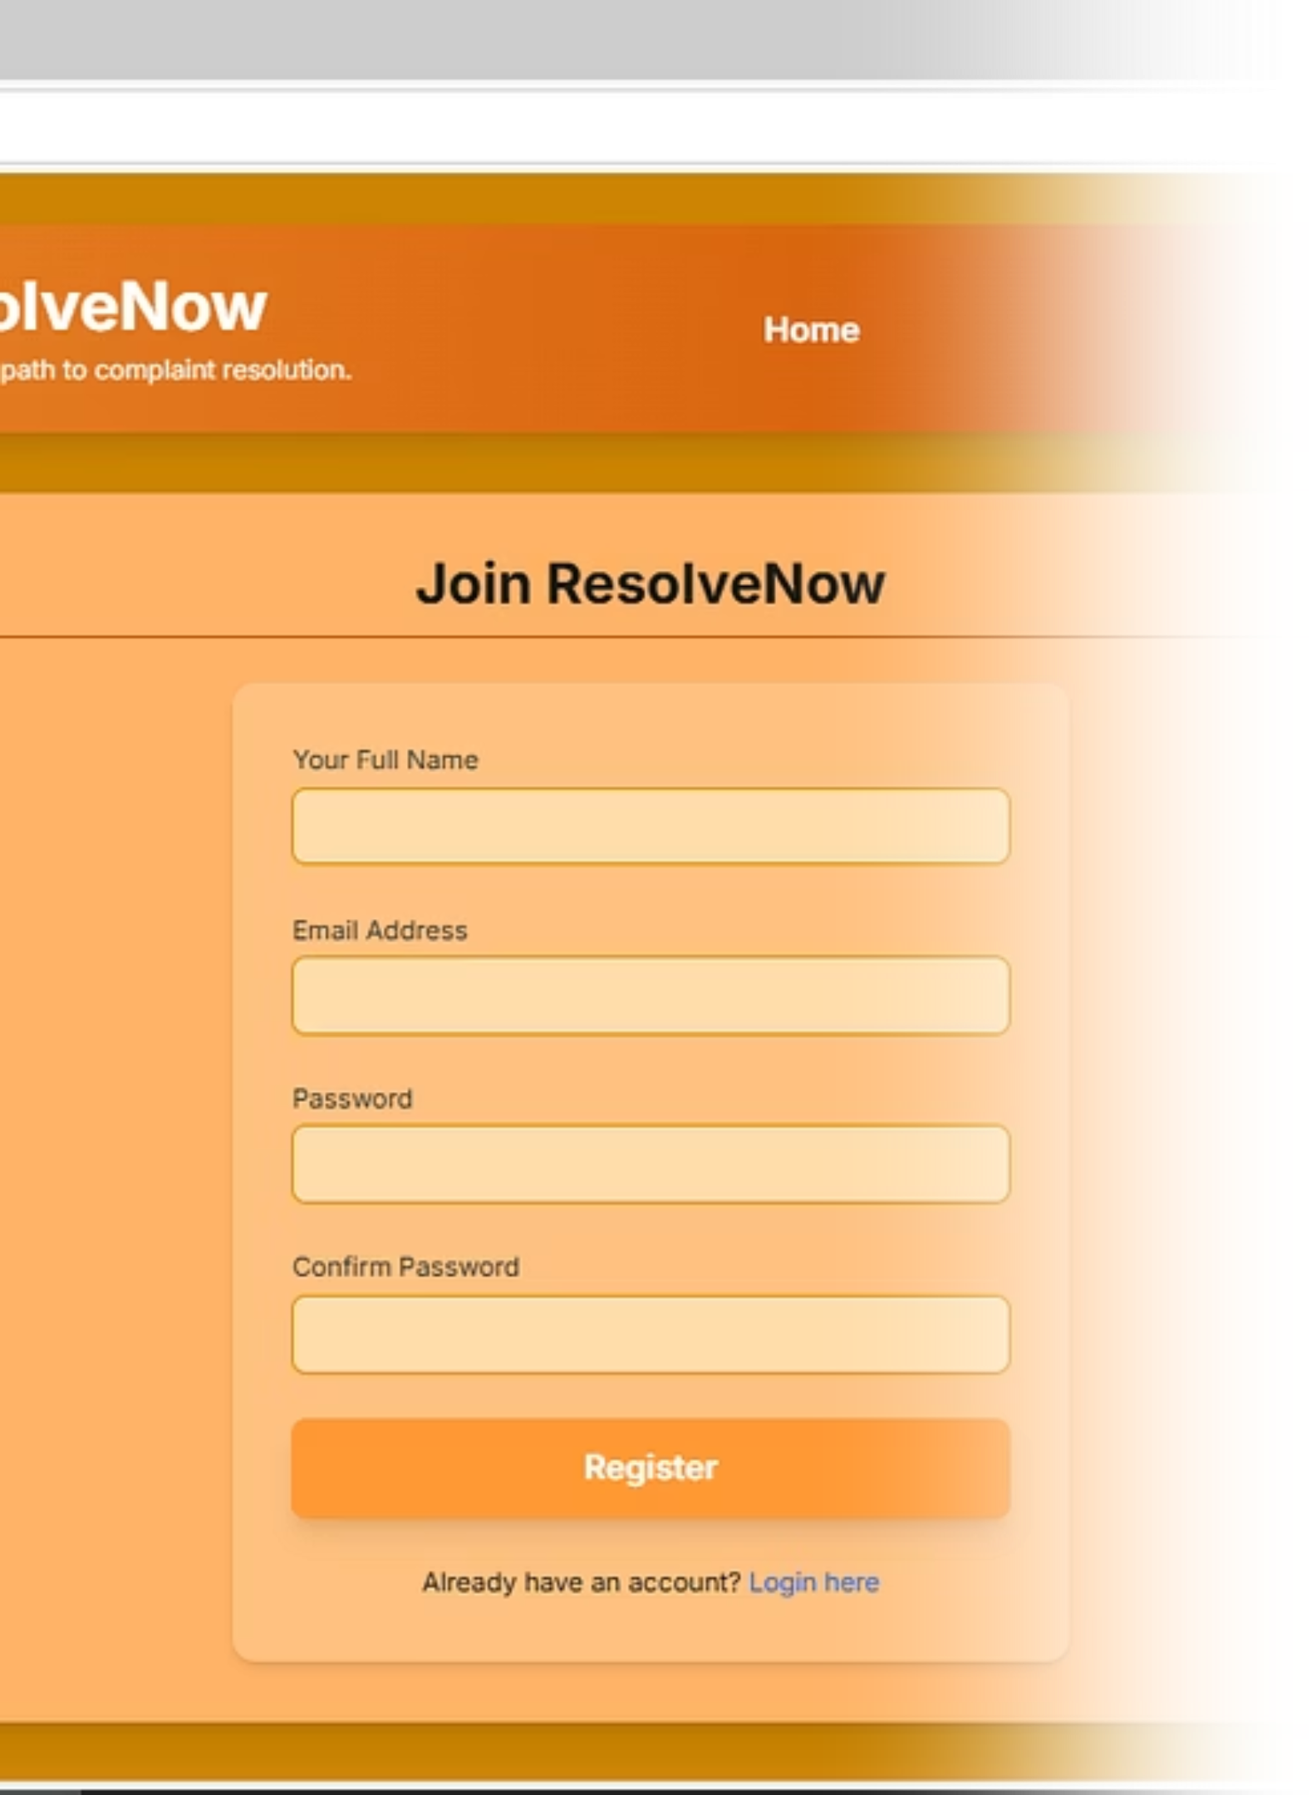
Customer Journey & Requirements
1
Submission
Easy, guided form for users to log complaints with attachments.
2
Tracking
Users receive a unique ID to monitor status in real-time.
3
Resolution
Admins process, escalate, and resolve complaints efficiently.
4
Feedback
Users can rate satisfaction and provide comments on resolution.

Slide 6
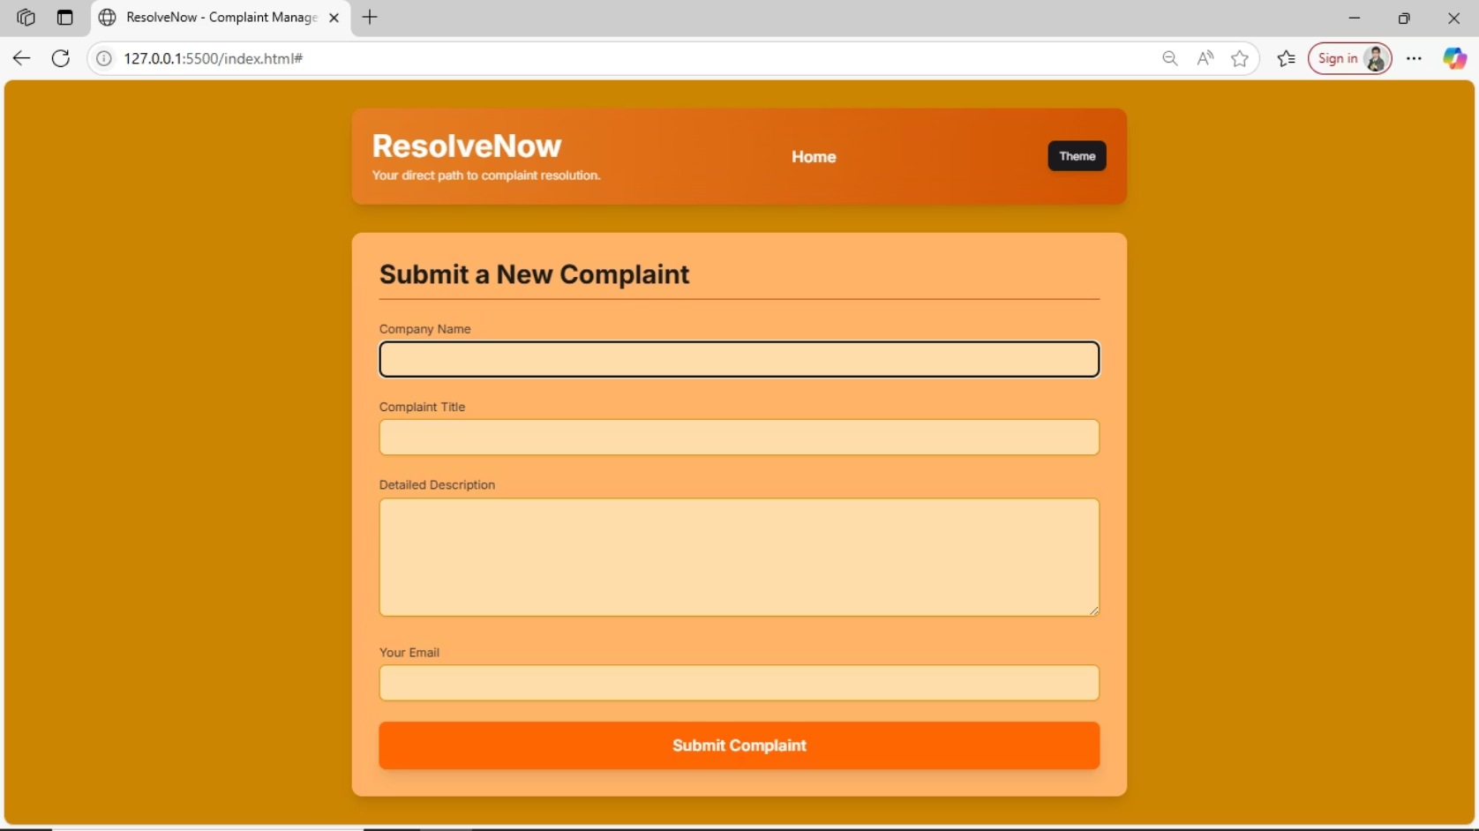
Technology Stack & Data Flow
Robust Technology Stack
Frontend: React.js for dynamic UI.
Backend: Node.js with Express.js for scalable APIs.
Database: MongoDB for flexible data storage.
Deployment: Cloud-based hosting for reliability.
This stack ensures a responsive, secure, and scalable platform.
Seamless Data Flow
Complaints flow from user submission through secure APIs to the database, then back to the user interface for tracking.
User input validation
Encrypted data transmission
Real-time database updates

Slide 7
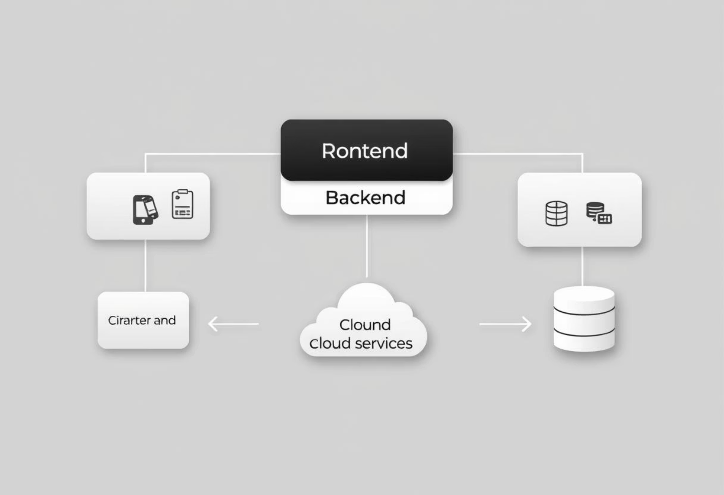
Proposed Solution & Architecture
Problem-Solution Fit
ResolveNow directly addresses transparency and efficiency issues by providing a centralized, accessible platform for all stakeholders.
Users gain visibility, while administrators gain powerful tools for managing and analyzing complaints.
Solution Architecture
Our microservices-based architecture ensures modularity and scalability. Each component can be independently developed, deployed, and scaled.
User Interface Layer
API Gateway
Complaint Service
Notification Service

Slide 8
Project Planning & Performance
12
98%
< 2s
Weeks to Launch
Uptime Target
Page Load Time
Ensuring constant availability for users and administrators.
Optimized for rapid response and smooth user experience.
Aggressive yet achievable timeline for initial deployment.

Slide 9
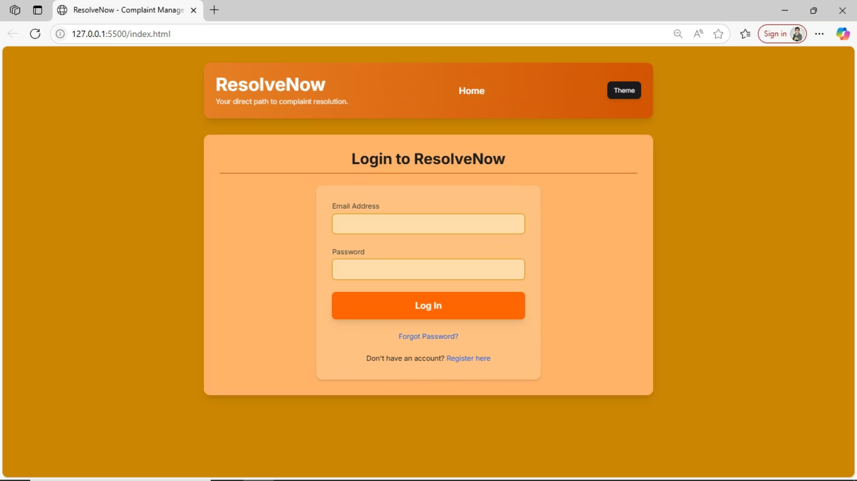
Conclusion & Future Scope
Key Takeaways
Future Enhancements
ResolveNow offers a robust, transparent, and user-friendly platform that empowers users and streamlines complaint management.
AI-powered complaint categorization and routing.
Integration with social media platforms for direct feedback.
It's built on a scalable architecture, ready for future enhancements.
Advanced analytics dashboard for trend identification.
Multi-language support for global accessibility.
We envision ResolveNow as the leading solution for complaint resolution worldwide.

