Slide 1


Ticketing portal

Slide 2

Presented by:
Teja Swaroop Reddy(TL)
Santhoshini.S
Tejas.G
Sridevi.M

Slide 3
Technologies used:
.NET Core Web App (MVC)
Entity Framework
.NET Core Web API
C#
HTML
CSS

Slide 4
What is ticket?
In smaller companies, whenever employees seek IT support, they can simply walk up to their internal IT team and get their issues fixed. But as organizations grow in size, managing employee issues and internal IT service requests tends to become cumbersome. Emails work when companies are small, but their speed and simplicity don’t cope well with the large number of requests that are being raised in a big organization.

Slide 5
introduction:
A ticket, in a helpdesk ticketing system, acts as a documentation of a particular problem, its current status, and other associated information. Raised by the end users of an organization whenever they encounter an event that interrupts their workflow, these tickets are routed to a ticketing software where they are categorized, prioritized, and assigned to different agents according to the organizational norms. The agents then analyze these tickets and suggest appropriate fixes or workarounds and resolve the issue. As a central repository of all these tickets, an IT Ticketing Software helps in providing the context of the issue history and its resolution.

Slide 6
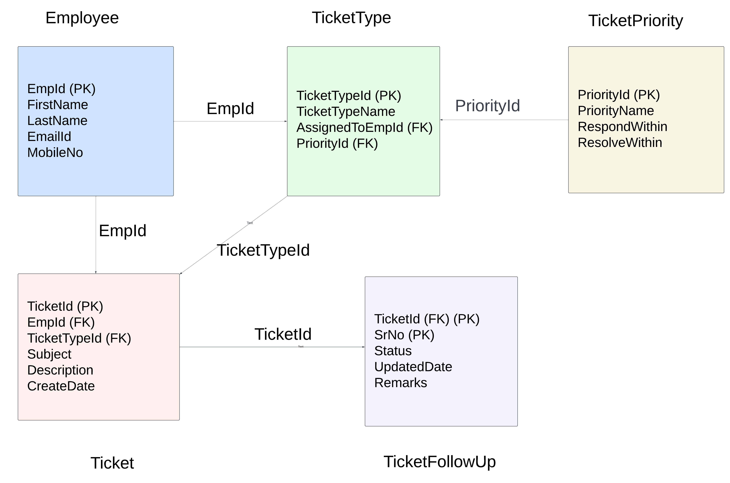
ER diagram:

Slide 7
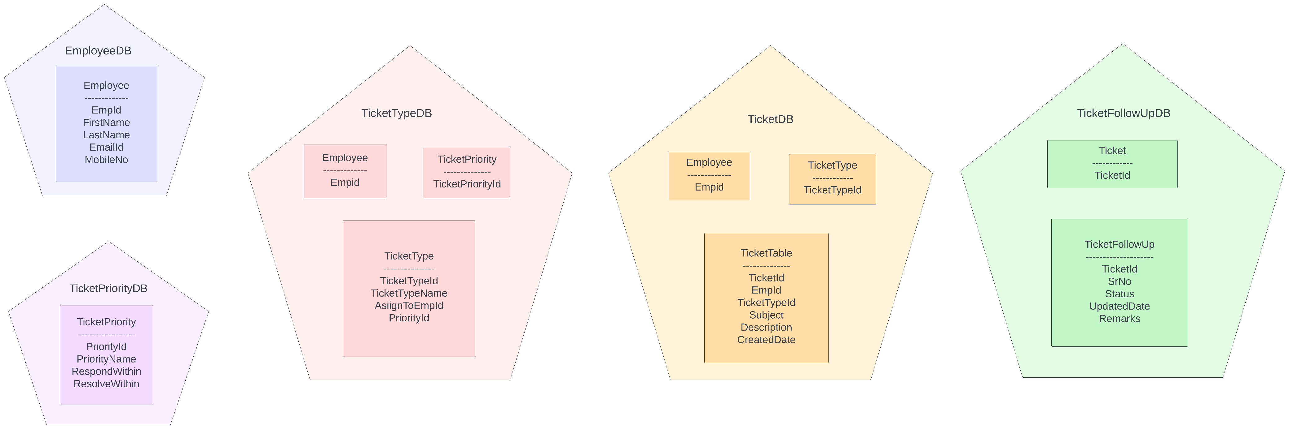
Database Connections:

Slide 8
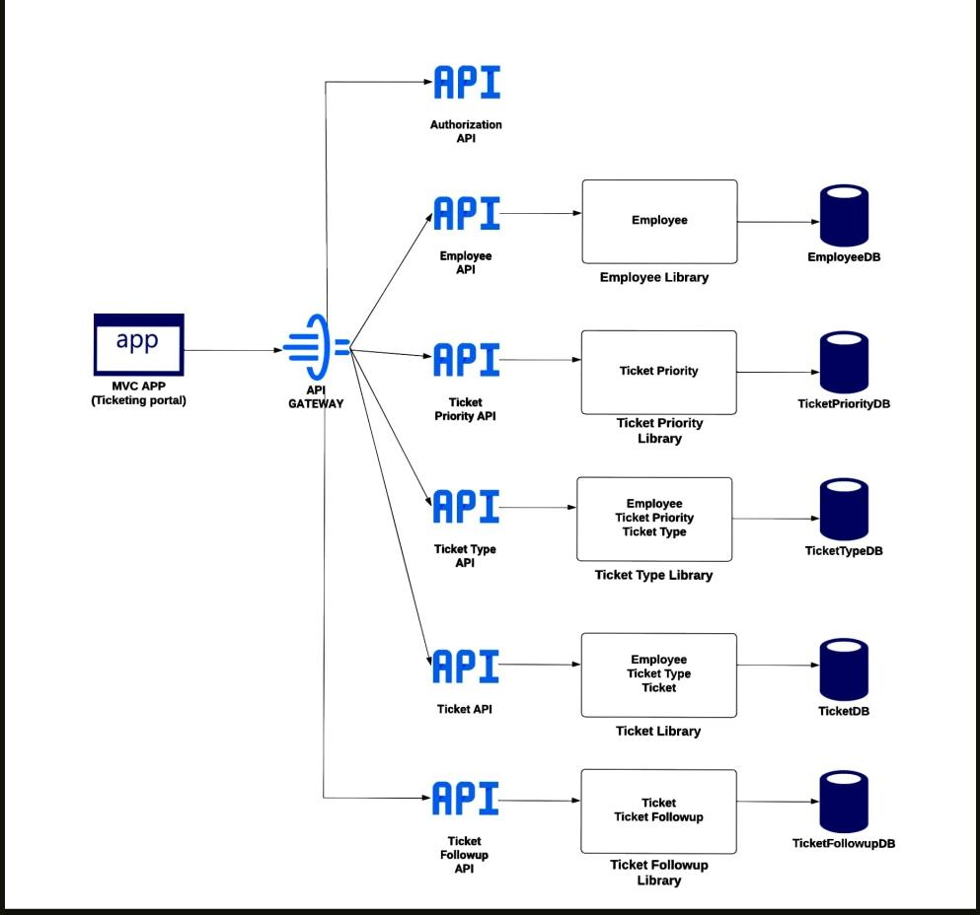
Ticketing portal microservices:

Slide 9
modules:
Employee
Ticket Priority
Ticket Type
Ticket
Ticket Follow Up

Slide 10
Employee:
Purpose: Handles HTTP requests and responses for Employee Operations
Index (GET): Returns all Employees
Details (GET): Fetches employee details by ID
Create (POST): Adds a new employee and communicates with external services
Edit (PUT): Updates employee details
Delete (DELETE): Deletes an employee and communicates with external services

Slide 11
Employee:
Integration with External APIs
Authentication: Requests token from the Auth API
Communication with TicketType and Ticket APIs
Handles operations related to employee associations with Tickets
Flow of Data:
User API Gateway EmployeeController(HTTP Request) Repository Methods EF Context Database

Slide 12
Ticket Priority:
Purpose: Handles HTTP requests and responses for TicketPriority Operations
Index (GET): Returns all Ticket Priorities
Details (GET): Fetches Ticket Priority details by Priority Id
Create (POST): Adds a new Ticket Priority and communicates with external services
Edit (PUT): Updates employee details
Delete (DELETE): Deletes an employee and communicates with external services

Slide 13
Ticket Priority:
Integration with External APIs
Authentication: Requests token from the Auth API
Communication with TicketType API
Handles operations related to TicketPriority associations with Tickets
Flow of Data:
User API Gateway TicketTypeController
(HTTP Request) Repository Methods
EF Context Database

Slide 14
Ticket Type:
Purpose: Handles HTTP requests and responses for TicketType Operations
Index (GET): Returns all Ticket Types
Details (GET): Fetches Ticket Type details by ticket type Id
Create (POST): Adds a new Ticket Type and communicates with external services
Edit (PUT): Updates Ticket Types details
Delete (DELETE): Deletes an employee and communicates with external services

Slide 15
^{Ticket Type:}
Integration with External APIs
Authentication: Requests token from the Auth API
Communication with Ticket API
Handles operations related to TicketType associations with Tickets
Flow of Data:
User API Gateway TicketTypeController (HTTP Request) Repository Methods EF Context Database

Slide 16
Ticket:
Purpose: Handles HTTP requests and responses for Ticket Operations
Index (GET): Returns all tickets
Details (GET): Fetches ticket details by Ticket Id
Create (POST): Adds new ticket and communicates with external services
Edit (PUT): Updates Ticket details
Delete (DELETE):Deletes a ticket and communicates with external services

Slide 17
Ticket:
Integration with External APIs
Authentication: Requests token from the Auth API
Communication with TicketFollowUp API
Handles operations related to Ticket associations with Tickets
Flow of Data:
User API Gateway TicketController(HTTP Request) Repository Methods EF Context Database

Slide 18
Ticket FollowUp:
Purpose: Handles HTTP requests and responses for TicketFollowUp Operations
Index (GET): Return all Ticket Follow ups
Details (GET): Fetches Ticket follow up details by ticket id and serial no
Create (POST): Adds new ticket follow up and communicates with external services
Edit (PUT): Updates Ticket Follow up details
Delete (DELETE):Deletes a ticket follow up and communicates with external services

Slide 19
Ticket FollowUp:
Integration with External APIs
Authentication: Requests token from the Auth API
Handles operations related to Ticket associations with Tickets
Flow of Data:
User API Gateway TicketController(HTTP Request) Repository Methods EF Context Database

Slide 20
Team collaboration:
Teja Swaroop Reddy(TL) Ticket Followup, Authorization API, Helper class
Santhoshini.S Employee, TicketPriority, ApiGateway
Tejas.G Ticket Type, Frontend
Sridevi.M Ticket, Frontend

Slide 21
Conclusion:
We were successfully able to build the Ticketing Portal project, providing the interface for the employees to create and manage the tickets.
The integration of key features such as User Authentication and API Validations has significantly improved the efficiency.

Slide 22
Thank you
Finally, we would like to thank Mr. S.N.Rao sir for your valuable guidance .

