Slide 1

Trendy Fit

Slide 2


Team Details
Sravanthi Silla
Developing the code for modules & testing
Manish Reddy Yadla
Developing the code for modules & testing
Sai Praveen Dadi
Designing the user inteface
Manoharachary Sriramula
Integration between pages and database
Sharath Chandra Garvanda
Creating Database tables & queries
Harsha Joji Reddy Allam
Designing the user interface
Yeswanth Gonugunta
Developing the code for the modules
Venkata Sai Teja Reddy Gajula
Test Cases

Slide 3




CONTENTS
Problem Statement About the project Implementation Requirements Frontend requirements Backend requirements Conclusion References

Slide 4

Problem Statement
The project's main goal is to create an application in which each user registers and receives a personalized dashboard with features tailored to their own needs. Our app caters to three kinds of users: administrators, designers, and users.
Users can interact with Designers by chat and Designers can choose from three different subscription plans. 3 months of silver, 6 months of gold, and an annual plan with a diamond

Slide 5
About the project
To access our applications, users must first register with their email ID and other personal information. After completing the registration process, customers are sent to the application's login page. Every user will have their own account and specified features.
The user must make a request to connect with the designer, and if the request is accepted, the user can chat with the designer for selecting a designer.

Slide 6

Implementation
If a user's credentials match those of an admin, the admin dashboard will display.
Register and log into the application
Create a separate profile for each user
If a user's credentials match those of an designer, the designer dashboard will display.
Register and log into the application
If a user's credentials match those of an user, the user dashboard will display.

Slide 7

Requirements
Software Requirements
Operating System : Ubuntu 18 Lts
Hardware Requirements
Processor : Dual-Core Processor
Browser Database
: Chrome/Firefox
: SQLite
Speed : 2.9Ghz
RAM :
4GB RAM
40GB
Hard Disk :

Slide 8



Frontend Requirements
HTML
CSS
JS
Bootstrap 5

Slide 9


Backend Requirements
Python
Django
SQLite

Slide 10
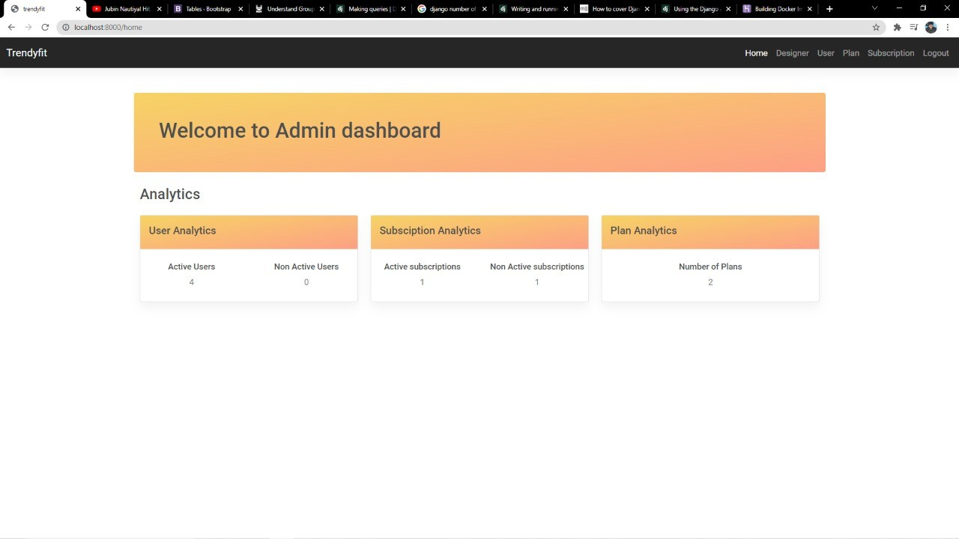
Working Screens
Admin Dashboard Home Page

Slide 11
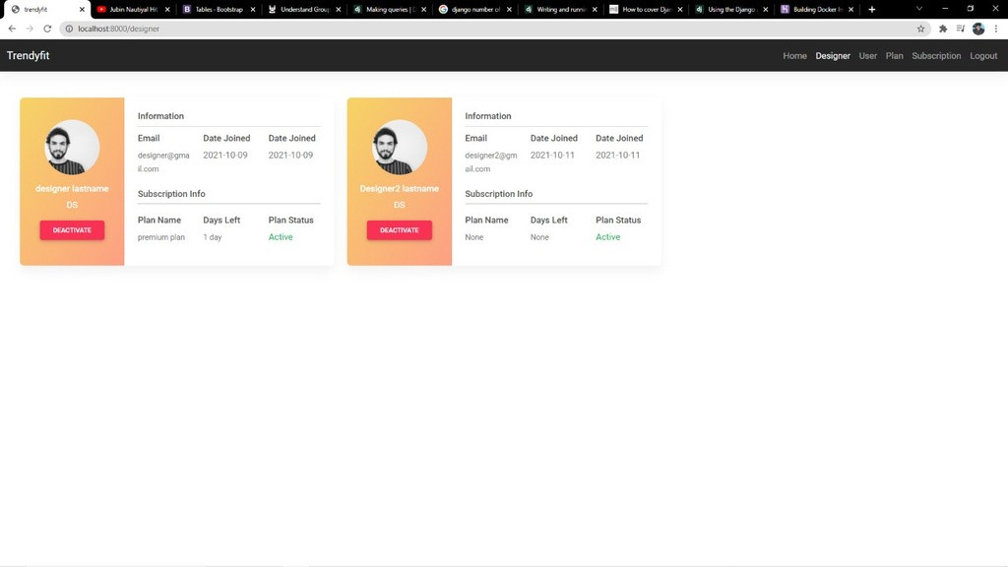
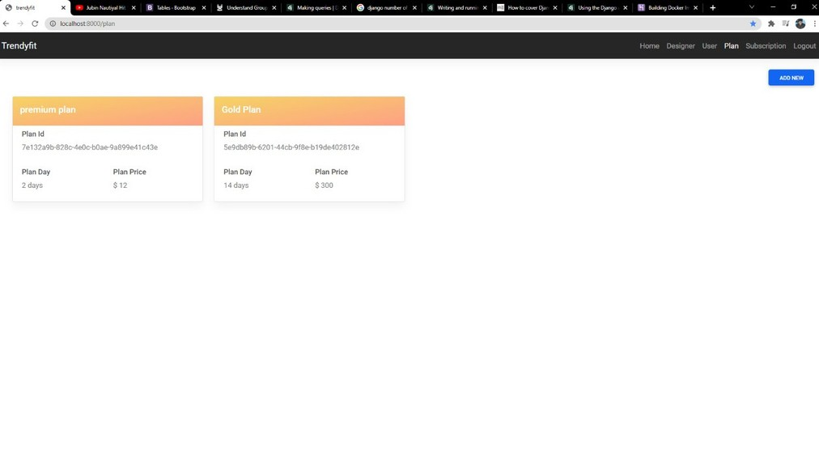
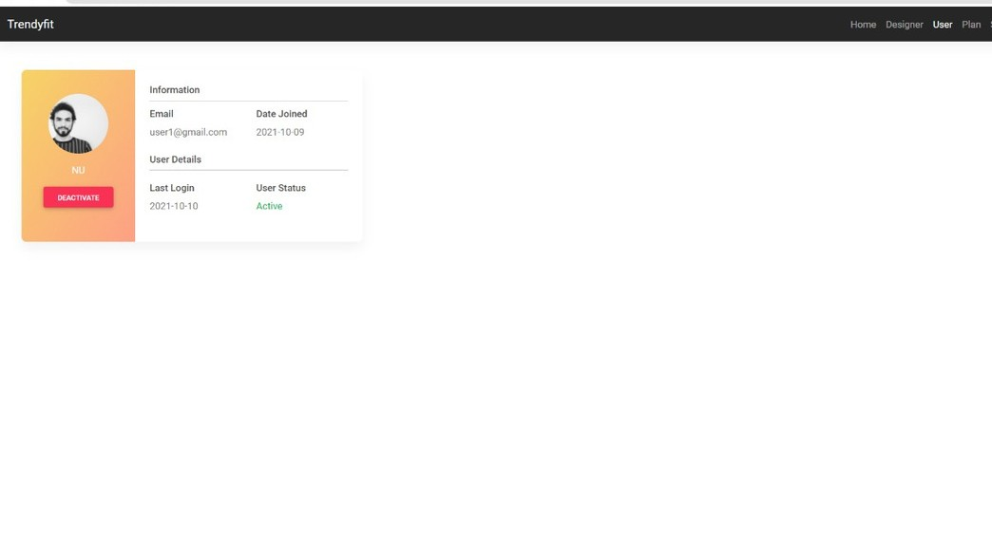
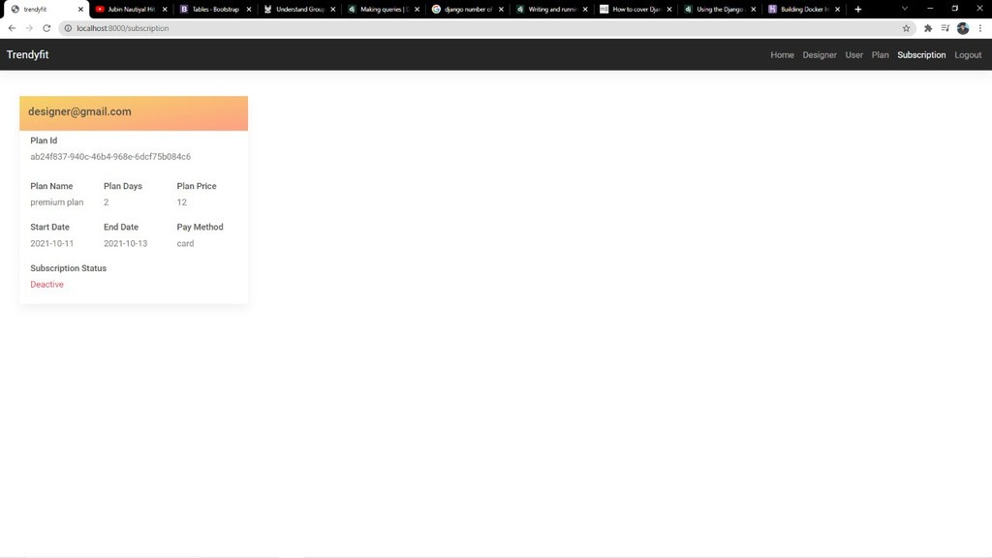
View Designer
View plans
View users
Subscription

Slide 12
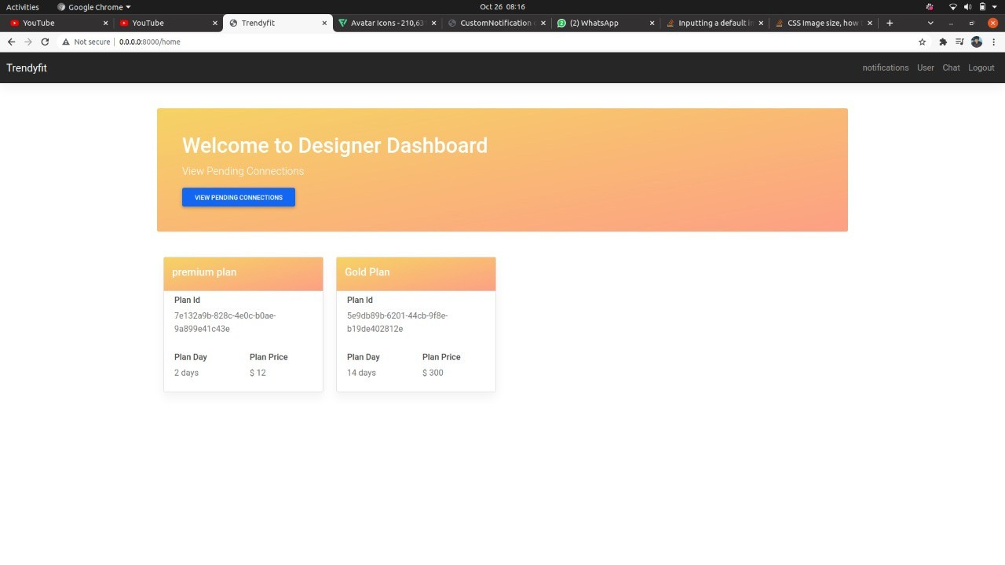
Working Screens
Designer Dashboard Home Page

Slide 13
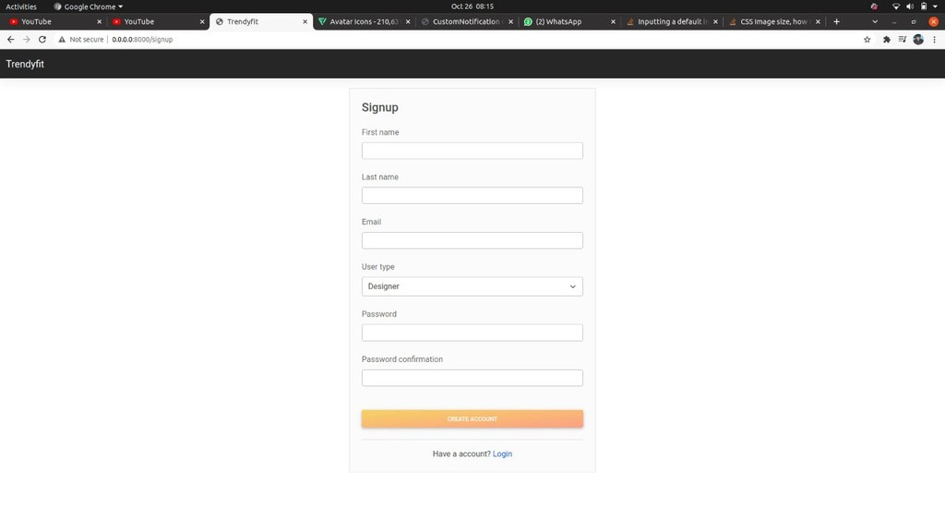
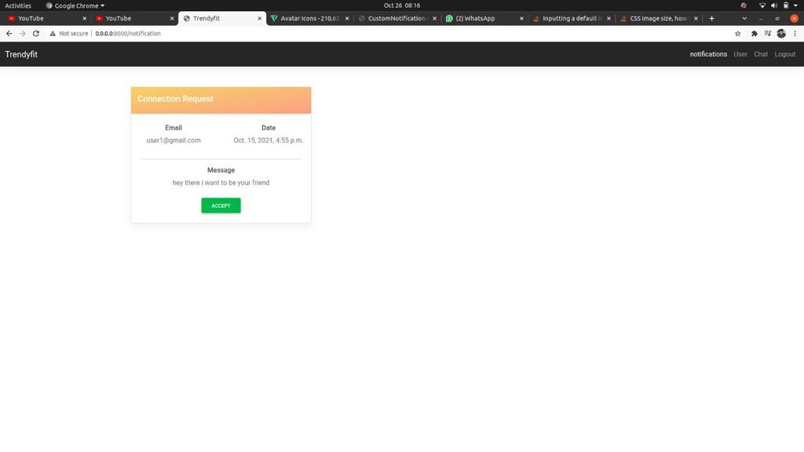
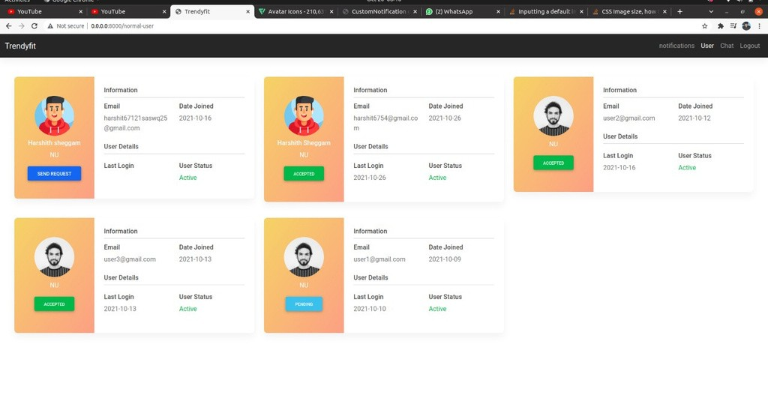
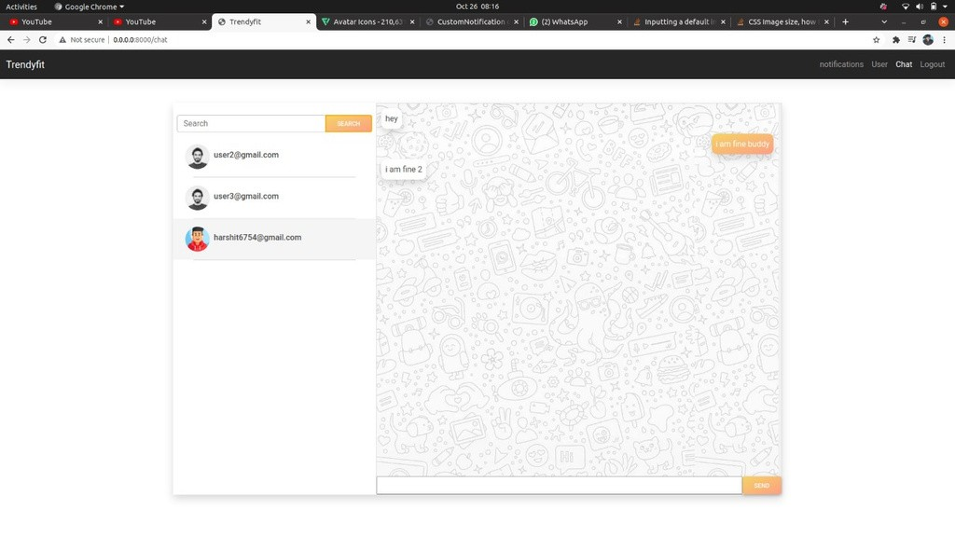
View notifications
Sign Up
View users
Chat

Slide 14

Working Screens
User Dashboard Sign up

Slide 15
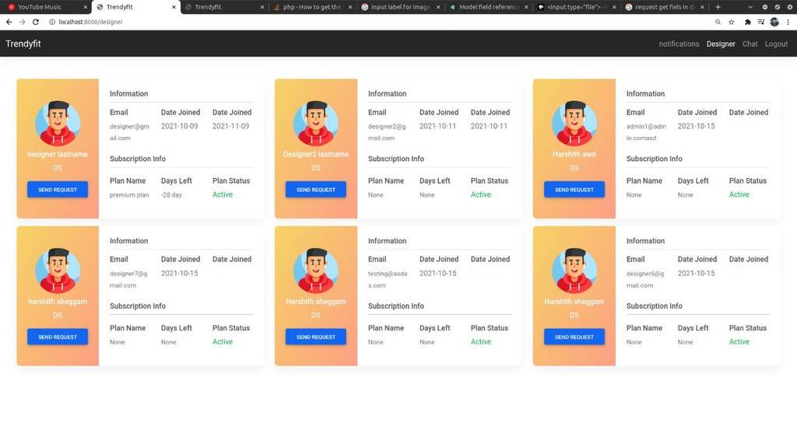
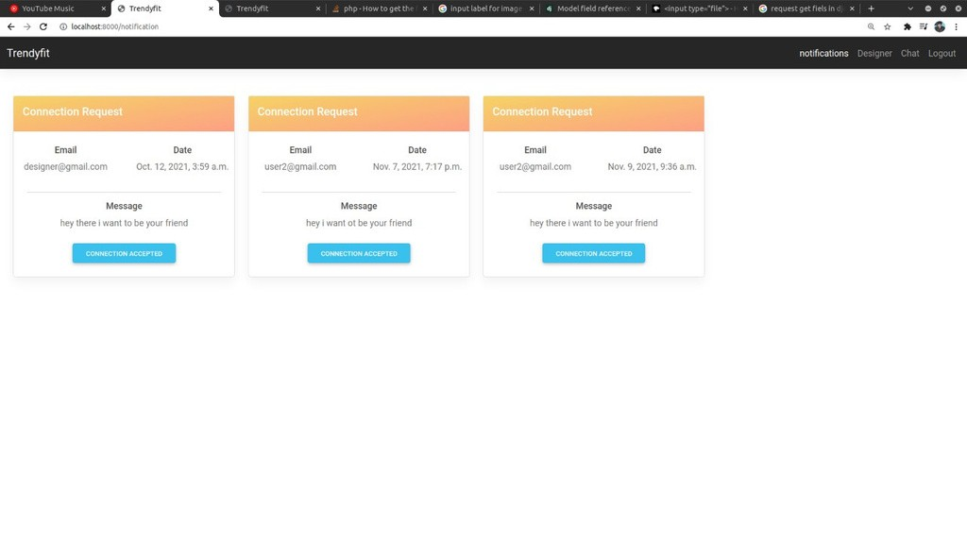
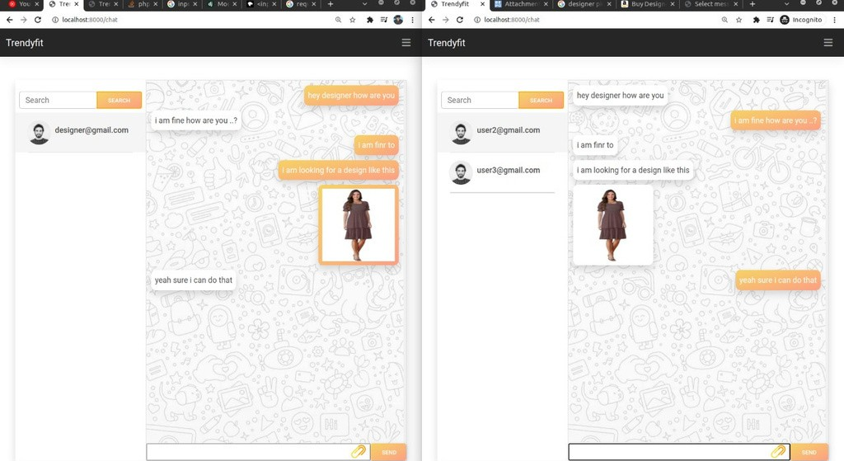
Notifications
View Dessigner
Chat

Slide 16
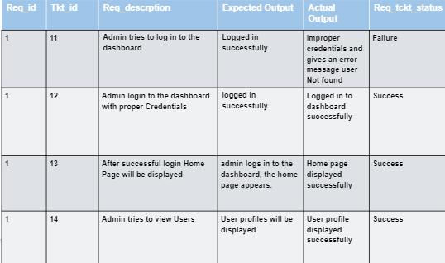

TEST EXPERIENCE, TEST CASES- ADMIN DASHBOARD
Test Case for Authentication

Slide 17
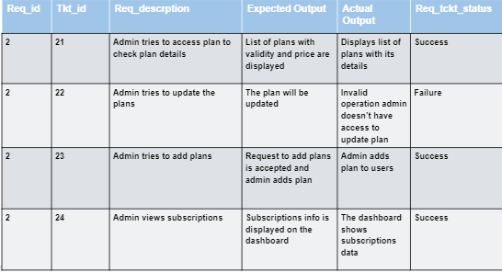
TEST CASES- ADMIN DASHBOARD
Test Case for Dashboard

Slide 18
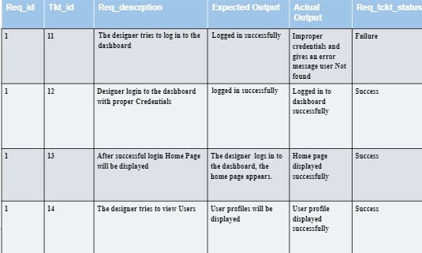
TEST CASES
-DESIGNER DASHBOARD
Test Case for Authentication

Slide 19
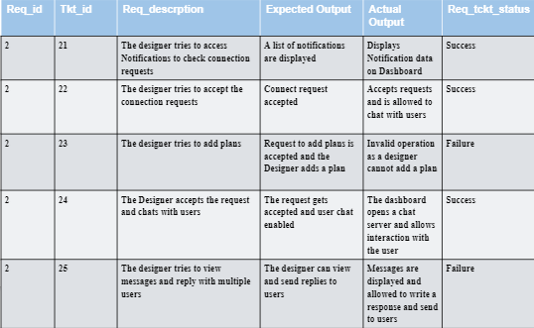
TEST CASES- DESIGNER DASHBOARD
Test Case for application

Slide 20
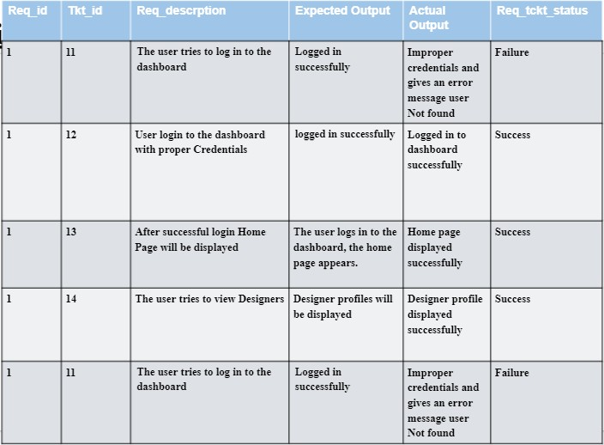
TEST CASES- USER DASHBOARD
Test Case for Authentication

Slide 21
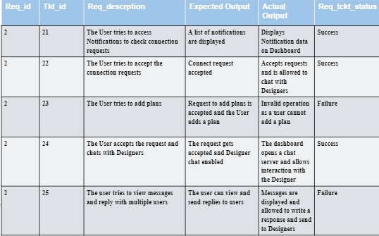
TEST CASES- USER DASHBOARD
Test Case for Application

Slide 22
Feedback from peer reviews:
Adding scrolling option to the Admin Dashboard
Partner team suggested to add a scrolling option in the admin dashboard in the user screen. We implemented pagination but to get the perfect user experience they suggested a scrolling option. We have accepted the suggestion provided by the partner team and have added a scrolling option to Admin Dashboard in the user screen and removed pagination.
UI change
Also made changes to UI based on the requirements like added designer image.

Slide 23
CONCLUSION
Our application will be a useful and effective tool for connecting customers with designers and assisting them in selecting a design oufits. By submitting a connection request on the website, customers can chat with other deisgners. Our application aids and concentrates on three distinct users: administrators, designers, and customers.

Slide 24
References
"Introduction to Redis". Redis is written in ANSI C and works in most POSIX systems like Linux, *BSD, OS X without external dependencies
"jQuery: The write less, do more, JavaScript library". The jQuery Project. Retrieved April 29, 2010.
"Security in Django". Django Project. Retrieved 25 March 2013.
Jesse James Garrett (18 February 2005). "Ajax: A New Approach to Web Applications". AdaptivePath.com. Archived from the original on 10 September 2015. Retrieved 19 June 2008.

Slide 25




THANK YOU

