Slide 1


Slide 2
RFID and Camera-Based Attendance System
Atchyuth Kalla – 320136412041
Sri Ram Kaganti – 320136412040
Teja Ijjada – 320136412038
Srujana Karri – 320136412046

Slide 3
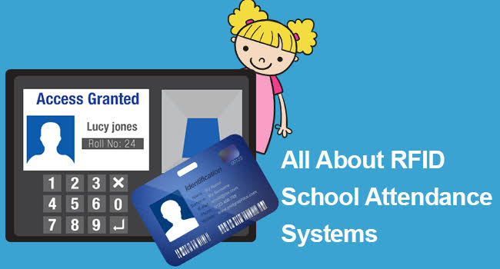

Slide 4
Introduction
This presentation focuses on introducing and detailing an RFID and camera-based attendance system, encompassing two modes: registration and attendance. It outlines the process of switching between modes, registering RFID cards to students, and accurately tracking attendance data in Google Sheets.
Efficient attendance management systems play a crucial role in enhancing organizational efficiency and productivity. They streamline the process of recording and tracking attendance, reducing administrative burden and human errors.

Slide 5


Slide 6
System Overview
This RFID and camera-based attendance system offers a comprehensive solution for efficient attendance management in educational institutions and organizations. It combines RFID technology with camera monitoring to provide accurate and reliable attendance tracking.
Two modes: Registration mode and Attendance mode.
Integration with Google Sheets for data management
Google Sheets serves as the central database for storing and managing attendance data.
Two separate sheets are utilized: one for Registration Mode and another for Attendance.
The Registration Mode sheet captures and stores the UID and corresponding names of registered individuals.
The Attendance sheet records attendance data, including names, UIDs, dates, and attendance statuses for each period throughout the day.
Integration with Google Sheets ensures data integrity, accessibility, and ease of analysis for administrative purposes.

Slide 7
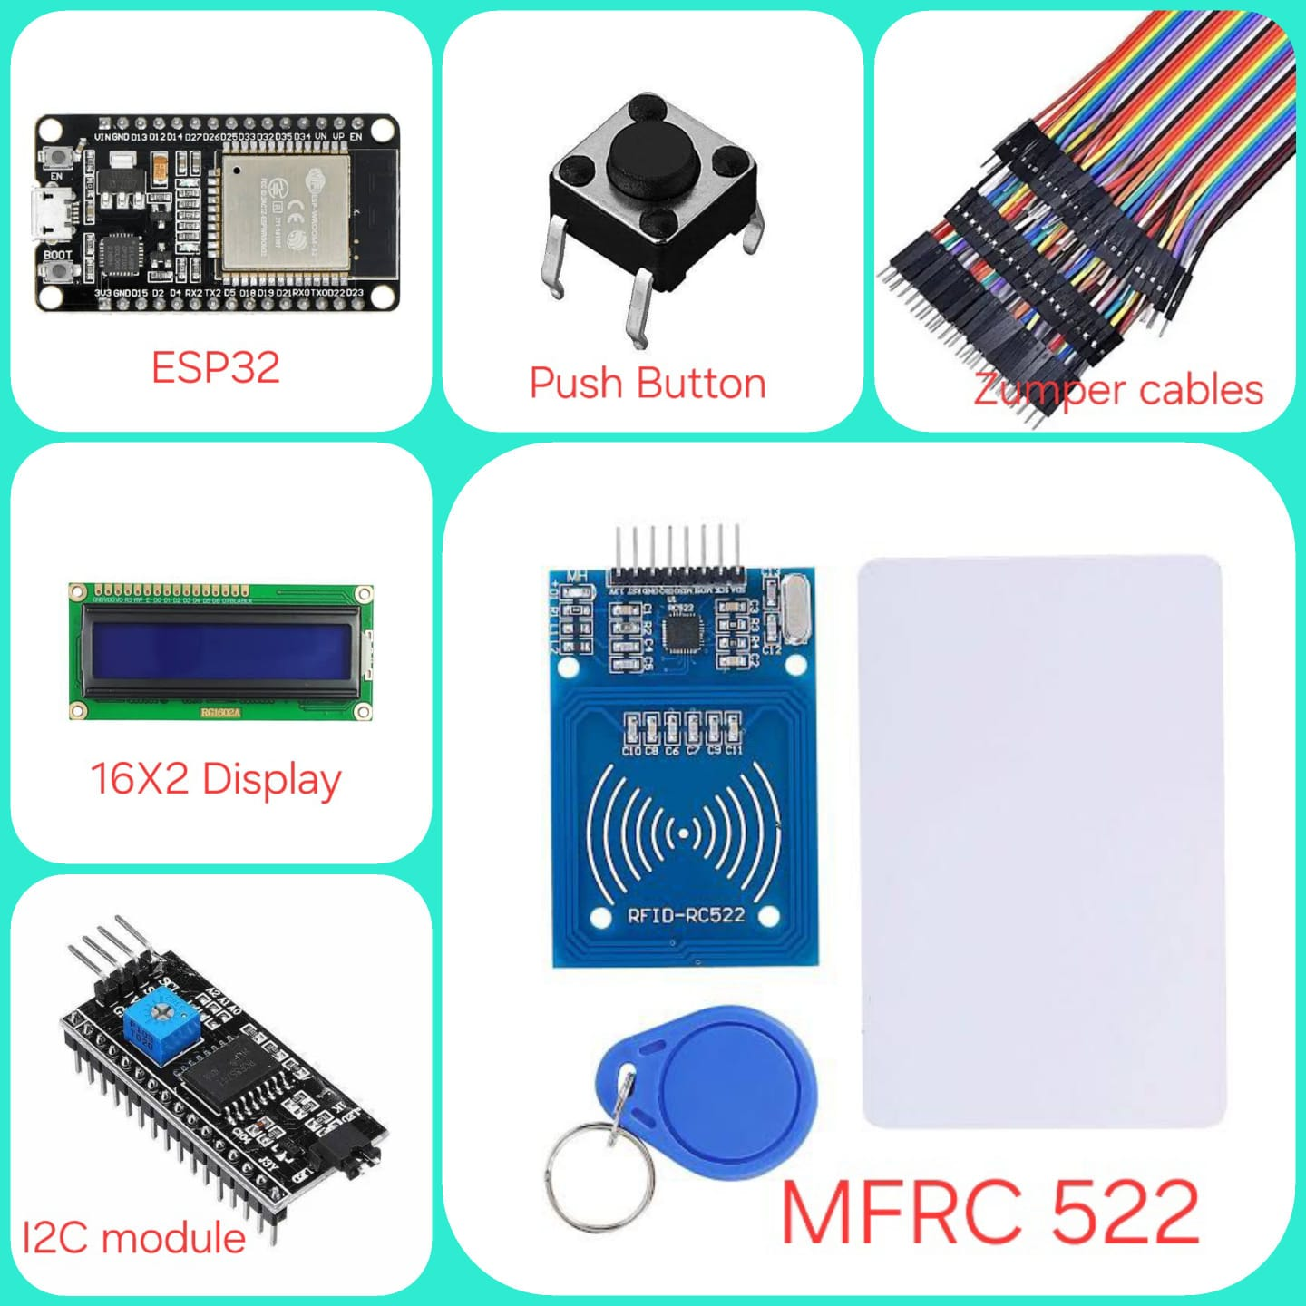
Components used

Slide 8
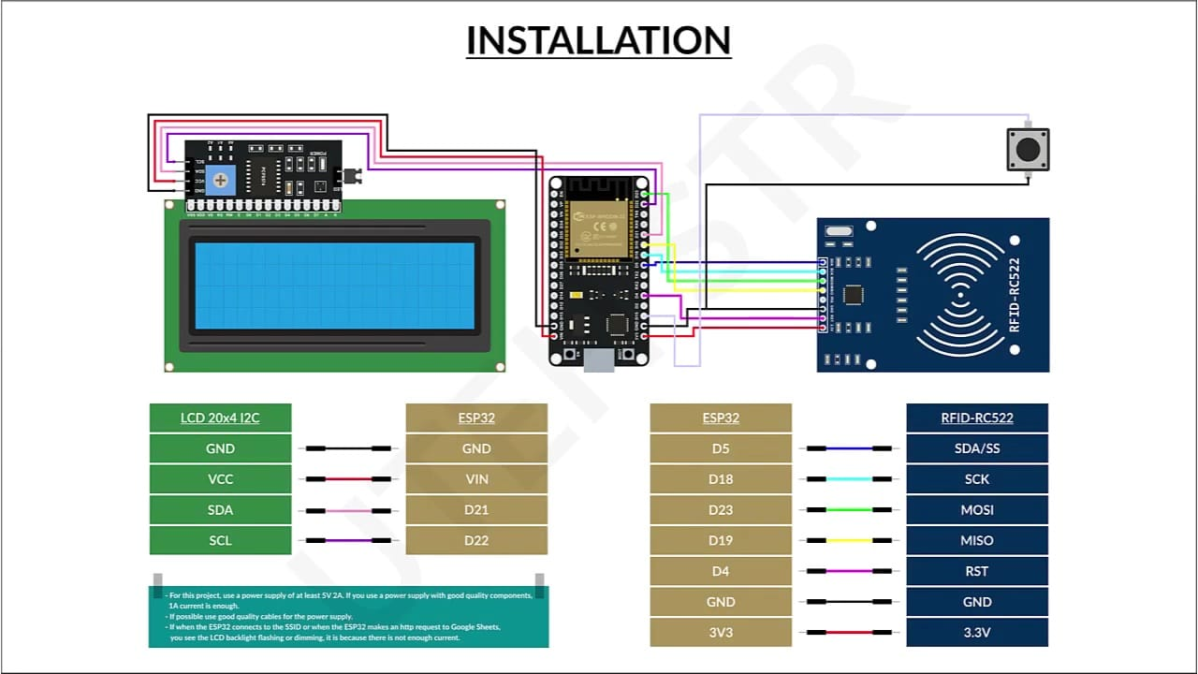
connections

Slide 9
Default Mode
By default, the system operates in Attendance Mode to facilitate real-time attendance tracking.
This mode is the standard operational mode when the system is powered on or reset.

Slide 10
Registration Mode
Registration Mode serves the purpose of facilitating the enrollment of new users or updating existing user information within the RFID and camera-based attendance system.
Assigning Student Names to RFID Cards*
When registering a new RFID card, the system captures the unique UID associated with the card and enters the captured UID into the corresponding column in the Registration Mode sheet.
In the adjacent column, we have to enter the student's name corresponding to the captured UID.

Slide 11
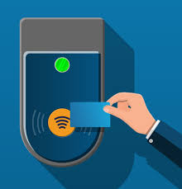
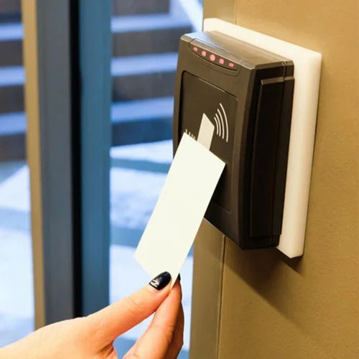

Slide 12
Handling Duplicate Registration
Preventing duplicate registrations is essential to maintain data integrity and ensure accurate attendance tracking within the RFID and camera-based attendance system. Notification when a card is already registered
Methods for Preventing Duplicate Registrations:
Implement checks within the system to verify if a card UID is already registered before allowing a new registration.
Compare the captured UID with existing entries in the registration database to identify duplicates.
Prompt users with an error message if a duplicate registration attempt is detected.

Slide 13
Attendance Mode
In Attendance Mode, the system continuously monitors RFID card readings to track students attendance.
When an RFID card is detected within the system's range, the system captures the card's unique UID.
The captured UID, along with the corresponding timestamp and date, is recorded in the designated Google Sheets document for attendance.
Attendance data is updated periodically for each period throughout the day.
Attendance status (present/absent) for each period is reported in real-time to provide timely insights into attendance patterns.

Slide 14



Slide 15
Purpose of the Push Button
The push button serves as a user interface element for mode selection.
It provides a simple and intuitive way for users to toggle between Registration Mode and Attendance Mode.
Users must press the push button to activate Registration Mode when they intend to register new RFID cards or update registration information.
The system's default mode being Attendance Mode ensures that attendance tracking is always active during regular operation.

Slide 16


Slide 17
Benefits of the System
Increased Efficiency: Automation of attendance tracking reduces manual effort and time required for data entry.
Enhanced Accuracy: RFID technology ensures accurate identification of students, minimizing errors associated with manual attendance recording.
Improved Transparency: Transparent attendance tracking allows administrators, teachers, and students to access real-time attendance data.
Cost-Effectiveness: Reduced administrative workload and paperless data management contribute to cost savings for the institution.
Scalability and Flexibility: The system can be easily scaled to accommodate varying institutional needs and requirements. Flexibility in customization allows for tailored solutions to meet specific attendance management challenges.

Slide 18
Conclusion
By adopting the RFID and camera-based attendance system, institutions can modernize their attendance management processes, realizing significant benefits in terms of efficiency, accuracy, and transparency.

Slide 19


