Slide 1


NYU Summer Machine Learning Program
Presenter Name Here
Date Here

Slide 2

Linear Regression
Day 2

Slide 3
Learning Objectives
How to load data from a text file
How to visualize data via a scatter plot
Describe a linear model for data
Identify the target variable and predictor
Compute optimal parameters for the model using the regression formula
Fit parameters for related models by minimizing the residual sum of squares
Compute the measure of the fit

Slide 4
Outline
Motivating Example: Virus inactivation in wetland waters due to sunlight
Linear Model
Least Squares Fit Problem
Sample Mean and Variance
LS Fit Solution
Assessing Goodness of Fit

Slide 5
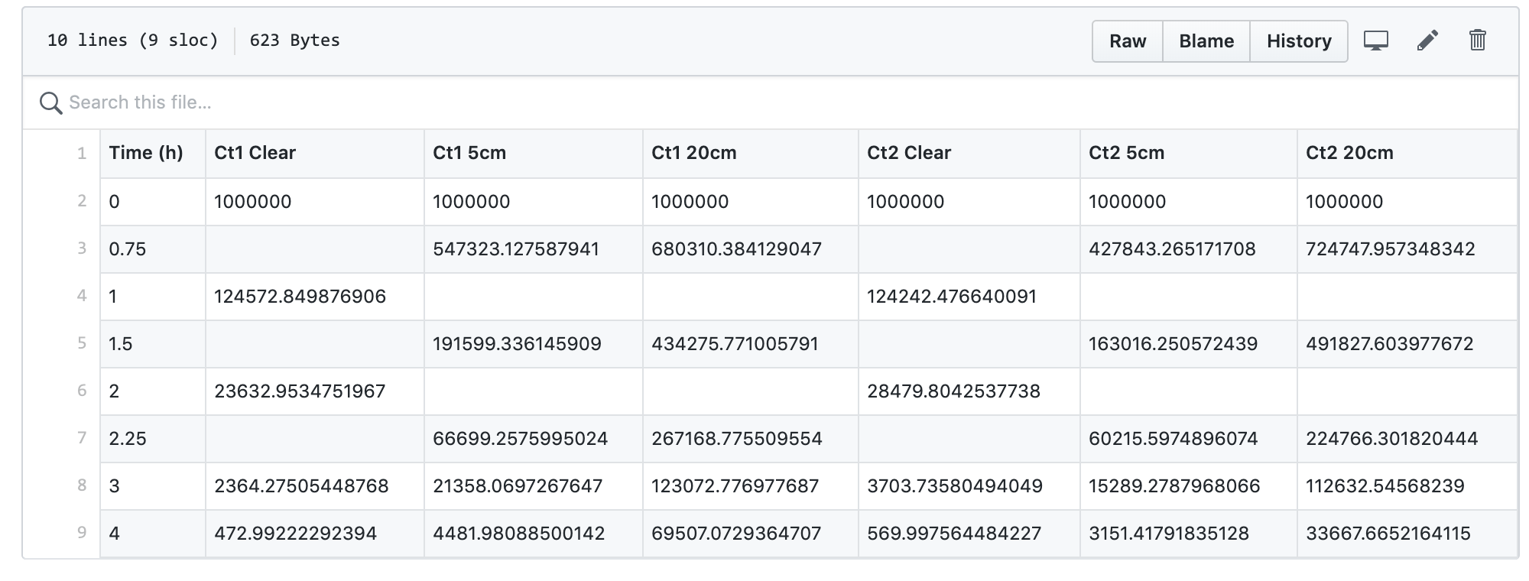
Example: Wetland Virus Inactivation from Sunlight Exposure
Getting the data:
Data can be found here.

Slide 6


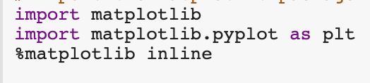
Example: Wetland Virus Inactivation from Sunlight Exposure
Reading & Visualizing the Data:
Using Python packages - Pandas, Numpy, Matplotlib.
Pandas:
Used for reading and writing data files
Loads data into dataframes
Numpy:
Used for numerical operations, including linear algebra
Data is stored in ndarray structure
We convert from dataframes to ndarray
Matplotlib:
Used for MATLAB-like plotting and visualization

Slide 7
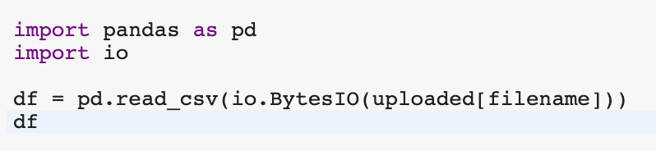
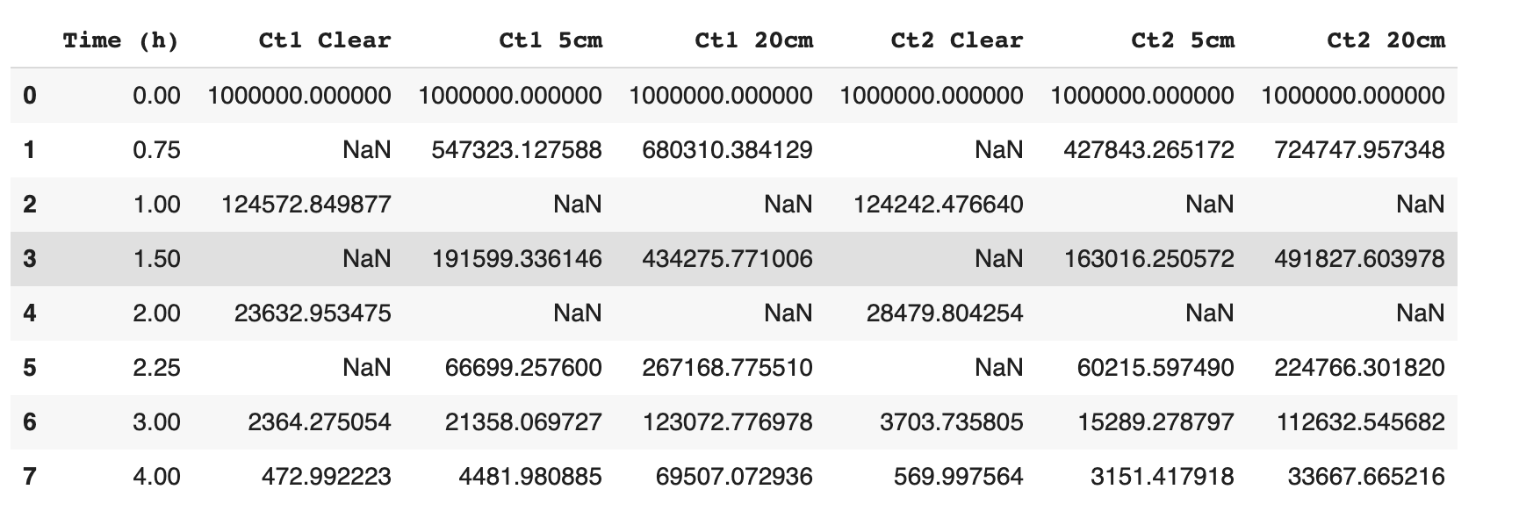
Example: Wetland Virus Inactivation from Sunlight Exposure
Reading the data using python’s pandas library:
pd.read_csv converts a comma-separated values file into a 2D data structure with labeled axes.

Slide 8
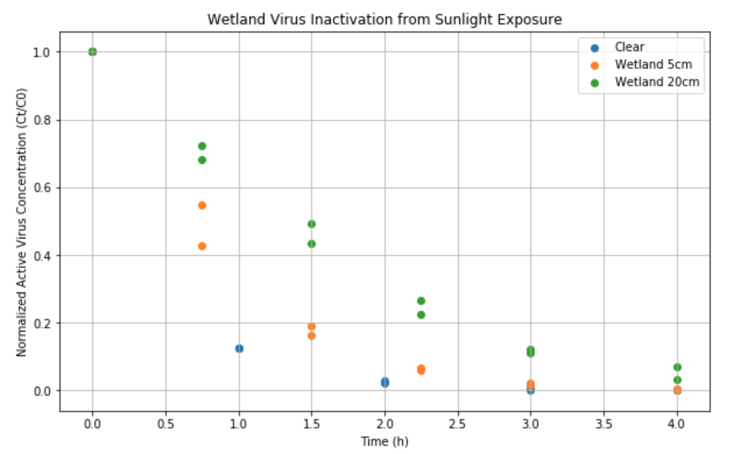
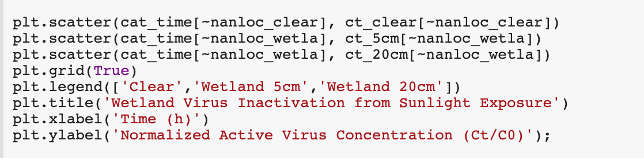
Example: Wetland Virus Inactivation from Sunlight Exposure
Visualizing the Data:
It’s always a good idea to visualize the data before performing any operations on it.
Using python’s Matplotlib:
plt.scatter(x,y) plots a scatter plot of y vs x.

Slide 9
Exercise: Postulate a Model
Try to find a mathematical model to predict the active virus concentration from time:
Try to make a reasonable/eyeball guess, without using a program.

Slide 10
Outline
Motivating Example: Virus inactivation in wetland waters due to sunlight
Linear Model
Least Squares Fit Problem
Sample Mean and Variance
LS Fit Solution
Assessing Goodness of Fit

Slide 11
Understanding the Data:
Our y axis: The variable we are trying to predict. Can be called: Dependent variable, response variable, target, regressand, …
Our x axis: The variable we are using to predict. Can be called: Predictor, attribute, covariate, regressor …
Each data point is called a sample. In this example, we are using a scatter plot to view the samples.

Slide 12
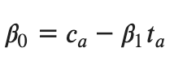

Linear Model
Assume a linear relationship among the samples - using the intercept (beta0) and slope (beta1).
Why do we use a Linear Model?
Generally, most natural phenomena have a linear relationship
Simple computation, and easy to interpret.

Slide 13
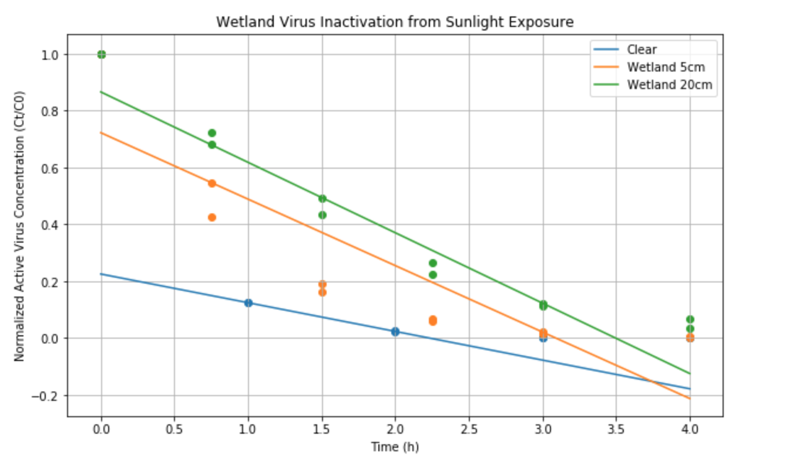
Linear Model
Plotting the Linear Model using python’s Matplotlib:
plt.plot is used to plot y versus x as lines or markers.

Slide 14
Outline
Motivating Example: Virus inactivation in wetland waters due to sunlight
Linear Model
Least Squares Fit Problem
Sample Mean and Variance
LS Fit Solution
Assessing Goodness of Fit

Slide 15


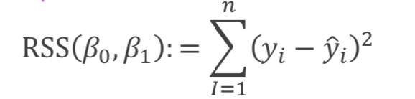
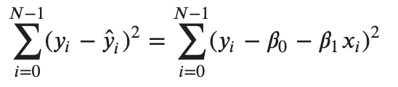

Linear Model Residual
As we can see, a linear model does not fit all the sample, which means it is not a good fit for our data.
We add a residual term to our lineal model (e):
For a
We define a residual sum of squares (RSS):
A Least Squares Solution is to find to minimise RSS.

Slide 16
Outline
Motivating Example: Virus inactivation in wetland waters due to sunlight
Linear Model
Least Squares Fit Problem
Sample Mean and Variance
LS Fit Solution
Assessing Goodness of Fit

Slide 17

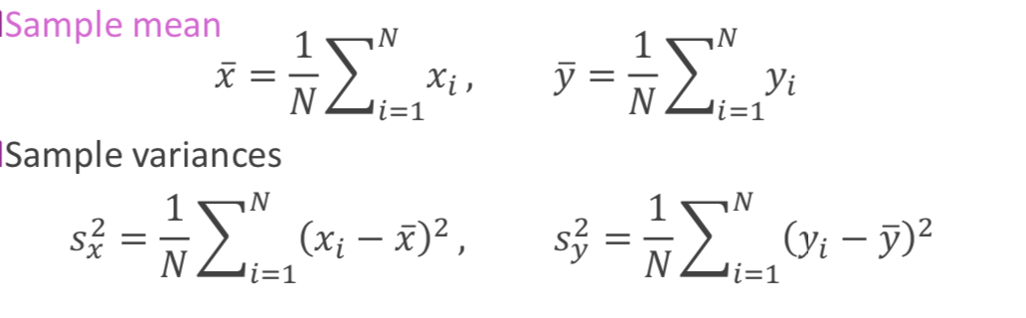
Least-Squares Fit Solution: Sample Mean and Standard Deviations
Given data:

Slide 18
Outline
Motivating Example: Virus inactivation in wetland waters due to sunlight
Linear Model
Least Squares Fit Problem
Sample Mean and Variance
LS Fit Solution
Assessing Goodness of Fit

Slide 19
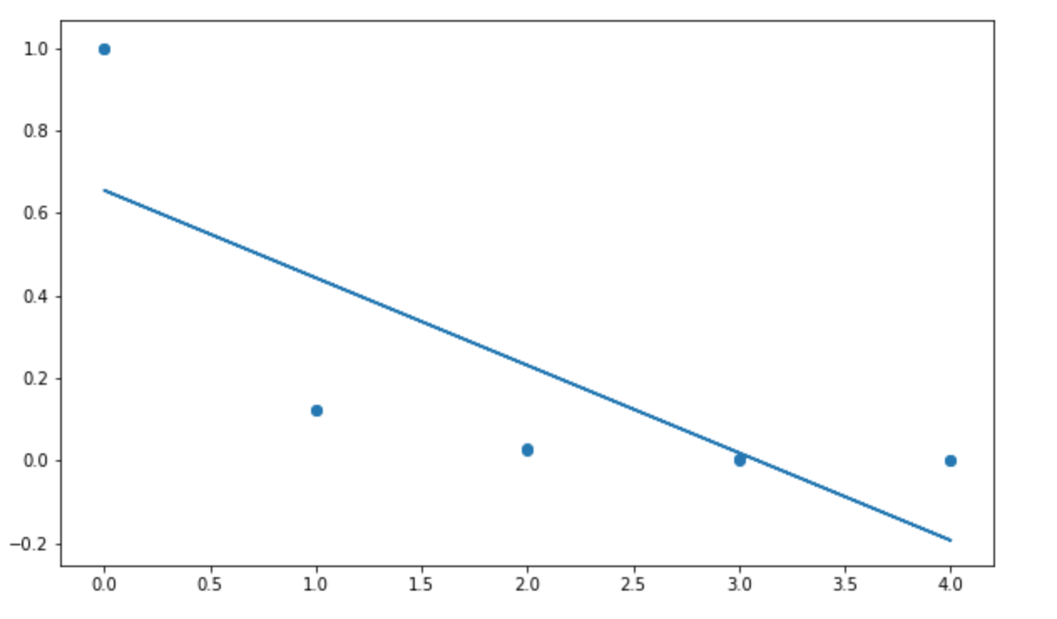
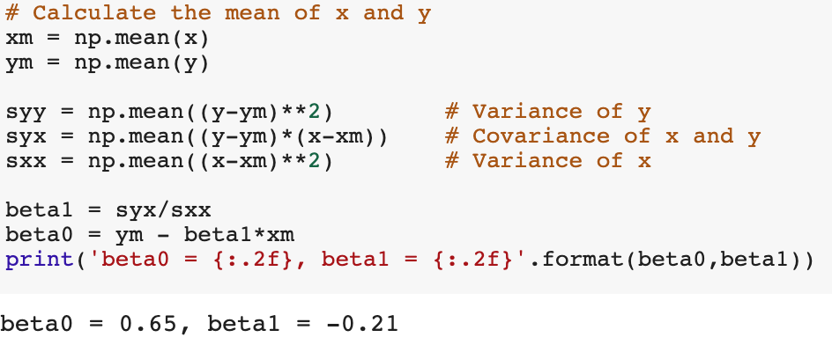
Least-Squares Fit Solution
Using python to find the Least Squares solutions
np.mean uses python’s numpy library to compute the arithmetic mean along the specified axis.

Slide 20
Outline
Motivating Example: Virus inactivation in wetland waters due to sunlight
Linear Model
Least Squares Fit Problem
Sample Mean and Variance
LS Fit Solution
Assessing Goodness of Fit

Slide 21
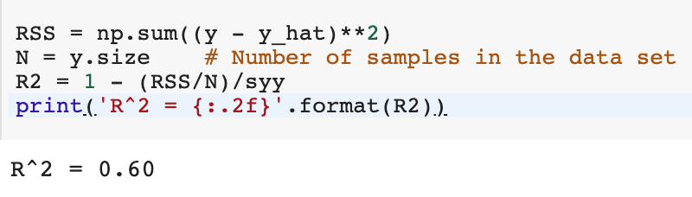
Assessing the goodness of the fit
We can use the R2 score to estimate the goodness of our fit.
The best (and maximum) R2 score is 1. It can be negative if the fit is really bad.
It can be calculated on python by:

